Slide 1
GEOS 28600
The science of landscapes:
Earth & Planetary Surface Processes
Lecture 10
Monday 10 Feb 2020

Slide 2
Prospectus: fluvial processes
Today: overview, hydraulics.
Next lecture: initiation of motion, channel width adjustment.
Channel long-profile evolution.
Mountain belts.
Looking ahead: landscape evolution (including fluvial processes.)
This section of the course draws on courses by W.E. Dietrich (Berkeley),
D. Mohrig (MIT → U.T. Austin), and J. Southard (MIT).

Slide 3
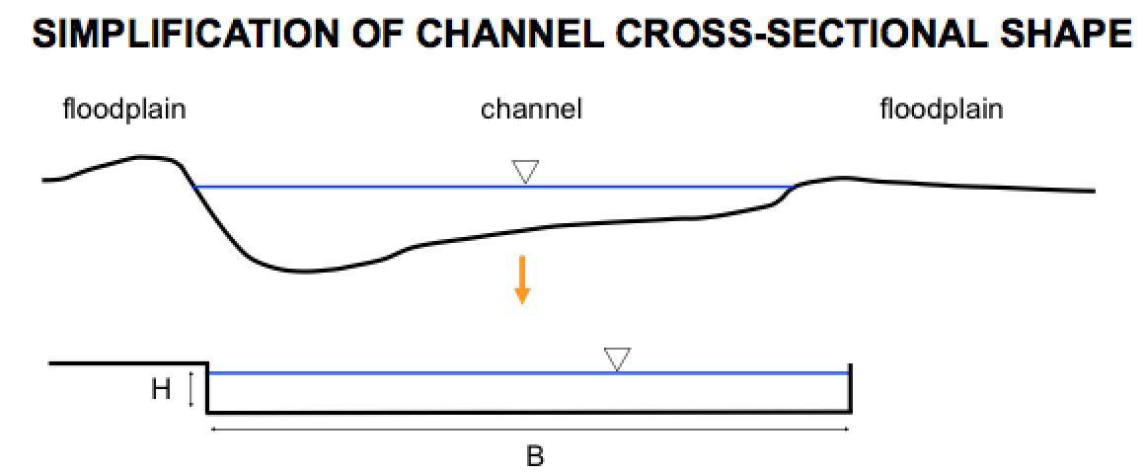
Hydraulics and sediment transport in rivers:
1) Relate flow to frictional resistance so can relate discharge to hydraulic geometry.
2) Calculate the boundary shear stress.
Simplified geometry: average over a reach (12-15 channel widths).
→ we can assume accelerations are zero.
→ this assumption is better for flood flow (when most of the erosion occurs).
riffle
pool
pool
riffle
Parker Morphodynamics e-book

Slide 4
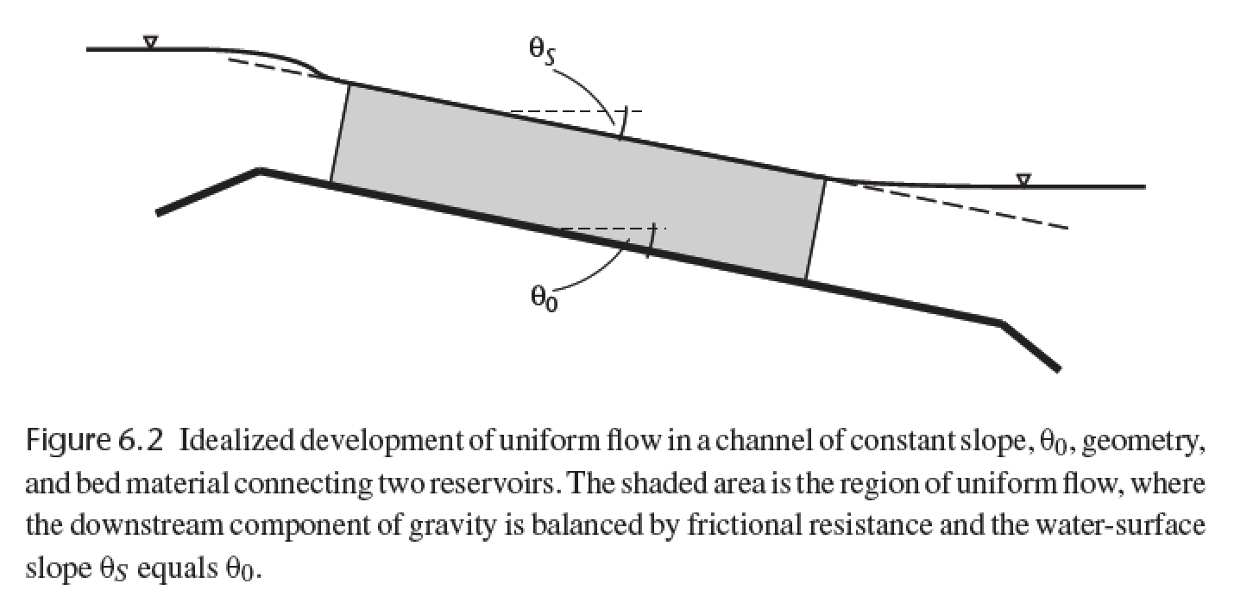
The assumption of no acceleration requires that gravity (resolved downslope) balances bed friction.
τ_{zx} = ρgh sinθ
averaging over 15-20 channel widths
forces the water slope to ~ parallel the
basal slope
Dingman, chapter 6

Slide 5
Basal shear stress, frictional resistance, and hydraulic radius
1
z/h
0
0
τ_{b}
τ_{zx} = ρgh sinθ
At low slope (S, water surface rise/run), θ ~ tan θ ~ sin θ
τ_{b} = ρgh S
Frictional resistance:
Boundary stress = ρgh sinθ L w
Frictional resistance = τ_{b} L (w + 2 h)
ρgh sinθ L w = τ_{b} L (w + 2 h)
τ_{b} = ρgh ( w / (w + 2 h ) ) sinθ
Define hydraulic radius, R = hw / (w + 2 h)
→ τ_{b} = ρgR sinθ
h
w
L
In very wide channels, R → h (w >> h)

Slide 6
Law of the wall:
Rivers ( Re >> 10, and fully turbulent):
Glaciers ( Re << 1):
τ_{zx} = ρ K_{T} (du/dz)
τ_{zx} = μ(T,σ) (du/dz)
eddy viscosity, “diffuses” velocity
Properties of turbulence:
Irregularity
Diffusivity
Vorticity
Dissipation
From empirical & theoretical studies:
K_{T} = (k z )² (du/dz)
(where k = 0.39-0.4 = von Karman’s constant)
→ τ_{B} = ρ(k z)² (du/dz)²
→ (τ_{B} /ρ )^{1/2} = k z (du / dz) = u* = “shear velocity”
Memorize this.
→ (ρ g h S /ρ )^{1/2} = u* = ( g h S )^{1/2}
Now u* = k z (du / dz)
Separate variables: du = (u* / k z ) dz
Integrate: u = (u*/k) (ln z + c). For convenience, set c = -ln(z₀)
Then, u = (u*/k) ln (z/z₀)
“law of the wall”
(explained on next slide)
when z = z₀, u = 0 m/s.

Slide 7
Calculating river discharge, Q (m³s⁻¹), from elementary
observations (bed grain size and river depth).
u = (u*/k) ln (z/z₀)
“law of the wall”
z₀ is a length scale for grain roughness
varies with the size of the bedload. In this class, use
z₀ = 0.12 D₈₄, where D₈₄ is the 84th
percentile size in a pebble-count (100th
percentile is the biggest).
brackets denote vertical
average
Q = <u> w h
h
<u> = u(z) dz (1/(h-z₀))
z₀
<u> = (u*/k) (z0 + h ( ln( h / z₀ ) – 1 ) ) (1/ (h - z₀))
h >> z₀:
Extending the law of the wall
throughout the entire depth of
the flow is a rough
approximation – do not use
this for civil-engineering
applications. This approach
does not work at all when
depth → clast grainsize.
<u> = (u*/k) ( ln( h / z₀ ) – 1 )
<u> = (u*/k) ln ( h / e z₀)
<u> = (u*/k) ln (0.368 h / z₀)
typically rounded to 0.4

Slide 8
Drag coefficient for bed particles:
→ τ_{B} = ρgRS = C_{D} ρ <u>² / 2
<u> = ( 2g R S / C_{D} )^{1/2}
( 2g / C_{D} )^{1/2} = C = Chezy coefficient
<u> = C ( R S )^{1/2}
Chezy equation (1769)
<u> = ( 8 g / f )^{1/2} ( R S )^{1/2}
f = Darcy-Weisbach friction factor
<u> = R^{2/3} S^{1/2} n⁻¹
n = Manning roughness coefficient
3 alternative methods
Most used, because lots of investment in measuring n for different objects
0.025 < n < 0.03 ----- Clean, straight rivers (no debris or wood in channel)
0.033 < n < 0.03 ----- Winding rivers with pools and riffles
0.075 < n < 0.15 ----- Weedy, winding and overgrown rivers
n = 0.031(D₈₄)^{1/6} ---- Straight, gravelled rivers
In sand-bedded rivers (e.g. Mississippi), form drag due to sand dunes is important.
In very steep streams, supercritical flow may occur:
supercritical flow
Froude number
Fr # = <u>/(gh)^{1/2} > 1

Slide 9
Getting from water flow to sediment flux

Slide 10
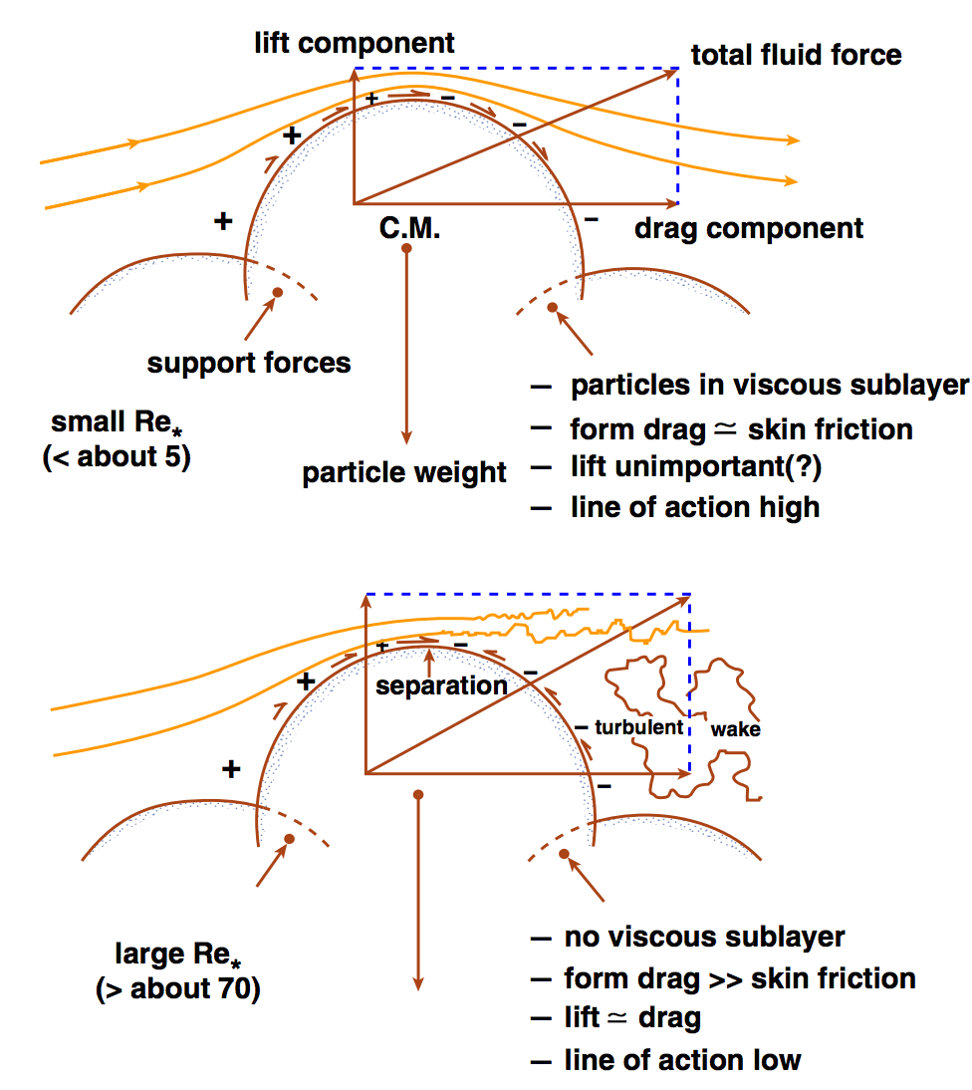
John Southard

Slide 11
Sediment transport in rivers:
(Shields number)
F_{L}
F_{D}
At the initiation of grain motion,
F_{D} = ( F’_{g} – F_{L} ) tan Φ
→ F_{D}/F’_{g} =
Φ
tan Φ
1 + (F_{L}/F_{D}) tan Φ
≈ τ_{c} D²
(ρ_{s} – ρ)gD³
F’_{g} (submerged weight)
= τ_{c} = τ*
(ρ_{s} – ρ)gD
Shields number (“drag/weight ratio”)
Is there a representative particle size for the bedload as a whole?
Yes: it’s D₅₀.

Slide 12
Equal mobility hypothesis
F_{L}
“Hiding” effect
small particles
don’t move significantly
before the D₅₀ moves.
F_{D}
Φ
Φ
D/D₅₀
Trade-off between size and embeddedness
F’_{g} (submerged weight)
Significant controversy over validity of equal mobility hypothesis in the late ’80s – early ’90s.
Parameterise using
τ* = B(D/D₅₀)^{α}
α = -1 would indicate perfect equal mobility (no sorting by grain size with downstream distance)
α = -0.9 found from flume experiments (permitting long-distance sorting by grain size).

Slide 13
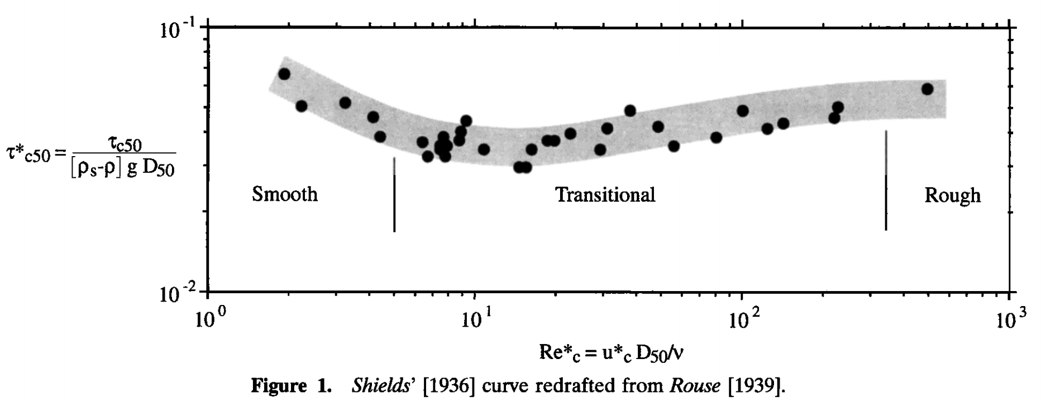
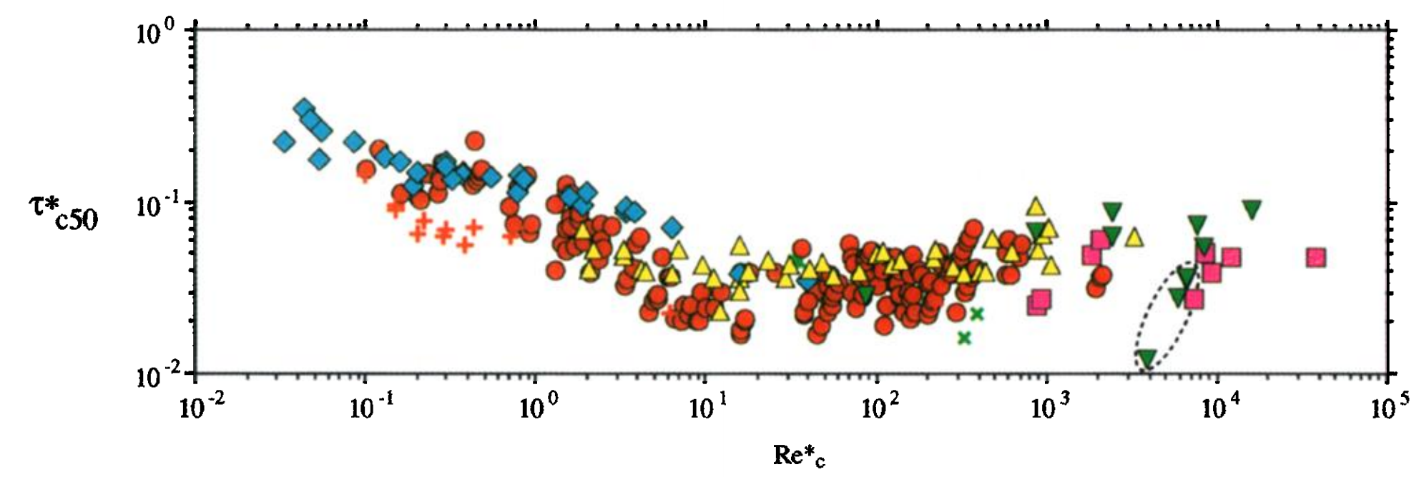
τ_{*c50} ~ 0.04, from experiments (0.045-0.047 for gravel, 0.03 for sand)
1936:
Hydraulically rough:
viscous sublayer is a thin
skin around the particles.
sand
gravel
Re* = “Reynolds roughness number”
1999:
Theory has approximately
reproduced some parts
of this curve.
Causes of scatter:
(1) differing definitions of
initiation of motion (most important).
(2) slope-dependence?
(Lamb et al. JGR 2008)
Buffington & Montgomery, Water Resources Research, 1999

Slide 14
Fluvial sediment transport: introduction
REVIEW OF REQUIRED READING (SCHOOF & HEWITT 2013)
TURBULENT VELOCITY PROFILES, INITIATION OF MOTION
BEDLOAD, RIVER GEOMETRY

Slide 15
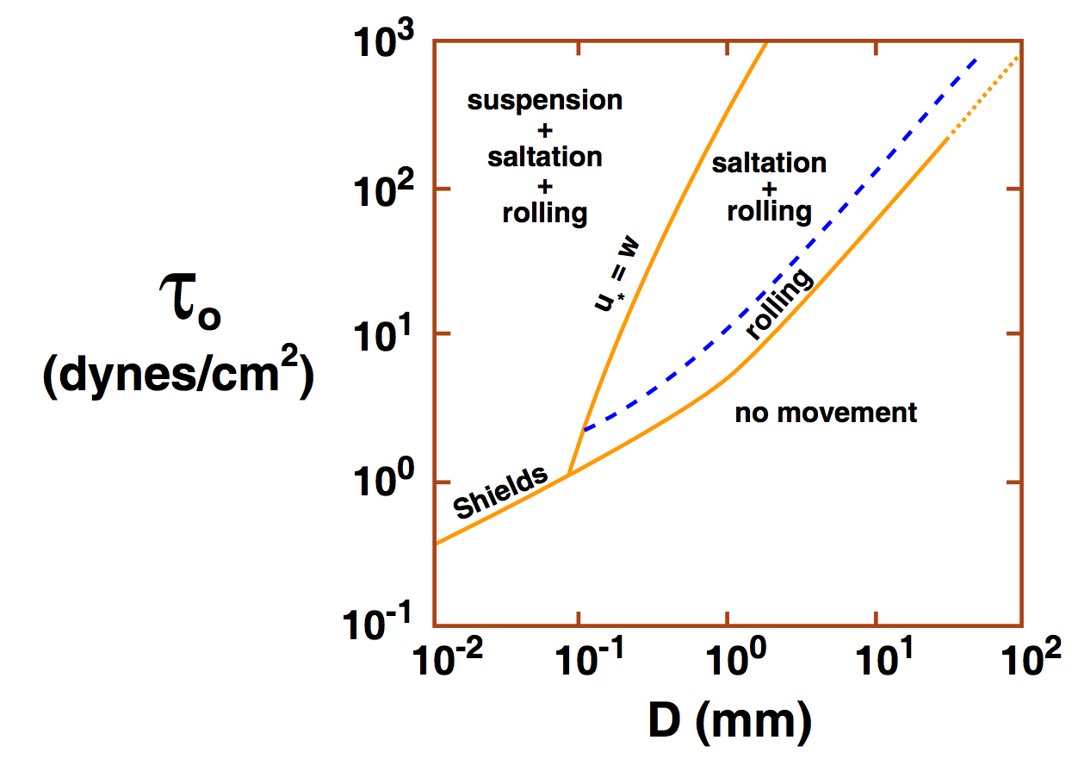
Consequences of increasing shear stress: gravel-bed vs. sand-bed rivers
Suspension: characteristic velocity for
turbulent fluctuations (u*) exceeds
settling velocity (ratio is ~Rouse number).
Typical transport distance
100m/yr in gravel-bedded bedload
Sand: km/day
John Southard
(Experimentally, u* is approximately
equal to rms
fluctuations in vertical
turbulent velocity)
Empirically, rivers are either gravel-bedded or sand-bedded (little in between)
The cause is unsettled: e.g. Jerolmack & Brzinski Geology 2010 vs. Lamb & Venditti GRL 2016

Slide 16
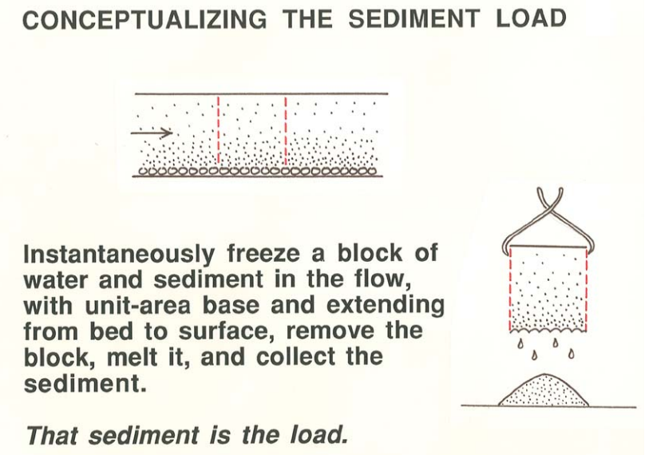
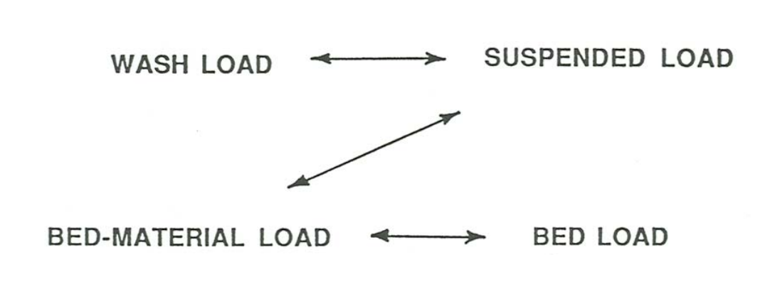
Bedload transport
(Most common:)
Meyer-Peter Muller
Many alternatives, e.g.
Yalin
Einstein
Discrete element modeling
q_{bl} = k_{b}(τ_{b} – τ_{c})^{3/2}
there is no theory for washload:
it is entirely controlled by upstream supply
John Southard

Slide 17
River channel morphology and dynamics
“Rivers are the authors of their own geometry” (L. Leopold)
And of their own bed grain-size distribution.
Rivers have well-defined banks.
Bankfull discharge 5-7 days per year; floodplains inundated every 1-2 years.
Regular geometry also applicable to canyon rivers.
Width scales as Q^{0.5}
River beds are (usually) not flat.
Plane beds are uncommon. Bars and pools, spacing = 5.4x width.
Rivers meander.
Wavelength ~ 11x channel width.
River profiles are concave-up.
Grainsize also decreases downstream.

Slide 18
Slope, grain size, and transport mechanism: strongly correlated
z
>20%; colluvial
8-20%
boulder
cascade
(periodically
swept by
debris
flows)
3-8%
step-pool
gravel
bedload
0.1-3%
bar-pool
gravel
bedload
<0.1%
bar-pool
sand
bedload & suspension
rocks may be
abraded in place;
fine sediment bypasses boulders

Slide 19
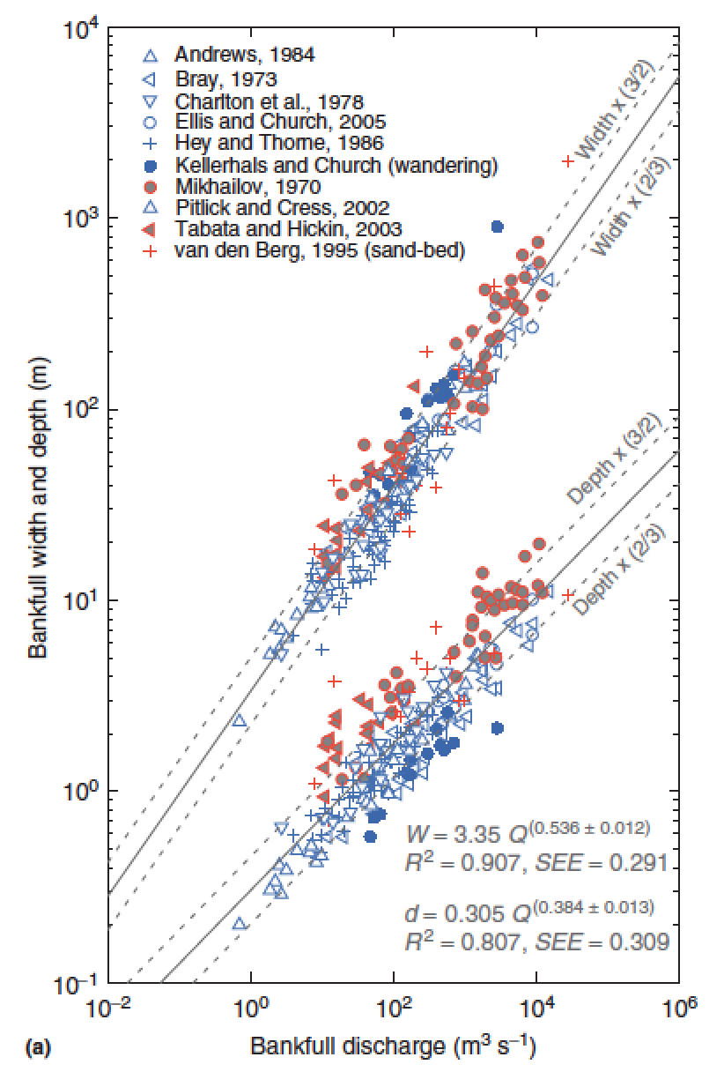
What sets width?
Q = wd<u>
w = aQ^{b}
d = cQ^{f}
<u> = kQ^{m}
b+f+m = 1
Comparing
different points
downstream
b = 0.5
m = 0.1
f = 0.4
Eaton, Treatise on
Geomorphology, 2013

Slide 20
What sets width? Three approaches to this unsolved question:
(1) Posit empirical relationships between hydraulics, sediment supply, and form (Parker et al. 2008 in suggested reading; Ikeda et al. 1988 Water Resources Research).
(2) Extremal hypotheses; posit an optimum channel, minimizing energy (Examples: minimum streampower per unit length; maximum friction; maximum sediment transport rate; minimum total streampower; minimize Froude number)
(3) What is the actual mechanism? What controls what sediment does, how high the bank is, & c.?

Slide 21
Key points from “Introduction to fluvial sediment transport”
Law of the wall – how to calculate river discharge from elementary measurements (bed grain size and river depth).
Critical Shields stress
Differences between gravel-bed vs. sand-bed rivers
Discharge-width scaling

Slide 22
Rivers and landscape evolution

Slide 23
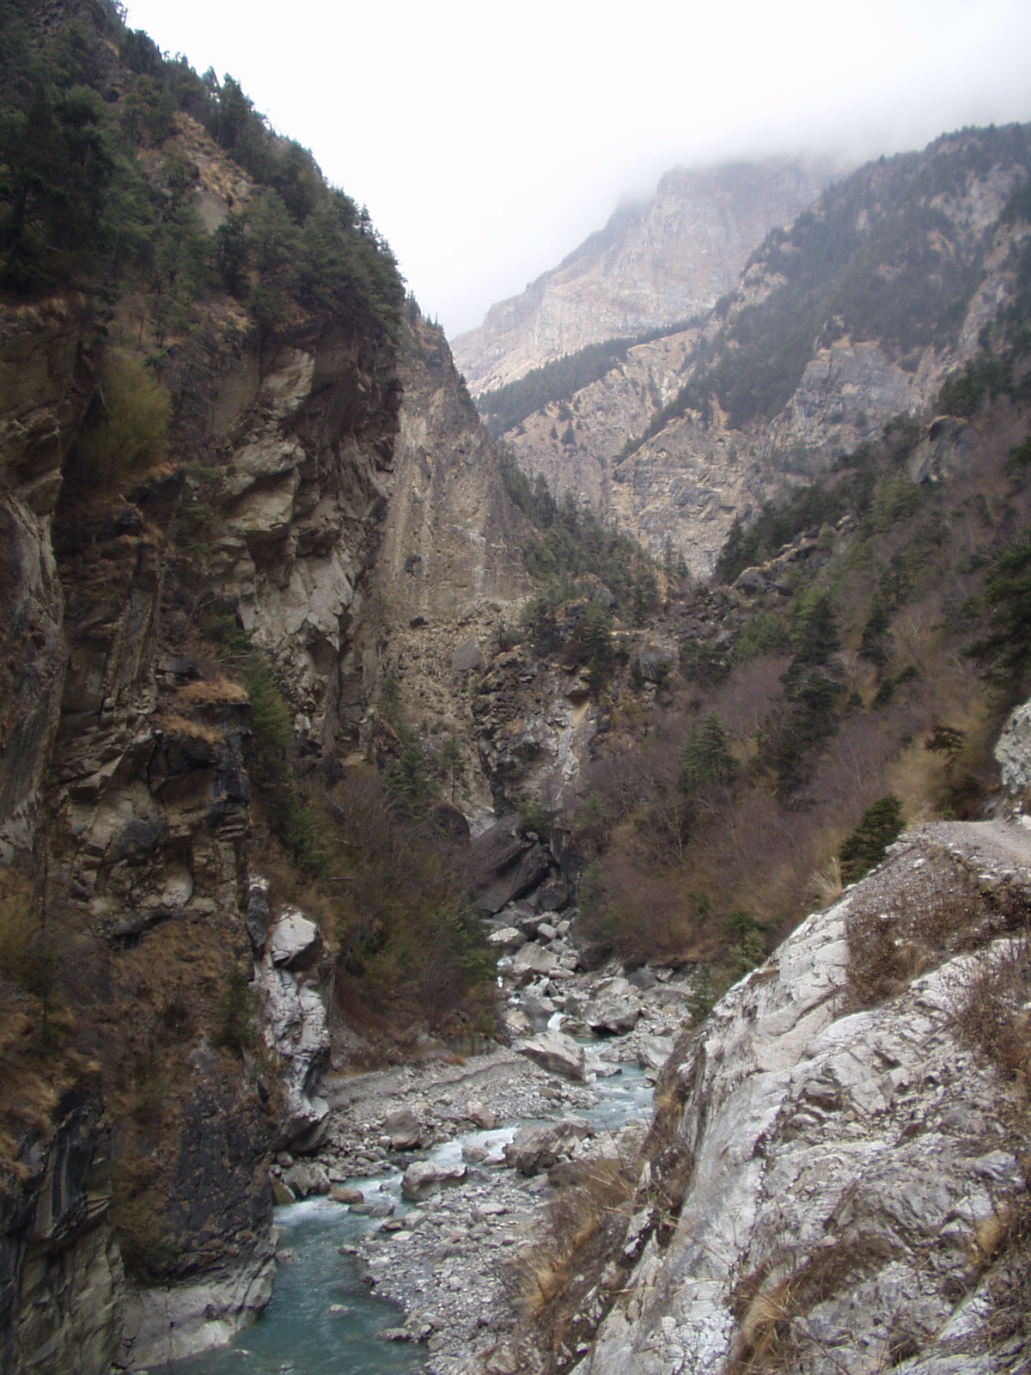
Bedrock rivers
Rivers that cut into bedrock
(“rock is everywhere close to the
surface and may be frequently
exposed during flood events or
on decadal to centennial
timescales”, Whipple et al. 2013)
Detachment-limited landscape
evolution (dz/dt ~ k dz/dx )
Clasts transported mainly by
bedload
Knickpoints can propagate
gm
What controls the rate of
downcutting?
What controls the height/
width/shape of mountain belts on
Earth?
Neil Humphrey, UWYO

Slide 24
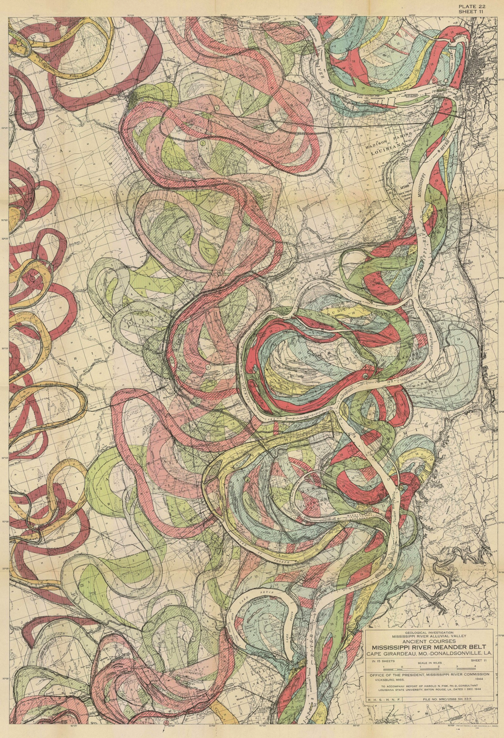
Alluvial rivers
Transport-limited
landscape evolution
(dz/dt ~ k d²z/dx² )
A large percentage of clast transport in suspension
When does meandering
occur?
US Army Corps of Engineers
(Lower Mississippi / Fisk 1944)

Slide 25
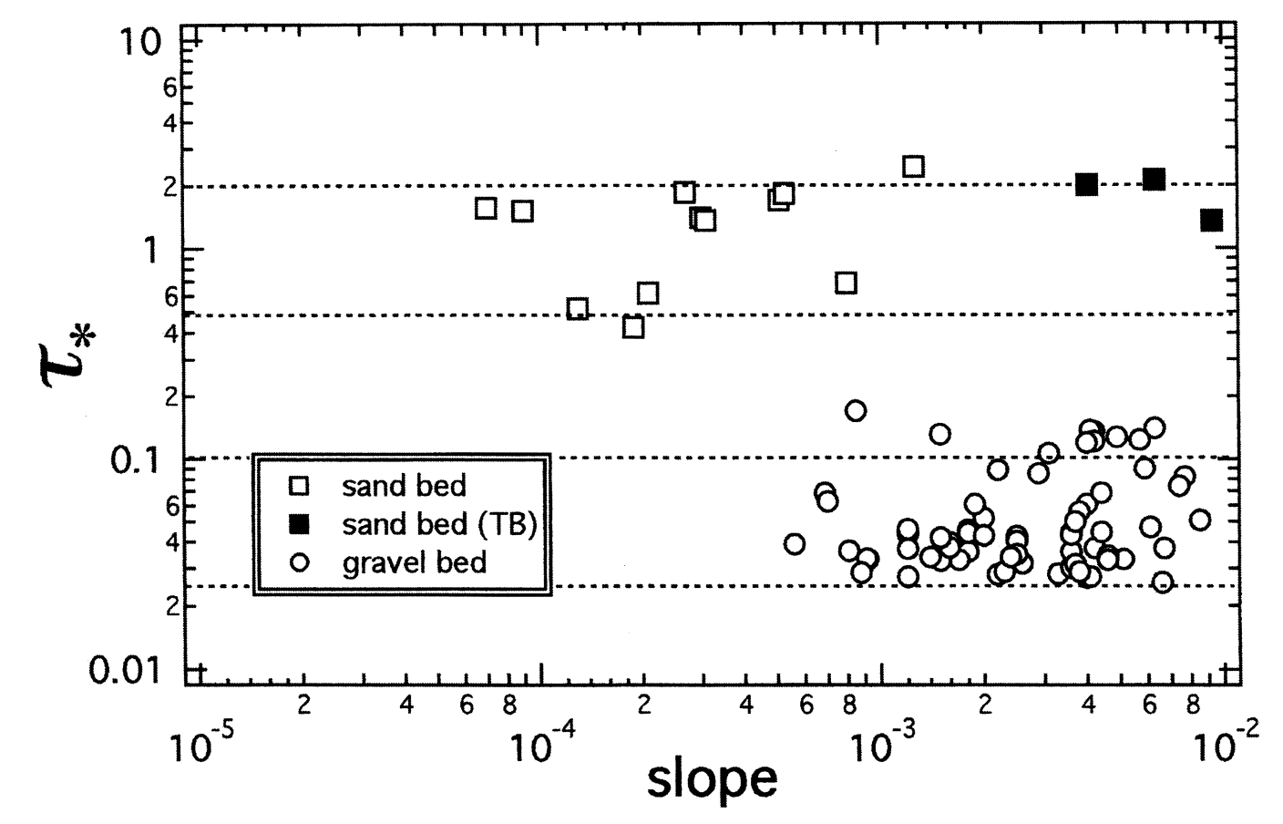
Usually (not always), Bedrock rivers ←→ gravel bed. Alluvial rivers can be sand or gravel bed.
τ_{*c}
Marr et al., Basin Research, 2000

Slide 26
Key points from “rivers and landscape evolution”
Advective vs. diffusive channel profile evolution
Hypotheses for controls on concavity
Know the streampower equation
Know bedrock erosion processes
In the required reading, don’t omit the section on transient evolution (bridge to next lecture)
Next lecture: Landscape-scale responses to forcing

Slide 27
Fluvial sediment transport: what controls the shape of rivers?
BASIC EQUATIONS GOVERNING BED ELEVATION
WHAT SETS RIVER PLANFORM?
WHAT SETS RIVER LONG PROFILE?
BEDROCK RIVER EROSION

Slide 28
Fluvial sediment transport: what controls the shape of rivers?
EXNER EQUATION
WHAT SETS RIVER PLANFORM?
WHAT SETS RIVER LONG PROFILE?
BEDROCK RIVER EROSION

Slide 29
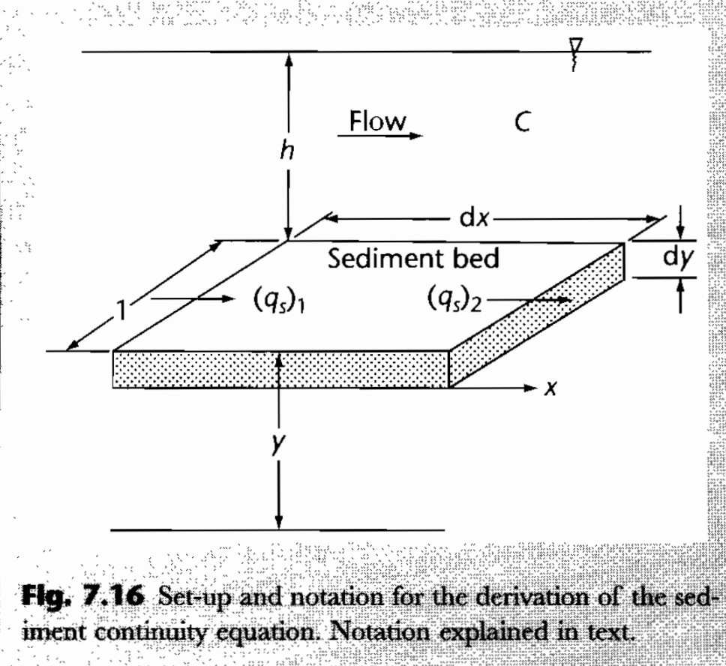
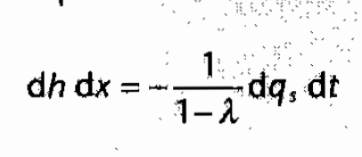
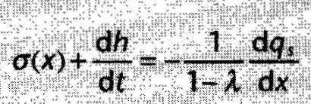
Mass balance for alluvial rivers (Exner equation)
Emphasizes suspended sediment
Steady sediment supply:
C = sediment concentration per unit volume
q_{s}= sediment flux
λ = porosity in bed material
Usually, gross transport >> net accumulation
Allen & Allen, Basin Analysis 2nd edn (2005), box 7.1

Slide 30
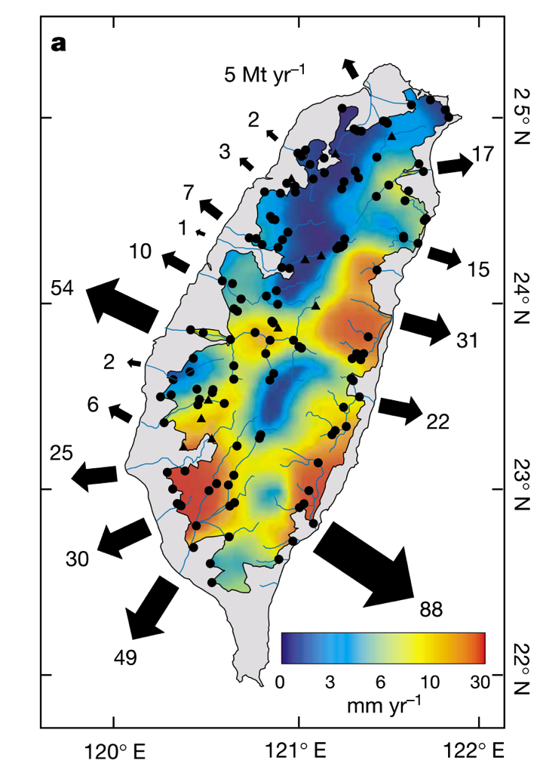
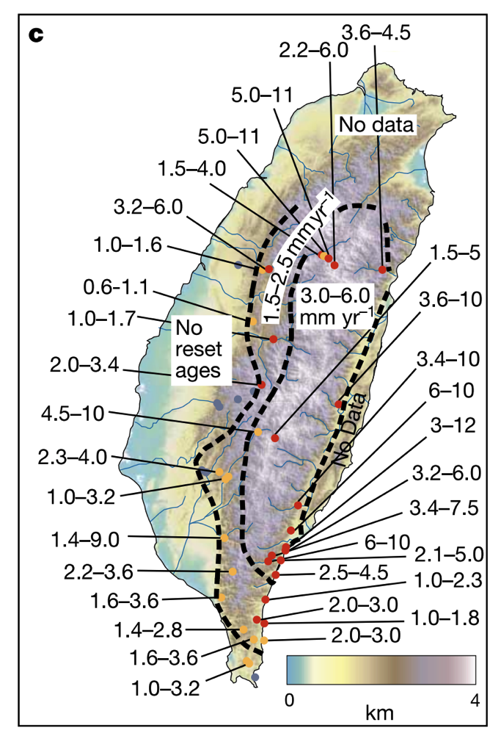
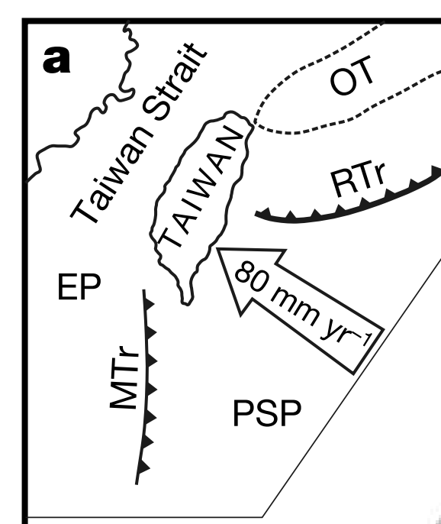
Natural laboratory: Taiwan
High mass fluxes forced by tectonics (uplift 2-5 mm/yr)
Do steady state landscapes exist on Earth?
Dadson et al.
Nature 2003
Exhumation (“unroofing”)
rate from apatite fission-track
data
Erosion rate from sediment
traps

Slide 31
Fluvial sediment transport: what controls the shape of rivers?
BASIC EQUATIONS GOVERNING BED ELEVATION
WHAT SETS RIVER PLANFORM?
WHAT SETS RIVER LONG PROFILE?
BEDROCK RIVER EROSION

Slide 32
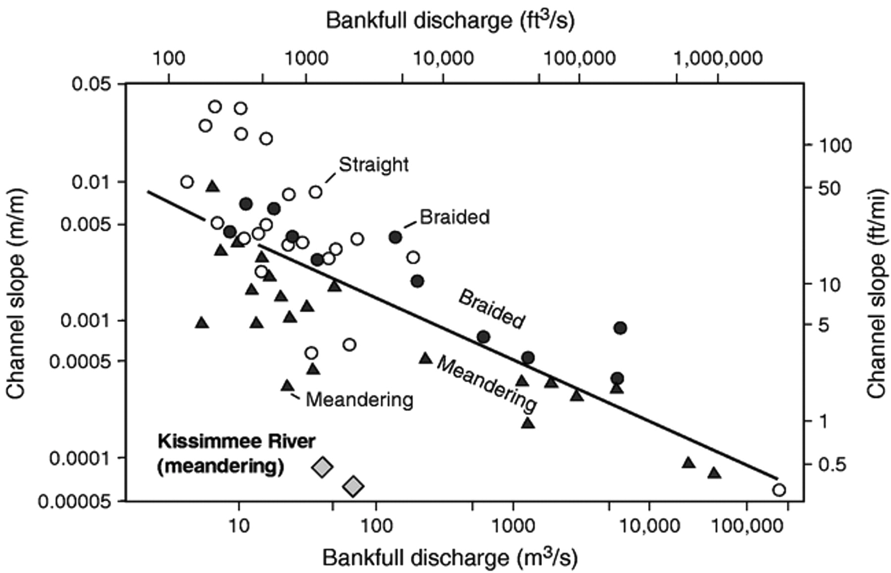
Meandering outcompetes braiding when banks are strong
Possible causes:
A grainsize effect?
Due to weak channel banks?s
S_{crit} = 0.012 Q ^{-0.44}
Warne et al.
GSA Bulletin 1999
“1.5 year flood”

Slide 33
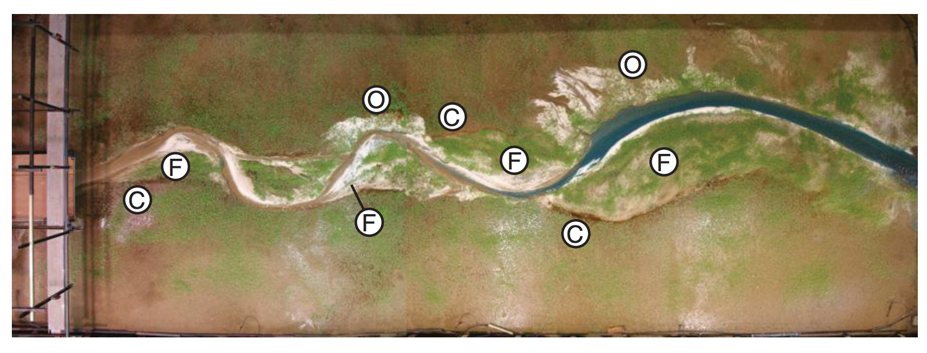
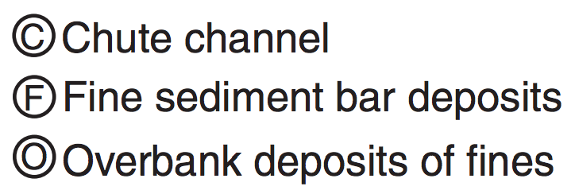
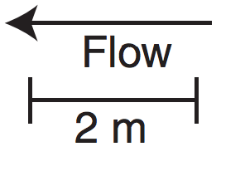
Laboratory replication of meandering is hard: vegetation matters
On Earth, most meandering-river deposits postdate the Devonian (evolution of roots)
Braudrick et al. PNAS 2009

Slide 34
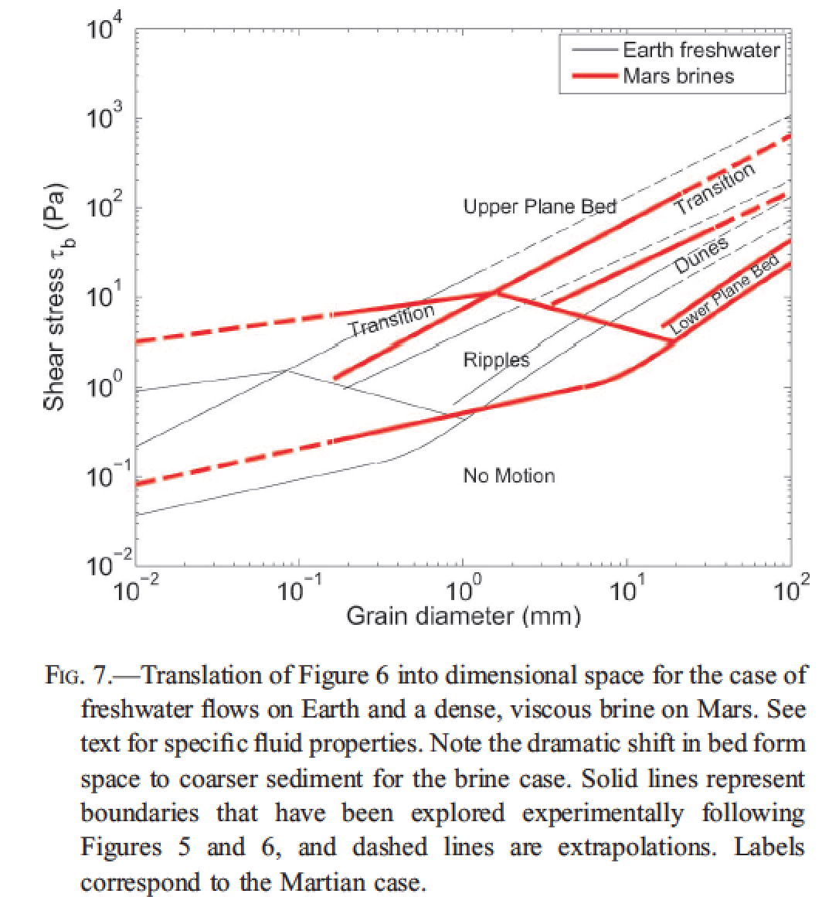
Fluvial bedforms constrain paleo-depth of flow
(uncommon) antidunes
Lamb et al. 2012, in
“Sedimentary Geology of Mars,”
Grotzinger & Milliken, eds.
Useful on other planets,
for Precambrian Earth,
and in rock outcrops where
full depth of river channel
is not always preserved

Slide 35
Fluvial sediment transport: what controls the shape of rivers?
BASIC EQUATIONS GOVERNING BED ELEVATION
WHAT SETS RIVER PLANFORM?
WHAT SETS RIVER LONG PROFILE?
BEDROCK RIVER EROSION

Slide 36
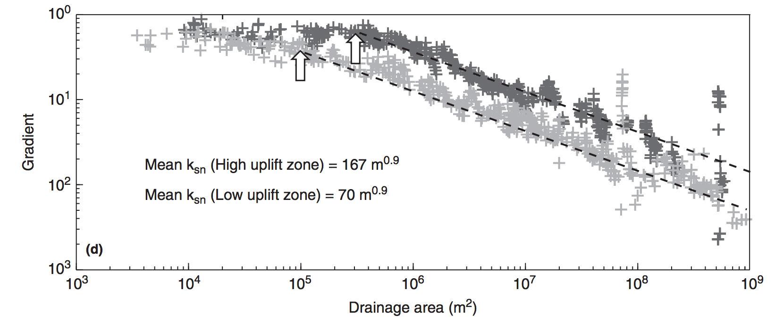
Debris flows and hillslopes
Fluvial processes

Slide 37
The broadest possible view (hypothesis 1):
z
lowland
floodplain
fans
delta
UPLIFT
SUBSIDENCE
x
However, we find that concavity is found within the bedrock-cutting and sediment-
transporting parts of the system. So what causes this concavity – if not the grand-scale
tectonics?
First, assume τ_{b} = τ_{c} everywhere on the profile (just moving “indestructible balls”).
Then, ρghS = τ_{c}. And τ_{c} / (ρ_{s} – ρ)gD₅₀ = τ_{*c} = “k” ~ constant (~0.045 for gravel, 0.03 for sand).
S = k(ρ_{s} – ρ)gD₅₀ / ρgh
S = k₁h⁻¹
(hypothesis 2 …)

Slide 38
From hydraulic geometry, h = cQ^{f} , f ~ 0.4. (Definition: Q = Q_{bf} = bankfull discharge)
last lecture …
Q is proportional to A (for small catchments)
S = k₂A^{-0.4}D₅₀
(hypothesis 2)
Prediction: A river’s slope is to some extent controlled by the grainsize it receives.
What if D₅₀ changes (change in hillslope or tributuary input, clast abrasion/dissolution)?
Downstream fining - e.g. , breakdown of sediment along the stream path?
Experimentally, D(x) = D₀ e^{-βx}
x is distance along flowpath
“Sternberg’s law”
with β = (10⁻⁵ – 10⁻¹) km⁻¹ (function of lithology)
Set L_{1/2} = travel distance at which grainsize is reduced by ½
L_{1/2} = ln(2)/β = (7 – 70,000) km
Set L_{D}* = travel distance at which grain goes into suspension.
Then L_{D}* = (1/β) ln (D₀/D_{min}), where D_{min} = size at suspension.

Slide 39
Amplitude of concavity depends on sediment supply (and sediment abrasion)
Transported sediment:
q_{s} = kτ_{b}^{n} per unit width (neglect τ_{c})
Q_{s} = q_{s}w = kτ_{b}^{n}w; τ_{b} = ρghS, where h = cA^{γ} ; w = dA^{b}
Input sediment: Q_{s} = aA^{α}
= k₁(ρgcA^{γ}S)^{n}dA^{b}
Conservation of mass:
aA^{α} = k₁(ρgc)^{n}A^{γn}S^{n}dA^{b}
S = k₂A^{(α – γn -} ^{b)/n}
(hypothesis 3)
Examples:
α = 1.0, γ = 0.4, n = 1.5, b = 0.5:
S = k₂A^{-0.07} → straight profile.
But, if α = 0,
S = k₂A^{-0.73} → large concavity.
(downstream fining control = hypothesis 4)

Slide 40
For rivers that cut through bedrock, how does this erosion affect the long profile?
neglect threshold
dz/dt = U – E. Hypothesis: E = k(streampower)^{n}
“Streampower”:power = force x distance / time
power/(bed area) = F x d
A x t
river
speed
τ_{b}
hypothesis:
widely used &
physically reasonable,
but not tested enough
to be trusted
ω = τ_{b}v
Q_{w} = hvw (Q_{w} = water flux)
ω = ρghVS =ρgQ_{w}S/w
E = k (ρgQ_{w}S/w)^{n}
Streampower erosion law

Slide 41
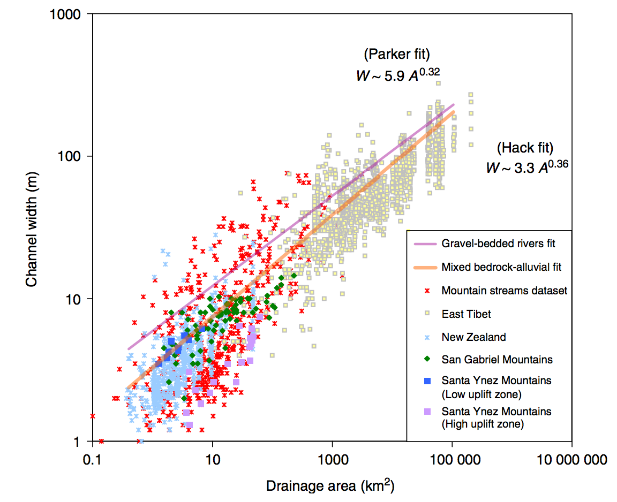

Slide 42
Streampower - topographic steady state:
Q = k_{q}A^{c}
w = k_{w}Q^{b}
Q = vhW τ_{b} = ρghS ω = τ_{b}v
E = (ρg)^{n}(k₃^{(1-b)}k₄⁻¹)^{n}A^{en(1-b)}S^{n}
Following Whipple and Tucker
JGR 1999
define this as “m”
E = k₅A^{m}S^{n}
The streampower hypothesis leads to E = kA^{m}S^{n}
“m” contains channel geometry information.
slope: m/n
log S
Steady state:
dz/dt = U - E = 0
Concavity
S = (U/k₅)^{1/n} A^{-m/n}
log A
(“Whipple’s”) steepness
index
Increasing uplift or harder rock
Decreasing uplift or softer rock

Slide 43
Summing up controls on longitudinal profiles: hypotheses
Gross topography (set by tectonics)
Threshold rivers (intent: gravel-bed rivers)
Power-law relation between sediment transport flux and basal shear stress (intent: sand-bed rivers)
Selective transport
Bedrock incision in canyons:
(5a) Streampower
(5b) Tools-and-cover (Leonard Sklar)
Large boulders: effectively
rough pieces of bedrock
(abraded in pace)
Sourcing may change from
coarse to fine downstream.

Slide 44
Fluvial sediment transport: what controls the shape of rivers?
BASIC EQUATIONS GOVERNING BED ELEVATION
WHAT SETS RIVER PLANFORM?
WHAT SETS RIVER LONG PROFILE?
BEDROCK RIVER EROSION

Slide 45
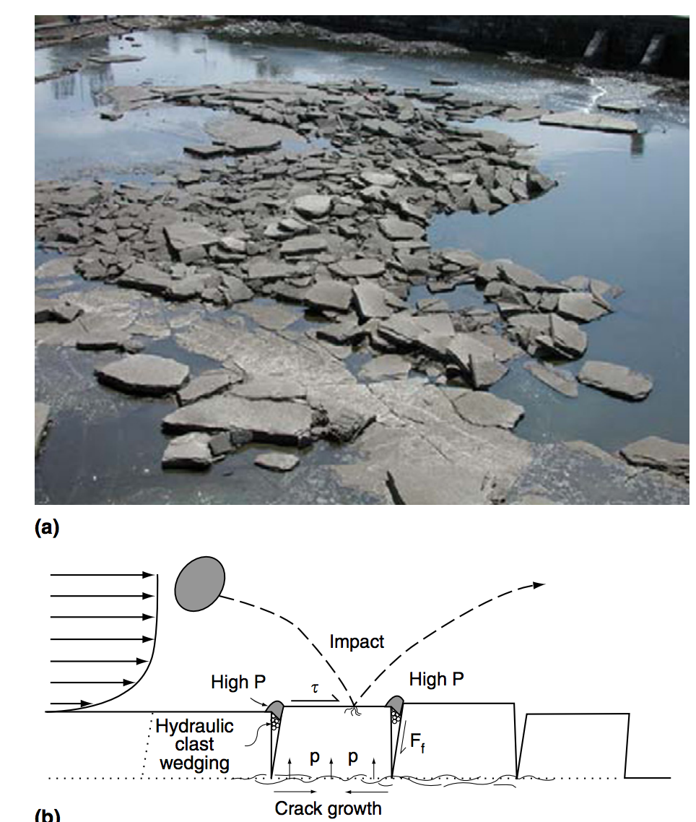
Mechanisms of bedrock erosion: plucking
Whipple et al., Treatise on Geomorphology 2013

Slide 46
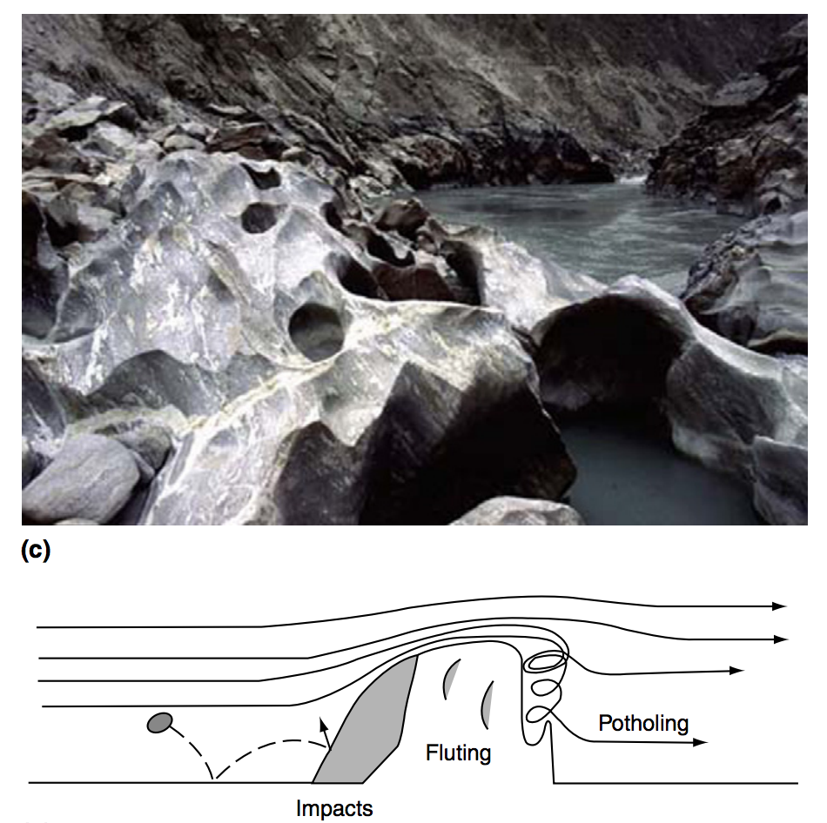
Mechanisms of bedrock erosion: abrasion
Whipple et al., Treatise on Geomorphology 2013

Slide 47
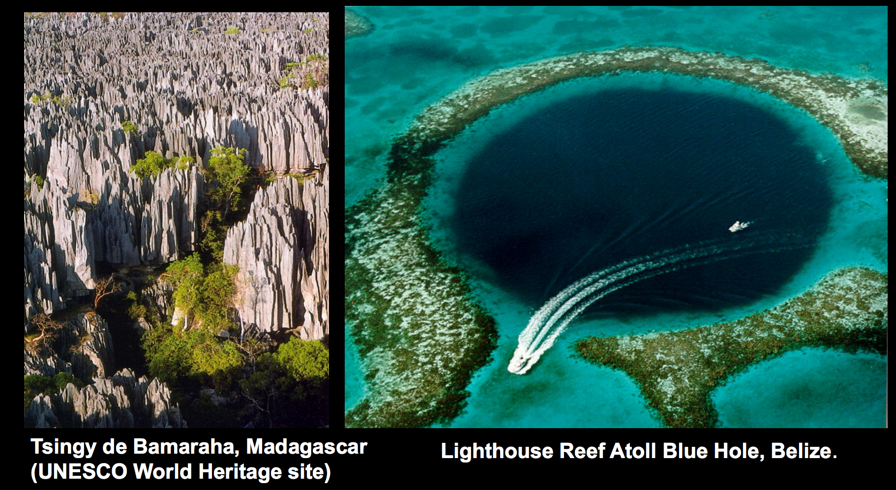
Mechanisms of bedrock erosion: corrosion (= weathering + dissolution)
Mike Malaska (JPL)

Slide 48
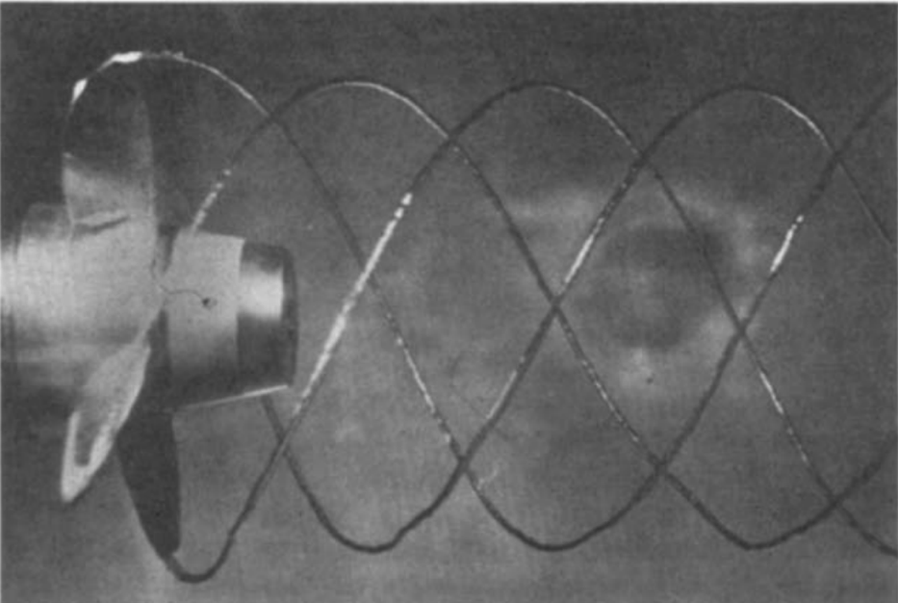
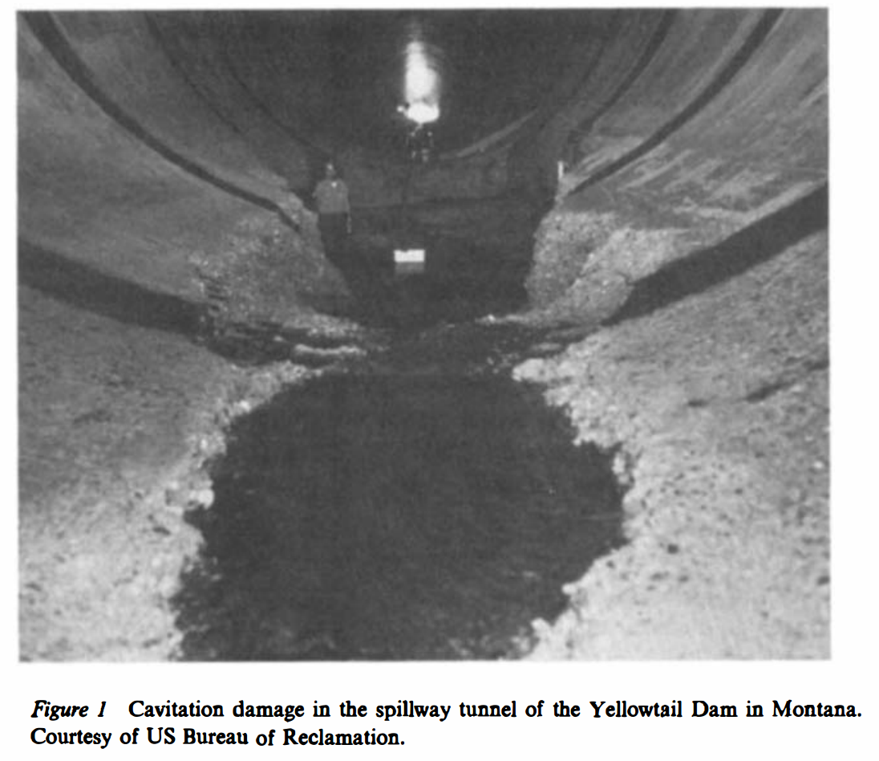
Mechanisms of bedrock erosion (?): cavitation?
Arndt, Annual Reviews of Fluid Mechanics, 1981

Slide 49
Points to remember for lab:
(Greg Tucker)

Slide 50
Key points from ‘intro. to rivers and landscape evolution’
Advective vs. diffusive channel profile evolution
Hypotheses for controls on concavity
Know the streampower equation
Know bedrock erosion processes
Next lecture: Landscape-scale responses to forcing

