Slide 1
GEOS 28600
The science of landscapes:
Earth & Planetary Surface Processes
Lecture 2
Wednesday 8 January 2020
i) Introduction.
ii) Shape, geoid, true polar wander.

Slide 2
SHAPE (HYDROSTATIC, ρ = ρ(r) )
GEOID (WHAT IS TOPOGRAPHY MEASURED RELATIVE TO?)
TRUE POLAR WANDER

Slide 3
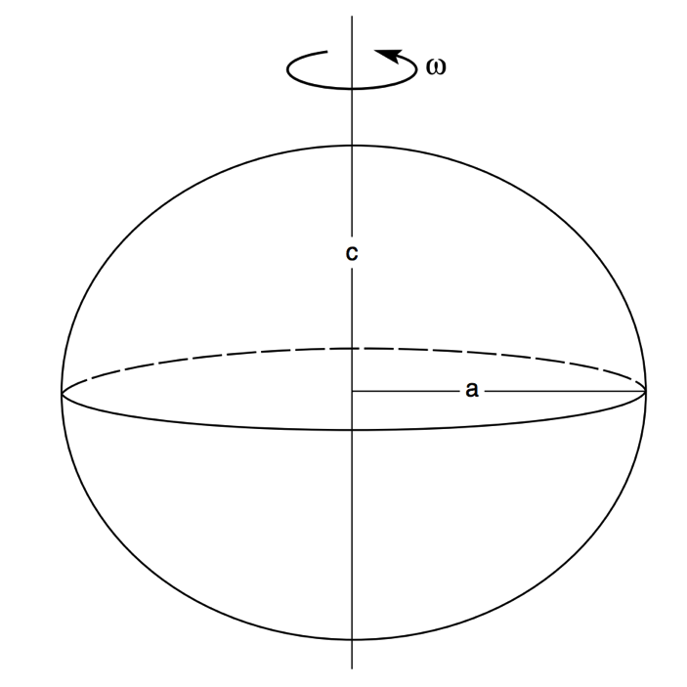
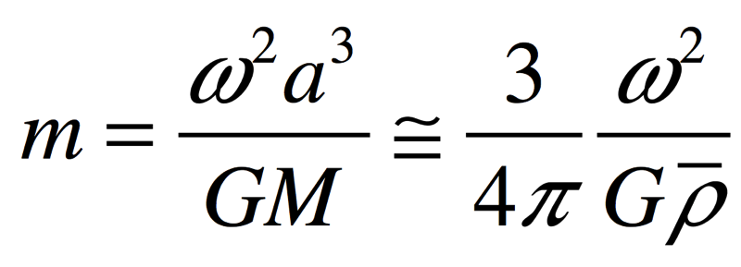
f = (a-c)/a = f(m) = ?
Why do planets in hydrostatic equilibrium bulge at the equator?
Assume: m<<1; no fluid circulation.
Basic criterion: no tangential forces at
surface.
f m
Hydrostatic equilibrium: pressure at
the bottom of column-of-water (a)
= pressure at the bottom of column-of
-water (c)
“the appropriate theory [for the proportionality constant relating f and m] is quite nasty …
and rather little insight emerges from wallowing in the nastiness.”

Slide 4
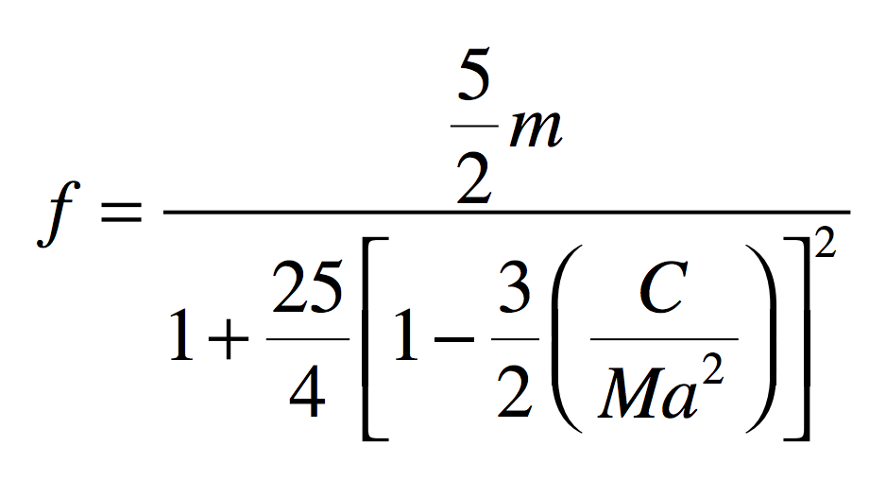
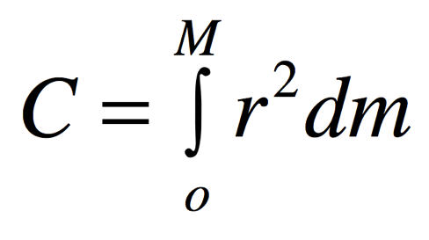
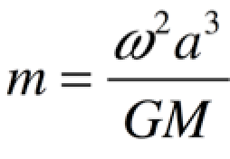
How much do planets in hydrostatic equilibrium bulge at the equator?
Maclaurin spheroid:
where r is distance from the polar axis
0 for a point mass
0.4 for uniform density
1.0 for all mass in outer shell
0.331 for real Earth
(central concentration
of mass)
Assume: m<<1; no fluid circulation.

Slide 5
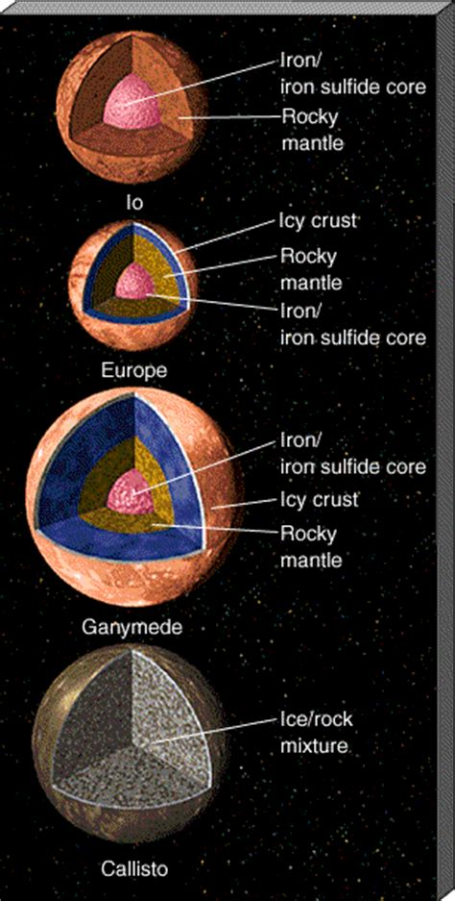
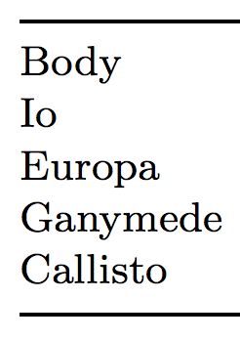
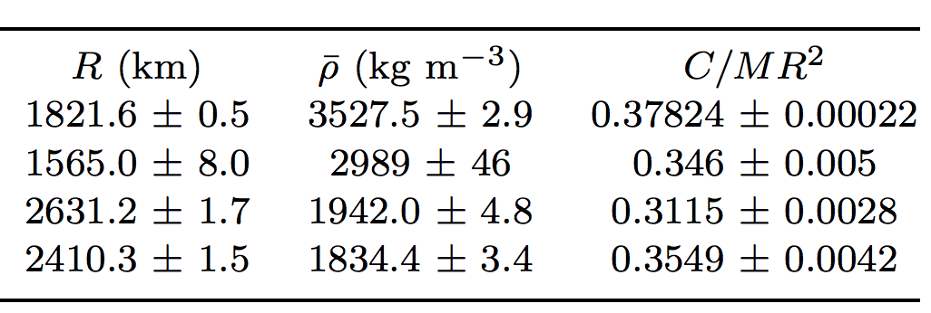
Application of C/Ma²:
structure of Galilean
satellites of
Jupiter
→ differentiation, formation history
Under the conditions of Galilean satellite interiors:
Density of icy crust and liquid water: 1000-1600 kg/m³
Density of rock: ~3000-3500 kg/m³
Density of Fe/FeS core: 5200-8000 kg/m³
Europa
A²
From Schubert et al. chapter in Cambridge University Press
Jupiter book
What surprises you about this table, given the picture?

Slide 6
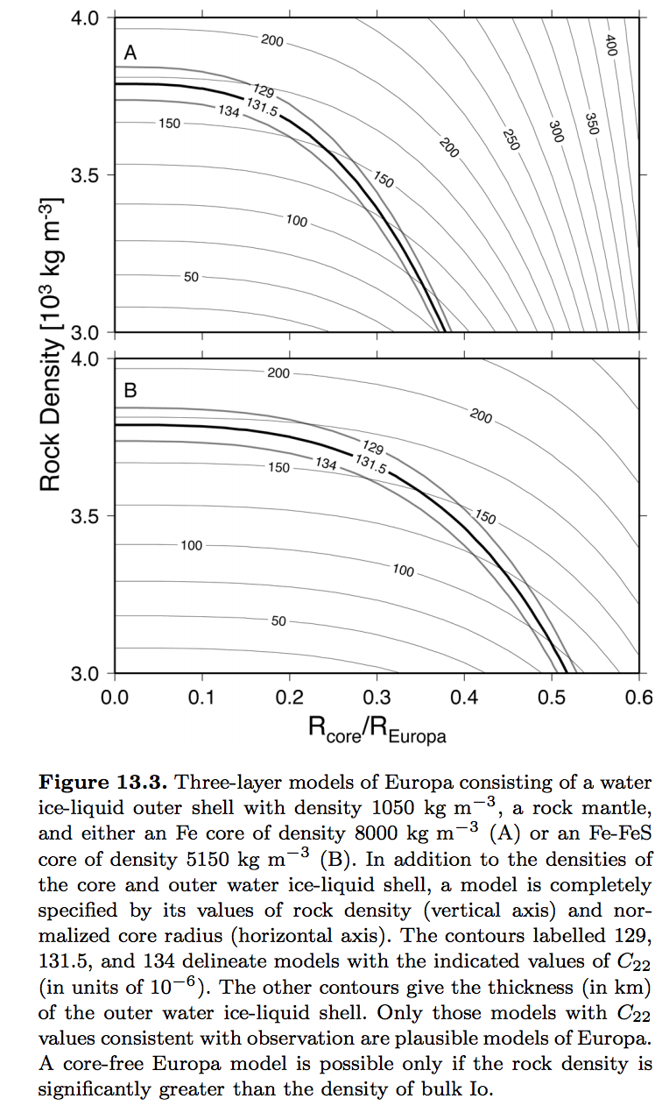
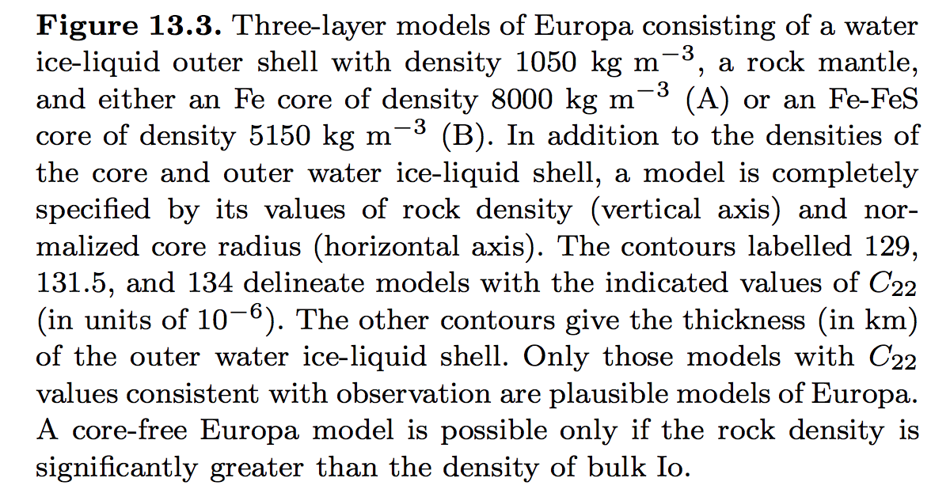
Trade-offs in determining internal structure

Slide 7
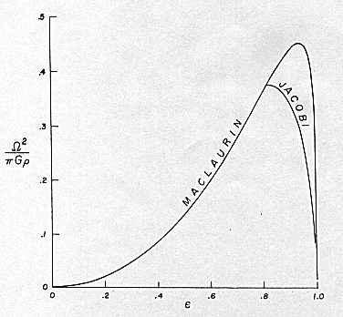
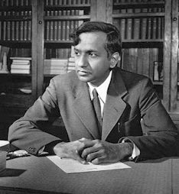
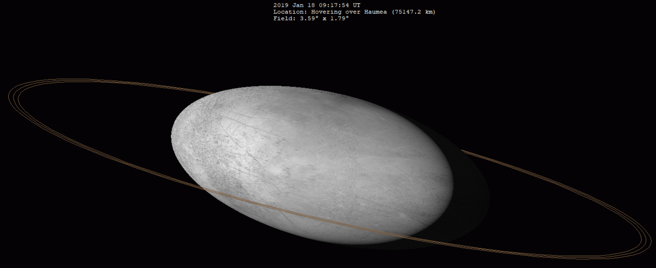
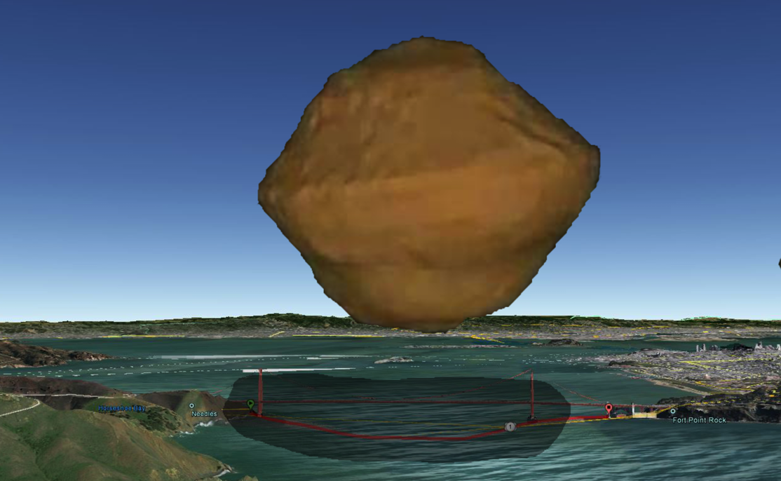
Hydrostatic equilibrium as m→1
Chandrasekhar
(“Ellipsoidal figures,”
1960)
Haumea
Spin-up of
small
asteroids
Arecibo
shape
model

Slide 8
INTRODUCTION
__________________________________________________
SHAPE (HYDROSTATIC, ρ = ρ(r) )
GEOID (WHAT IS TOPOGRAPHY MEASURED RELATIVE TO?)
TRUE POLAR WANDER

Slide 9
Reference ellipsoid, vs. geoid, vs. topography
SHAPE
TOPOGRAPHY
distance from Earth’s center
GEOID
ANOMALY
GEOID
(FLUID LEVEL,
EQUIPOTENTIAL)
REFERENCE ELLIPSOID
(defined for convenience;
not necessarily the same
as the Maclaurin ellipsoid)
distance along a line of longitude

Slide 10
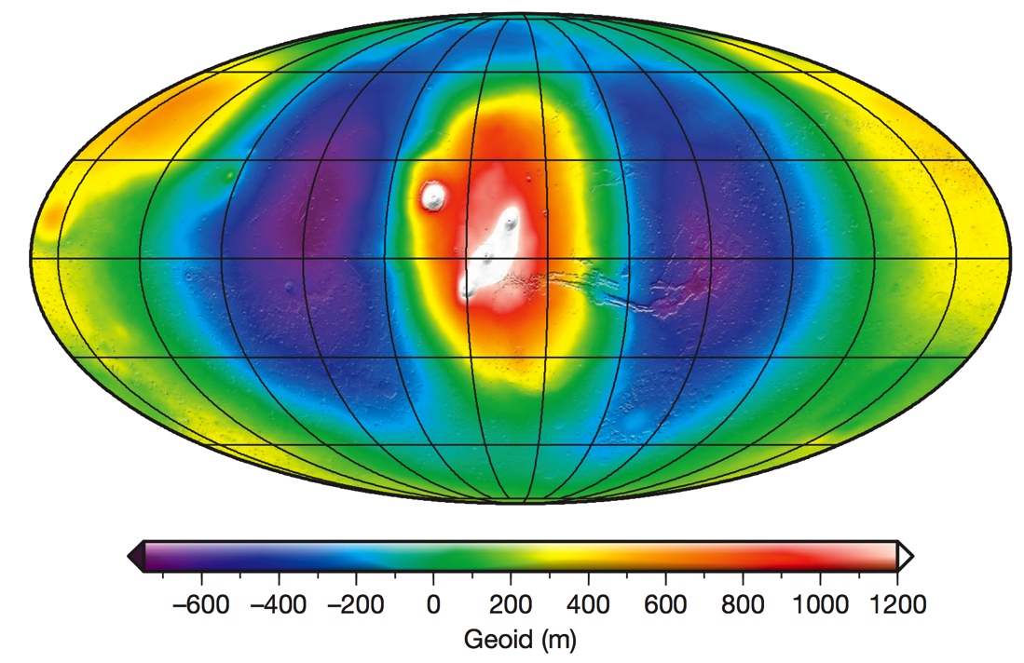
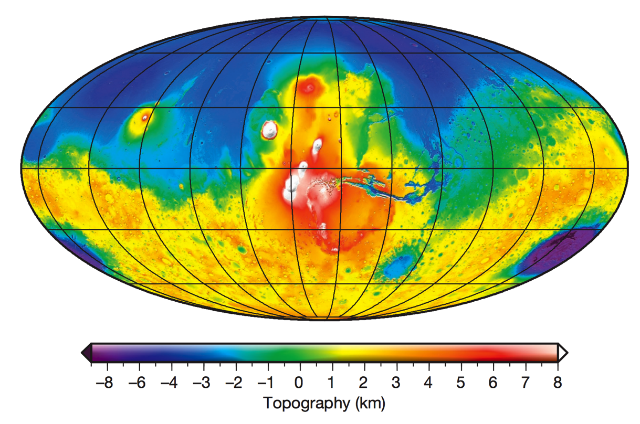
Mars’ geoid: correlated with topography
- The large <4 Ga volcanoes are geoid highs
- The >4 Ga ancient dichotomy between southern highlands and northern lowlands leaves no trace in the geoid
MARS GEOID
MARS TOPOGRAPHY
MSL lander had the wrong amount of
fuel in its tanks (by a lot) due to not
correcting adequately for Mars’ gravity/geoid
Contrast between Earth & Mars geoid is mainly due to a difference in strength of the lithosphere

Slide 11
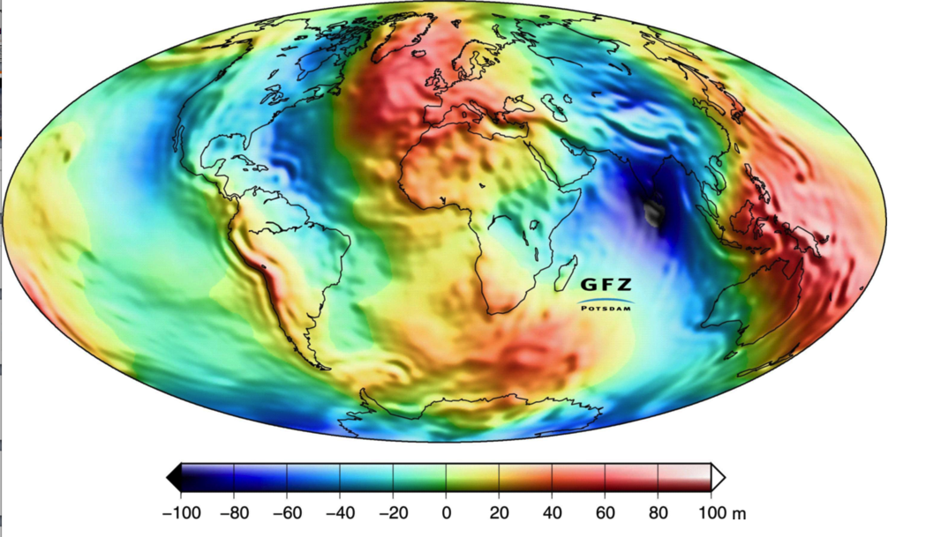
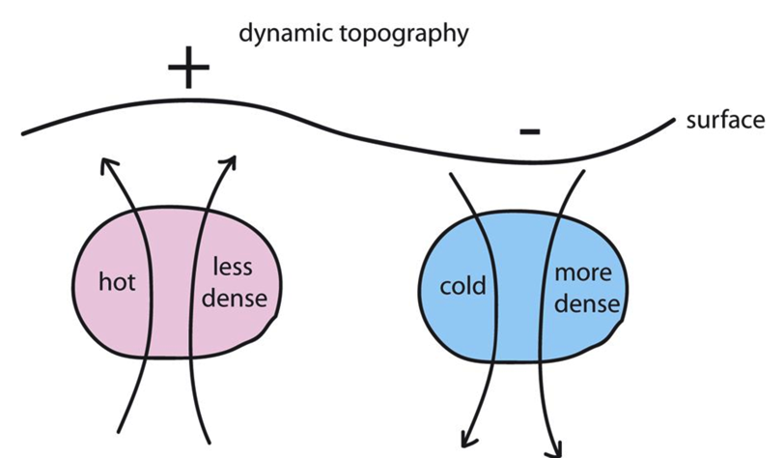
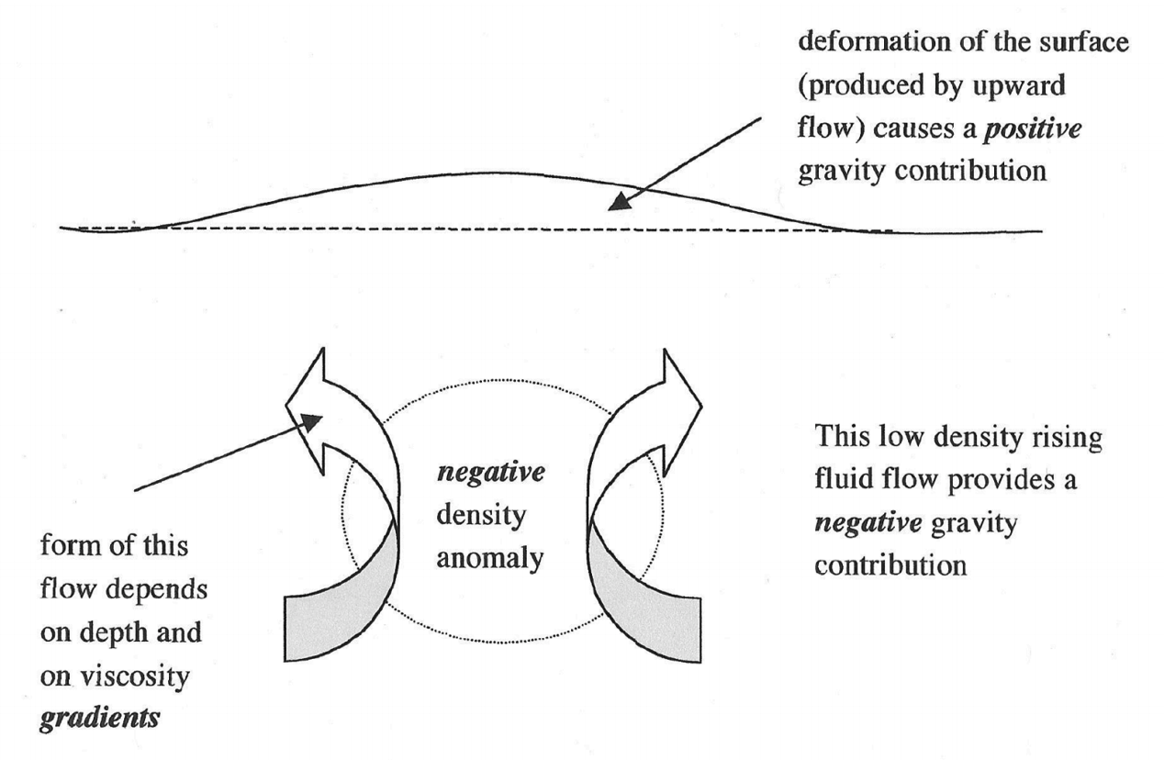
Earth’s geoid: uncorrelated with topography
Not a record of surface processes (instead, mantle convection)
Can drive surface processes (e.g., Western Interior Seaway)
Steady, solid-state
mantle convection
Earth dynamic topography:
amplitude km
Richards & Hager, JGR 1988

Slide 12
INTRODUCTION
__________________________________________________
SHAPE (HYDROSTATIC, ρ = ρ(r) )
GEOID (WHAT IS TOPOGRAPHY MEASURED RELATIVE TO?)
TRUE POLAR WANDER

Slide 13
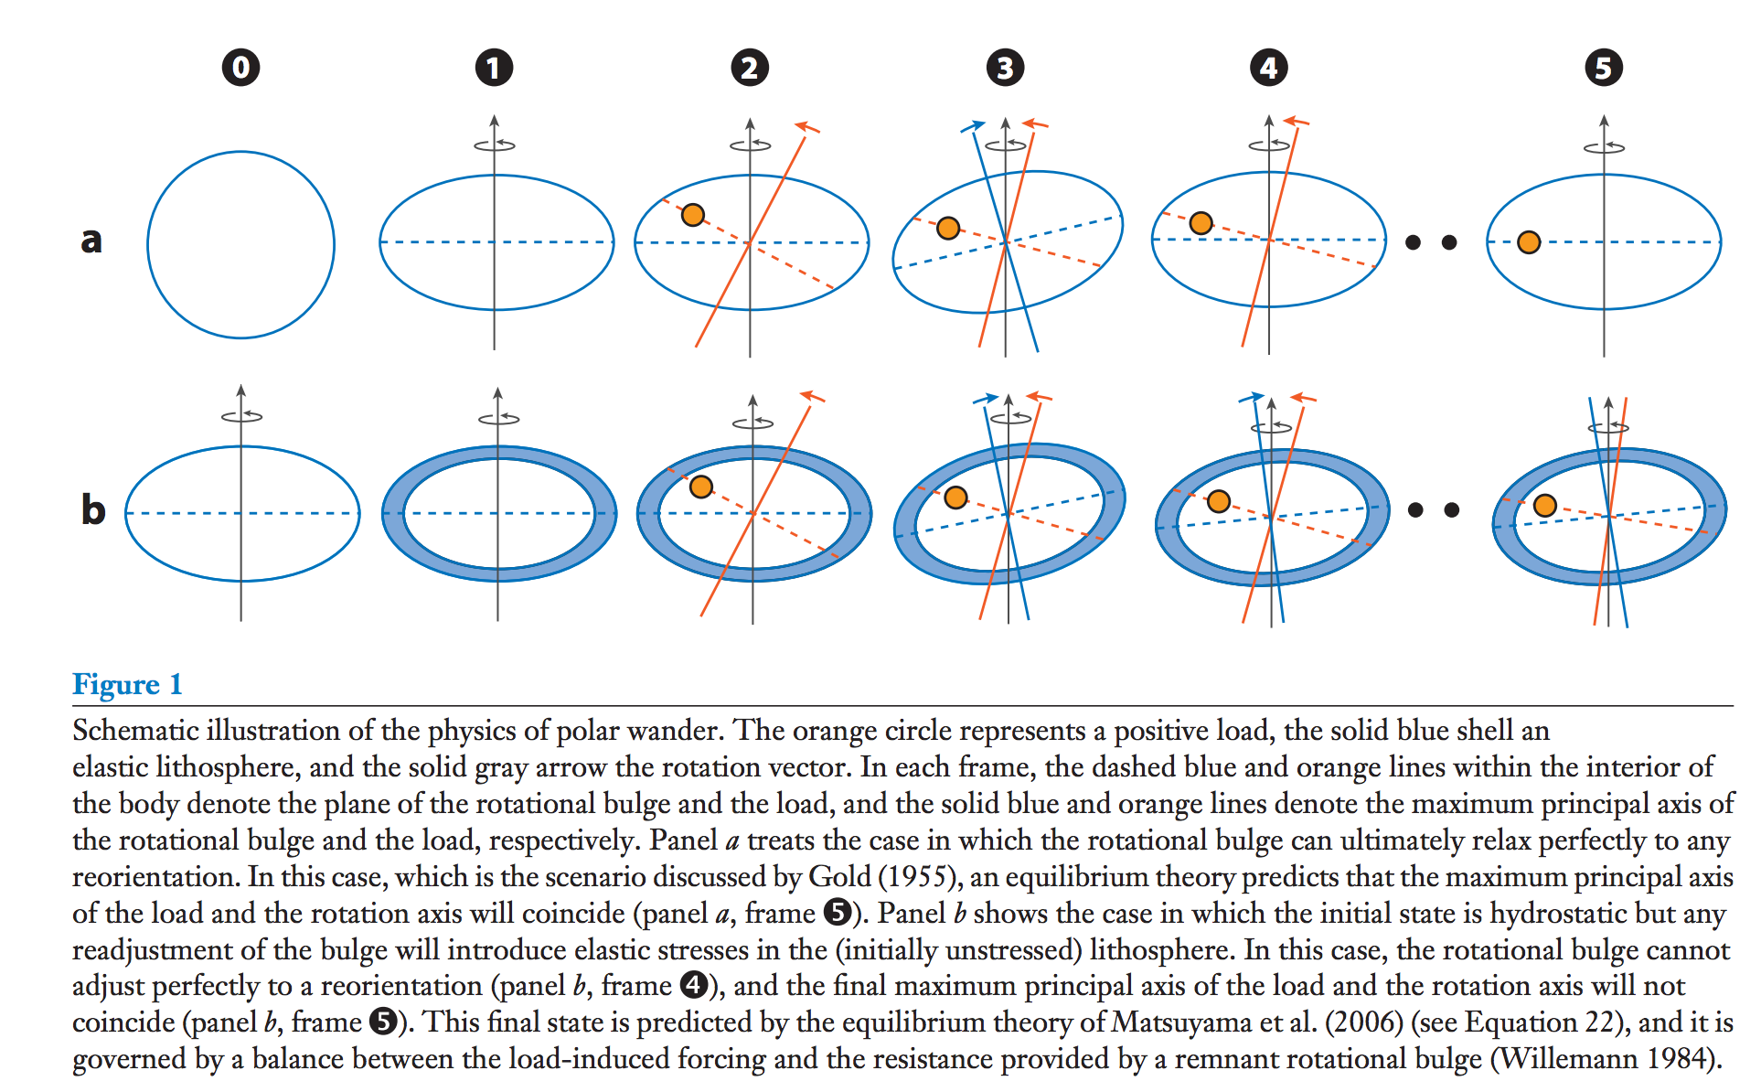
True polar wander – migration of +ve (-ve) nonhydrostatic mass anomalies to equator (poles)
Over geologic time, energy dissipation within viscous interior will align the spin axis
with the maximum moment of inertia.
Matsuyama et al., Annual Reviews of Earth & Planetary Science, 2014

Slide 14
Significance of true polar wander
(Potentially rapid) shifts of (paleo)latitude
Complicate reconstruction of past climate

Slide 15
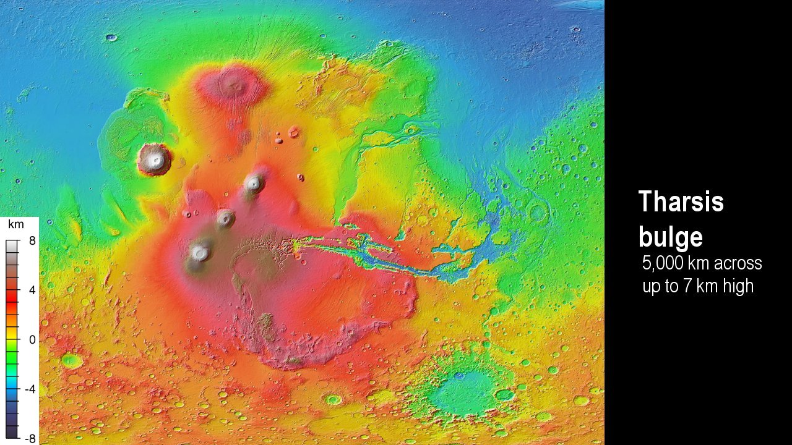
Matsuyama & Manga, JGR, 2010

Slide 16
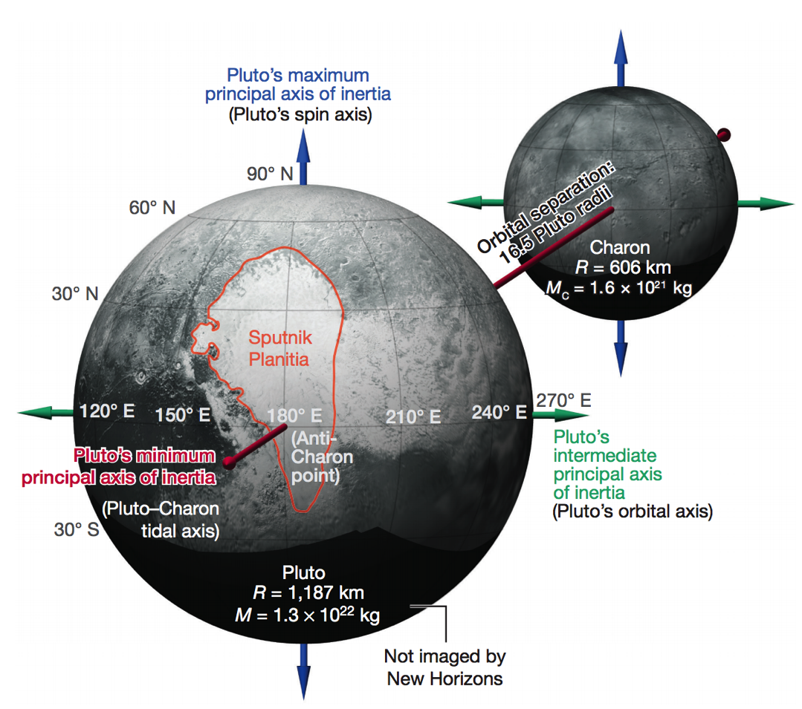
TPW on Pluto
Keane et al. Nature 2016

Slide 17
Key points from first lecture
why planets are roughly spherical;
relationship between internal mass
distribution and rotational bulge.
the definition of the geoid;
principle of true polar wander;
evidence for true polar wander.
Next lecture
- How is topography supported?

Slide 18
Key points from second lecture
Relationship between topography & gravity at length scales much larger than, comparable to, and much smaller than, the lithospheric thickness.
Explanation of Airy isostasy
Quantities inferred from topography←→gravity comparison.

Slide 19
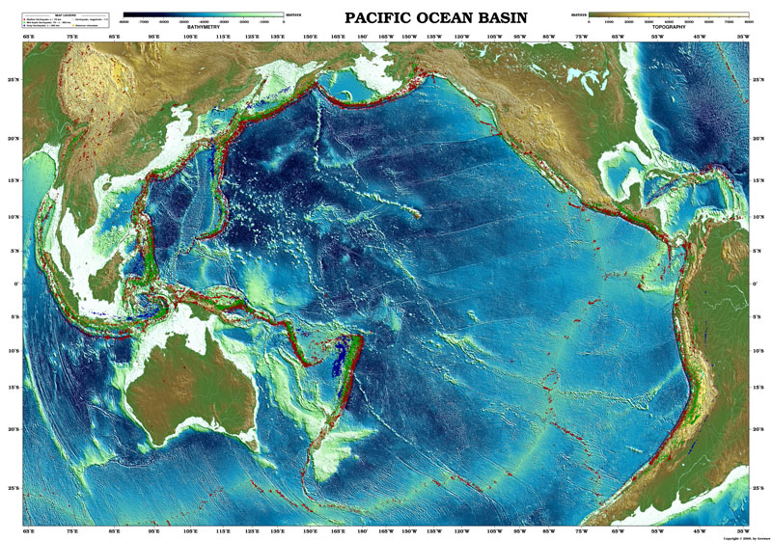
Topography of the oceans: How is topography supported?

Slide 20
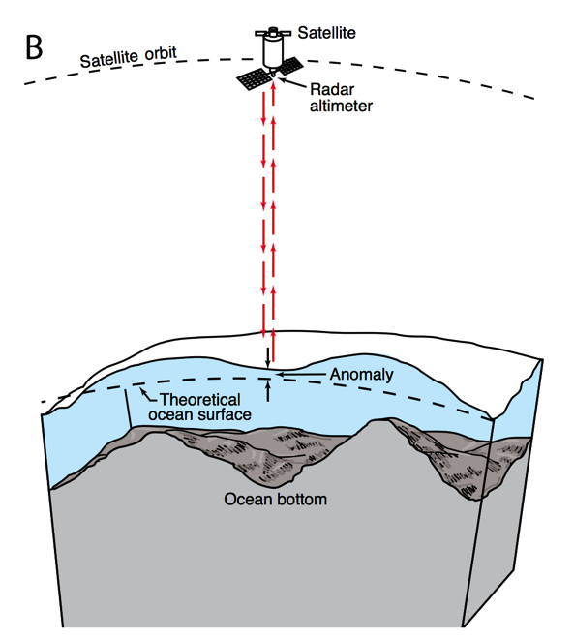
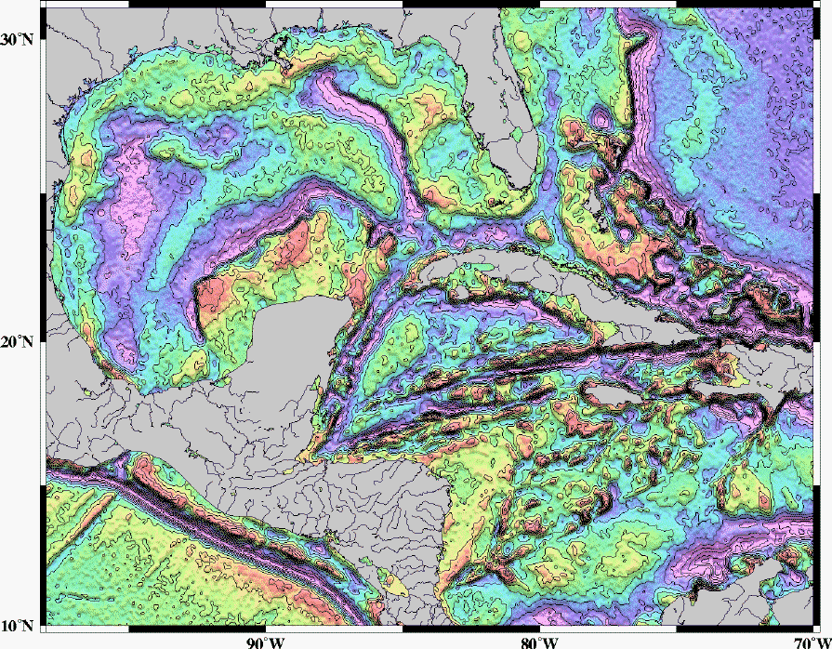
Mapping underwater volcanoes from space
Wessel et al. Oceanography 2010
Smith & Sandwell 1997

Slide 21
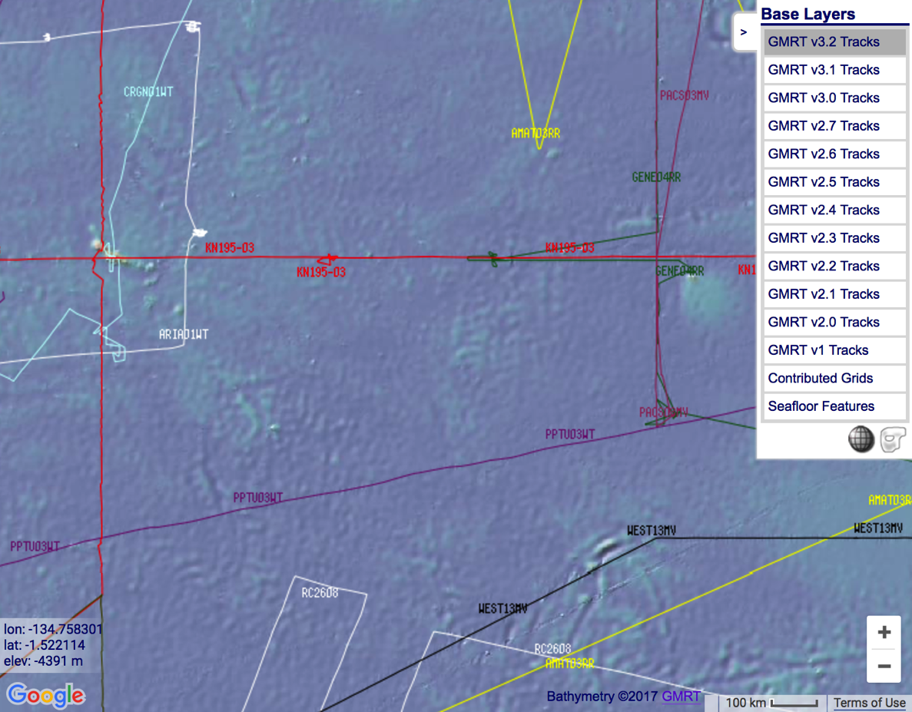
http://www.marine-geo.org/portals/gmrt/
Most Earth seafloor “bathymetry” is actually inferred from constraints on gravity!
gaps between tracks: bathymetry
inferred from altimetry→ gravity
gaps
are
large!
sonar bathymetry

Slide 22
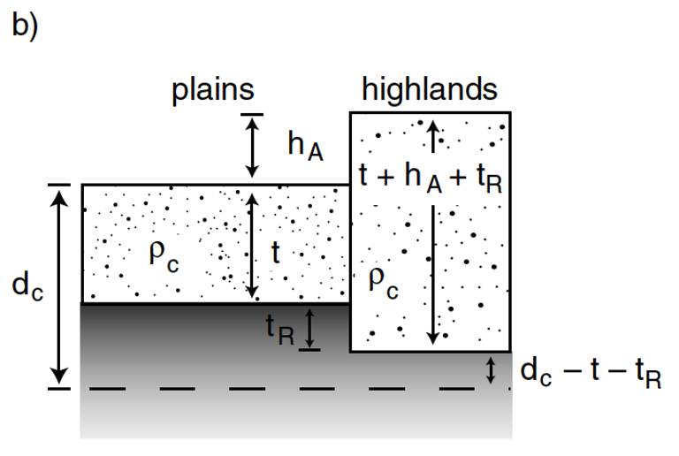
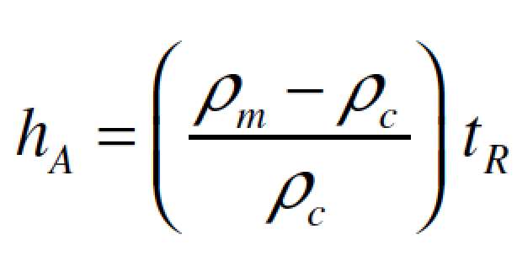
Airy isostasy (floating)
Free-air gravity anomaly is negligibly small for loads small compared to planet radius

Slide 23
Switch to chalkboard

Slide 24
How is topography supported?
EXPECTATIONS AND OBSERVATIONS: BOUGUER GRAVITY EQUATION, GRAVITY-TOPOGRAPHY CORRELATION, ADMITTANCE
MECHANISMS: AIRY ISOSTASY, FLEXURE
(MEMBRANE STRESSES)
APPLICATIONS: DENSITY/POROSITY; INFERENCE OF BURIED OCEANS; STRENGTH
→ HEAT FLOW → THERMAL HISTORY

Slide 25
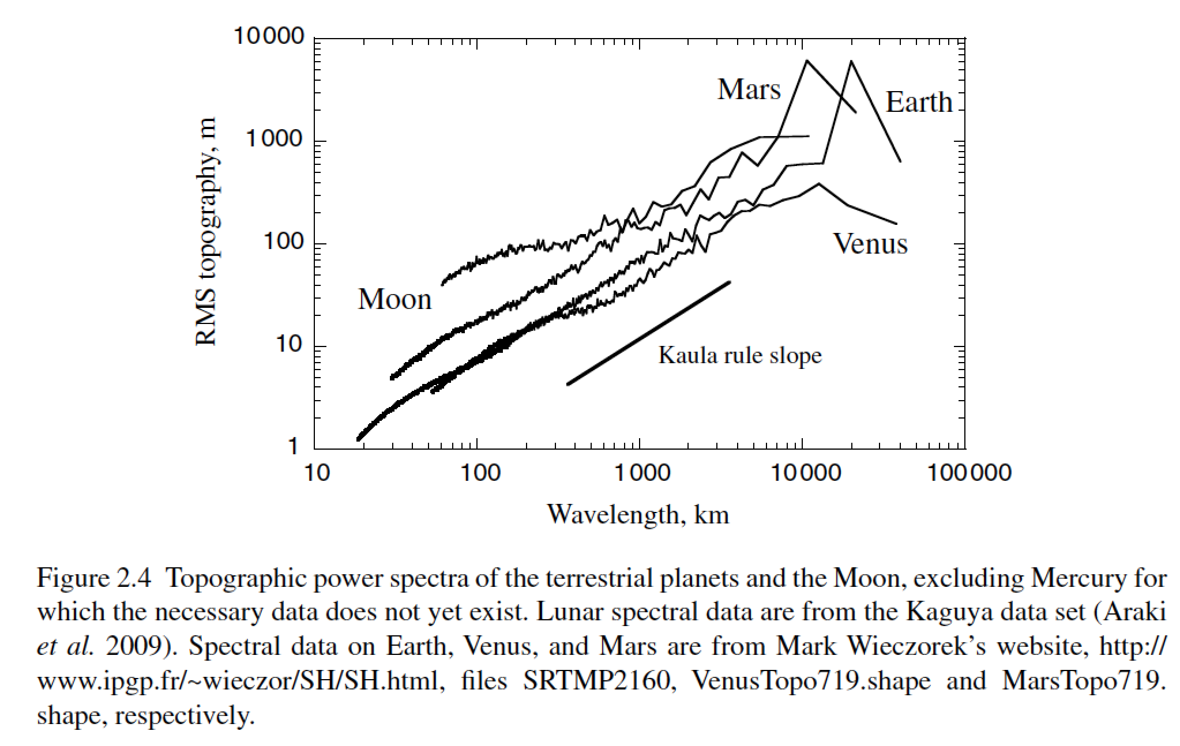
Unsolved theory problem (Rosenberg, Aharonson & Sari, JGR 2015)
Matern functions? (Simons et al. AGU 2015)

Slide 26
How is topography supported?
WRAP-UP TRUE POLAR WANDER FROM LECTURE 1
REVIEW REQUIRED READING (CHAPTER 2 IN MELOSH)
_____________________________________________________________
EXPECTATIONS AND OBSERVATIONS: BOUGUER GRAVITY EQUATION, GRAVITY-TOPOGRAPHY CORRELATION, ADMITTANCE
MECHANISMS: AIRY ISOSTASY, FLEXURE
(MEMBRANE STRESSES)
APPLICATIONS: DENSITY/POROSITY; INFERENCE OF BURIED OCEANS; STRENGTH → HEAT FLOW → THERMAL HISTORY

Slide 27
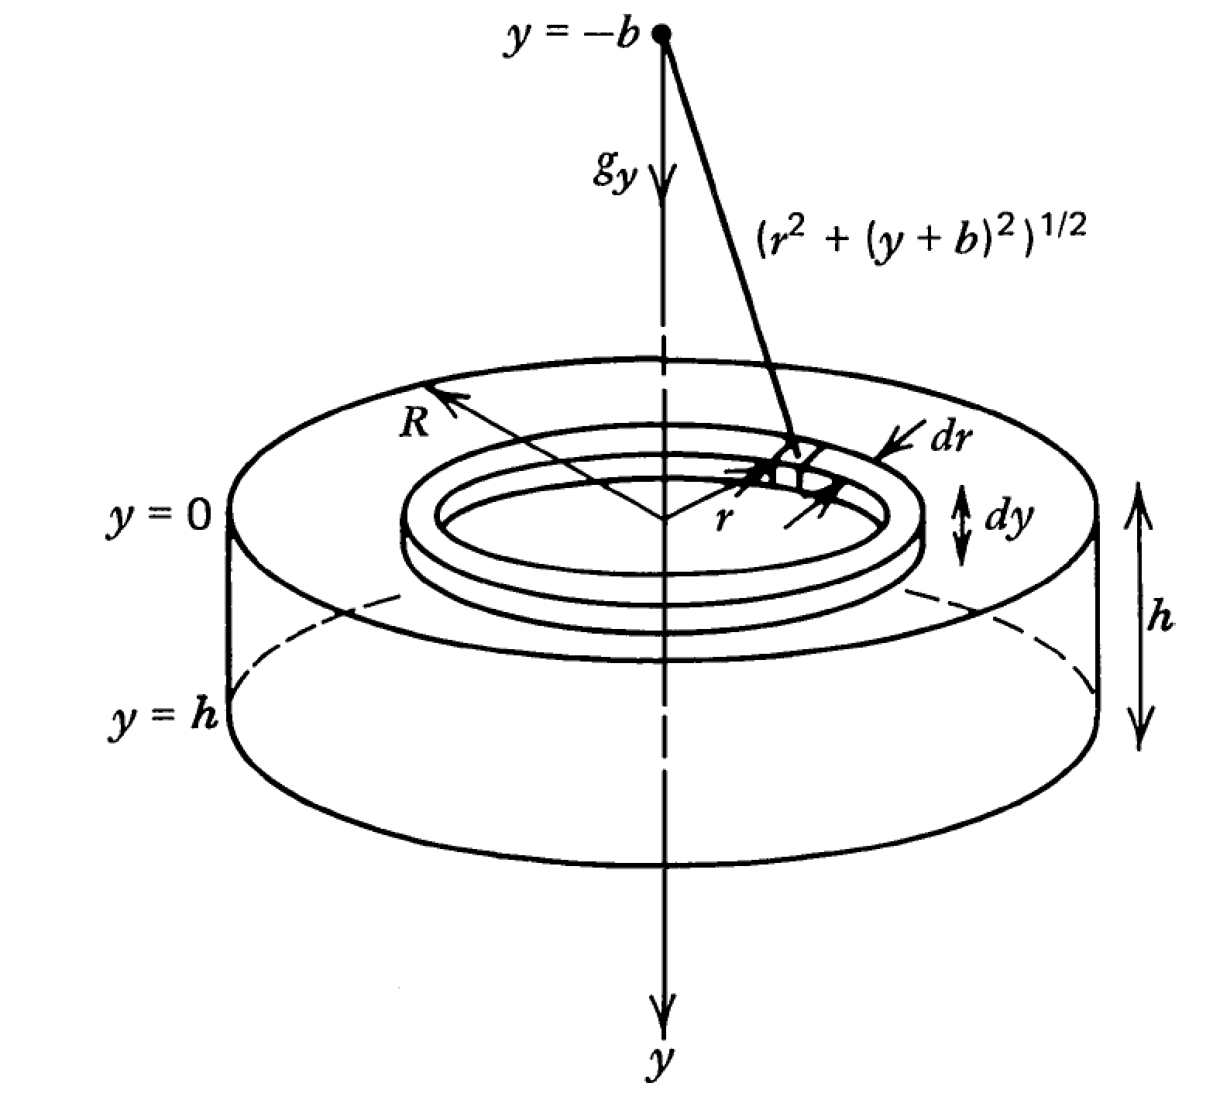

Slide 28
Following Turcotte & Schubert (2nd edn):

Slide 29
Example: map underwater volcanoes from space
Wessel et al. Oceanography 2010
Smith & Sandwell 1997

Slide 30
http://www.marine-geo.org/portals/gmrt/
Most Earth seafloor “bathymetry” is actually inferred from constraints on gravity!
gaps between tracks: bathymetry
inferred from altimetry→ gravity
gaps
are
large!
sonar bathymetry

Slide 31
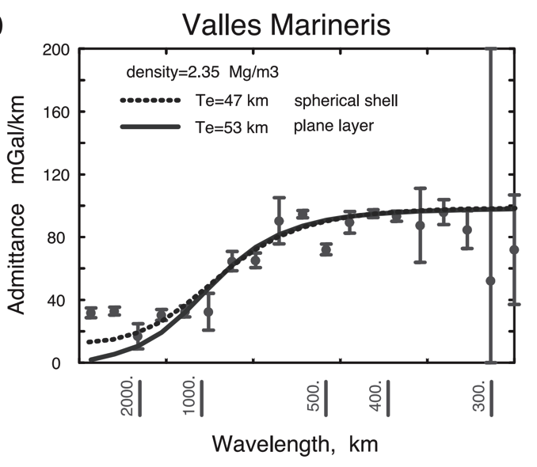
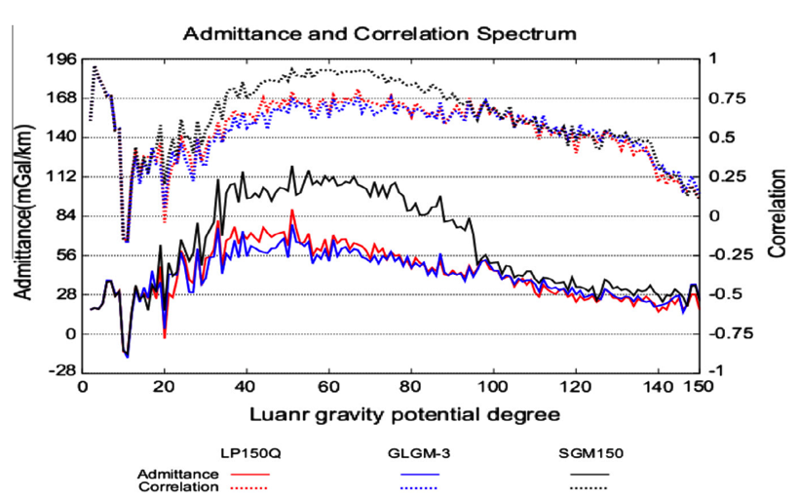
Different worlds show similar behavior in gravity-topography ratio (“admittance”) as a function of wavelength
2πGρΔz
Moon
Mars
Admittance is sometimes calculated using “Bouguer gravity”, gravity that
has been corrected for mass of topography
In this course we only use “free-air gravity” (uncorrected for topography).

Slide 32
What is responsible for this support?

Slide 33
How is topography supported?
WRAP-UP TRUE POLAR WANDER FROM LECTURE 1
REVIEW REQUIRED READING (CHAPTER 2 IN MELOSH)
_____________________________________________________________
EXPECTATIONS AND OBSERVATIONS: BOUGUER GRAVITY EQUATION, GRAVITY-TOPOGRAPHY CORRELATION, ADMITTANCE
MECHANISMS: AIRY ISOSTASY, FLEXURE
(MEMBRANE STRESSES)
APPLICATIONS: DENSITY/POROSITY; INFERENCE OF BURIED OCEANS; STRENGTH → HEAT FLOW → THERMAL HISTORY

Slide 34
Airy isostasy (floating)
Free-air gravity anomaly is negligibly small for loads small compared to planet radius

Slide 35
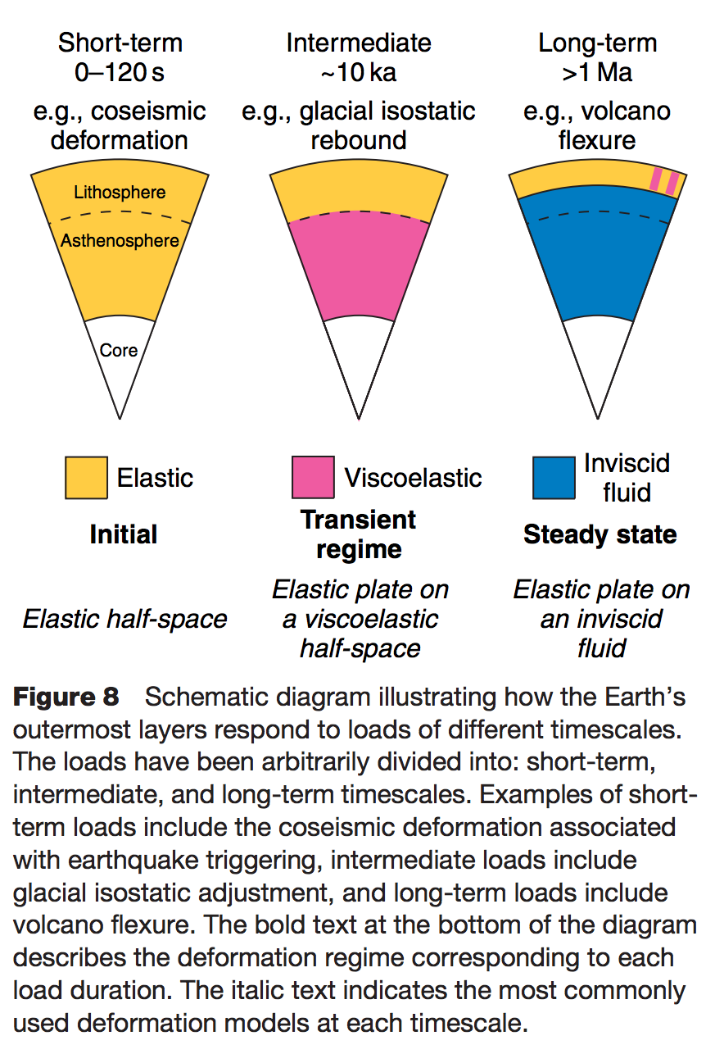
Definition of the lithosphere
elastic lithosphere
– supports loads over geologic time
separate from:
seismic lithosphere – permits earthquakes
thermal boundary layer
layer that is conductively affected
by the cold boundary condition of
the planet’s surface
Watts, in Treatise on Geophysics
(1st edn.), 2007

Slide 36
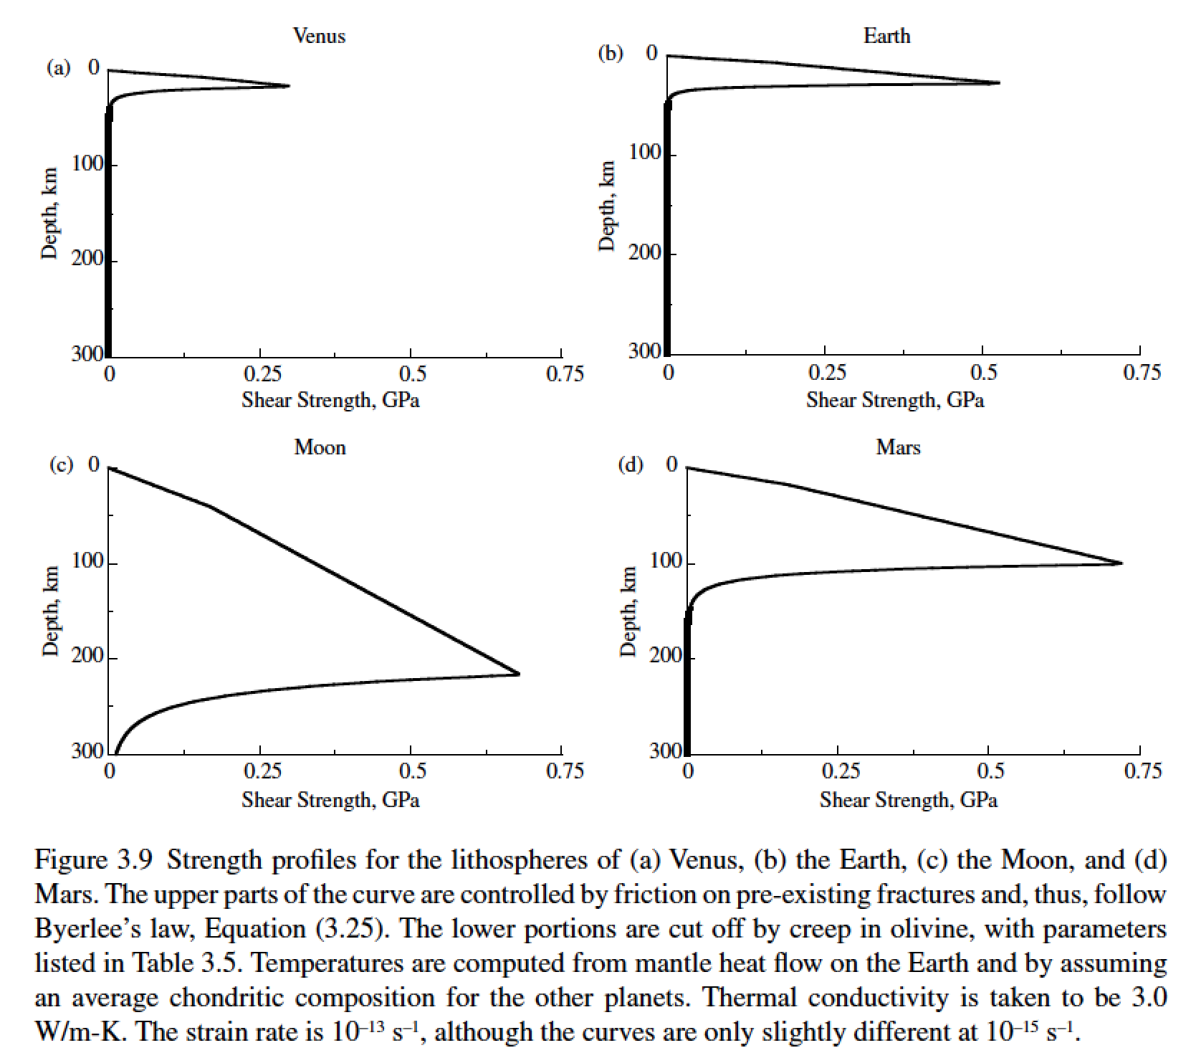
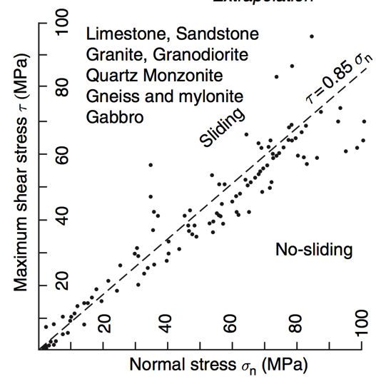
Lithosphere: strength versus depth
g=8.9 m s⁻²
g=9.8 m s⁻²
g=1.6 m s⁻²
g=3.7 m s⁻²
Byerlee’s law

Slide 37
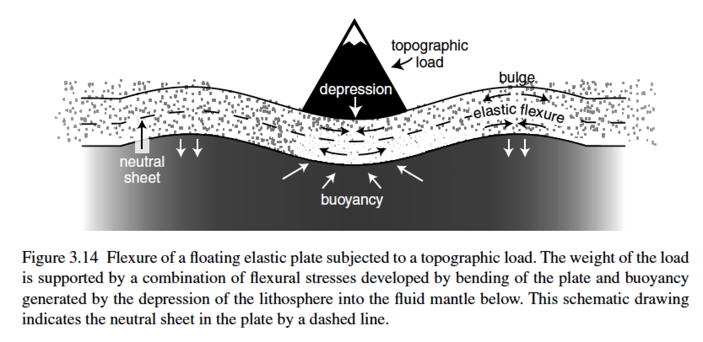
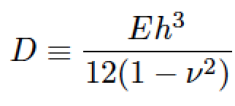
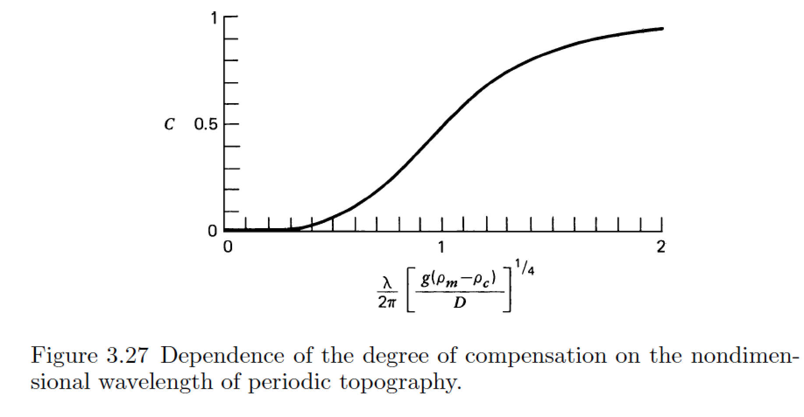
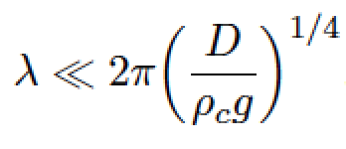
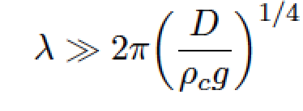
stiffness (Pa, N m⁻²)
Young’s modulus
elastic thickness (m)
Poisson’s ratio (0.25 – 0.33, dimensionless)
flexural rigidity (N m)
compensation, c
Compensation curves
can be used to constrain
D
wavelength (m)
m = [ (kg m s⁻²)/(kg m⁻³ × m s⁻²) ]^{1/4}

Slide 38
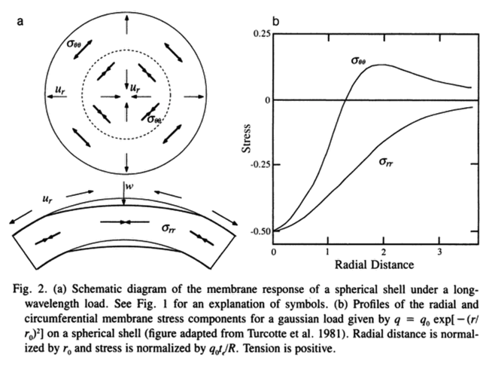
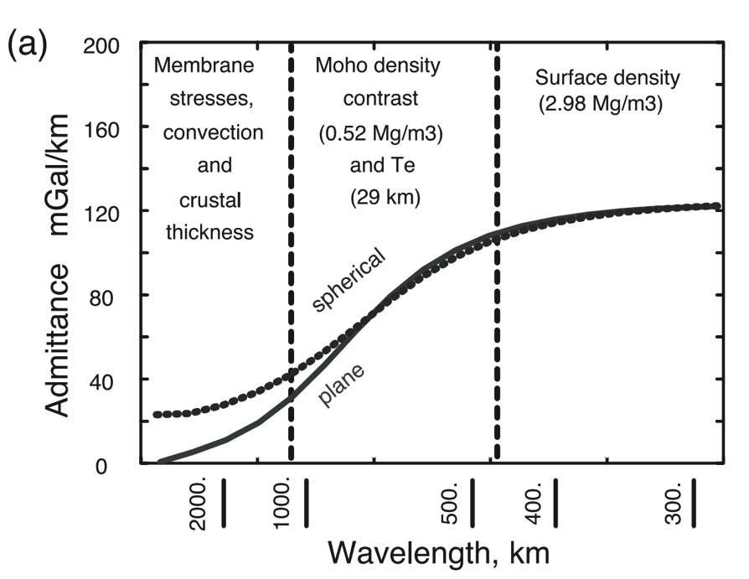
A different technique is needed for loads with wavelength comparable to the radius of the planet (consider membrane stresses)
Banerdt et al., ch. in
Kieffer et al. (eds). “Mars”, 1992
McKenzie et al. EPSL 2002

Slide 39
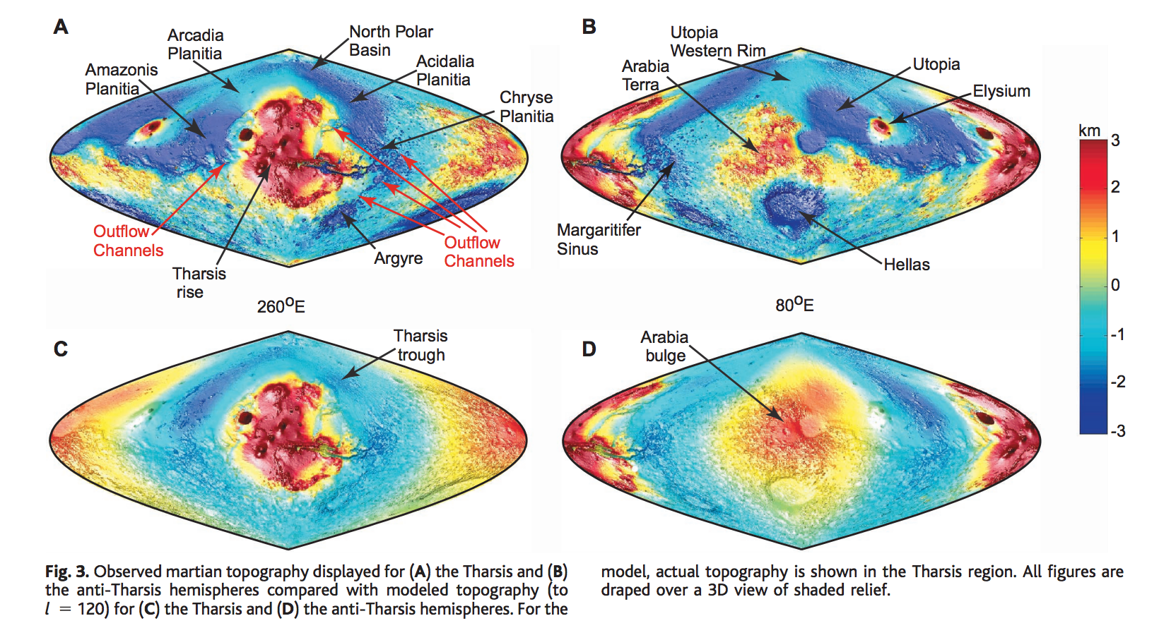
Membrane support example: Tharsis (volcanic province) load on Mars
Phillips et al. Science 2001

Slide 40
How is topography supported?
WRAP-UP TRUE POLAR WANDER FROM LECTURE 1
REVIEW REQUIRED READING (CHAPTER 2 IN MELOSH)
_____________________________________________________________
EXPECTATIONS AND OBSERVATIONS: BOUGUER GRAVITY EQUATION, GRAVITY-TOPOGRAPHY CORRELATION, ADMITTANCE
MECHANISMS: AIRY ISOSTASY, FLEXURE
(MEMBRANE STRESSES)
APPLICATIONS: DENSITY/POROSITY; INFERENCE OF BURIED OCEANS; STRENGTH → HEAT FLOW → THERMAL HISTORY

Slide 41
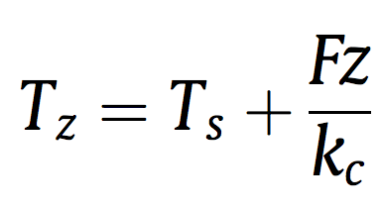
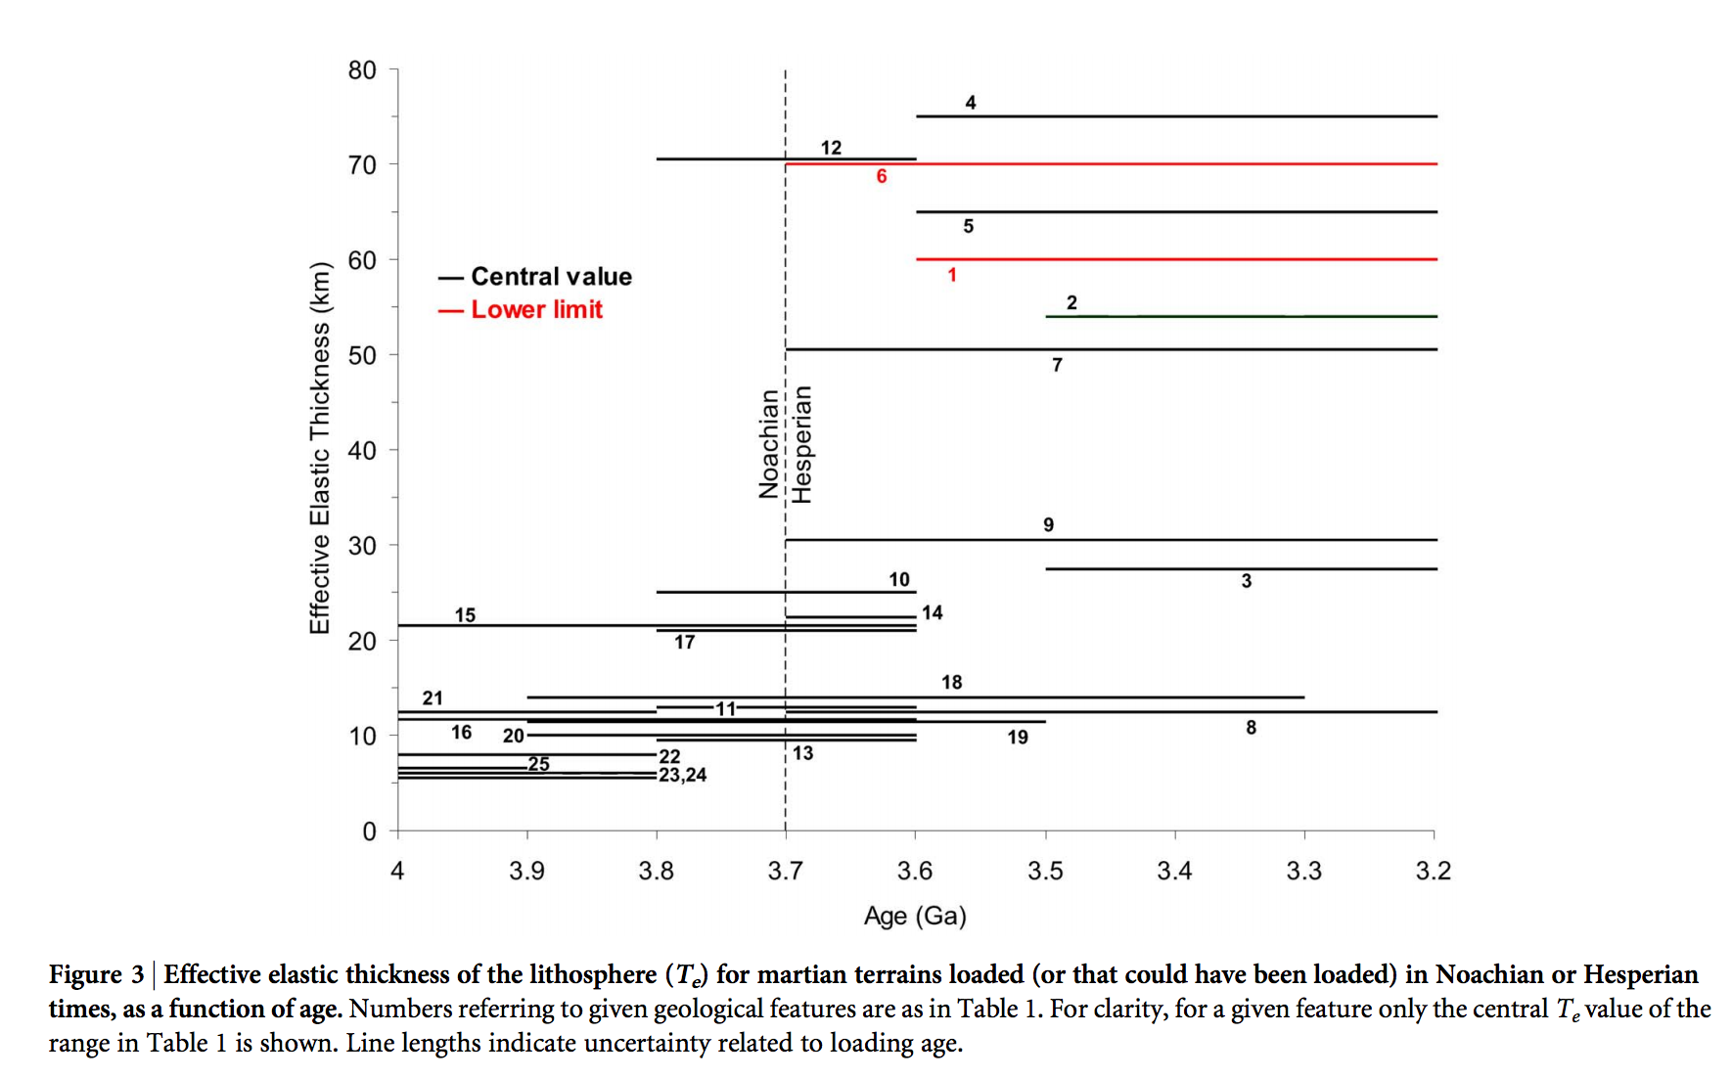
Thermal history of Mars
heat flow (W m⁻²)
depth(m)
Base of elastic lithosphere corresponds to T ~ 550-600 C
(McNutt, JGR, 1984)
thermal
conductivity
(W m⁻¹ K⁻¹)
surface T(K)
Major reduction
in Mars’ geothermal
heat flow at around
the time that the
surface was drying out.
Ruiz et al., Nature Scientific Reports, 2014

Slide 42
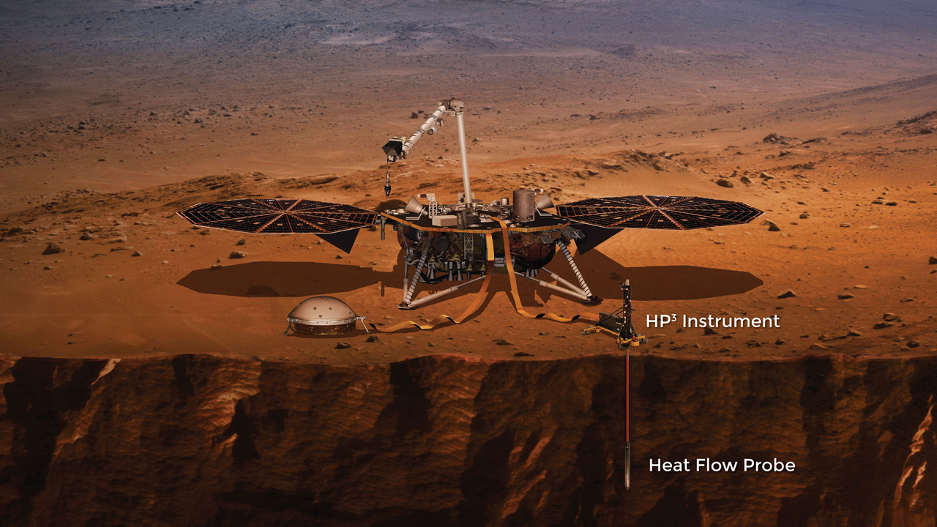

Slide 43
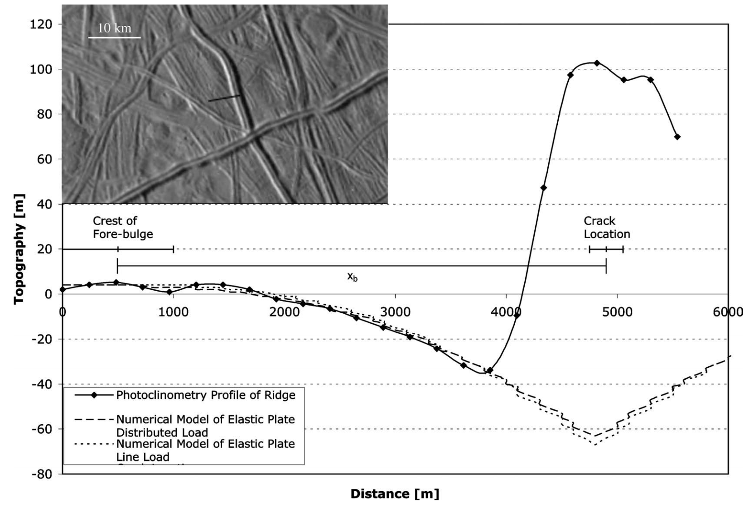
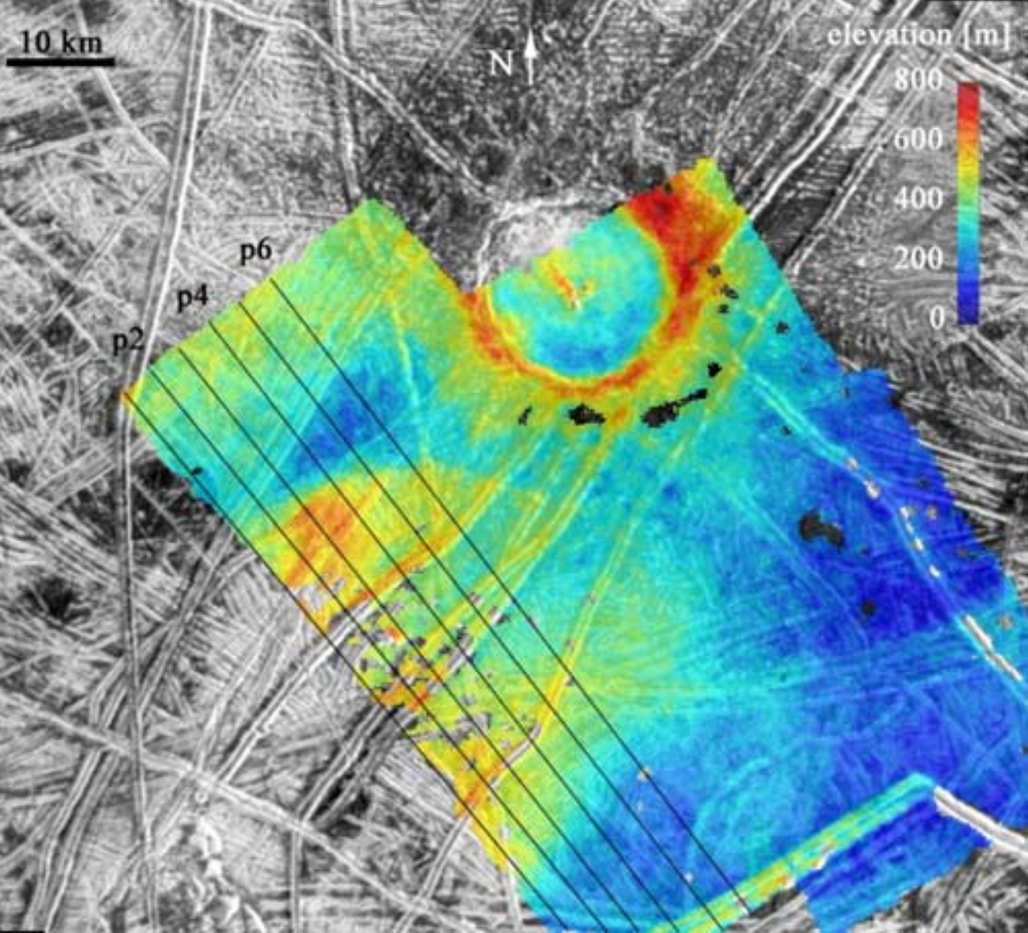
Inferring oceans on Europa
Hurford et al. Icarus 2005
Billings & Kattenhorn Icarus 2005
Elastic thickness is
small
Ice is soft and warm at
shallow depths
(From Europa’s overall
density) water substance
persists to great depth
Most of the water is
very warm and likely
liquid

Slide 44
Key points: topography versus gravity
Relationship between topography & gravity at length scales much larger than, comparable to, and much smaller than, the lithospheric thickness.
Explanation of Airy isostasy
Quantities inferred from topography←→gravity comparison.
Next lecture: topography and tectonics.

