Slide 1
GEOS 22060/ GEOS 32060 / ASTR 45900
What makes a planet habitable?
Lecture 1
Tuesday 2 April 2018

Slide 2
Today:
Logistics (course handout, introductions, designate presenters for Tue 10 paper presentation, set times of catch-up lectures)
Options: Thu 5, 5p-6p; Fri 6, 8a-9a or 9a-10a; Tu 10, 8:15a-9:15a or 5p-6p; Tu 17, 8:15a-9:15a or 1p-2p or 4p-5p or 5p-6p
Course outline, motivation, scope
Earth history, post-Hadean

Slide 3
Course outline
Foundations (1-2 weeks)
Earth history
HZ concept, atmospheric science essentials
Post-Hadean Earth system
Principles – how are habitable planets initiated and sustained? (4-5 weeks)
Volatile supply, volatile escape
Long-term climate evolution
Runaway greenhouse, moist greenhouse
Specifics (~2 weeks)
Early Mars
Hyperthermals on Earth
Oceans within ice-covered moons
Exoplanetary systems e.g. TRAPPIST-1 system

Slide 4
There is no course textbook
PDFs of required and suggested reading will be made available
at http://geosci.uchicago.edu/~kite/geos32060/
Particularly useful books:
Atmospheric evolution on inhabited and lifeless worlds, Catling & Kasting
How to build a habitable planets, Langmuir & Broecker
Principles of planetary climate, Pierrehumbert
Accessible and solid introductions:
Life on a young planet, Andy Knoll (climate/life on Earth)
Planet Mars, Francois Forget (climate history on Mars)
Five billion years of solitude, Lee Billings (exoplanets)

Slide 5
Lecture 1 Key points
Earth has stayed habitable for >3 Gyr
Continuously
Earth inhabited only by microbes pre-1 Gya
A `difficult step’ is a step in biological evolution whose characteristic wait time (given a habitable planet) is >> 10 Gyr. There are at least three candidate difficult steps on the evolutionary path leading to people.
Earth’s continuous habitability implies that Earth’s climate has stayed within the habitable range at least for the last 3.5 Ga
However, Earth’s pO2, pCO2, and ocean chemistry have changed over time.

Slide 6
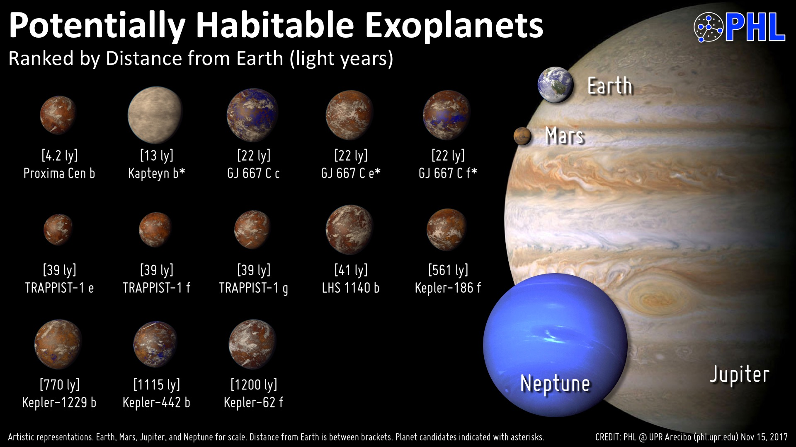

Slide 7
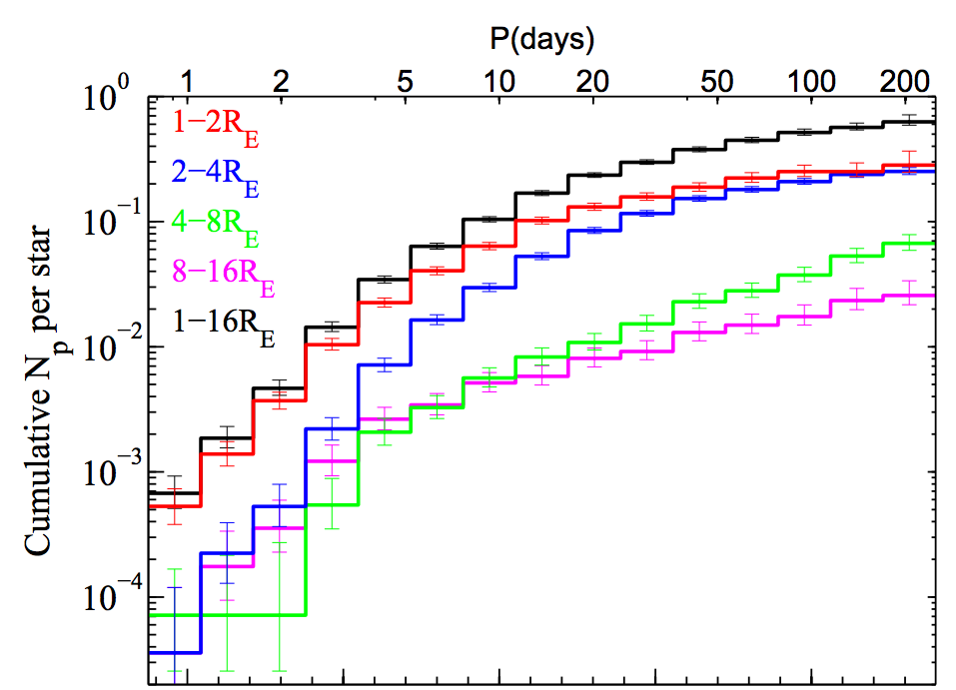
Earth-sized planets are common
Sun-like stars
Dong et al.
ApJ 2012

Slide 8
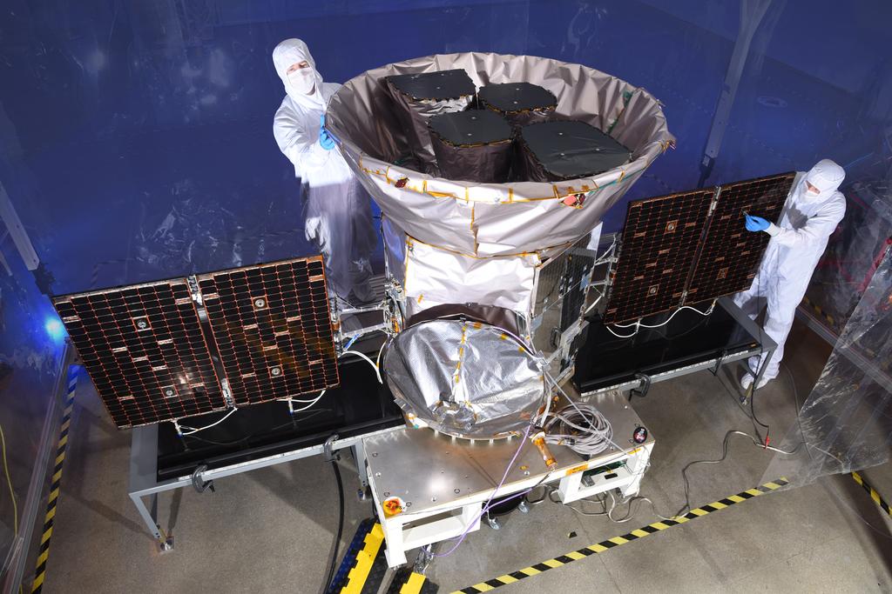
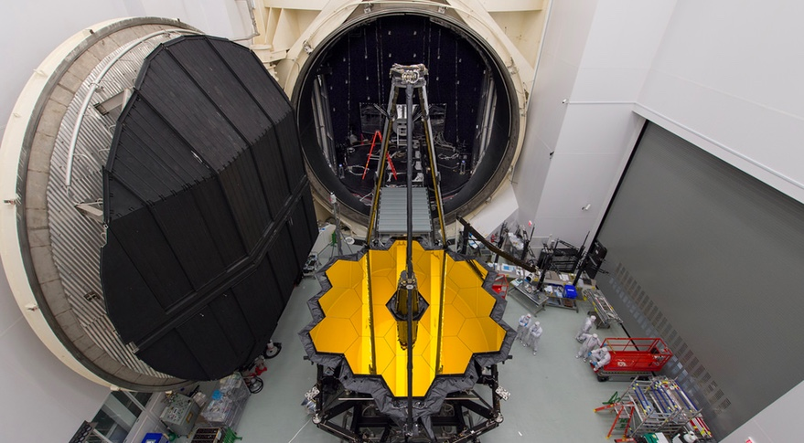

Slide 9
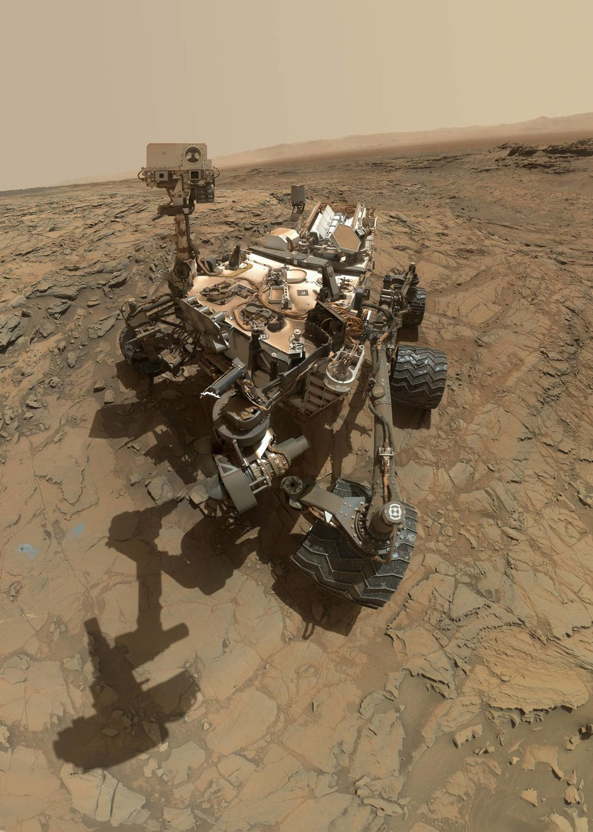
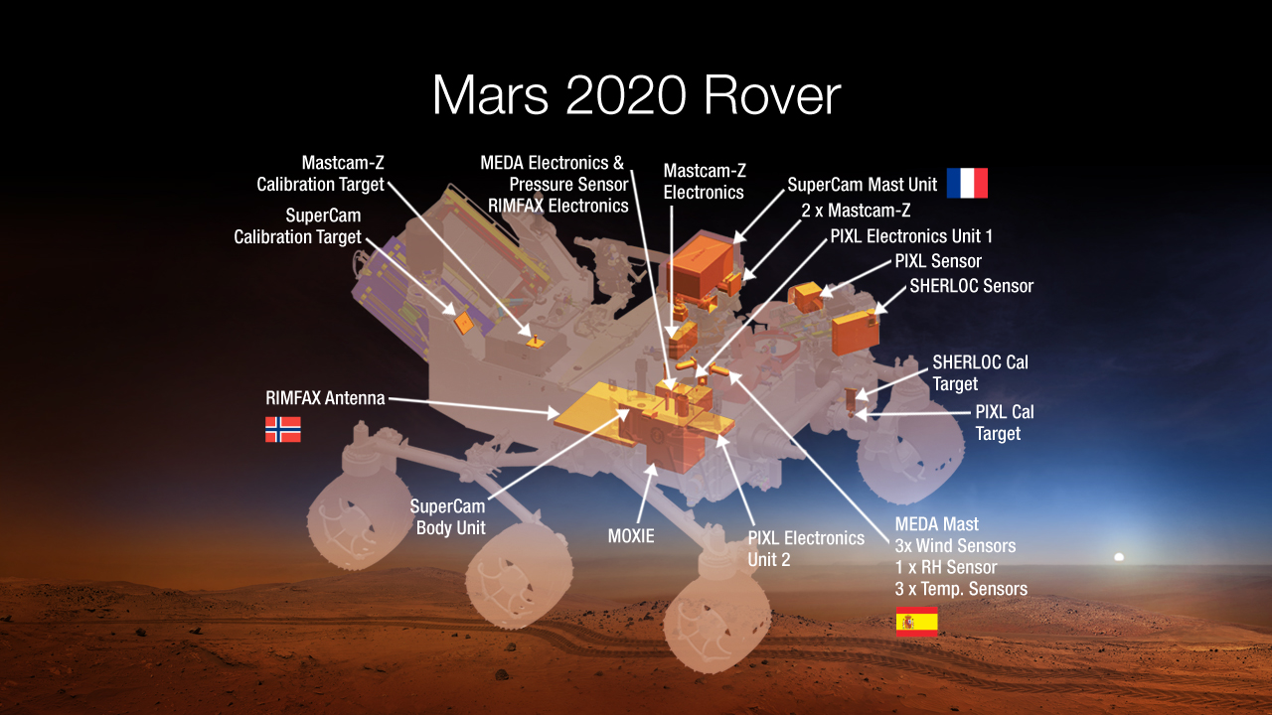

Slide 10
What makes a planet habitable?
For the purposes of this course:
A planet is a sub-stellar mass object
that has never undergone nuclear fusion
and which has sufficient self-gravitation to
assume a spheroidal shape adequately
described by a triaxial ellipsoid regardless of
its orbital parameters.
For the purposes of this course:
A habitable exoplanet maintains T<400K
liquid water on its surface continuously
for timescale that are relevant for
biological macroevolution (>>10^7 yr). Sub-ice oceans in extrasolar planetary
systems may be habitable, but this cannot
be confirmed from Earth by remote sensing.
(Sub-ice oceans will be covered in Week 9).

Slide 11
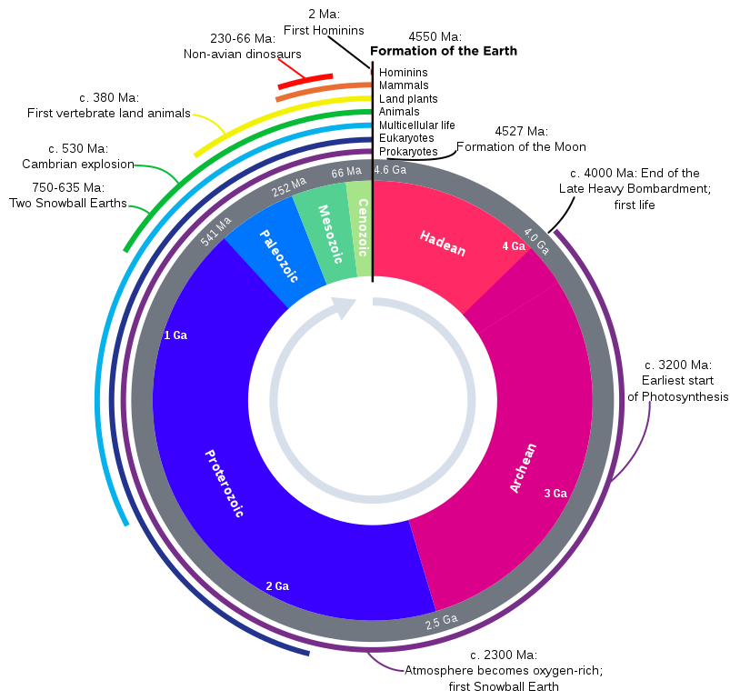

Slide 12
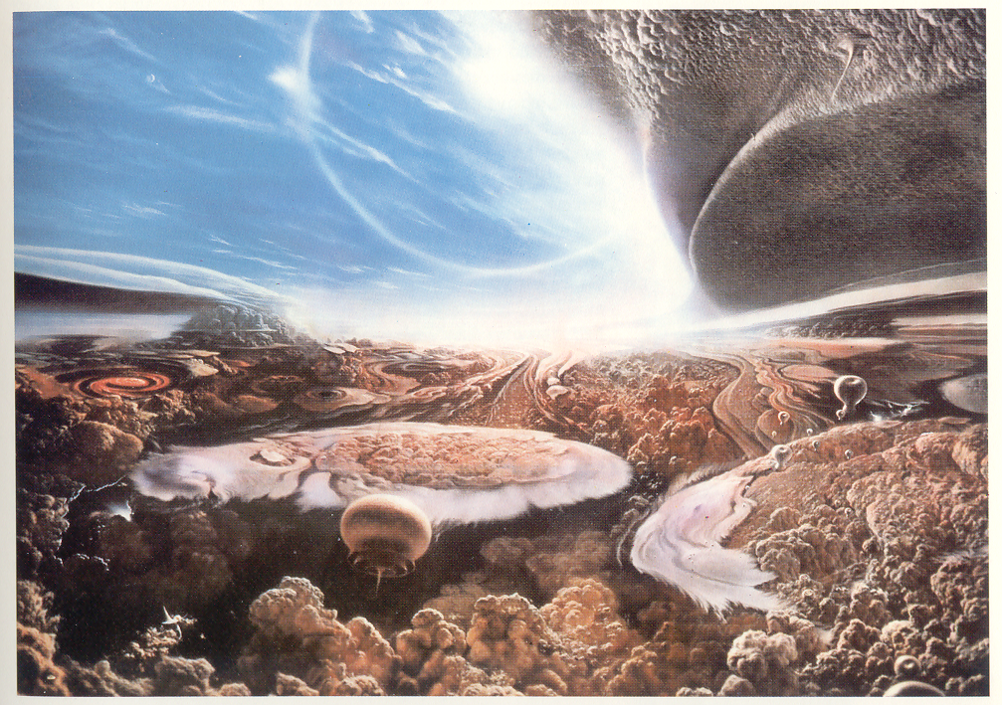
Habitable for what?
Carl Sagan’s “Cosmos”

Slide 13
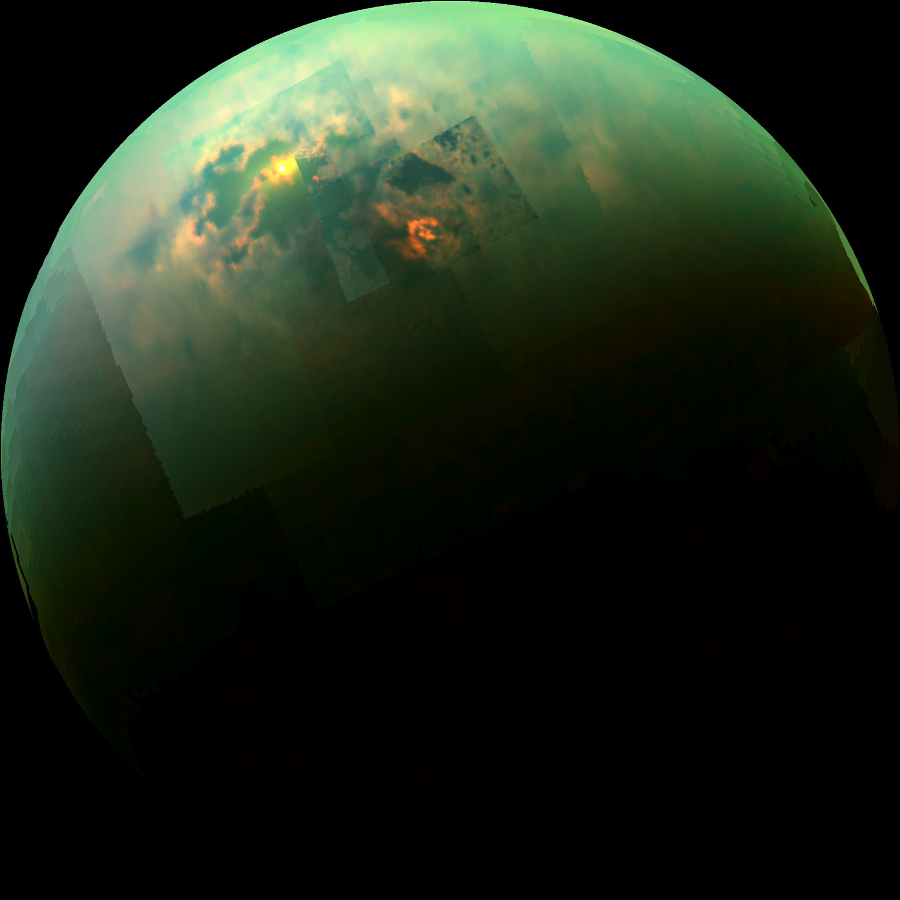
Habitable for what?
Specular reflection from Punga Mare, Titan
NRC report, “The Limits of Organic Life in Planetary Systems,” 2007

Slide 14
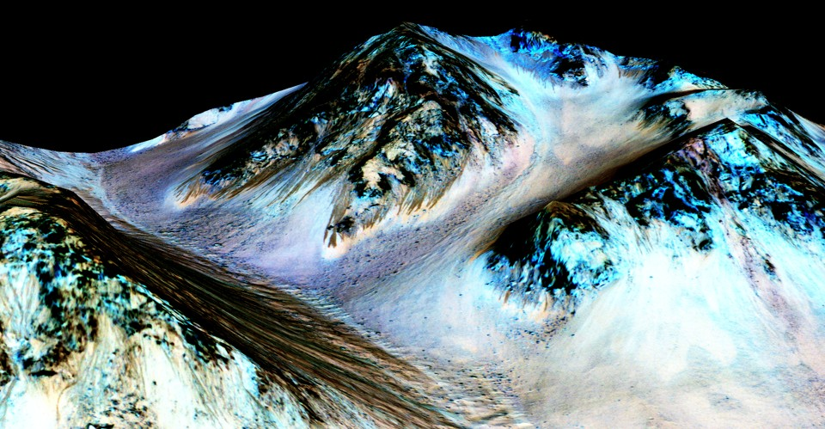
How do we know habitability when we see it?
Recurring Slope Lineae on Mars
Ojha et al Nature Geosci. 2015

Slide 15
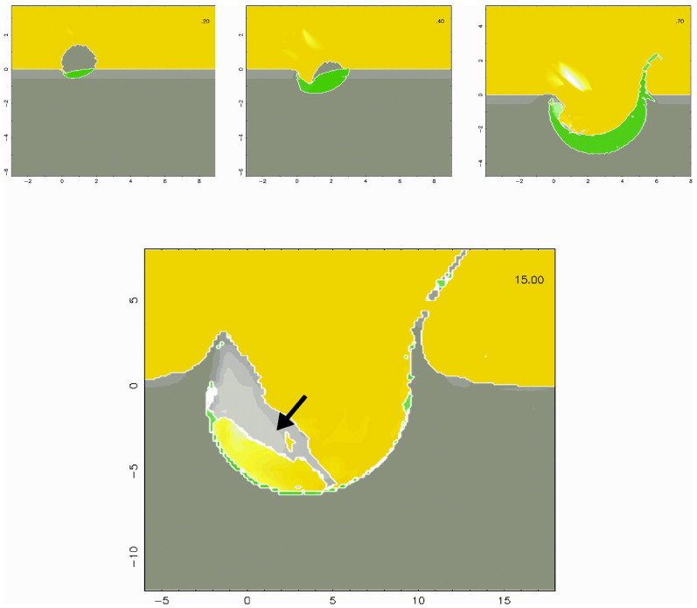
Habitable environments can be short-lived. How short-lived is too short-lived to be interesting?
Comet
impacts on
Titan
Armetieva & Lunine
Icarus
2003

Slide 16
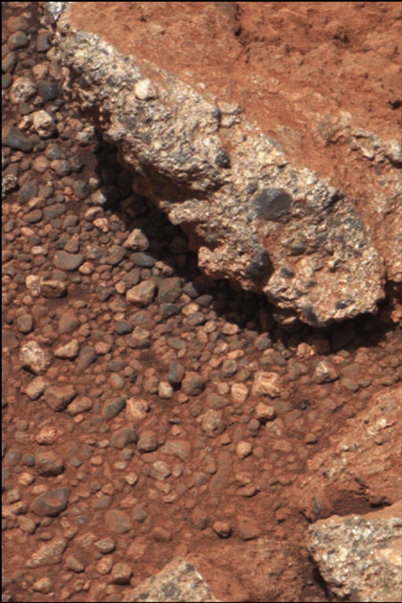
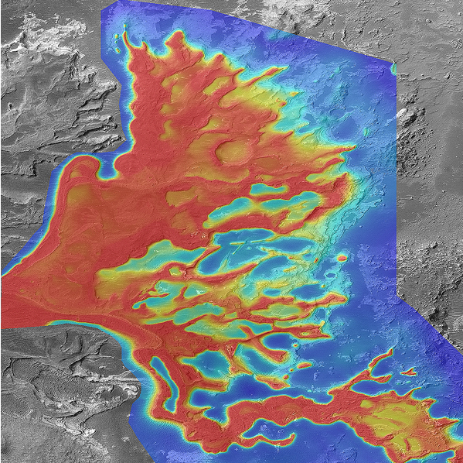
1cm
If definition of habitability involves geologic timescales → geologic data needed
1km
Leslie Wood/John Andrews/BEG
Scale bars are approximate
NASA/JPL
Notes:
A plea

Slide 17
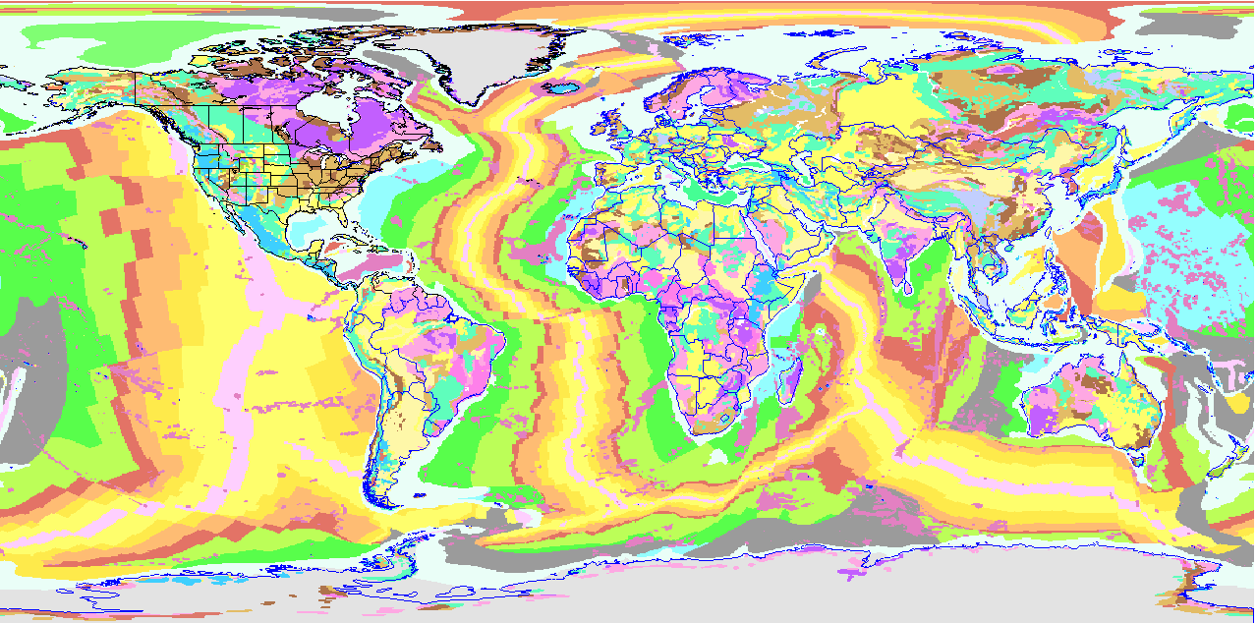
Earth history post-Hadean
dark purple = >2.5 Ga rocks (most have been subjected to high T/P which destroys fossils)
Plate tectonics has destroyed most of the evidence of Earth’s earliest (pre-3.8 Ga) history

Slide 18
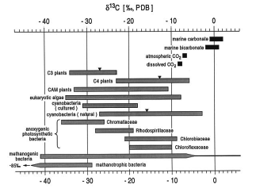
Carbon Isotopes
¹⁴C, ¹³C, and ¹²C.
Organisms prefer to use ¹²C - most abundant, most reactive,
preferred by enzymes in the cell.
Biomass enriched in ¹²C, carbonate enriched in ¹³C.
Ratio of ¹²C:¹³C provides carbon isotopic fractionation value.
Measured as a δ¹³C value:
δ¹³C = [¹³C/¹²C]sample
[¹³C/¹²C]standard
‰, per mil.
- 1
stolen from Carrine Blank (WUSTL)

Slide 19
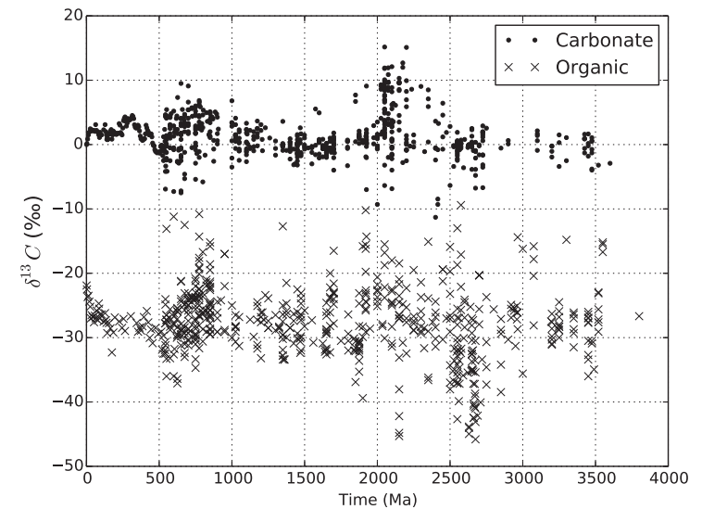
‘Fundamentals of geobiology’ book

Slide 20
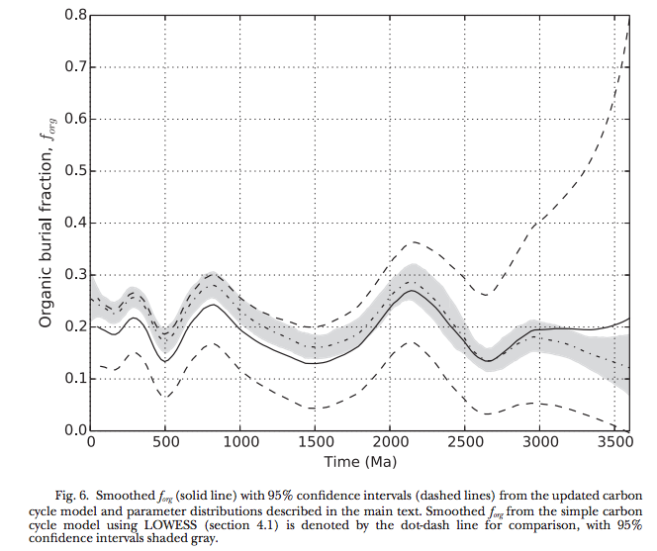
Krissansen-Totten et al. Am. J. Sci. 2015

Slide 21
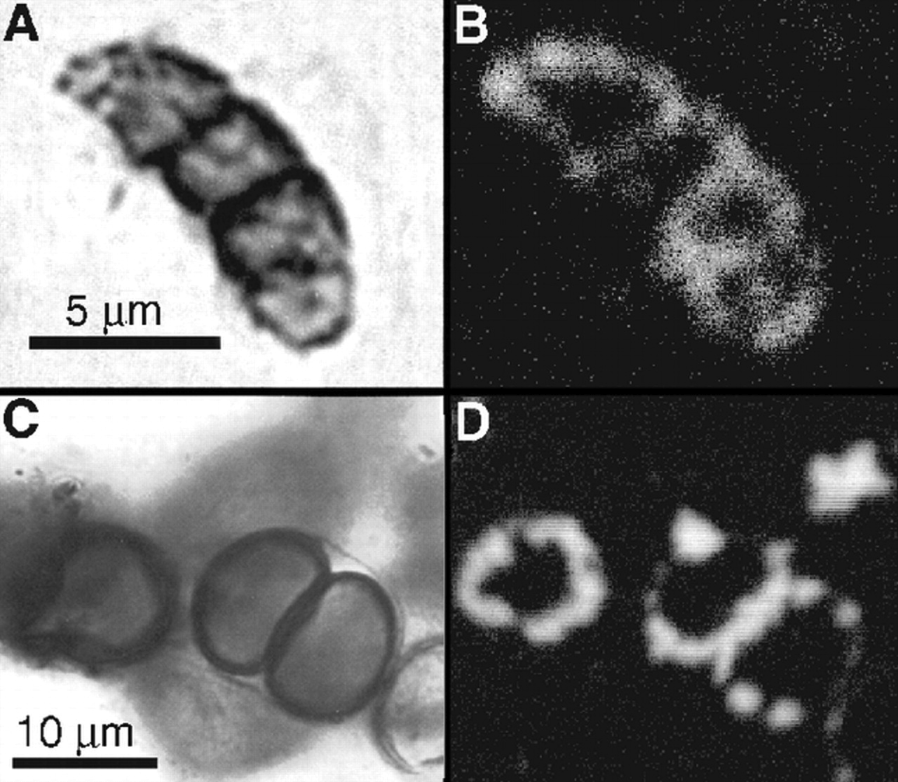
Continuity of life: body fossils
1.9 Ga
Gunflint
Chert

Slide 22
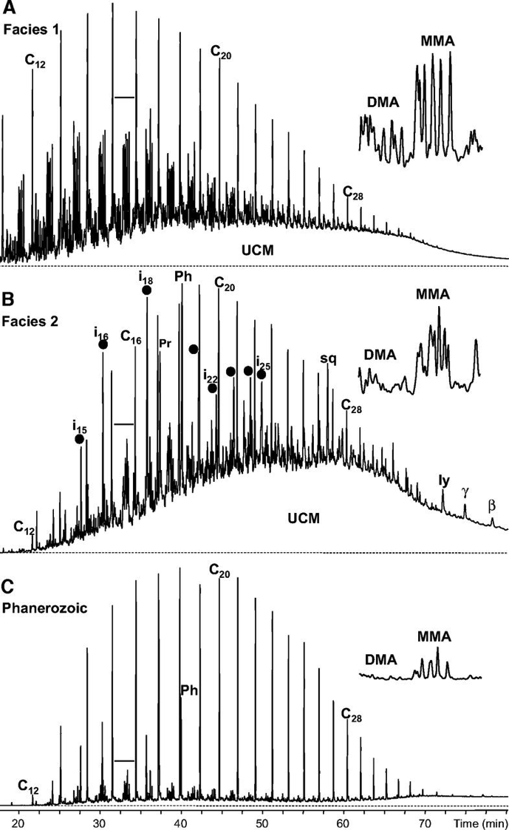
Continuity of life: Proterozoic molecular fossils
Pawloska et al. Geology 2012

Slide 23
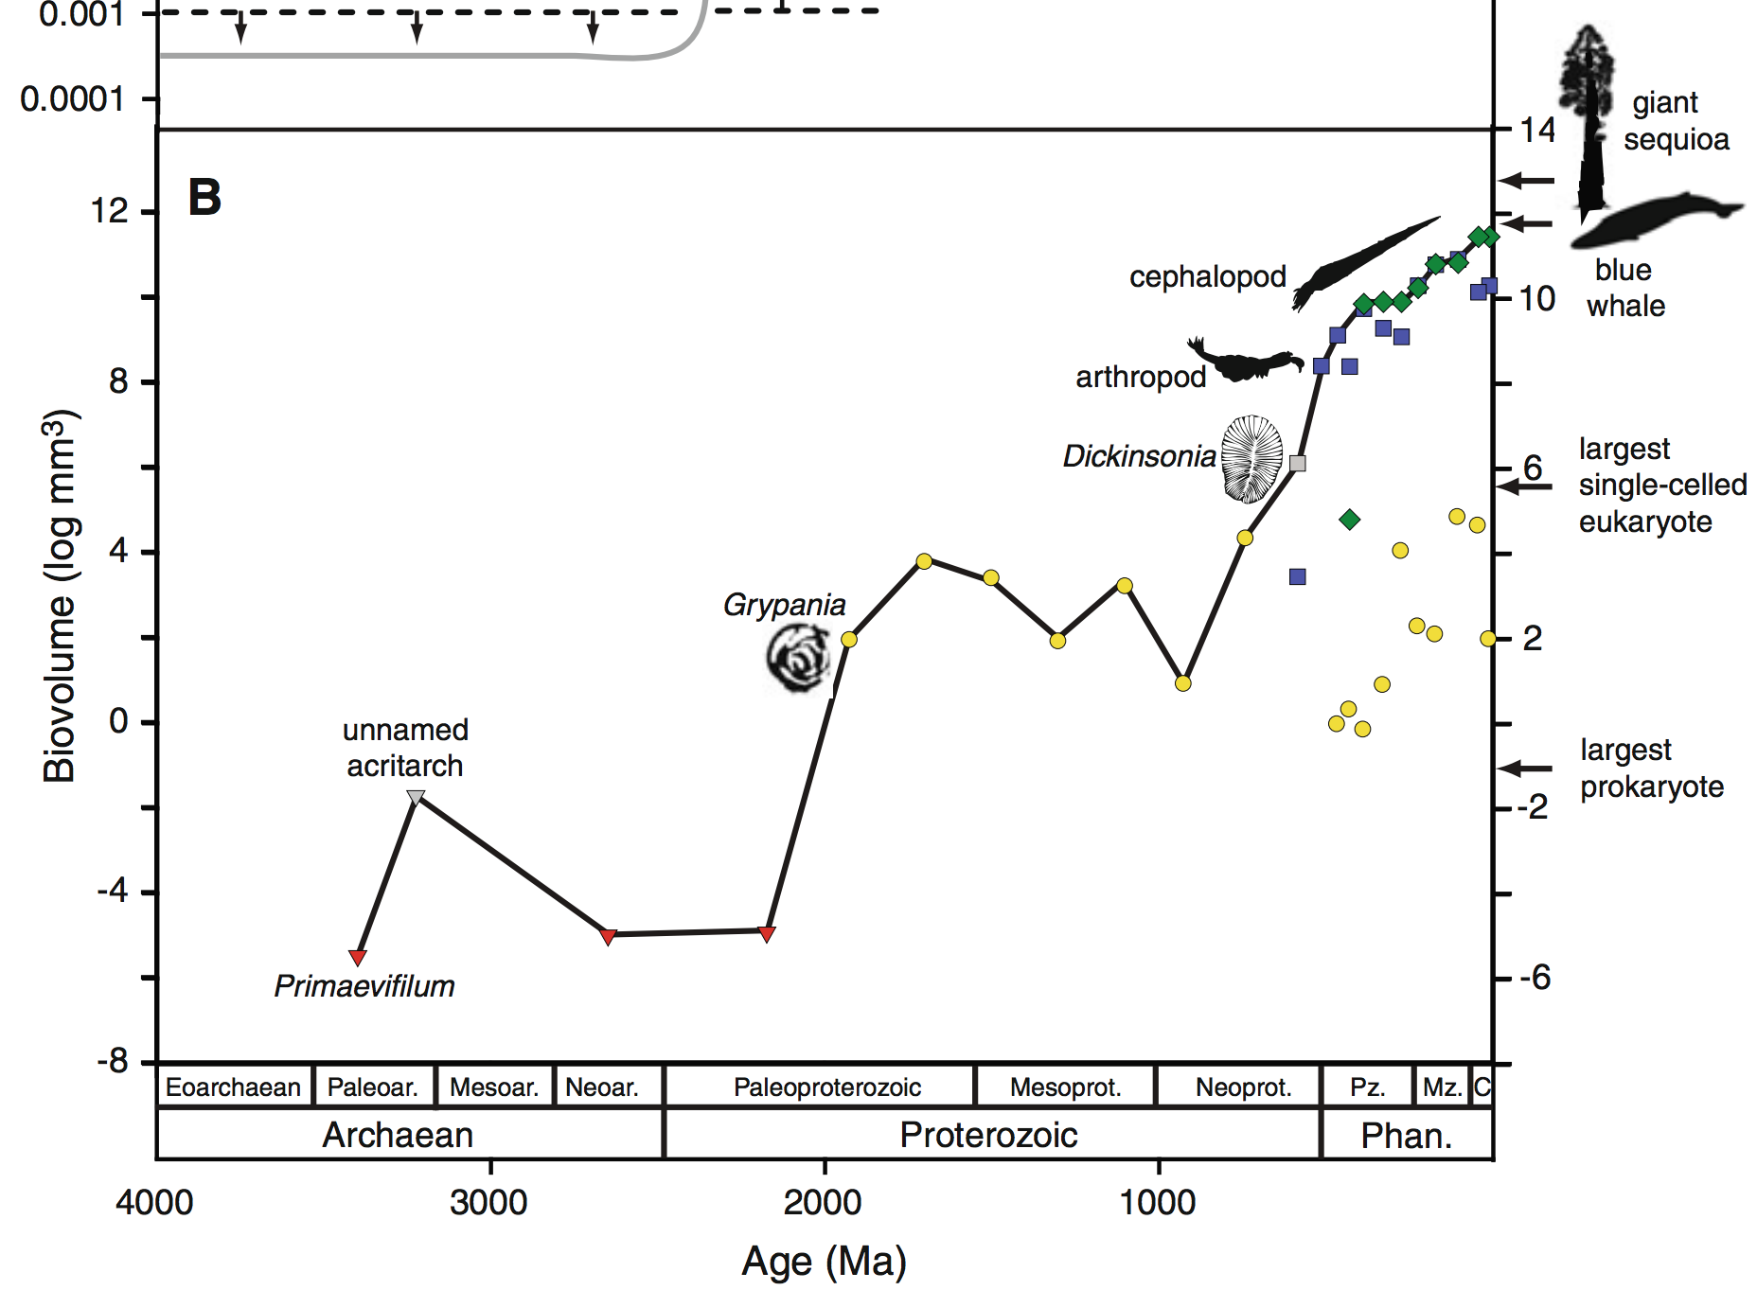
Body size has increased over geologic time
Payne et al. 2011 Photosynthesis Research

Slide 24
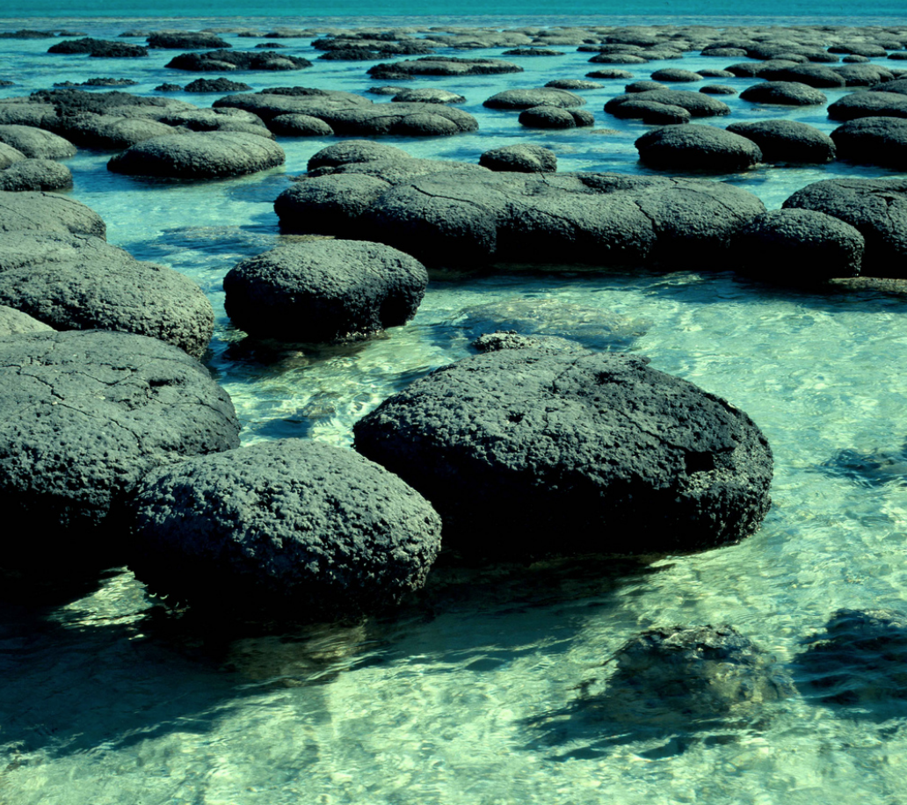
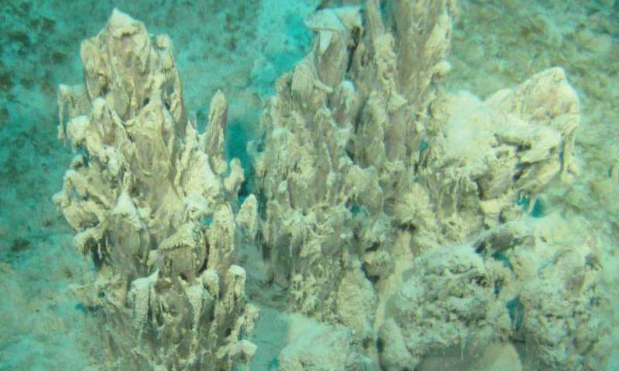

Slide 25
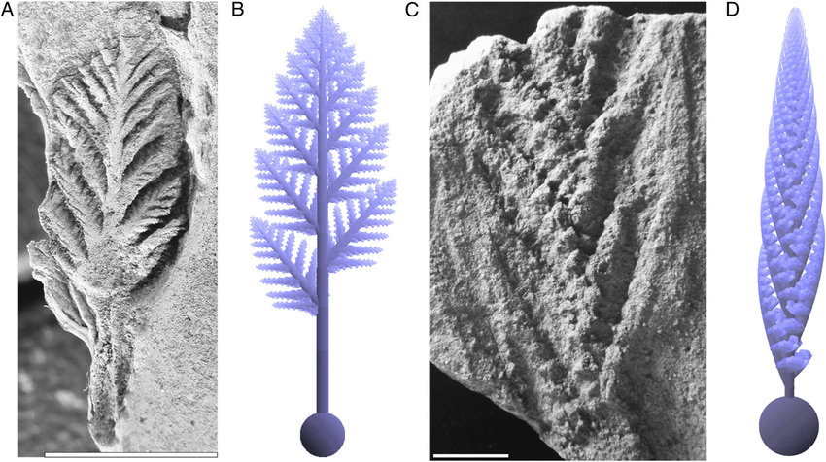
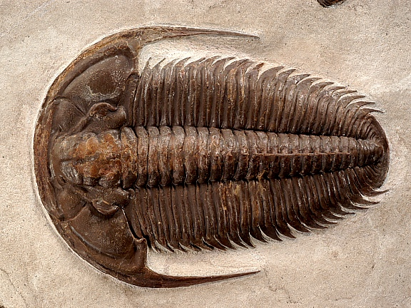
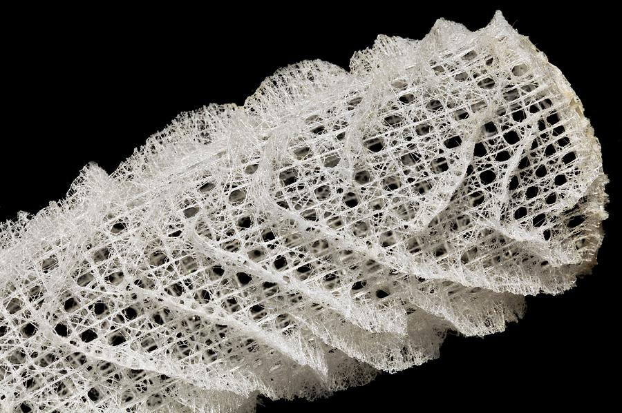
<10^8 yr increase in complexity of life in Ediacaran -> Cambrian
High levels of atmospheric oxygen are required for animal life
Rangeomorph
Spicules from sponges
(modern sponge
shown)
Yacatus

Slide 26
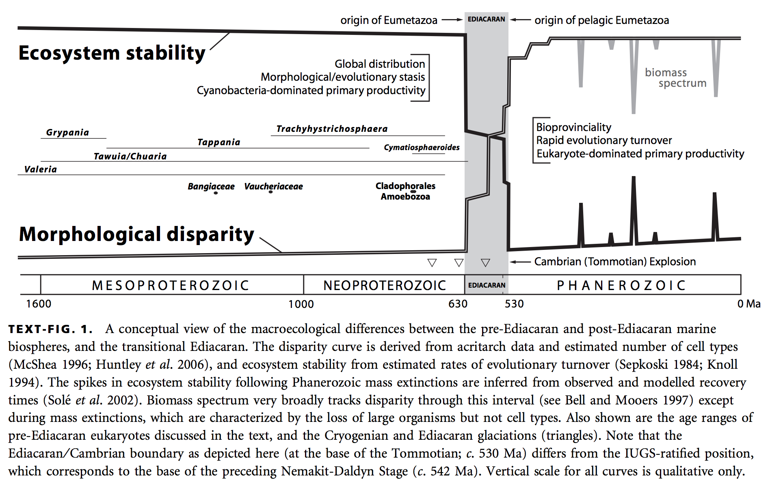
Complex life and complex biospheres are lacking for most of Earth history
Nick Butterfield, Macroevolution and macroecology through deep time, Paleontology, 2007

Slide 27
Why did the development of complex, multicellular life on Earth take so long?
Long wait for origin of life? (very unlikely)
Evolutionary innovations the rate-limiting step?
Environmental changes the rate-limiting step?
Focus for the rest of this course: microbial habitability

Slide 28
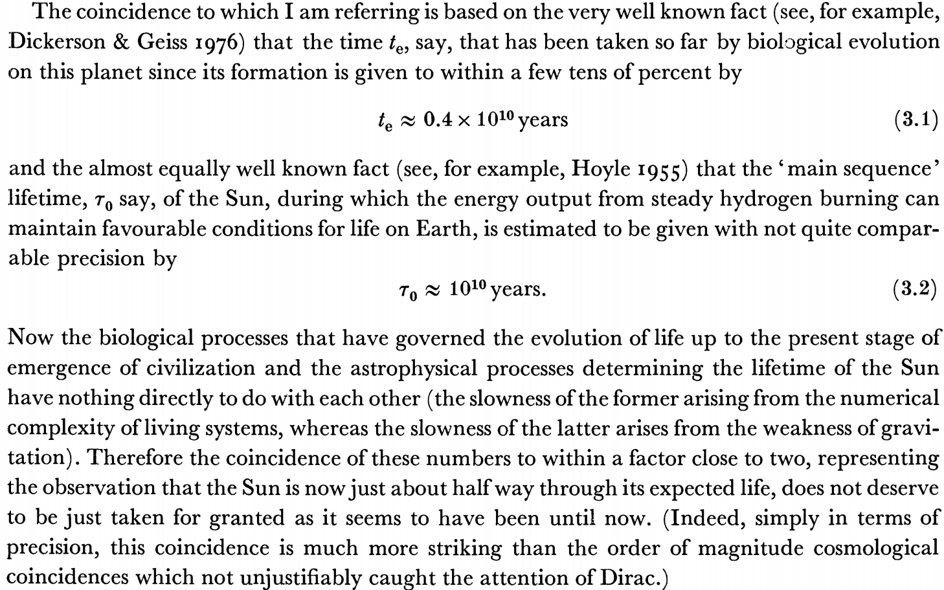
Carter 1983
Phil. Trans.
Possible responses to Carter’s argument include:
It is a very powerful argument that uses only a few unobjectionable assumptions,
One bit of data is worth more than a hundred pages of this kind of argument.

Slide 29
What can we infer about climate from the continuity of life?
Continuous surface (or near-surface) liquid water
Life is known to proliferate at least within this range:
T = -25C to 122C
pH = 0 to 13
P up to 200 MPa
Water activity as low as 0.6
Searching for Life Across Space and Time: Proceedings of a Workshop, 2017

Slide 30
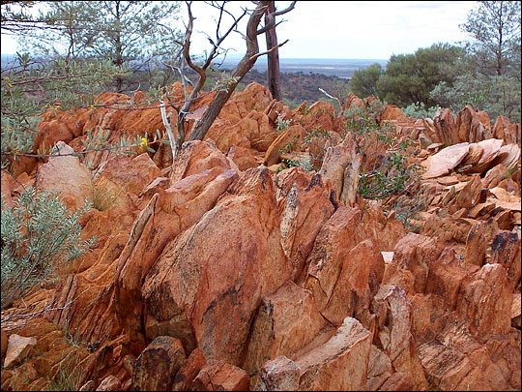
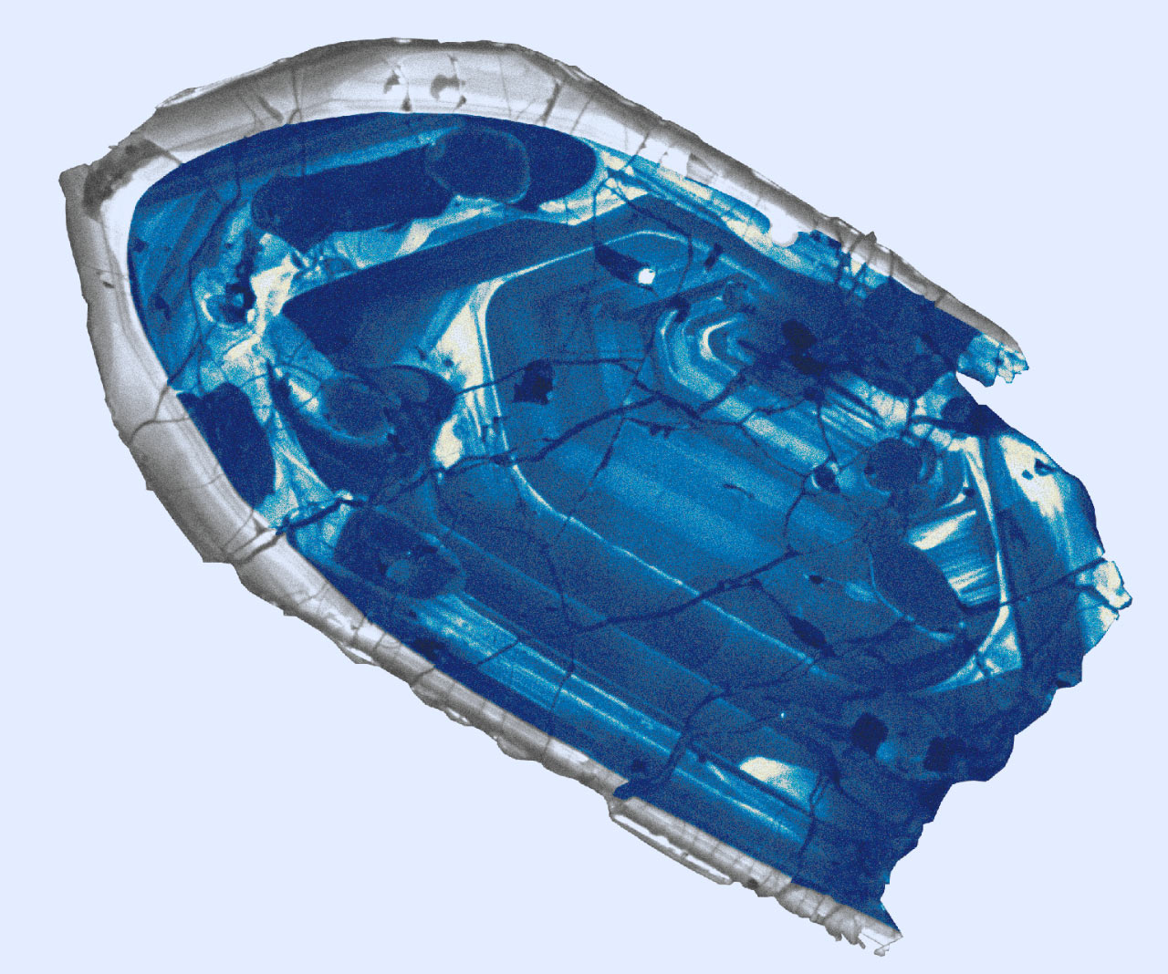
Evidence for oceans on Earth >4.0 Ga
Jack Hills zircons

Slide 31
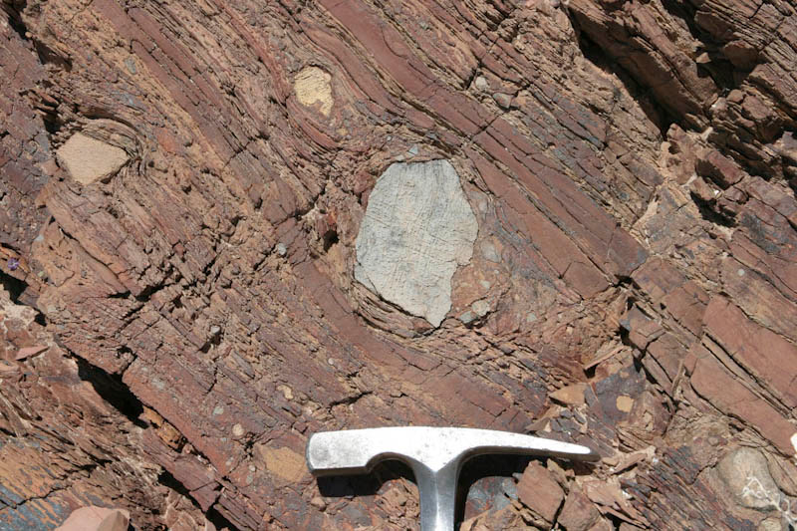
Glaciation uncommon in Earth history

Slide 32
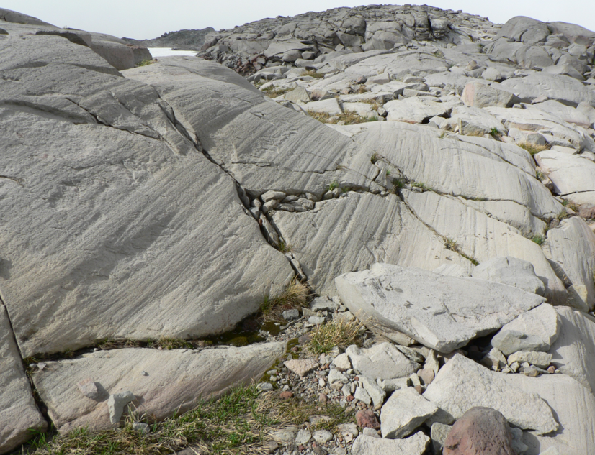

Slide 33
History of Earth’s climate

Slide 34
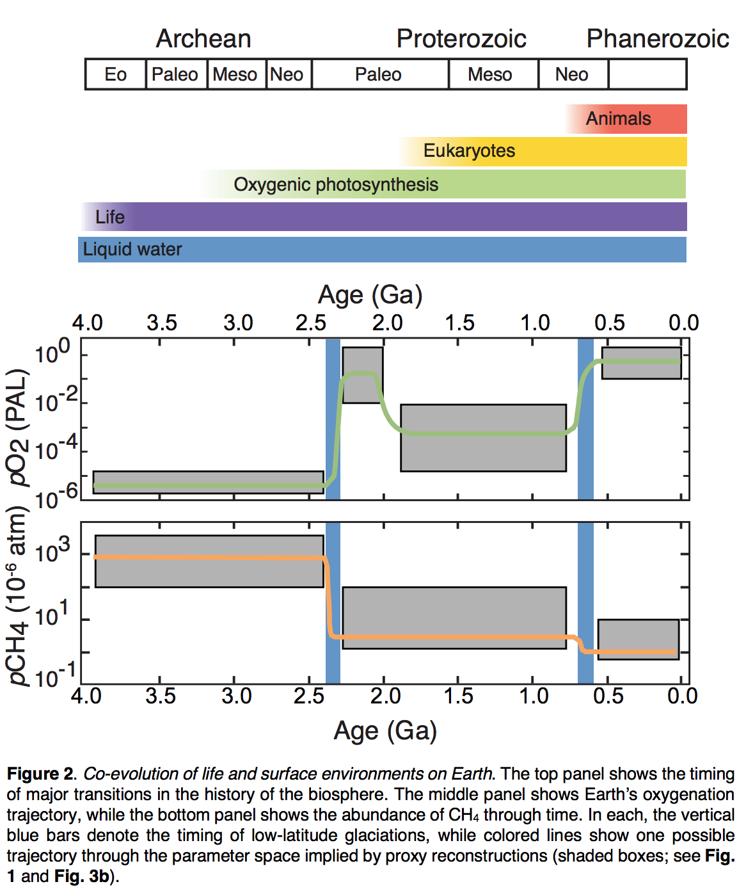
Stephanie
Olson et al.,
arXiv 2018

Slide 35
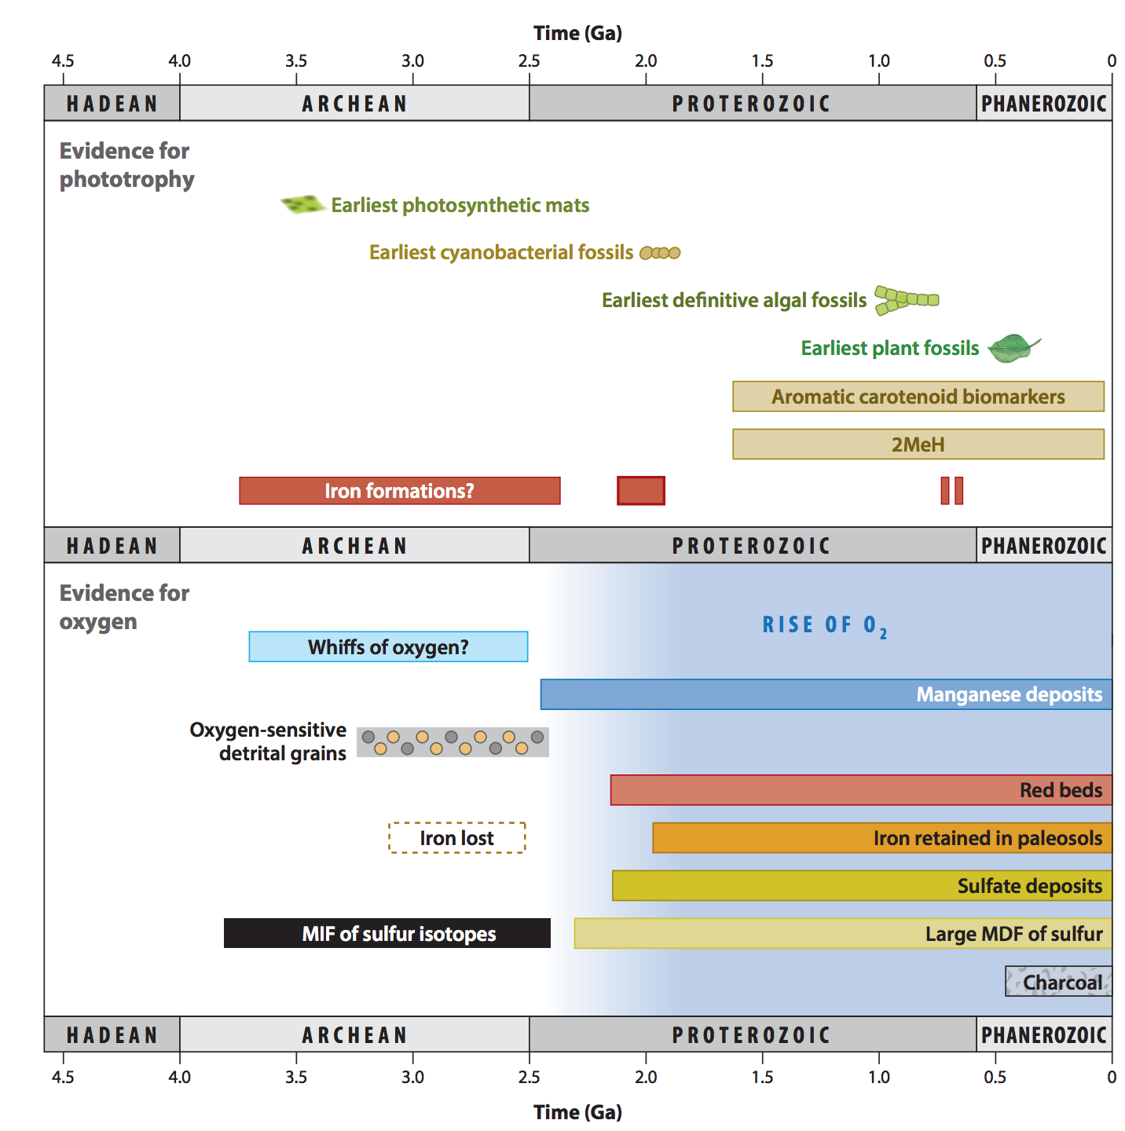
Origin of oxygenic photosynthesis
Fischer et al., Annual Reviews, 2016

Slide 36
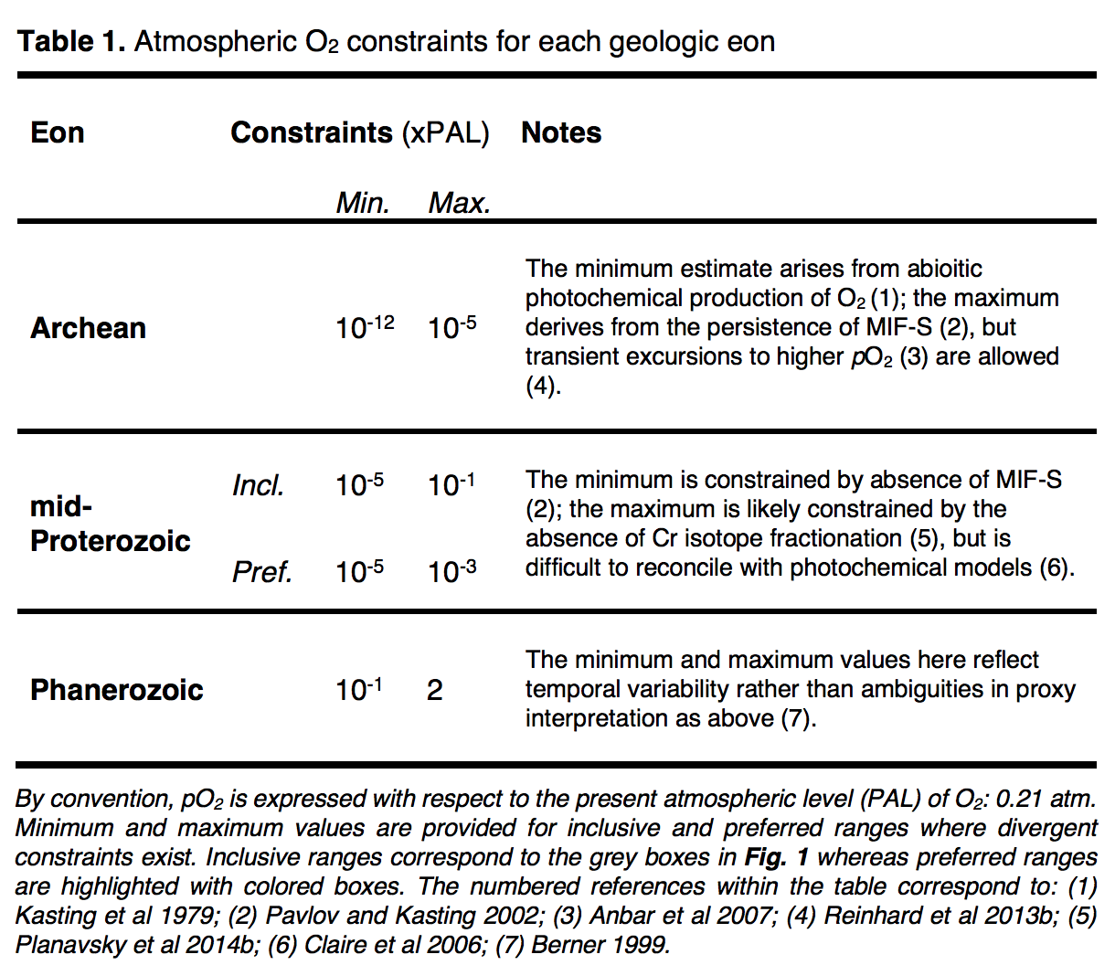
Stephanie
Olson et al.,
arXiv 2018

Slide 37
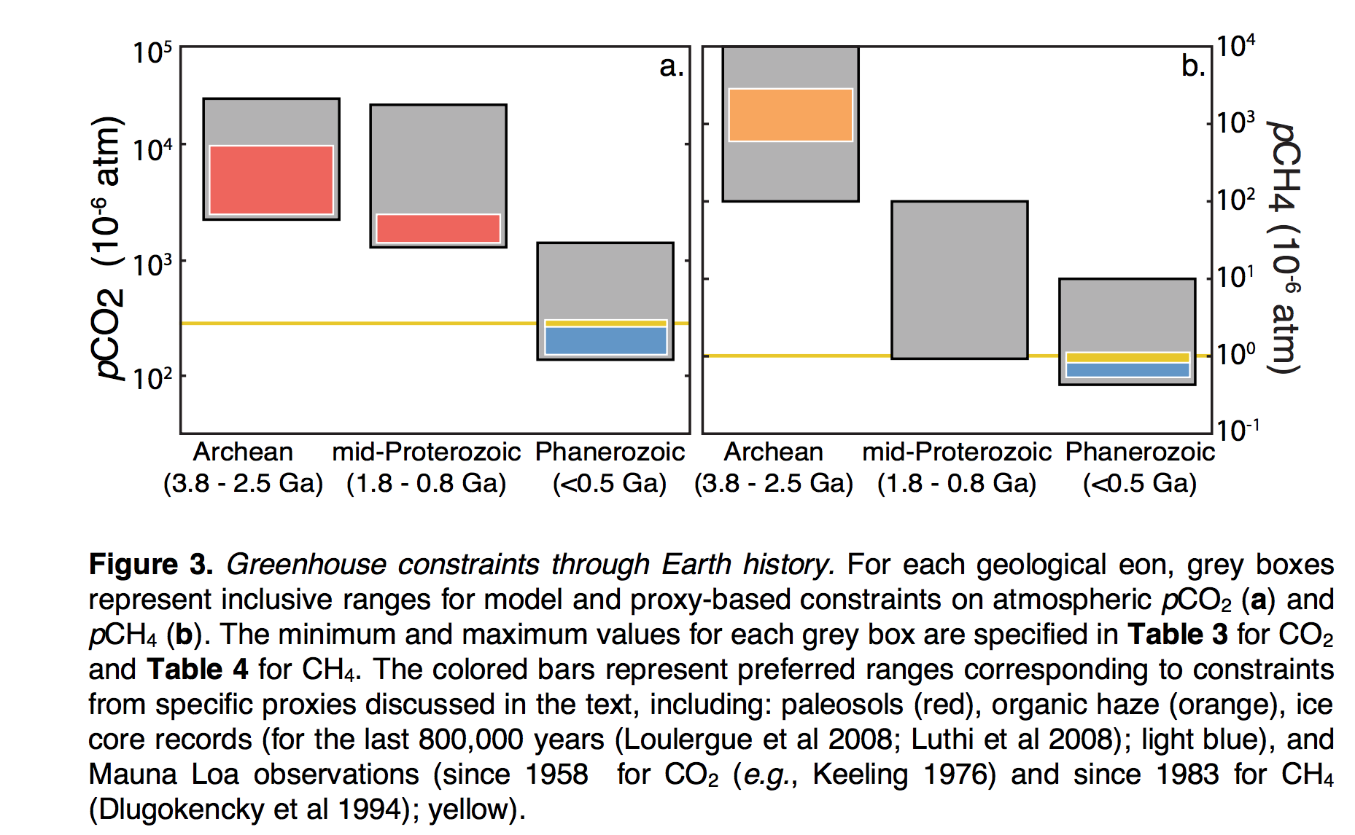

Slide 38
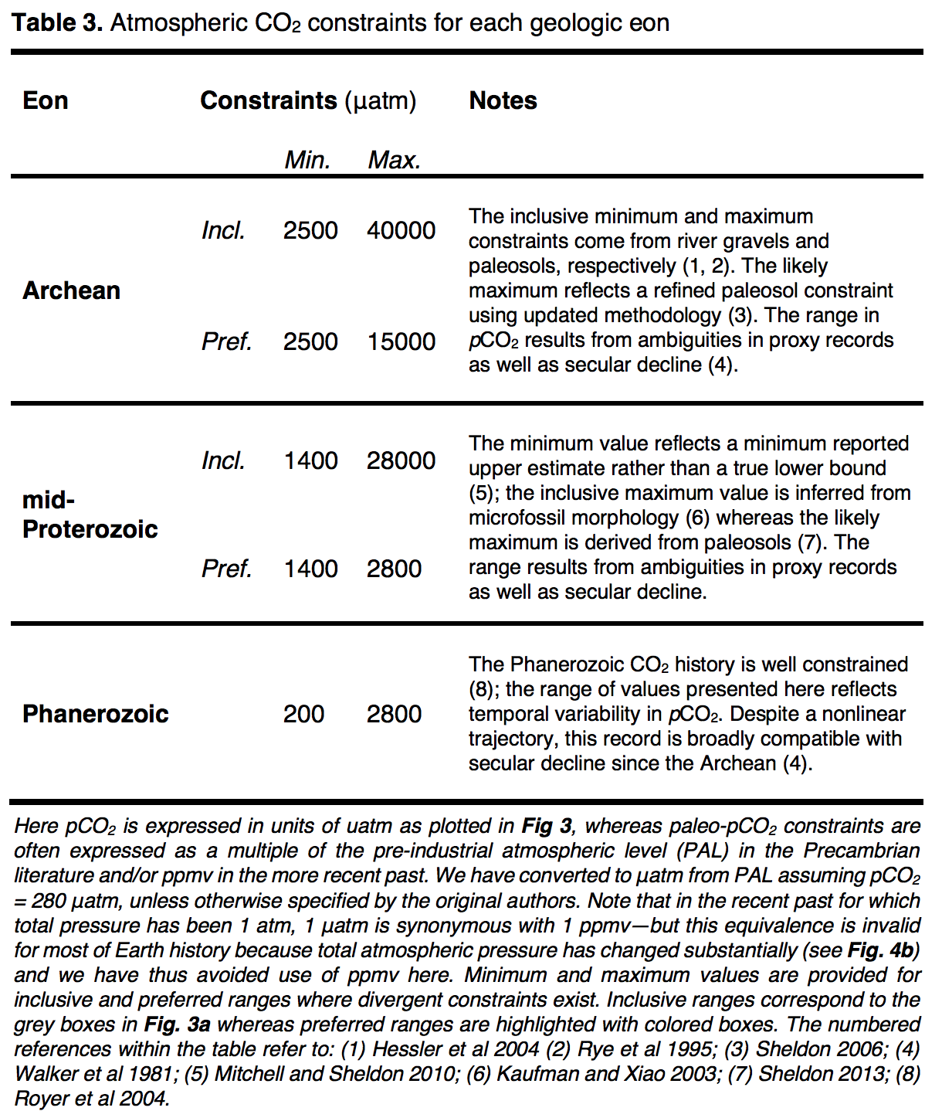
Stephanie
Olson et al.,
arXiv 2018

Slide 39
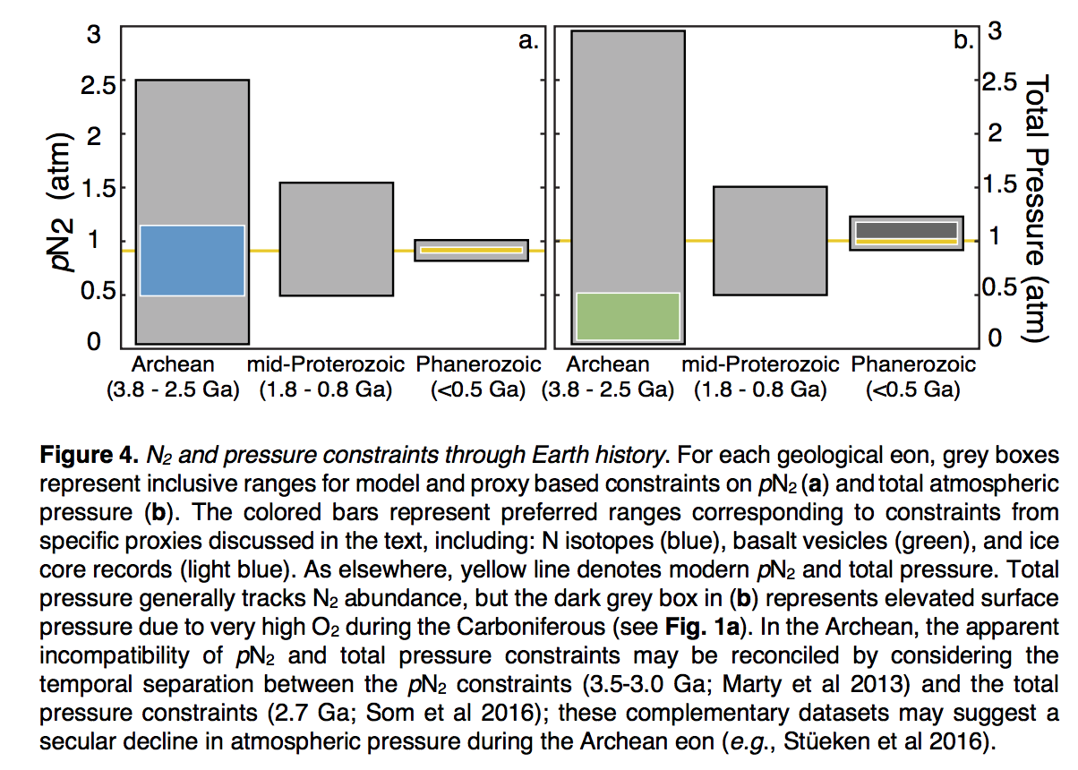
Stephanie
Olson et al.,
arXiv 2018

Slide 40
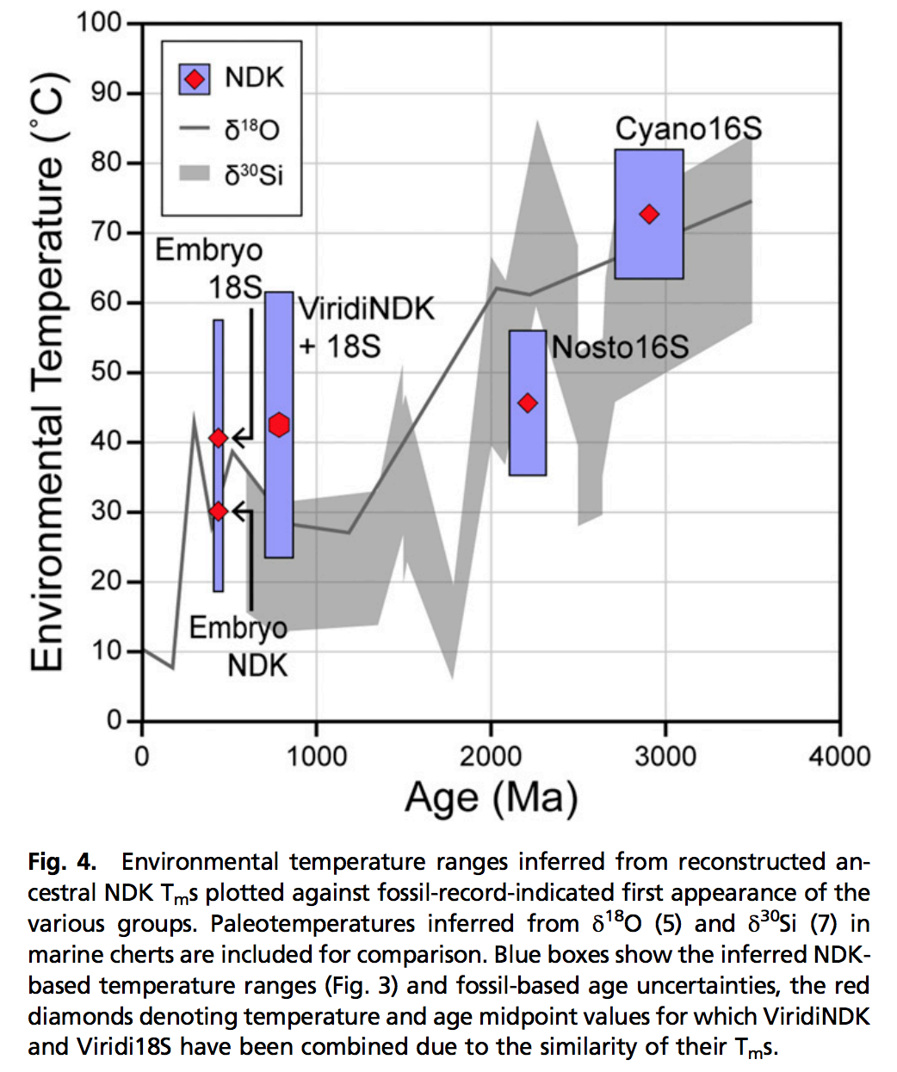
Using genetic data to probe paleoclimate?
new, little-tested method
- Resurrect ancestral proteins
- Determine their temperature
sensitivity
NDK = nucleoside diphosphate kinases
Garcia et al. PNAS 2017

Slide 41
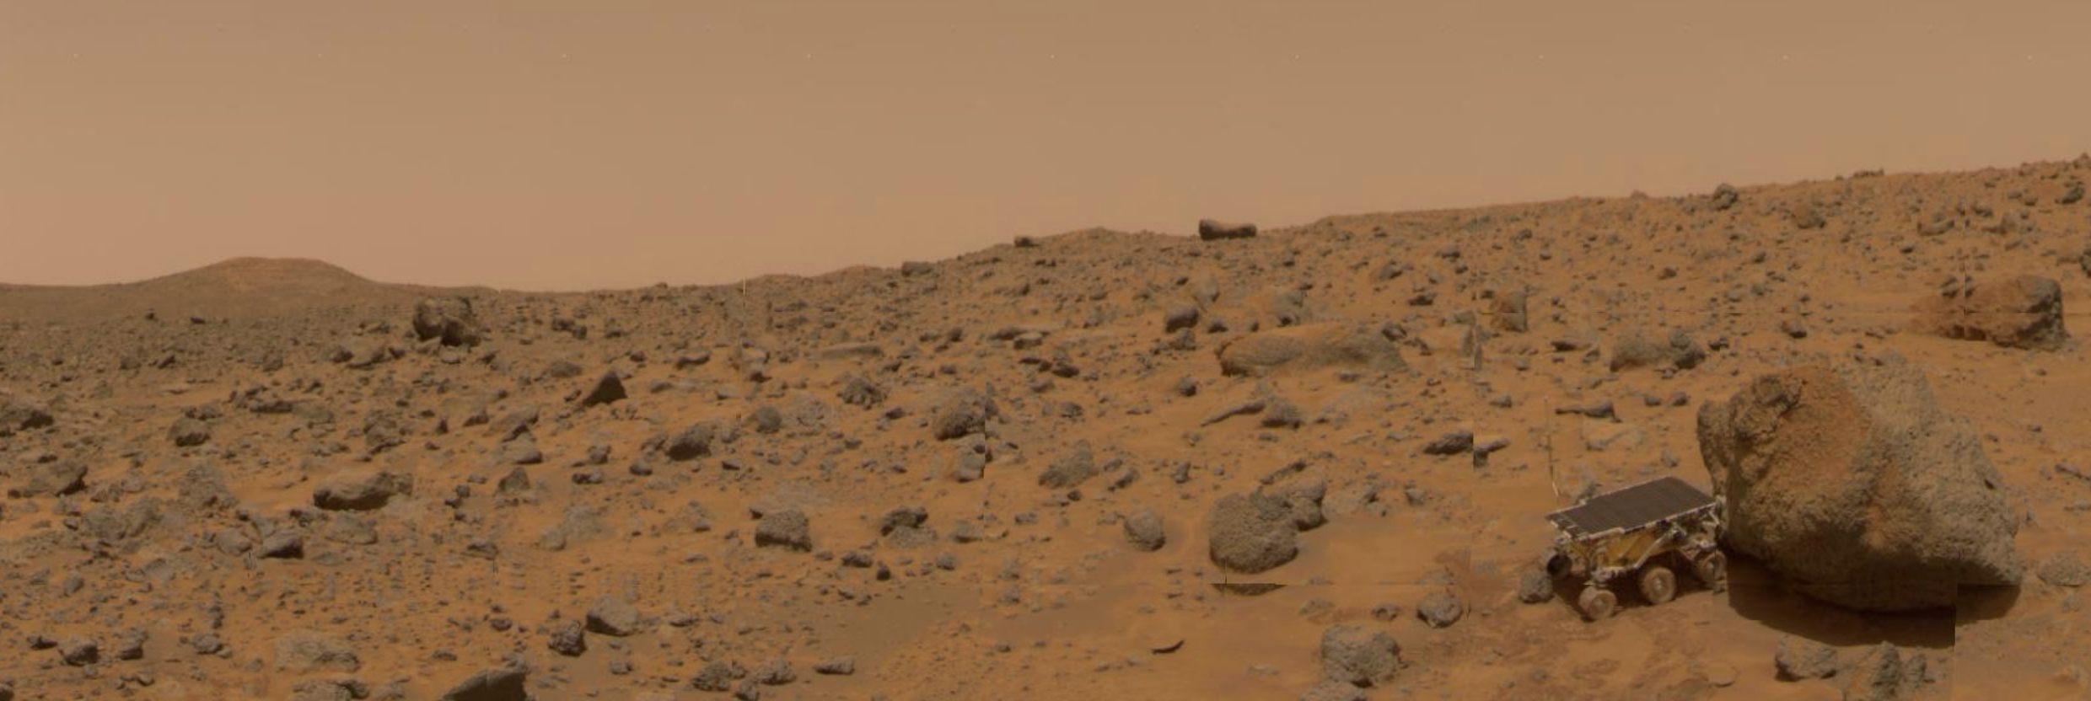
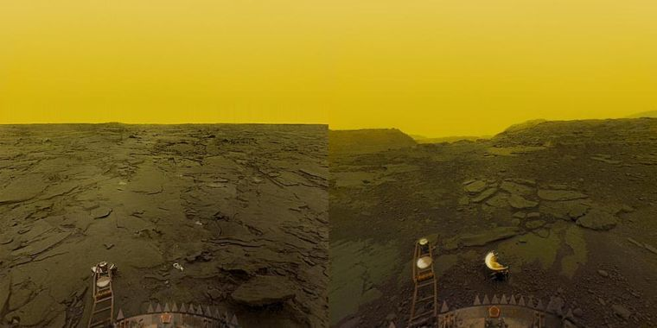
Next lecture: why has Earth avoided the fates of Mars and Earth?
http://geosci.uchicago.edu/~kite/geos32060/

