Slide 1
GEOS 22060/ GEOS 32060 / ASTR 45900
What makes a planet habitable?
Lecture 7
Volatile escape, concluded
Tuesday 28 January 2020

Slide 2
Course outline
Foundations (1-2 weeks)
Earth history
HZ concept, atmospheric science essentials
Post-Hadean Earth system
Principles – how are habitable planets initiated and sustained? (4-5 weeks)
Volatile supply, volatile escape
Long-term climate evolution
Runaway greenhouse, moist greenhouse
Specifics (~2 weeks)
Early Mars
Hyperthermals on Earth
Oceans within ice-covered moons
Exoplanetary systems e.g. TRAPPIST-1 system
TODAY

Slide 3
Lecture 6 key concepts
Energy sources for atmospheric escape
Thermal, individual-photons, solar wind, impacts
Bottlenecks for atmospheric escape
Energy supply, exobase, homopause, condensation in atmosphere, condensation at surface
Escape parameter, exobase, Jeans escape
The role of the sonic point in hydrodynamic escape

Slide 4
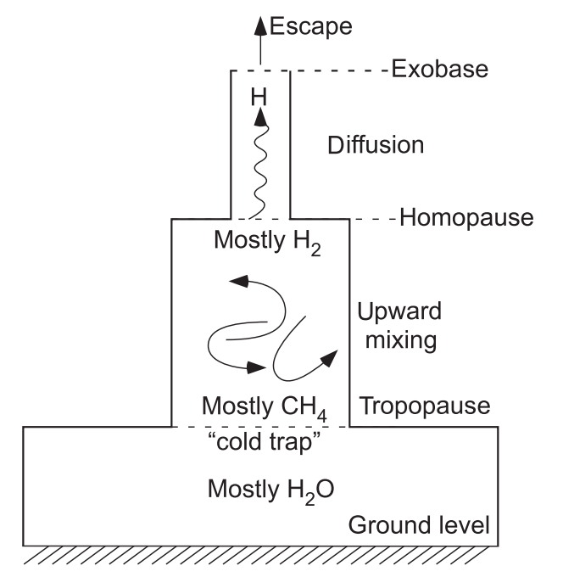
Bottlenecks for atmospheric escape
carriers of H
in Earth’s
atmosphere
for minor constituent:

Slide 5
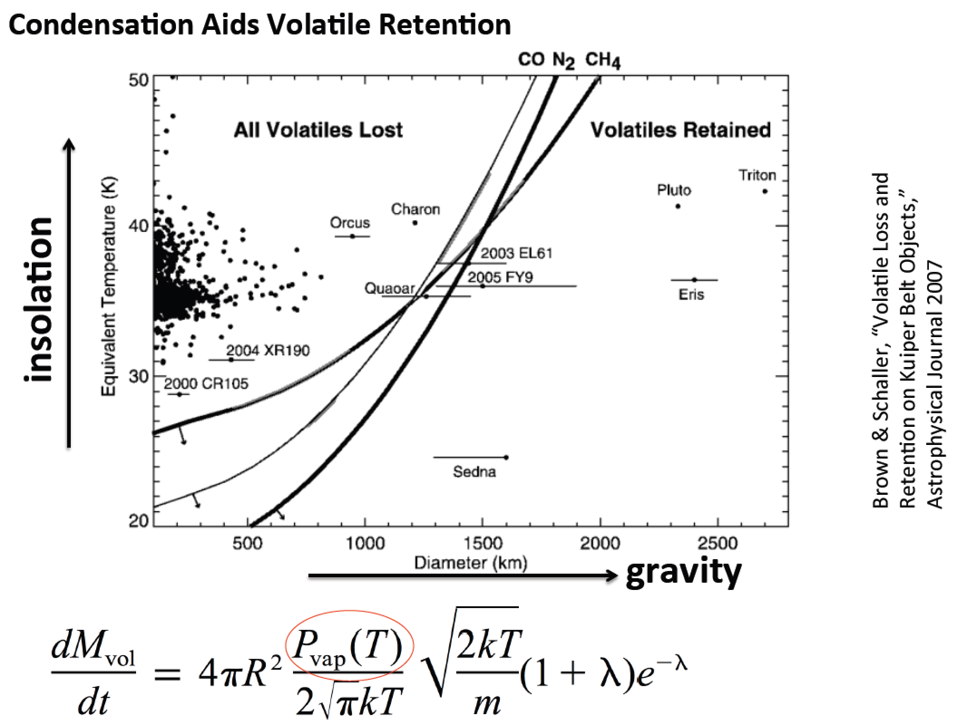
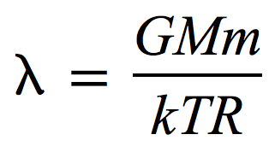
v

Slide 6
Introduction to Hydrodynamic Escape
De Laval nozzle (w/polytrope equation of state)
Spherical outflows/inflows (polytrope & isothermal)
Relevant to solar wind, Bondi-Hoyle accretion of stars and gas-giant planets, and hydrodynamic escape

Slide 7
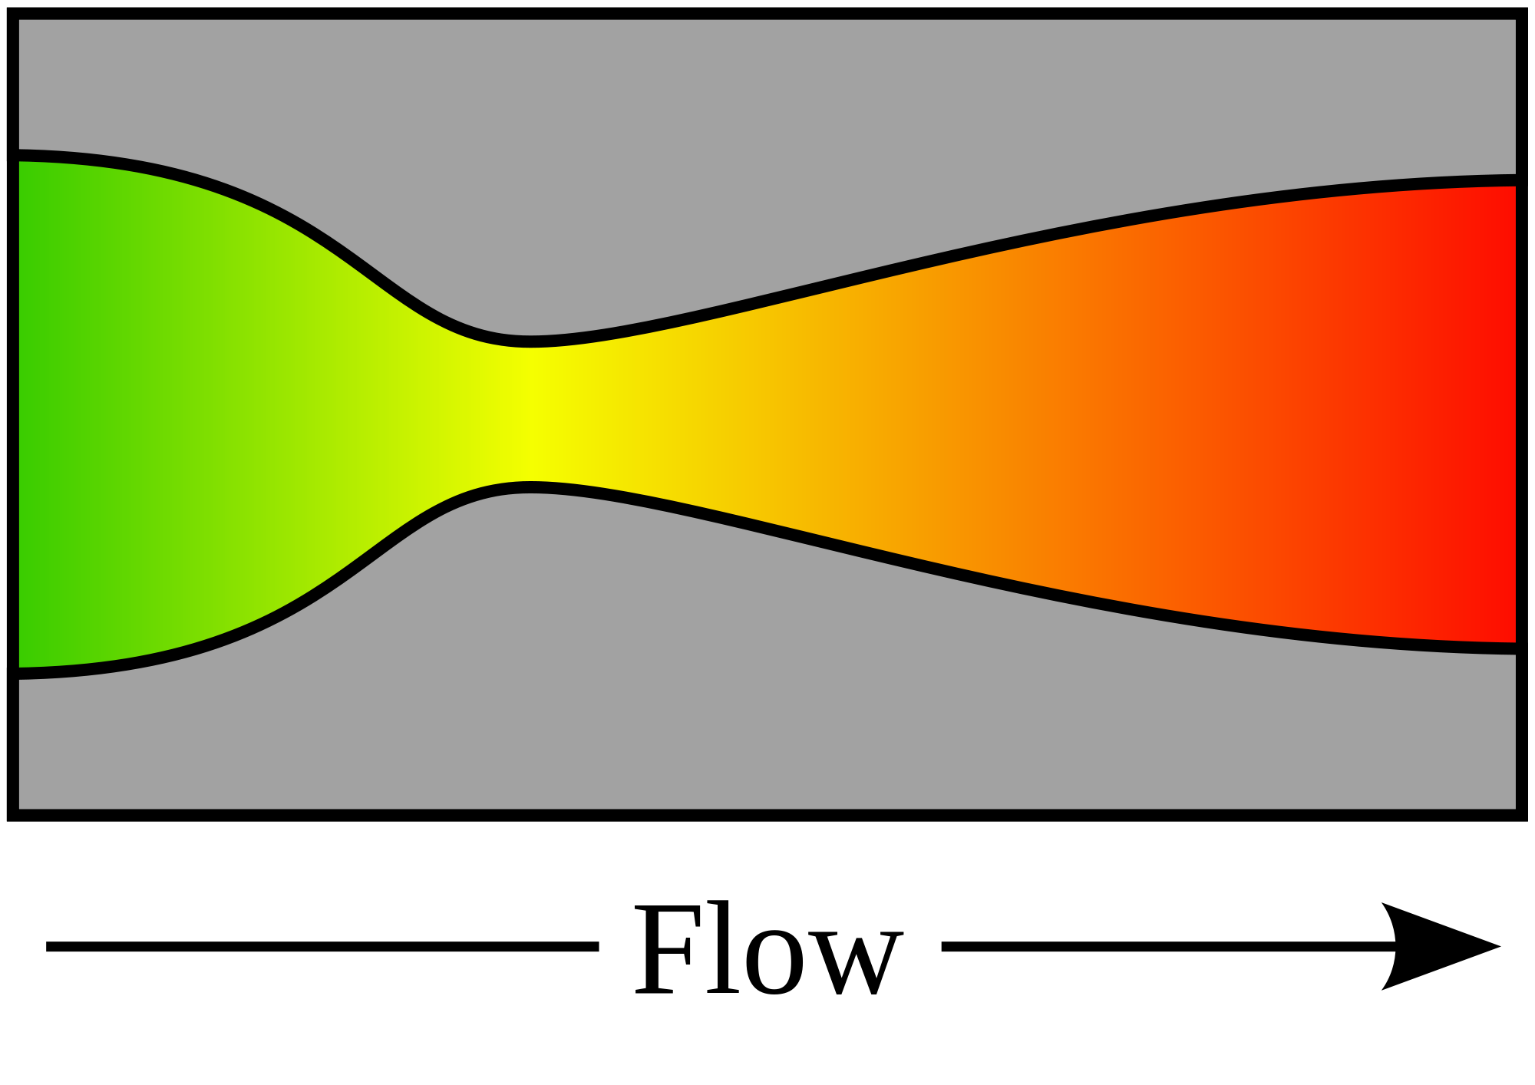
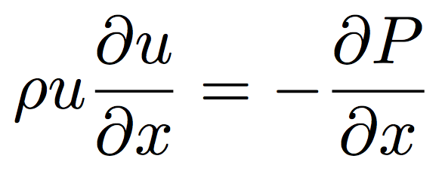
De Laval nozzle
fluid
density
mass
flow rate
nozzle
cross-sectional area
fluid
velocity
continuity
1D, no body forces,
no viscous forces
momentum
“energy”
(equation of state)
(polytrope)
= 1: special case (isothermal)

Slide 8
NOZZLE EQUATION
Neat features:
- Completely reversible (describes inflow and outflow) (u²)
(e.g., loss of gas from a planet and accretion of gas onto a planet)
(inflow of gas onto a star, and outflow of gas from a star = stellar wind / solar wind)
- If subsonic, then will accelerate on convergence and deccelerate on convergence
- If supersonic, then will accelerate on divergence and decelerate on convergence.
(This is because supersonic flows are highly compressible; the increase in A leads to large decrease in density, so u must increase by continuity).
- At the choke point, we must have either a sonic→ supersonic transition, or a maximum or a minimum in velocity.

Slide 9
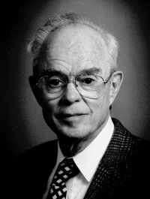
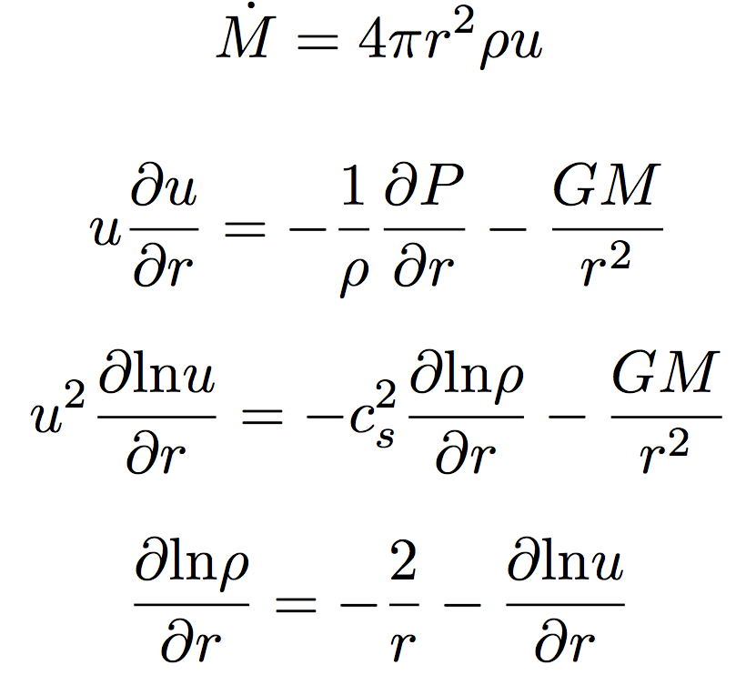
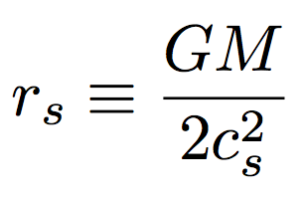
Spherical outflows & the sonic radius
Parker &
Chandra &
Fermi &
Compton &
Hubble
Eugene Parker
(U. Chicago)
Basis for defining
sonic radius
Sonic radius

Slide 10
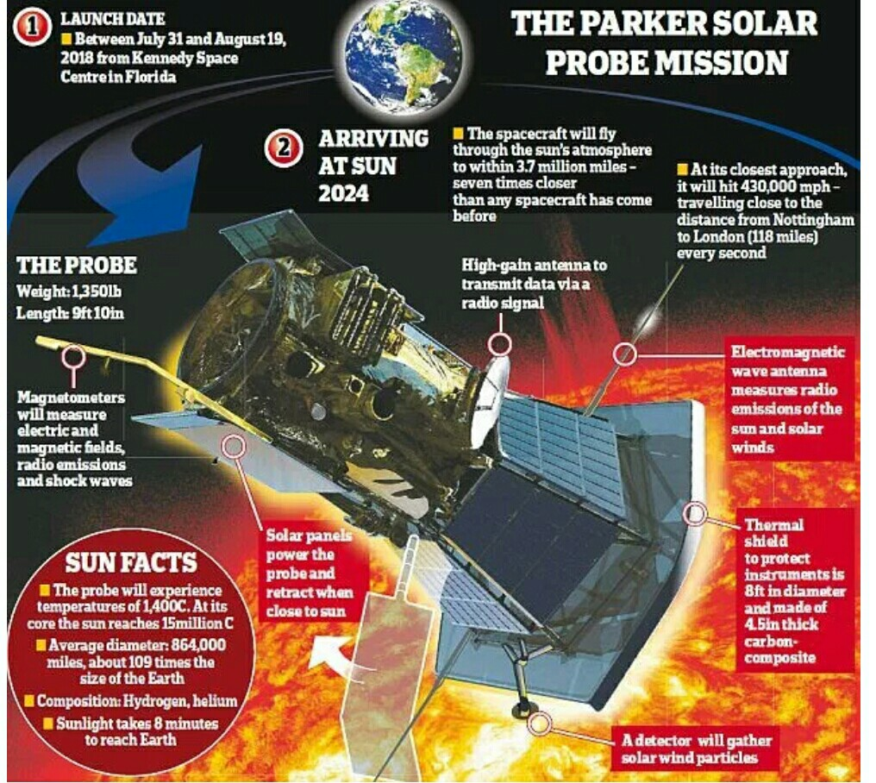

Slide 12
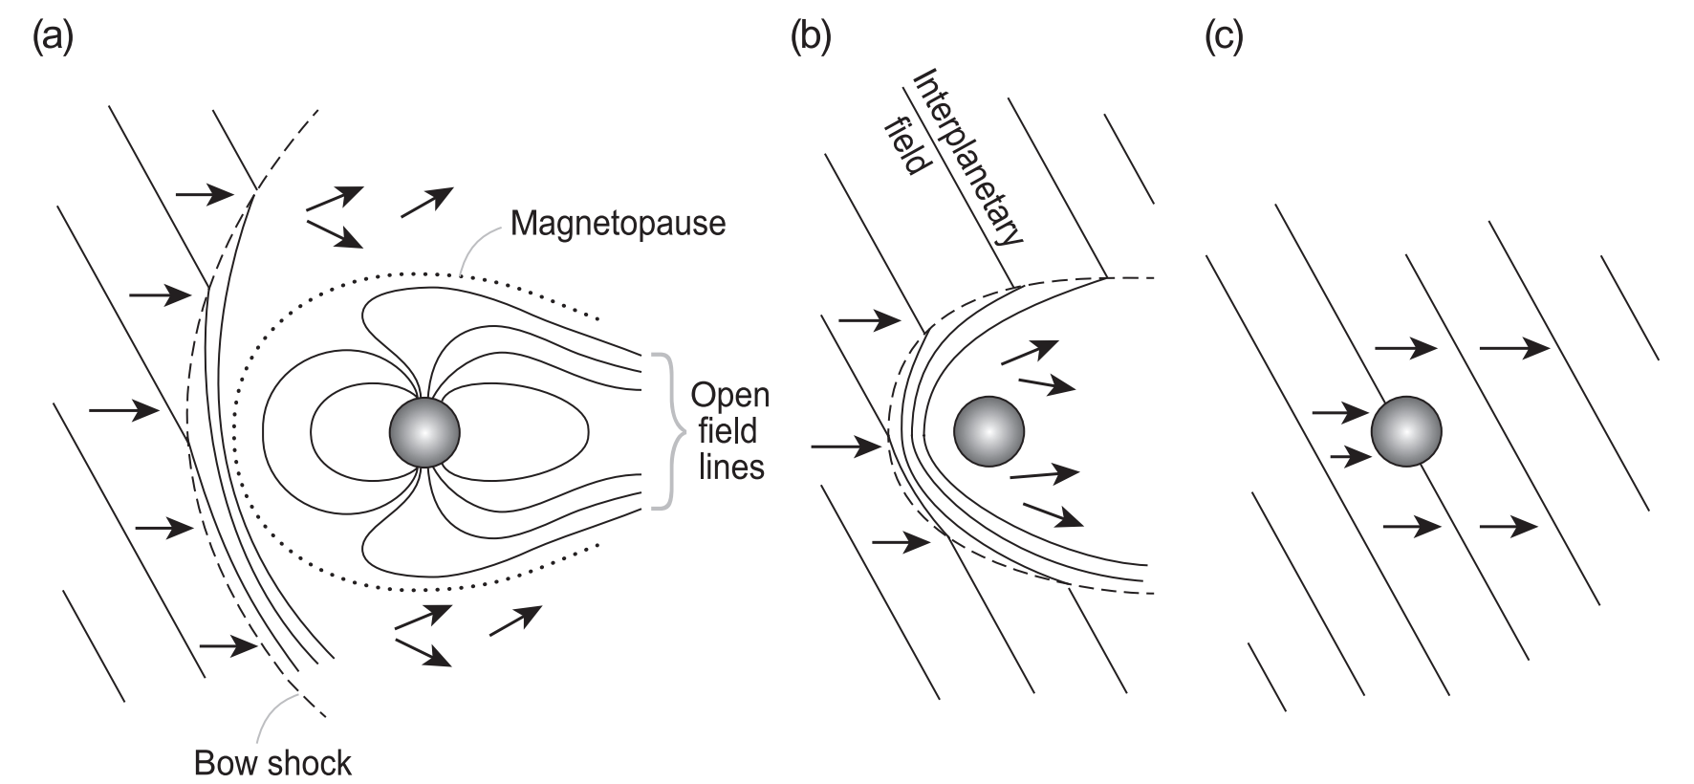
Protective (?) role of planetary magnetic field with respect to solar wind stripping

Slide 14
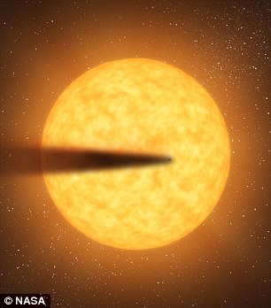
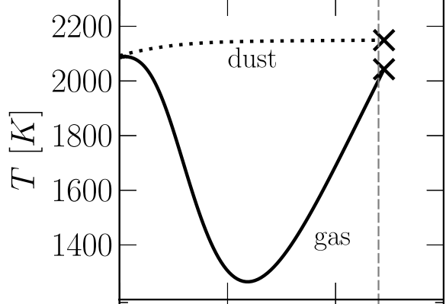
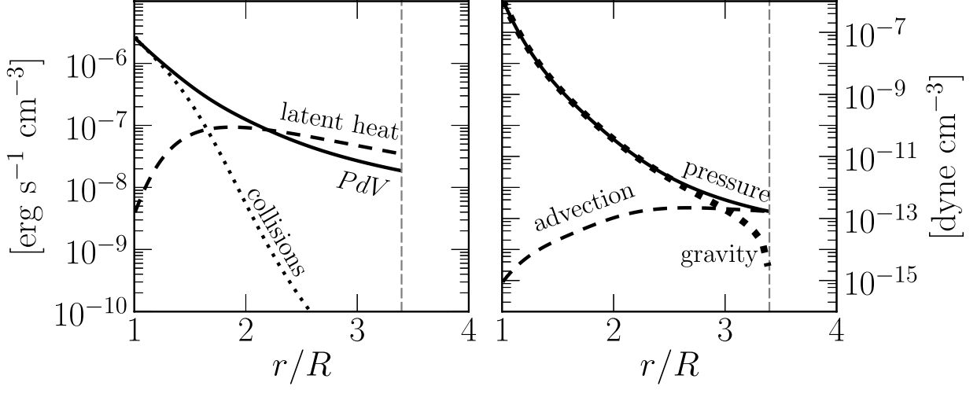
Recent development: Rocky-planet destruction by hydrodynamic escape
N.B. This does not apply to planets near the habitable zone (due to low vapor pressures)
Main-sequence stars orbited by planets that are currently being destroyed: KIC 12557548, KOI-2700, K2-22.
E.g. Perez-Becker & Chiang Astrophysical Journal 2013 “Catastrophic destruction of rocky planets.”
Destruction of Mercury-mass
planet:
Notice the minimum
in gas temperature -
discussed in this week’s
reading (Walker et al.)

Slide 15
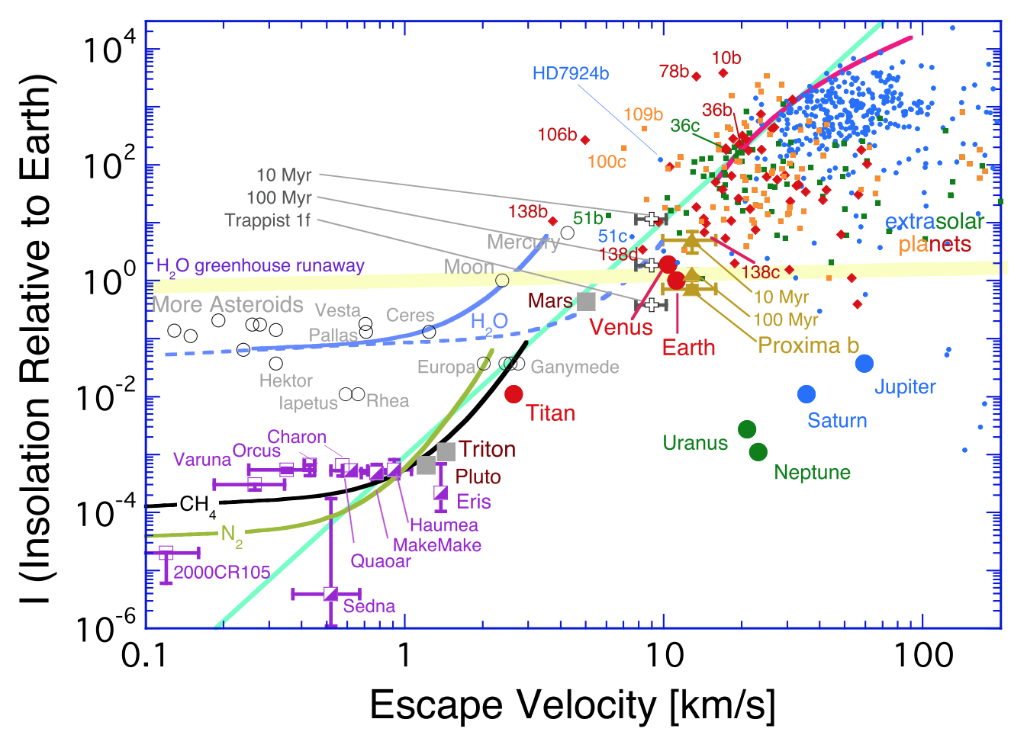

Slide 16
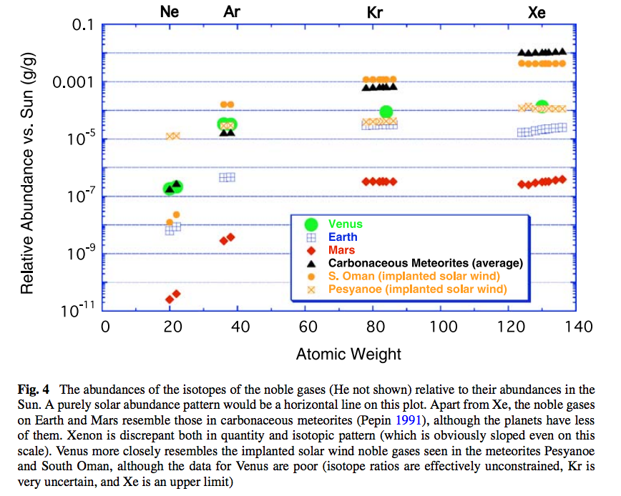
Noble gas abundance ratios and isotope ratios provide evidence for atmospheric loss.

Slide 17
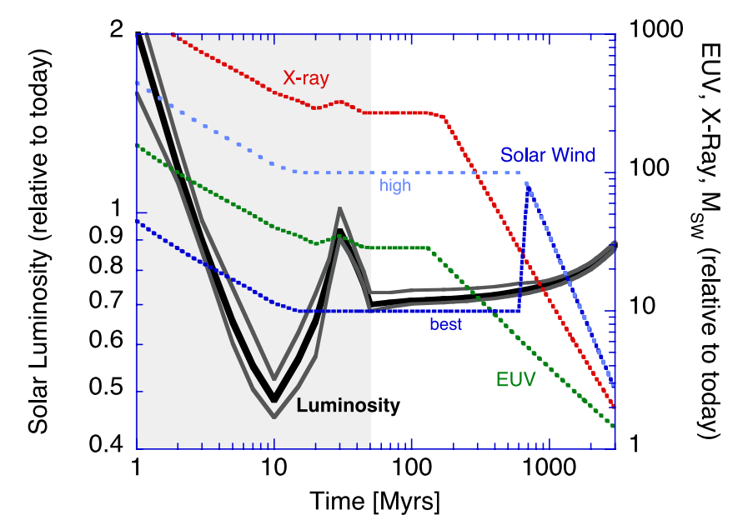
Relative to today’s Sun, the Sun around the time of the Moon-forming impact had lower bolometric luminosity, but much higher EUV / soft X-ray luminosity.
Zahnle et al. 2007 (in required reading)

Slide 18
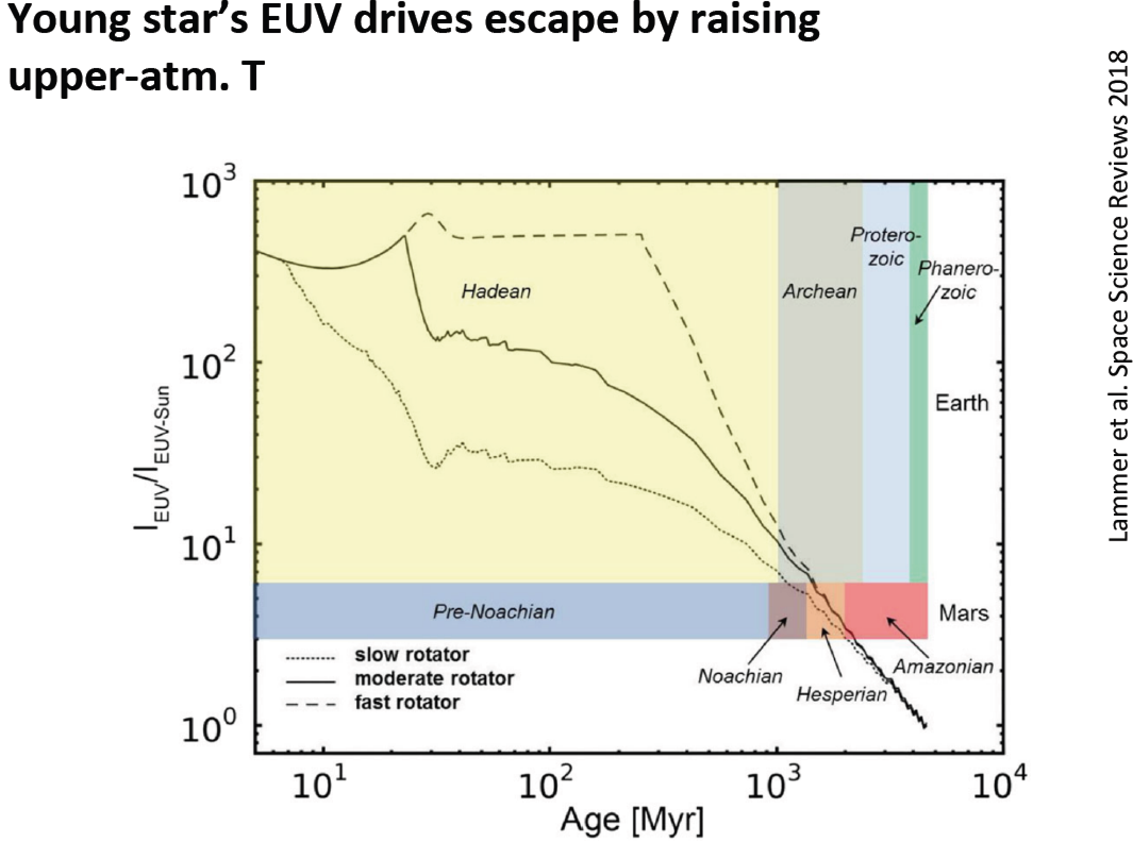

Slide 19
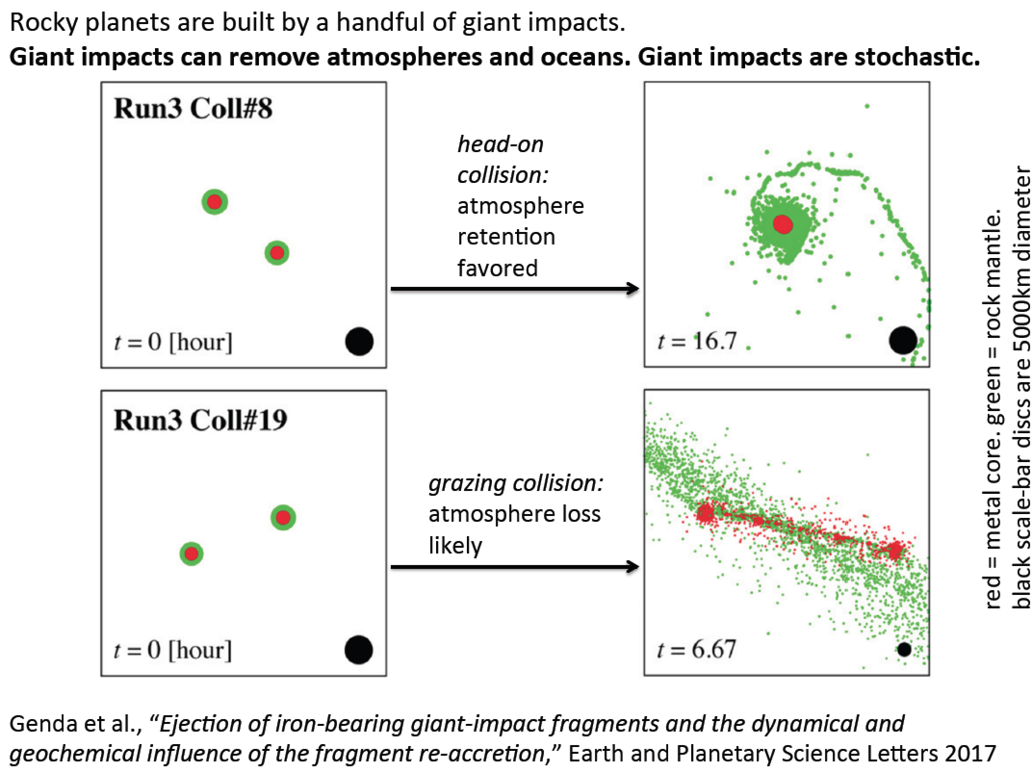

Slide 20
Lecture 6 key concepts
Bottlenecks for atmospheric escape
Energy supply, exobase, homopause, condensation in atmosphere, condensation at surface
Energy sources for atmospheric escape
Thermal, individual-photons, solar wind, impacts
Escape parameter, exobase, Jeans escape
The role of the sonic point in hydrodynamic escape

Slide 21
Lecture 7

Slide 22
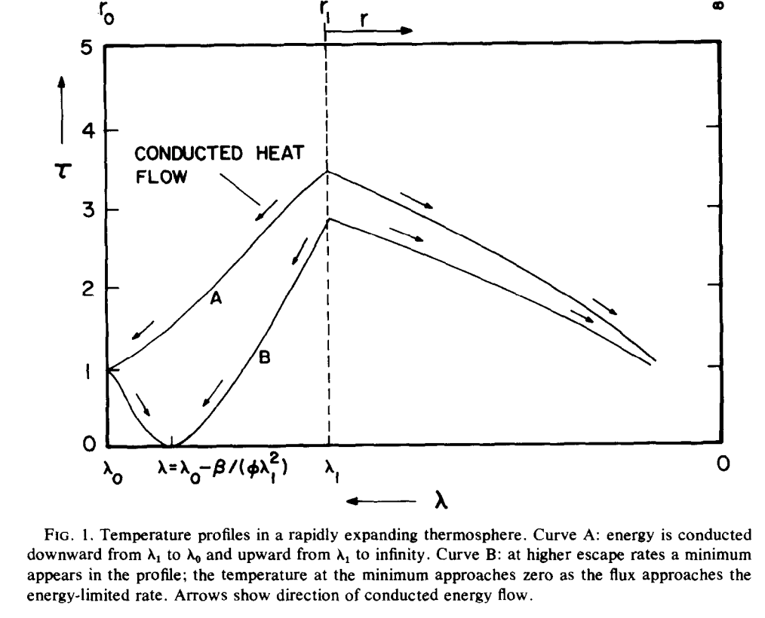
Thermal structure of hydrodynamic outflow (Watson et al. 1981)
dimensionless
temperature
all XUV assumed to be
absorbed at a single level
sonic
point
PdV work done on ascending
fluid cools the flow
skin temperature
(loosely:
stratospheric
temperature)
distance down gravity well
Assumes: Collisional at sonic level (bad approxm. for Titan and Pluto)
No convective adjustment, Single-component, H/H2 dominated, Neutral (vs. ionized) outflow

Slide 23
Atmospheric escape – key unifying concepts
Energy sources for atmospheric escape
Thermal, individual-photons, solar wind, impacts
Bottlenecks for atmospheric escape
Energy supply, exobase, homopause, condensation in atmosphere, condensation at surface
Escape parameter, exobase, Jeans escape
The role of the sonic point in hydrodynamic escape

Slide 24
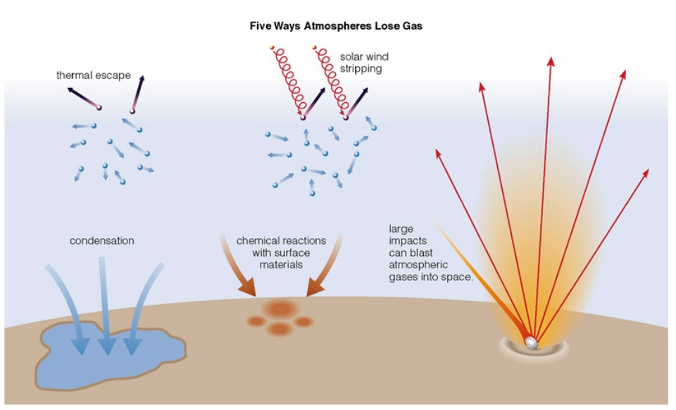
Energy sources for atmospheric escape
Today
not covered
in this course
today
also: lag formation
via James Wray

Slide 25
Lecture 7 topics
Energy-limit: XUV driven escape more-likely-than-not sculpts the exoplanet radius-period distribution (‘photo-evaporation valley’)
Diffusion limit: what regulates H loss from Venus, Earth and Mars today
Impact erosion – giant impacts and planetesimal impacts

Slide 26
Lecture 7 topics
Energy-limit: XUV driven escape more-likely-than-not sculpts the exoplanet radius-period distribution (‘photo-evaporation valley’)
Diffusion limit: what regulates H loss from Venus, Earth and Mars today
Impact erosion – giant impacts and planetesimal impacts

Slide 27
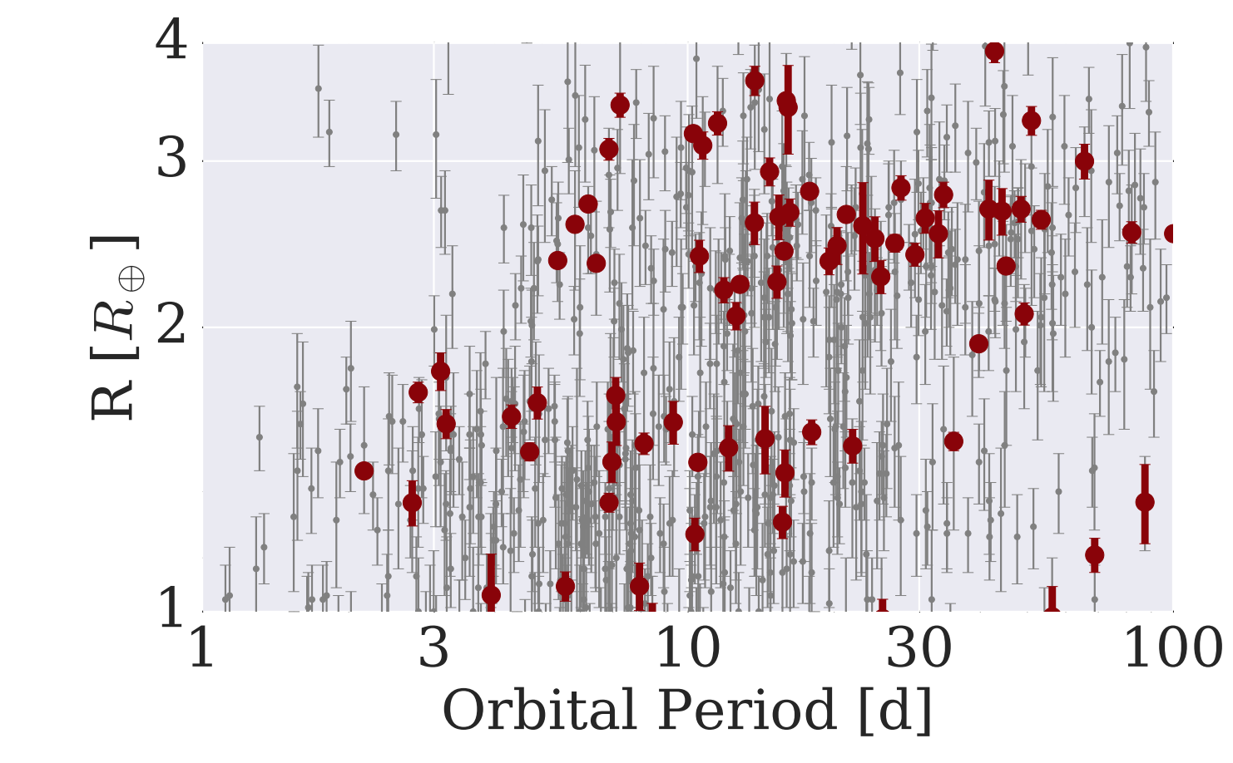
The Galaxy has many H₂-absent Super-Earths and many >~1 wt% H₂ mini-Neptunes: not much in between
mostly not rocky
based on density data
(L. Rogers ApJ 2015)
harder to detect
< 1.6 R_Earth
planets
>1.6 R_Earth
planets
van Eylen et al. MNRAS 2018

Slide 28
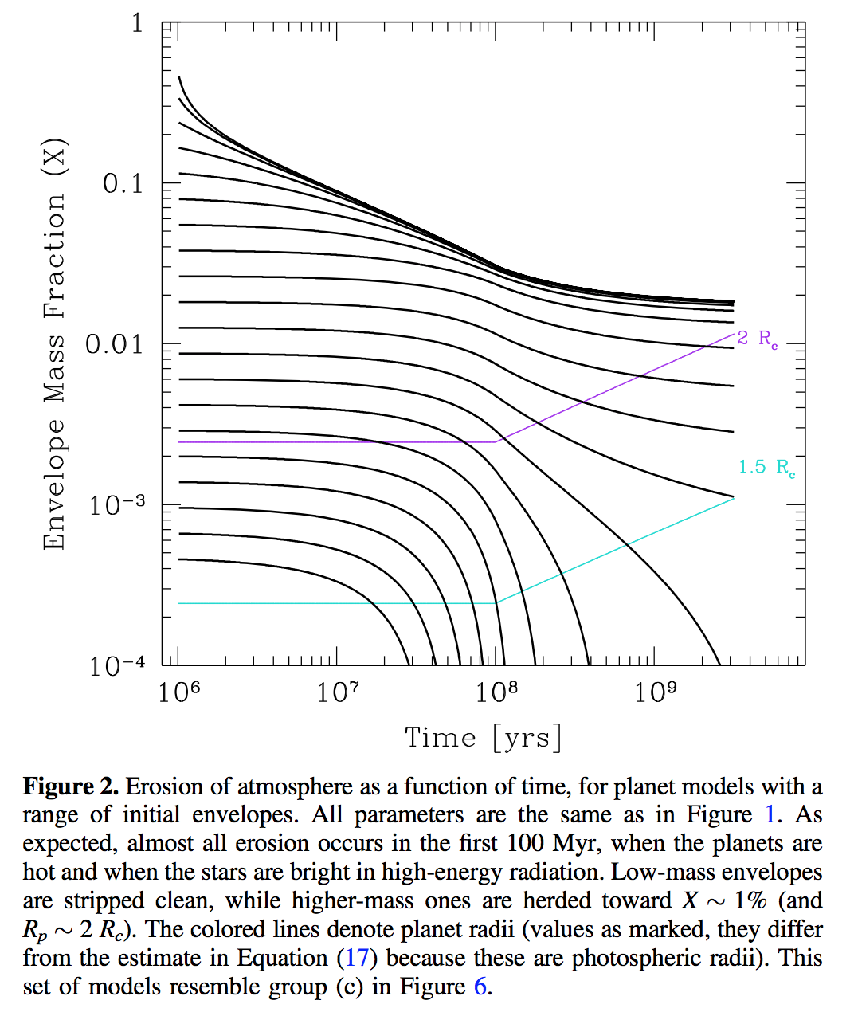
This gap in the radius distribution can be understood as a photo-evaporation valley driven by hydrodynamic escape of hydrogen
Owen & Wu ApJ 2017

Slide 29
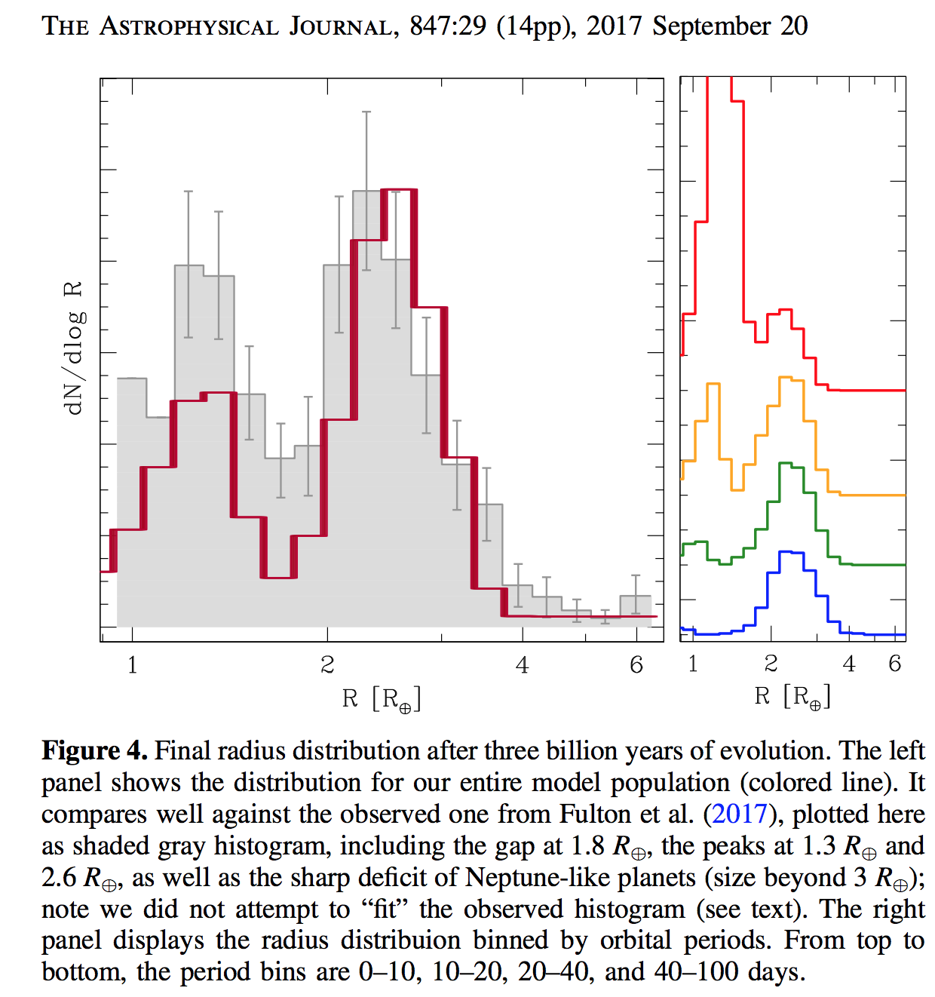
This gap in the radius distribution can be understood as a photo-evaporation valley driven by hydrodynamic escape of hydrogen
Owen & Wu ApJ 2017

Slide 30
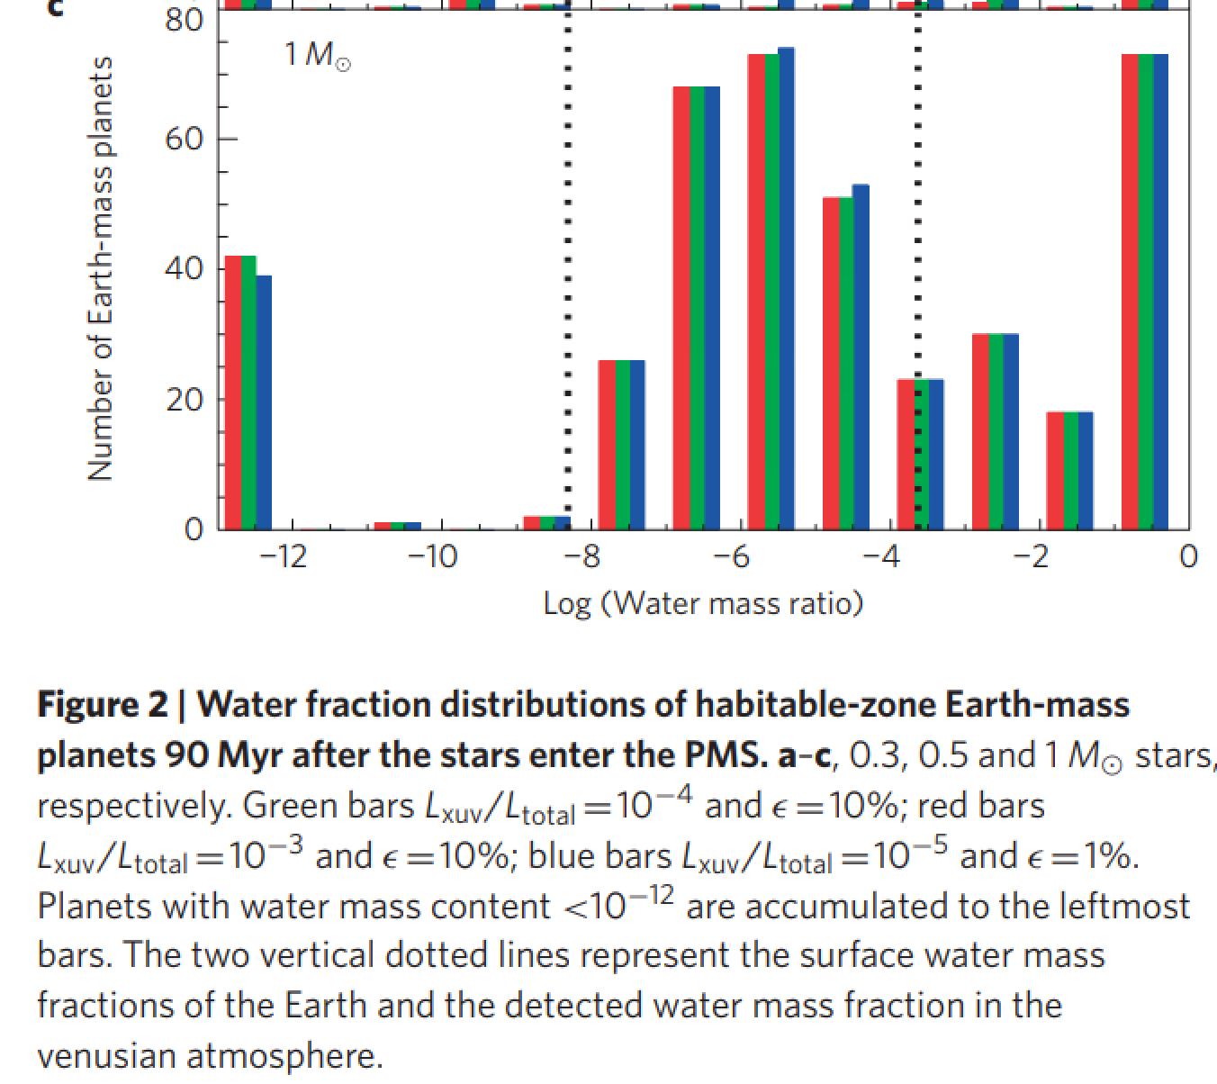
UV-driven atmospheric escape is predicted to lead to a bimodal distribution of water abundance
in the habitable zone
Tian & Ida Nature Geoscience 2015

Slide 31
Lecture 7 topics
Energy-limit: XUV driven escape more-likely-than-not sculpts the exoplanet radius-period distribution (‘photo-evaporation valley’)
Diffusion limit: what regulates H loss from Venus, Earth and Mars today
Impact erosion – giant impacts and planetesimal impacts

Slide 32
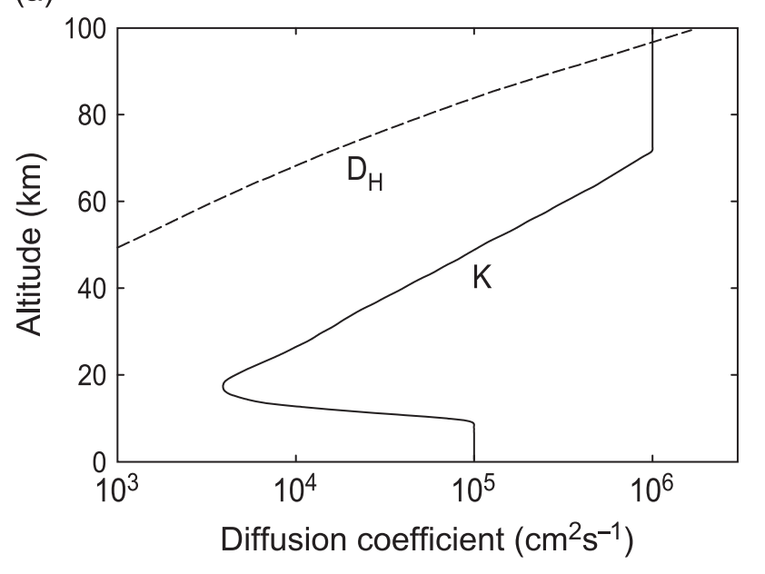
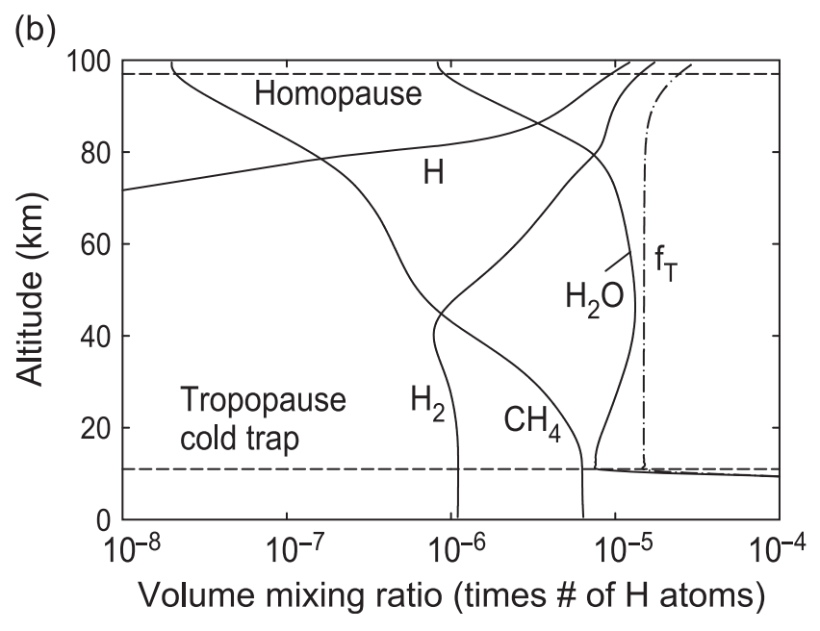
Diffusion-limited escape

Slide 33
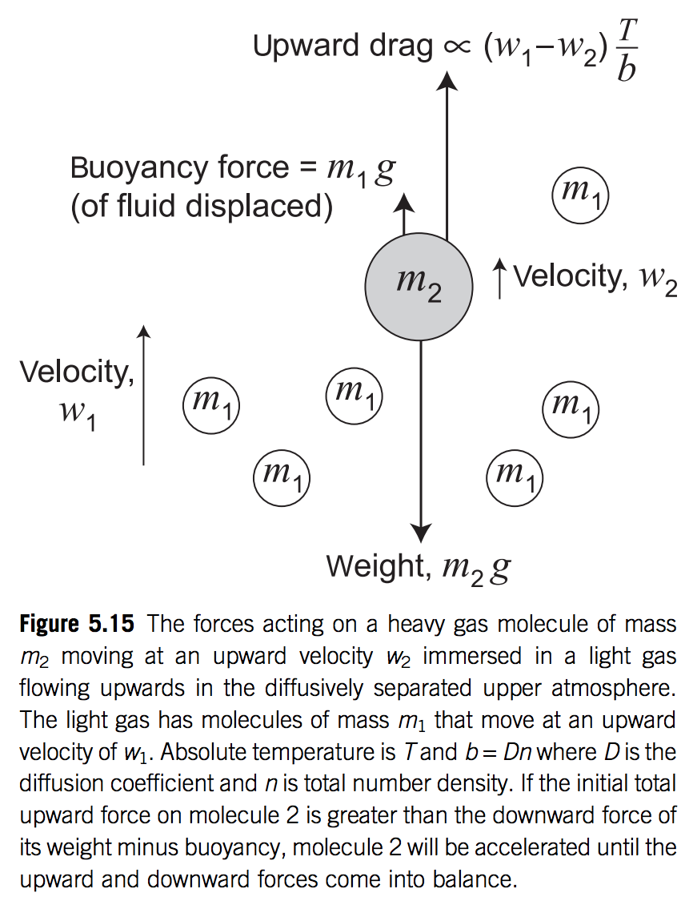

Slide 34
Lecture 7 topics
Energy-limit: XUV driven escape more-likely-than-not sculpts the exoplanet radius-period distribution (‘photo-evaporation valley’)
Diffusion limit: what regulates H loss from Venus, Earth and Mars today
Impact erosion – giant impacts and planetesimal impacts

Slide 36
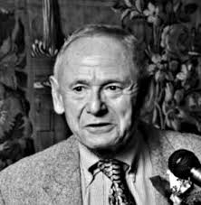
History of planetary impact research: gas guns and smooth-particle hydrodynamics (SPH) codes
Jay Melosh
Robin Canup
Sarah Stewart
author of the only
book in this field
(“Impact Cratering”)
Tom Ahrens
classical giant impact
hypothesis for Moon
origin
early gas gun work
Zoe Leinhardt
exoplanet giant
impact SPH
high-angular-momentum
Lunar origin theory
(“Synestia”)

Slide 37
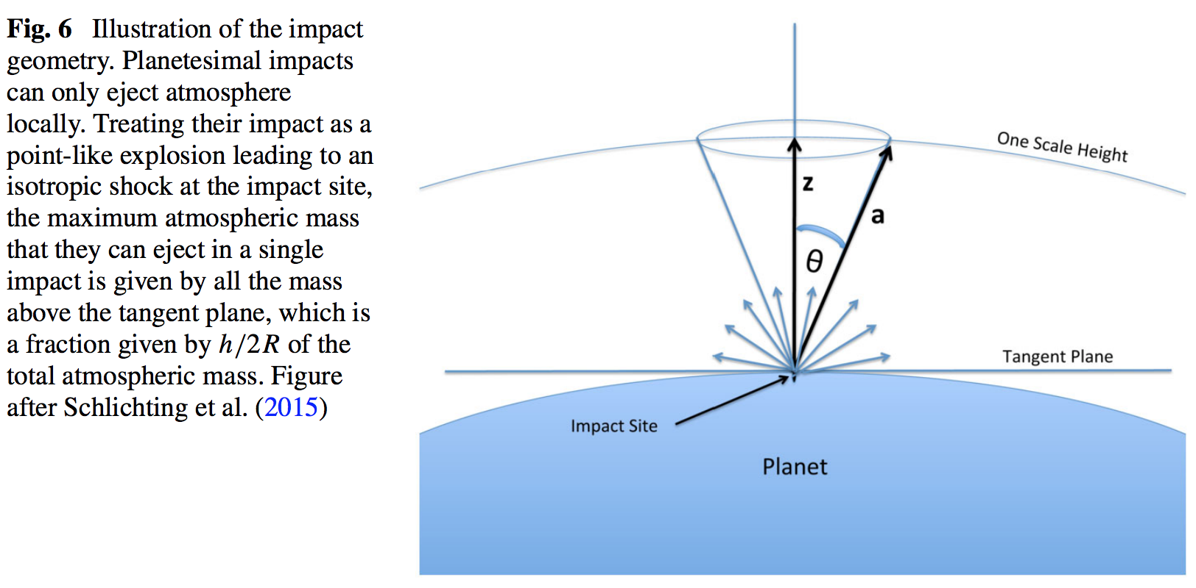

Slide 38
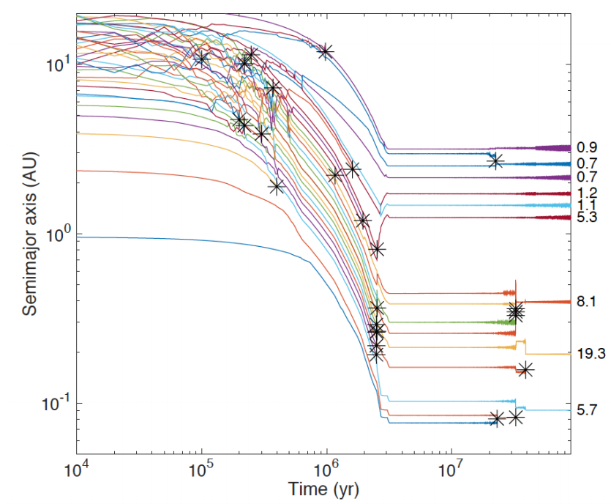
Formation of Earth-sized planets involves giant (oligarchic) impacts.
Masses of resulting
planets (Earths)
* = giant impacts
The output
underlying this plot
was generated by
C. Cossou.
The Moon-forming
impact was not
the last big impact
on Earth, but it was
the last time that
Earth hit another
planet.
Simulation intended to
reproduce “typical”
Kepler system of short-period,
tightly-packed inner planets

Slide 39
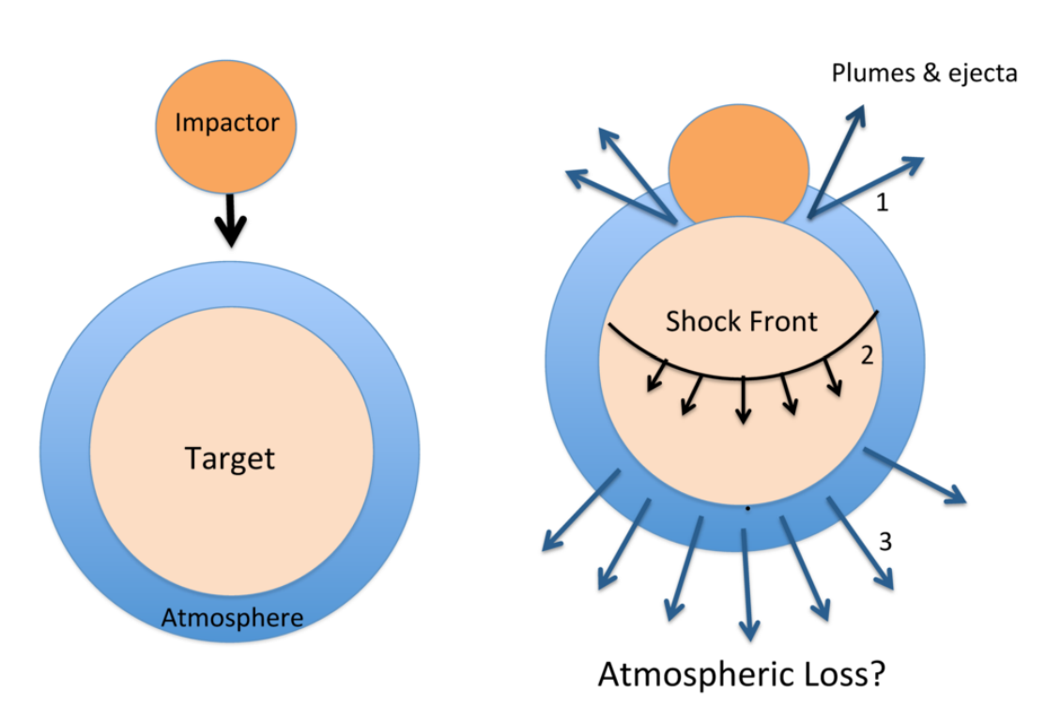
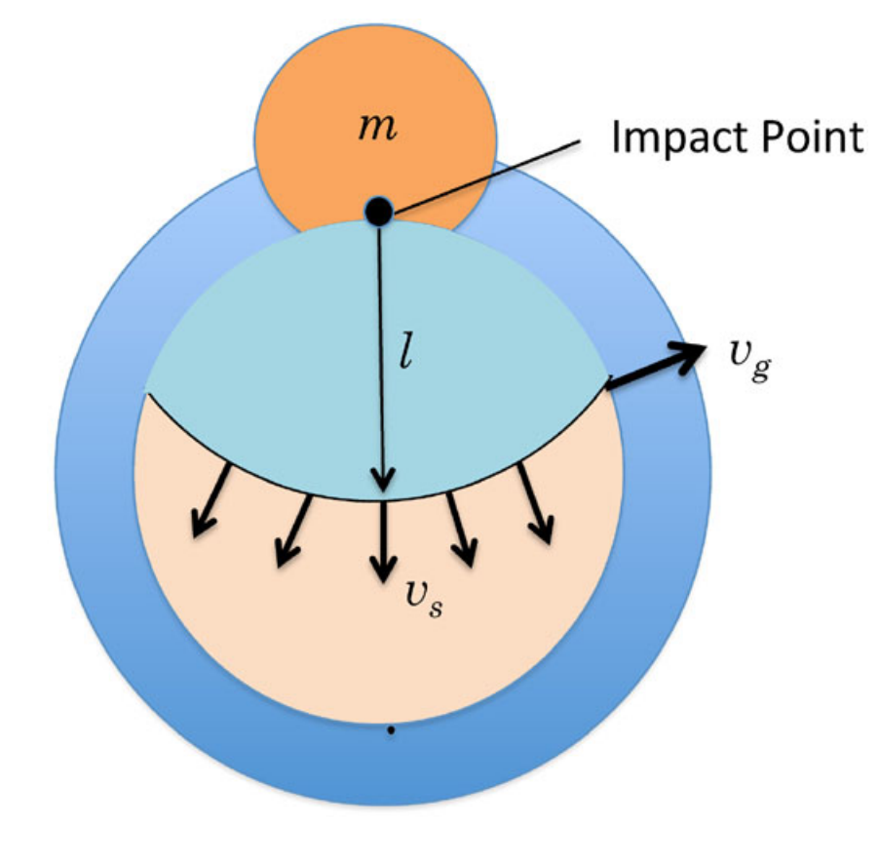
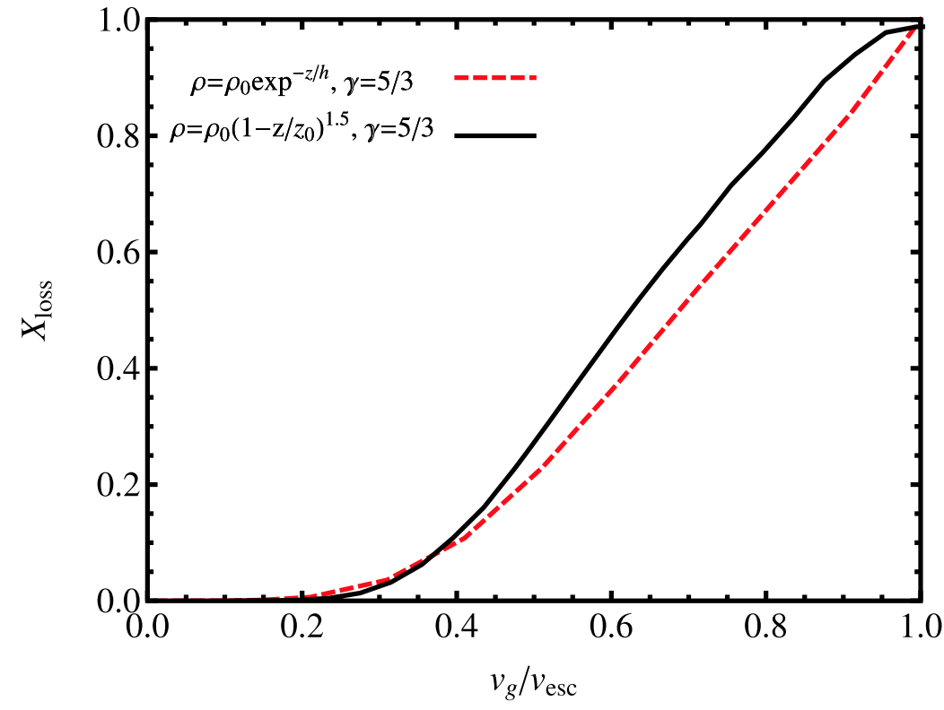
The atmosphere-loss escape efficiency of giant impacts is set by the ground-motion speed
Schlichting & Mukhopadhay 2018

Slide 40
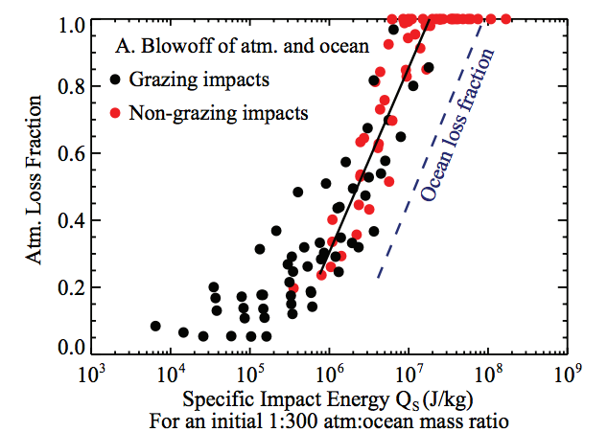
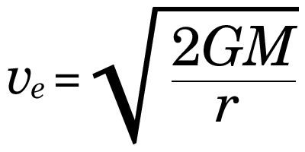
Ocean removal by giant impacts? (Ocean vaporization != ocean removal)
Simulations suggest that the Moon-
forming impact was marginally able
to remove any pre-existing Earth
ocean
Q_{s} ~ v_{e}² for oligarchic impact
Stewart et al. LPSC 2014
escape velocity
There have also been major recent developments in our understanding of Moon formation,
the Moon’s orbital evolution, and Moon-induced tidal heating, but orbital/tidal effects are
not part of this course.

Slide 41
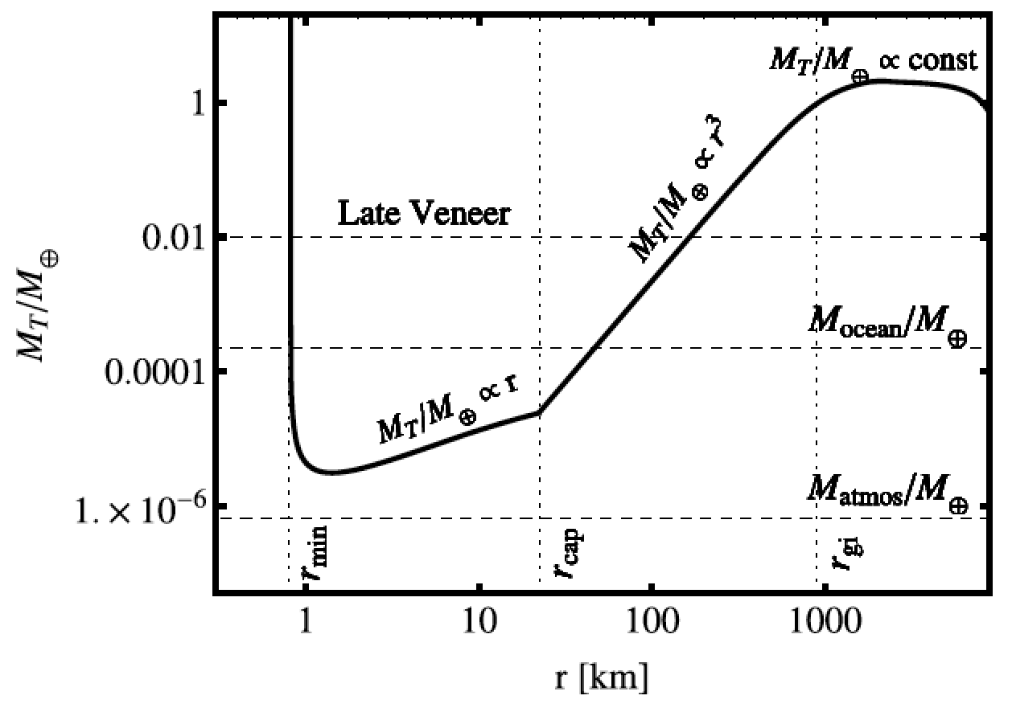
Total impactor mass needed to eject the atmosphere as a function of impactor radius
Schlichting & Mukhopadhay 2018

Slide 42
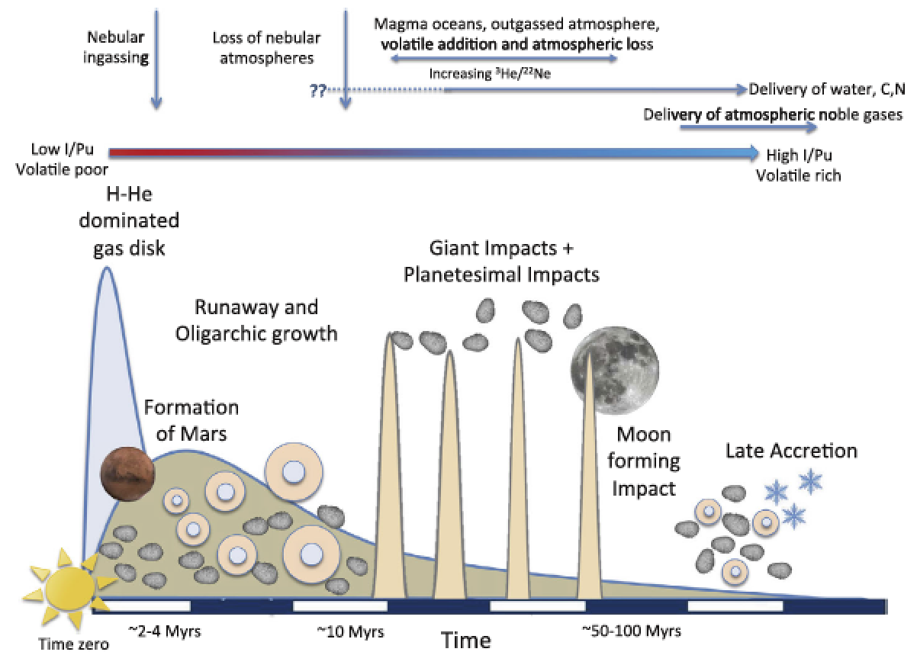
EARTH-SPECIFIC
Schlichting & Mukhopadhay 2018

Slide 43
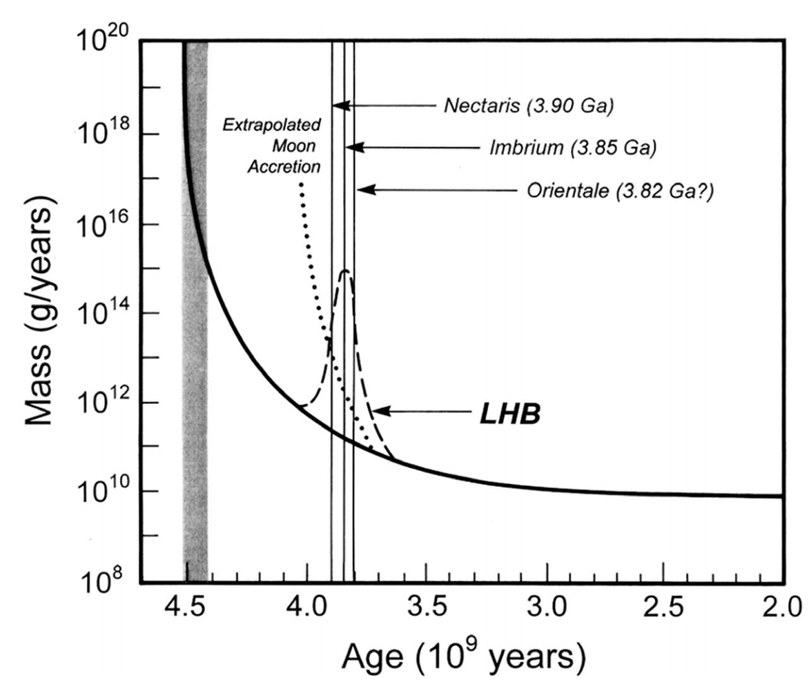
Catling & Kasting ch. 6 (Fig. 6.18)

Slide 44
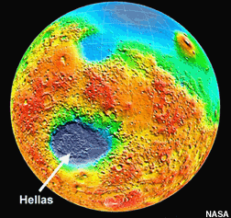
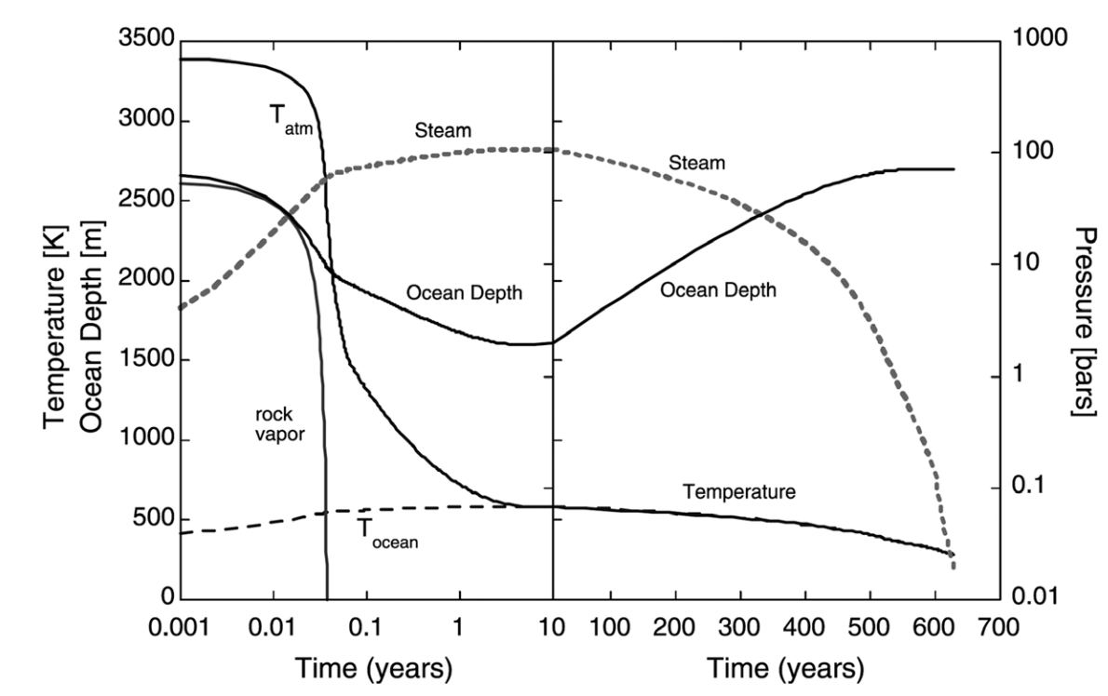
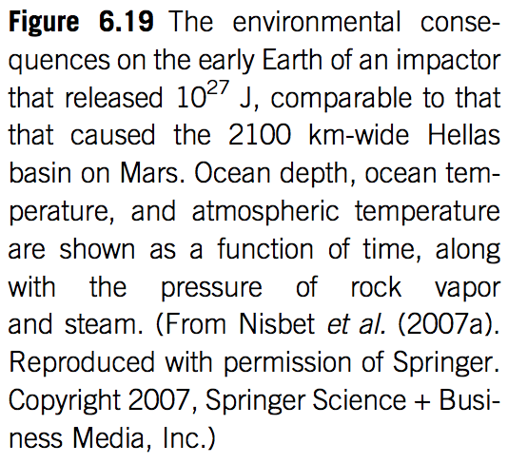

Slide 45
Bonus slides – Volatile escape

Slide 46
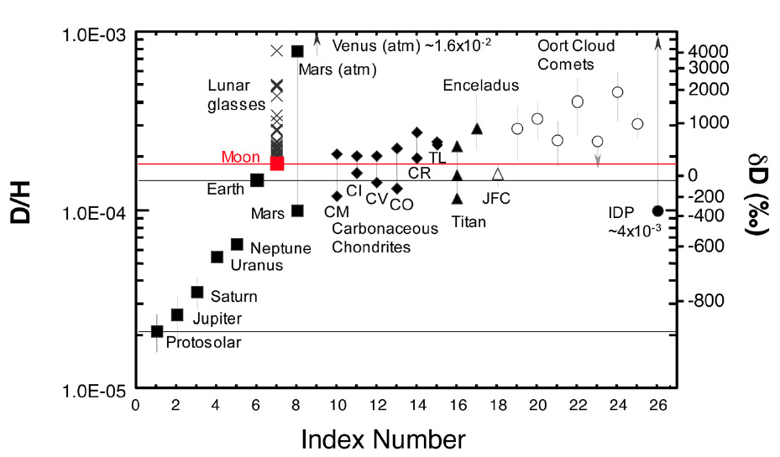

Slide 47
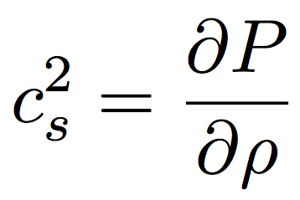
From momentum:
sound speed c_{s}:
Divide by , integrate both sides

Slide 48
From continuity:
Substitute in
(from previous slide):

Slide 49
Formation of Earth-sized planets involves giant (oligarchic) impacts.
Masses of resulting
planets (Earths)
* = giant impacts
The output
underlying this plot
was generated by
C. Cossou.
The Moon-forming
impact was not
the last big impact
on Earth, but it was
the last time that
Earth hit another
planet.
Simulation intended to
reproduce “typical”
Kepler system of short-period,
tightly-packed inner planets

Slide 50
(If time permits:) Bondi-Hoyle Accretion
Isothermal Bondi-Hoyle
(Bernoulli)
but
so

Slide 51
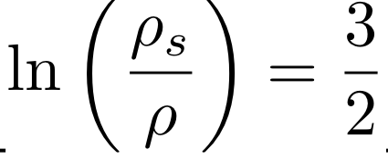
Isothermal Bondi-Hoyle
As r → 0, gas is in free fall
As r → infinity, u = 0 implies

