Slide 1
GEOS 38600/ GEOS 28600
Lecture 3
Wednesday 11 January 2017
Mountains and tectonics

Slide 2
Today: what drives mountain formation?
This Monday: what supports nonhydrostatic
loads, e.g. topography?
Last Wednesday: what sets the overall shape of this planet?

Slide 3
Mountains and tectonics
STRESS AND TECTONICS ON ONE-PLATE PLANETS
THRUST WEDGE: MOUNTAIN BUILDING ON EARTH
CRUSTAL FLOW: MOUNTAIN COLLAPSE

Slide 4
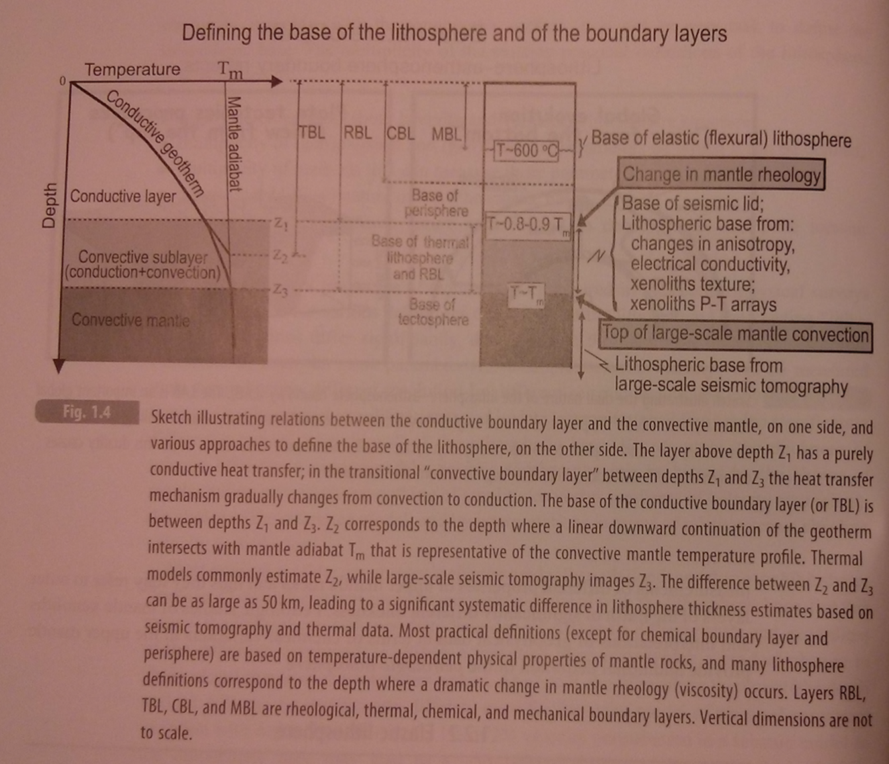
Lithosphere definition
Artemieva, “The Lithosphere”, 2010, p.6

Slide 5
Key points: mountains and tectonics
Know and explain the patterns of stress produced by planetary contraction, despinning, and polar wander
Be able to quantify the forces driving thrust wedges, and at least one plate-tectonic driving force
Explain crustal flow.

Slide 6
Mountains and tectonics
STRESS AND TECTONICS ON ONE-PLATE PLANETS
THRUST WEDGE: MOUNTAIN BUILDING ON EARTH
CRUSTAL FLOW: MOUNTAIN COLLAPSE

Slide 7
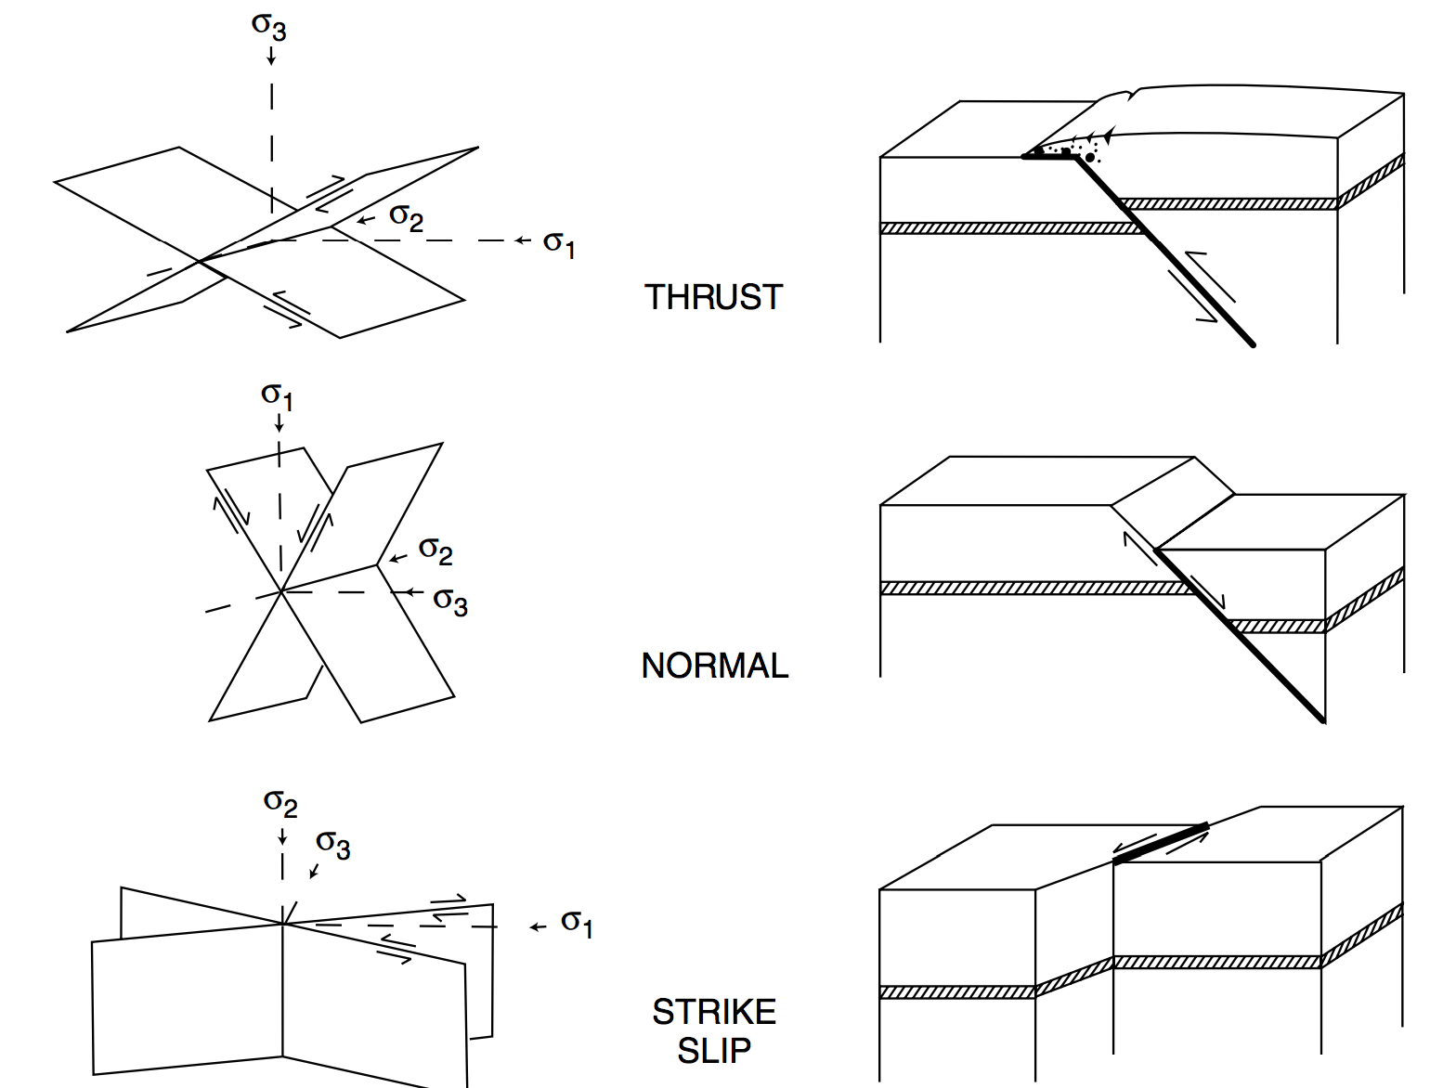
Relationship between stress and tectonic faulting
exact
angle depends
on coefficient of
friction: “Anderson
theory”
structures inferred from outcrop are
confirmed by deep seismic reflection
profiling

Slide 8
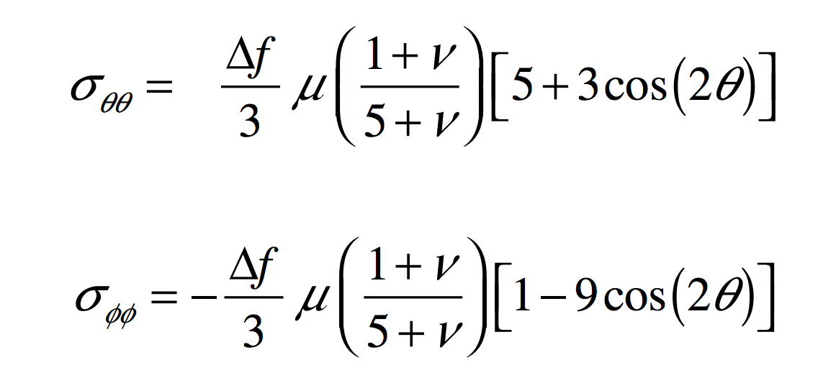
Vening-Meinesz equations
Assume: thin shell over fluid interior
change in rotational flattening
Spin-up/spin-down:
colatitude
East-West:
shear modulus (Pa)
Poisson’s ratio
North-South:

Slide 9
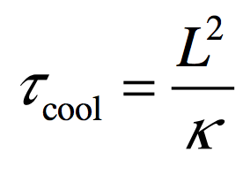
Planetary contraction:
Stress:
Magnitude:
3 x 10⁻⁵ K⁻¹ is less than a
factor of 2 in error for most
planetary rocks and ices
Timescale:
lithosphere thickness, not planet size
10⁻⁶ m²s⁻¹ is less than an order of magnitude
in error for most planetary rocks and ices
(exceptions: regolith, clathrates)

Slide 10
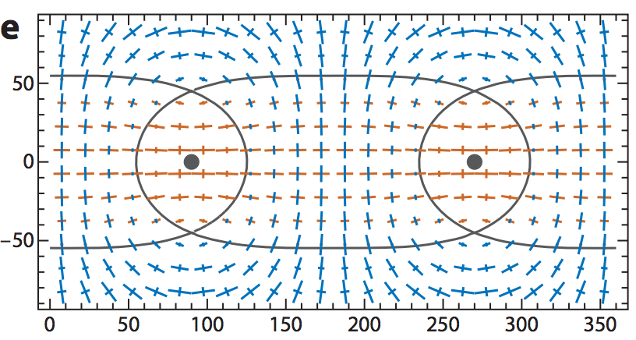
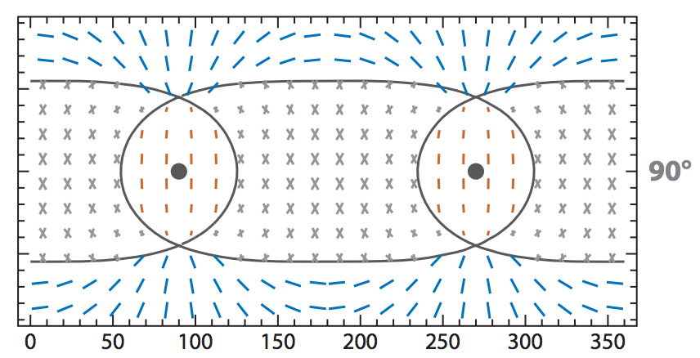
Stresses and fault pattern caused by
maximum True Polar Wander (90 degrees)
Matsuyama, Annual Reviews,2014
Predicted differential stress pattern:
Orange = extensional stress.
Blue = compressional stress.
Predicted fault pattern:
Orange = normal fault.
Blue = thrust fault.
Gray = strike-slip fault.

Slide 11
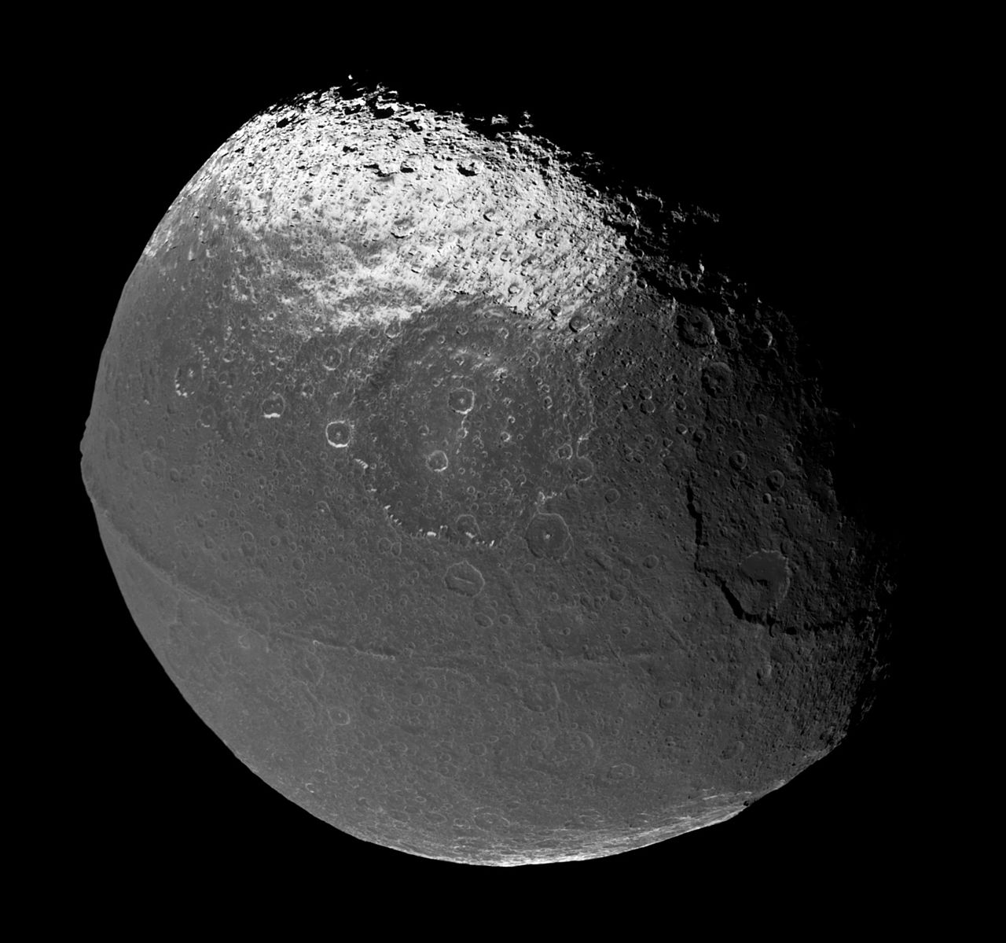
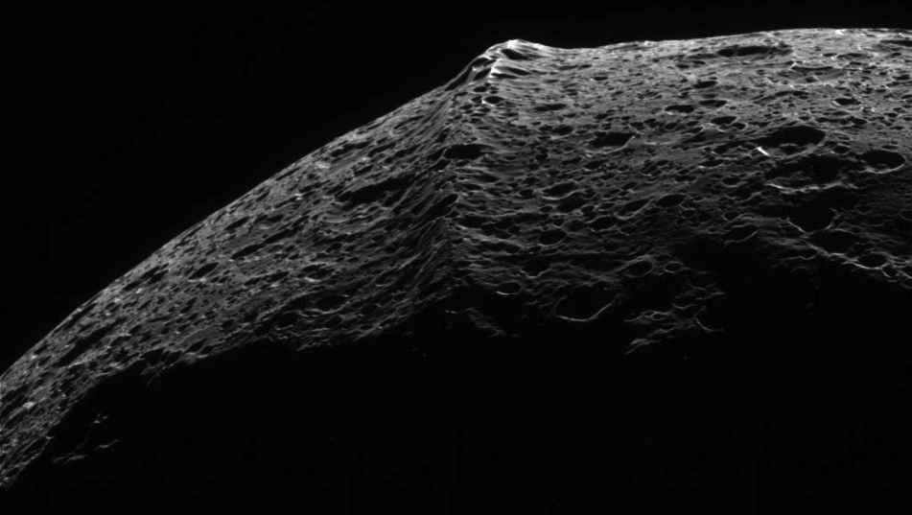
Of the 3 mechanisms discussed so far, which is/are possible cause(s) of Iapetus’ equatorial ridge?
Assume linear rheology.
Iapetus:
d = 1500 km

Slide 12
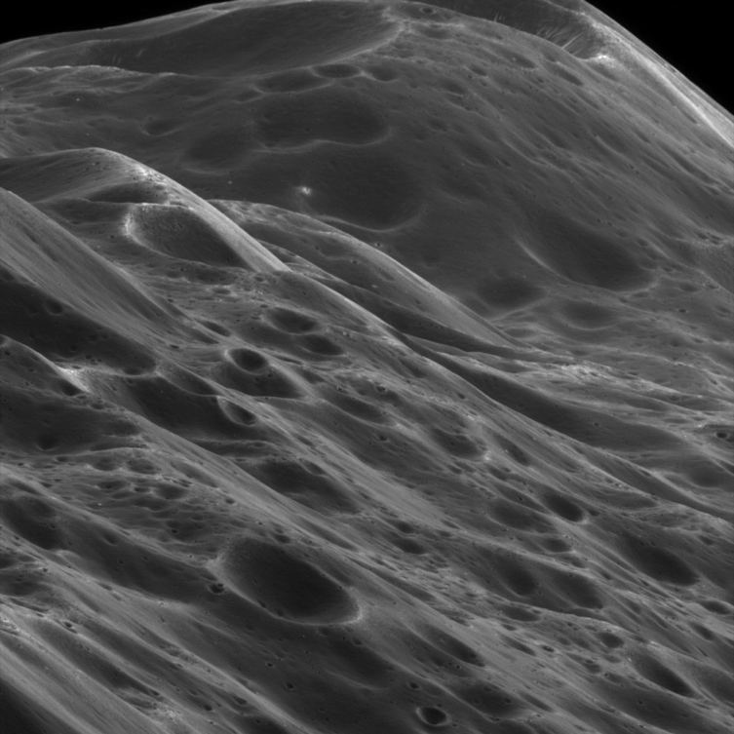
Of the mechanisms so far, which is a possible cause of Iapetus’ equatorial ridge?
Iapetus:
d = 1500 km
a – c = 34 km → f = 0.05
day length = 79 days

Slide 13
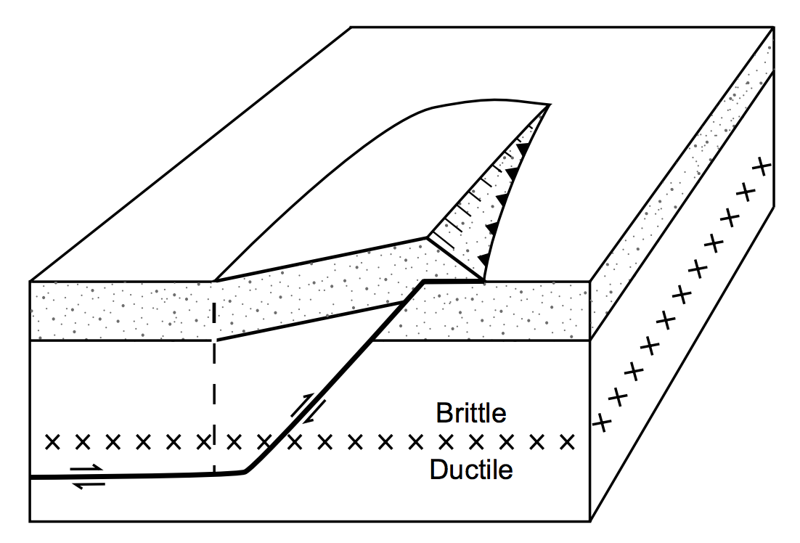
Tectonic mountain-building forces are usually horizontal
Example: Himalaya cross-section

Slide 14
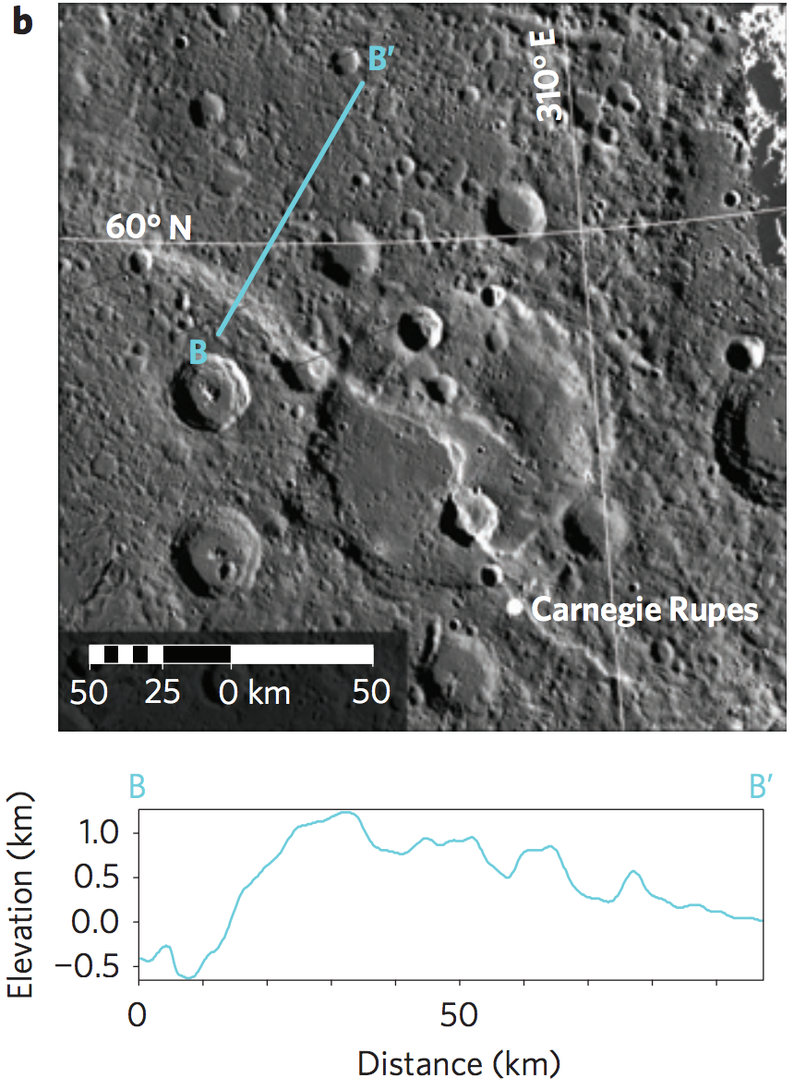
Tectonics on Mercury
What is the horizontal strain
along B – B’ for fault dip angle
30 degrees?
Byrne et al.
Nature Geoscience 2014

Slide 15
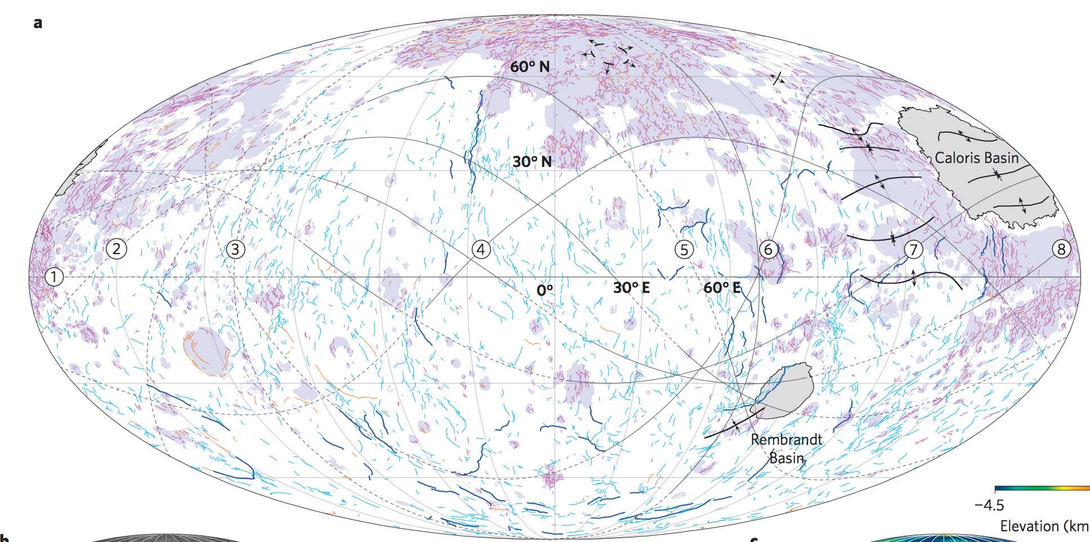
Global tectonic map of Mercury
irregular lines = faults (almost all are wrinkle ridges)
Byrne et al.
Nature Geoscience 2014
Total radius change ~ 7 km
Mercury radius = 2400 km
Temperature change = ?
Mars also has a global network of wrinkle ridges

Slide 16
Mountains and tectonics
STRESS AND TECTONICS ON ONE-PLATE PLANETS
THRUST WEDGE: MOUNTAIN BUILDING ON EARTH
CRUSTAL FLOW: MOUNTAIN COLLAPSE

Slide 17
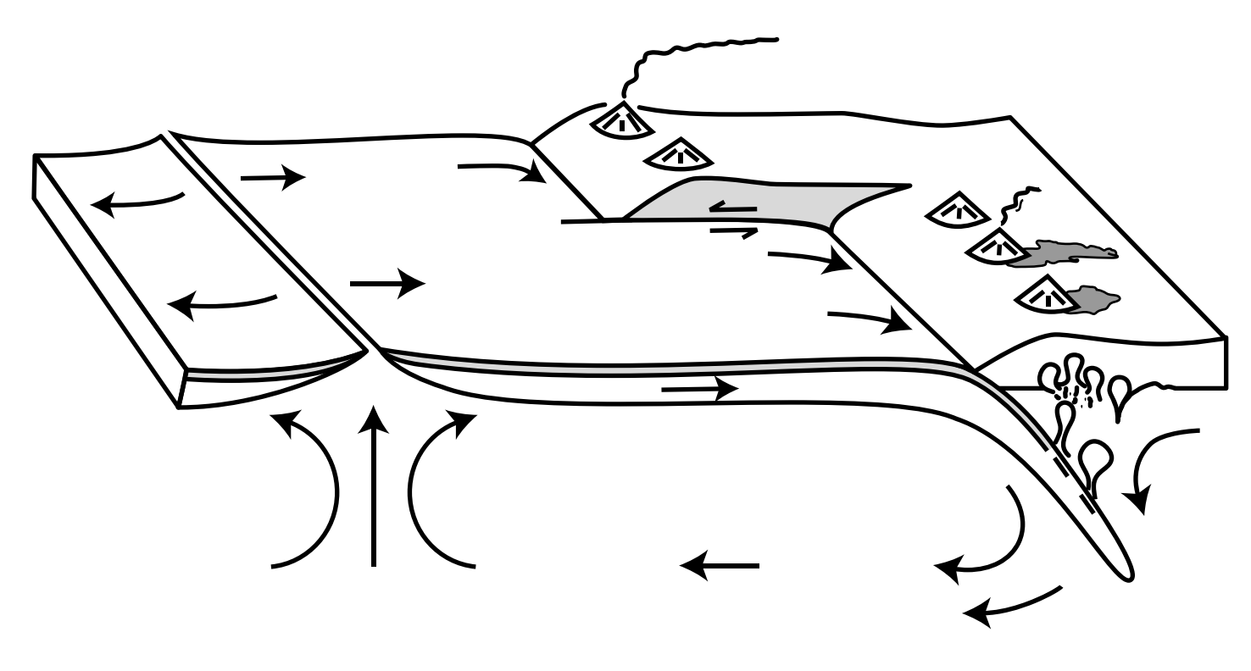
Earth (plate tectonics): How big are the forces that build mountains?
ridge push
basal traction
slab pull
David Rowley,
U. Chicago tectonicist
(guest lecturer
in week 5)

Slide 18
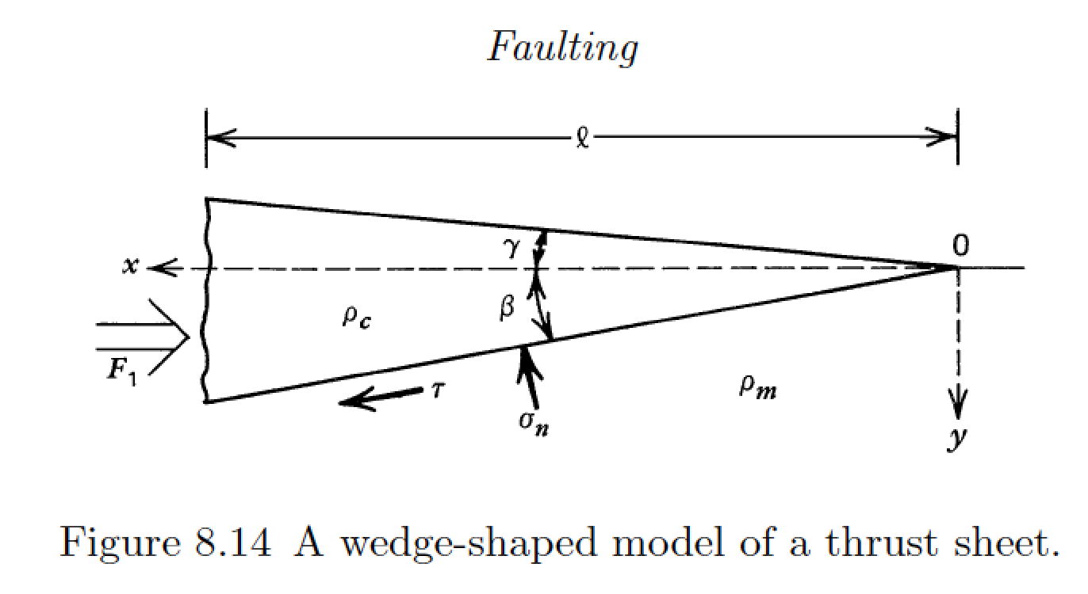
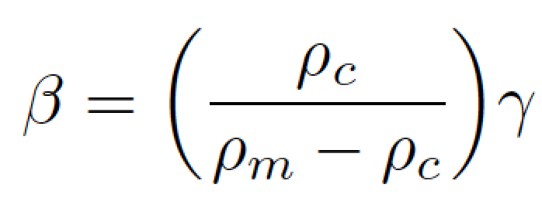
Simple thrust sheet model is relevant to most mountain belts on Earth
“backstop”
Turcotte & Schubert, 2nd edition
Isostasy:

Slide 19
small-angle approximation

Slide 20
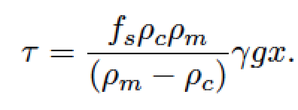
(Amontons’ law)
So, how big are the forces
that build mountains?

Slide 21
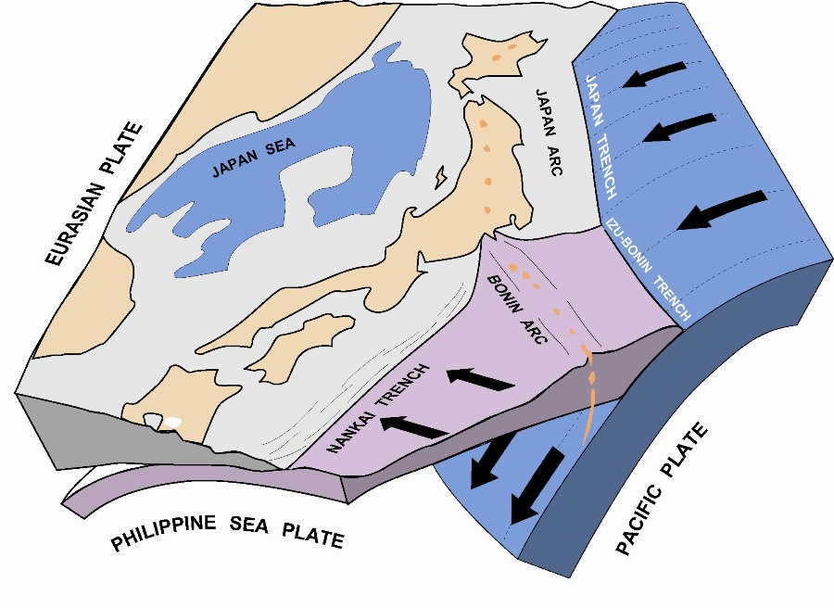
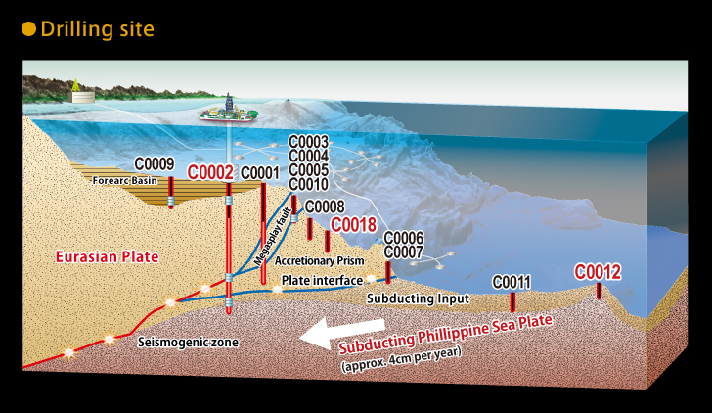
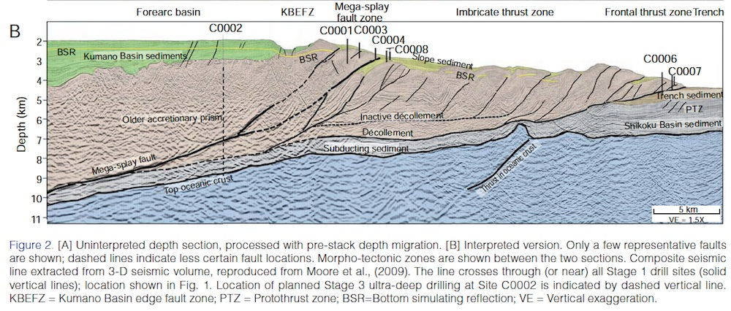
Example of accretionary wedge: offshore Japan

Slide 22
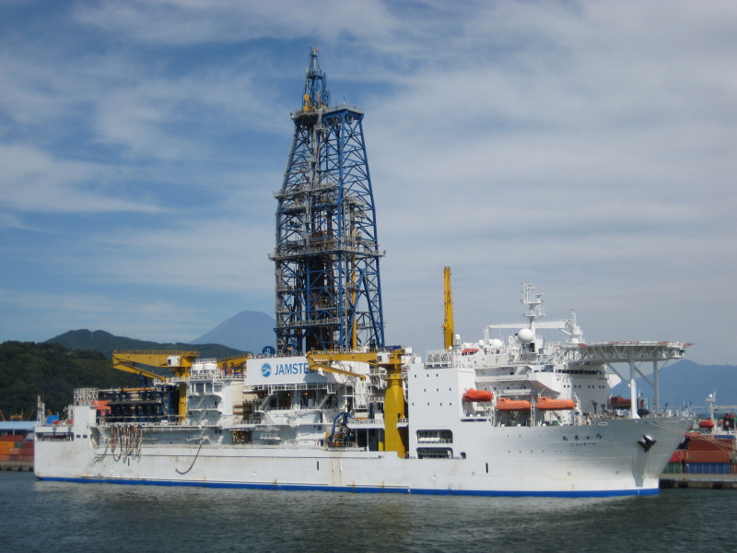
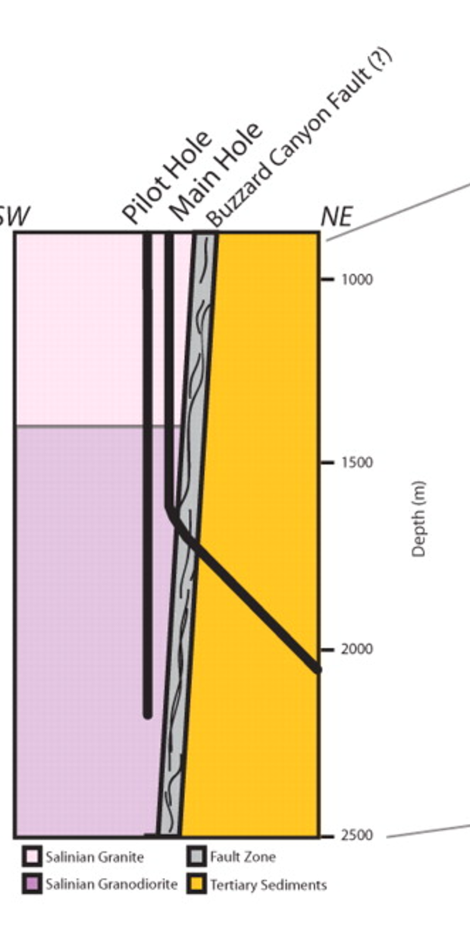
Measuring f_{s} at earthquake-generating depths on active fault zones is expensive
RV Chikyu (~$1 bn) – Japan subduction zone:
San Andreas
Fault Observatory
at Depth:

Slide 23
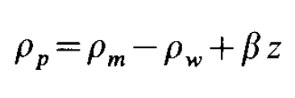
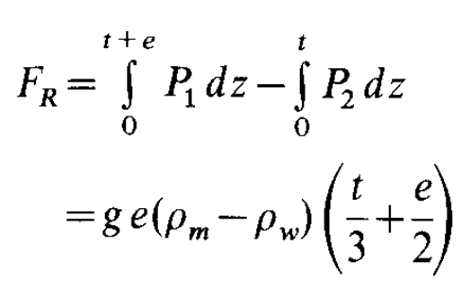
One example of a plate tectonic driving force: ridge push
Richter & McKenzie, J. Geophys, 1978
TRENCH
RIDGE
e
P₁(z)
After conductive profile has been established:
(“effective density”)
t
z
P₂(z)
isostasy
Assumes: hydrostatic pore pressure
ridge push
plate slide

Slide 24
Mountains and tectonics
STRESS AND TECTONICS ON ONE-PLATE PLANETS
THRUST WEDGE: MOUNTAIN BUILDING ON EARTH
CRUSTAL FLOW: MOUNTAIN COLLAPSE

Slide 25
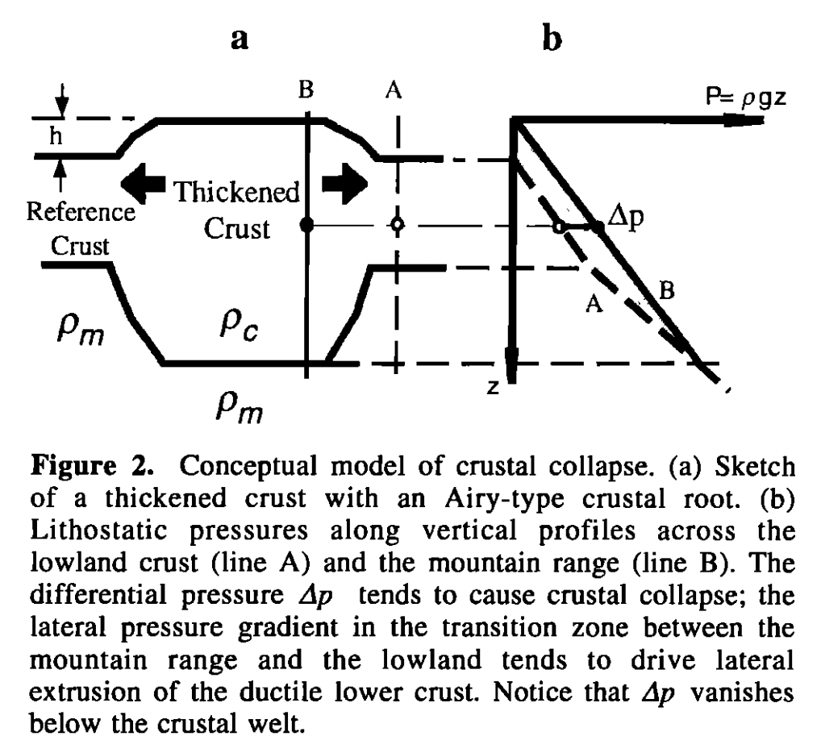
Isostasy is not an equilibrium state
Liu & Shen, Tectonics, 1998

Slide 26
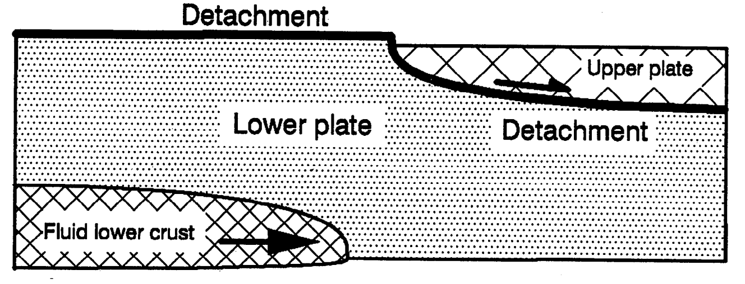
Crustal flow
McKenzie et al. JGR 2000

Slide 27
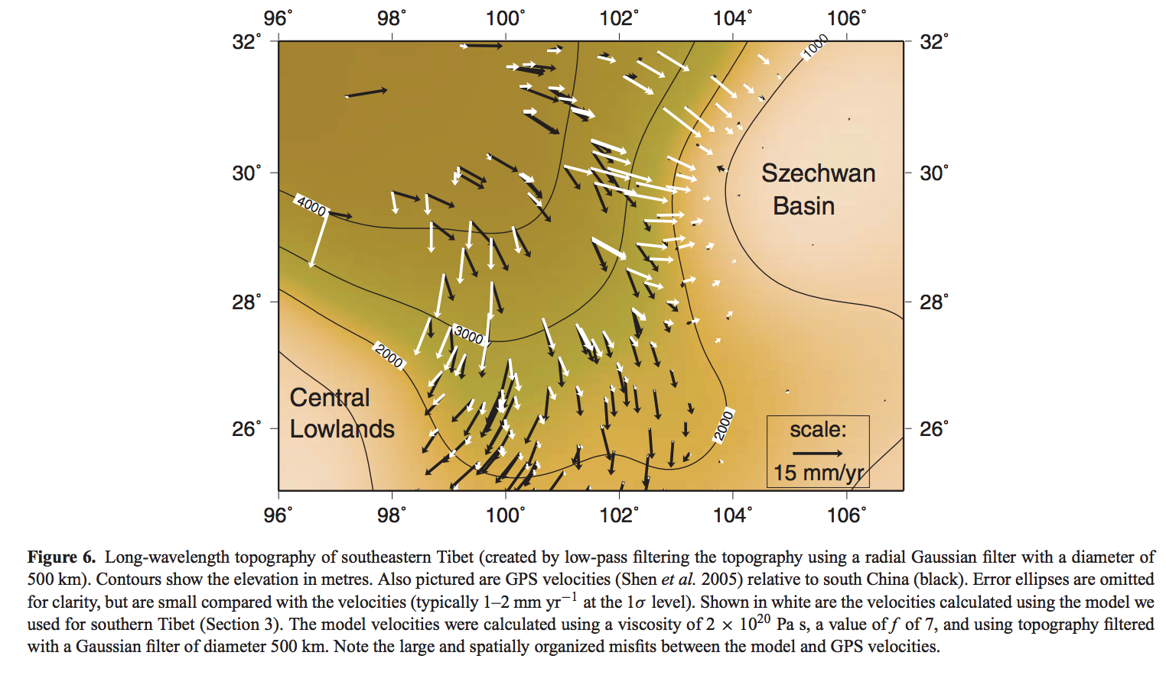
Gravitational collapse of mountain belts
Copley & McKenzie, Geophys. J. Int. 2007

Slide 28
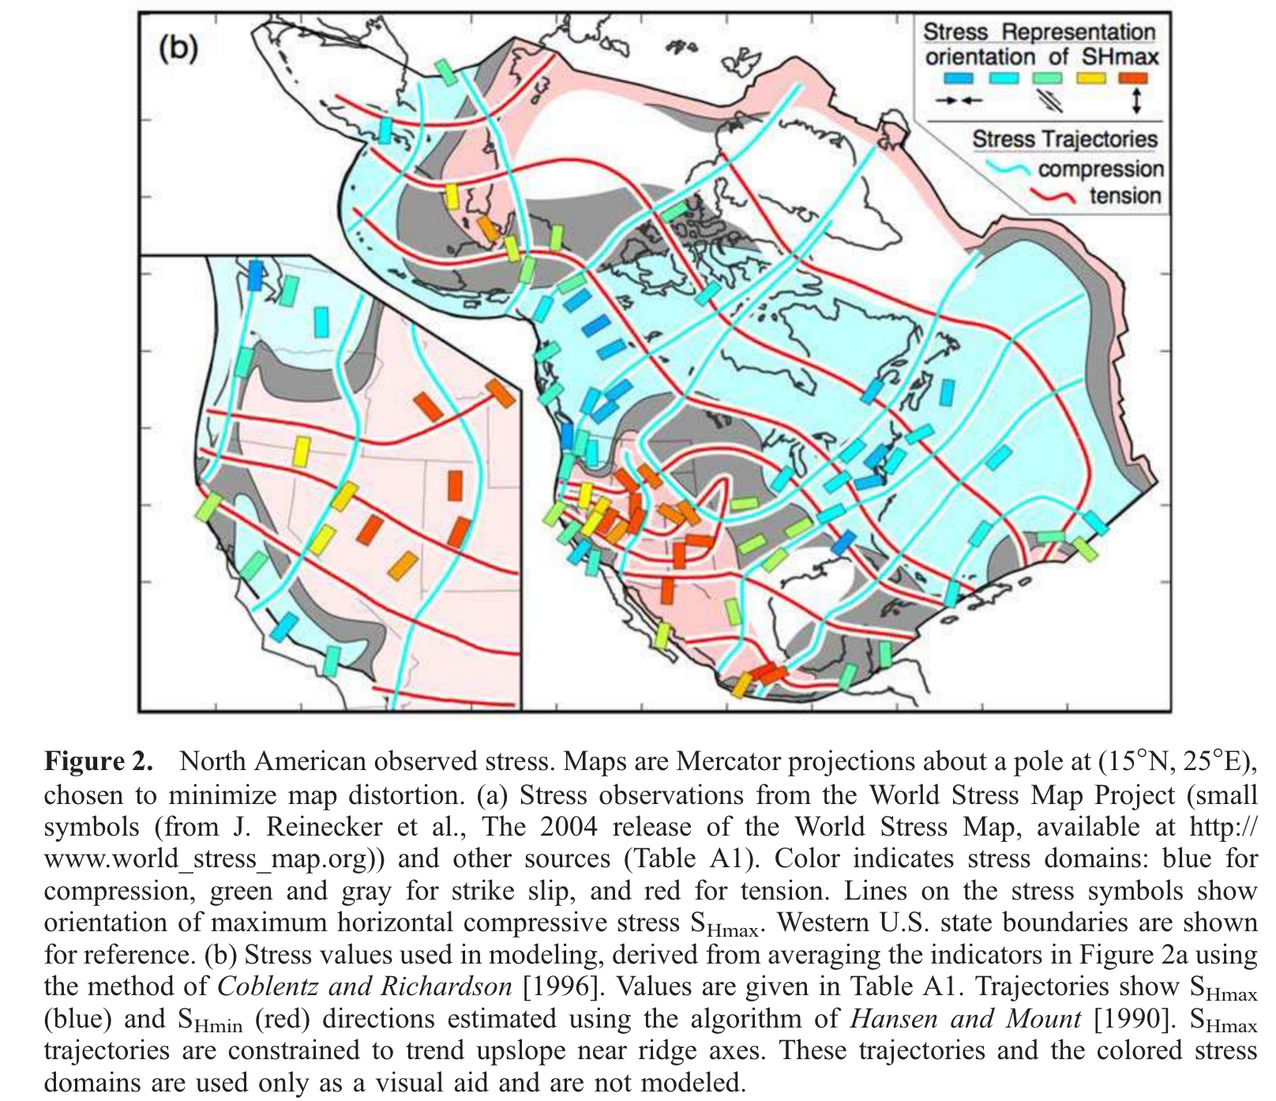
The Basin & Range was once the ‘Nevadoplano’
Humphreys & Koblentz, Rev. Geophys. 2007

Slide 29
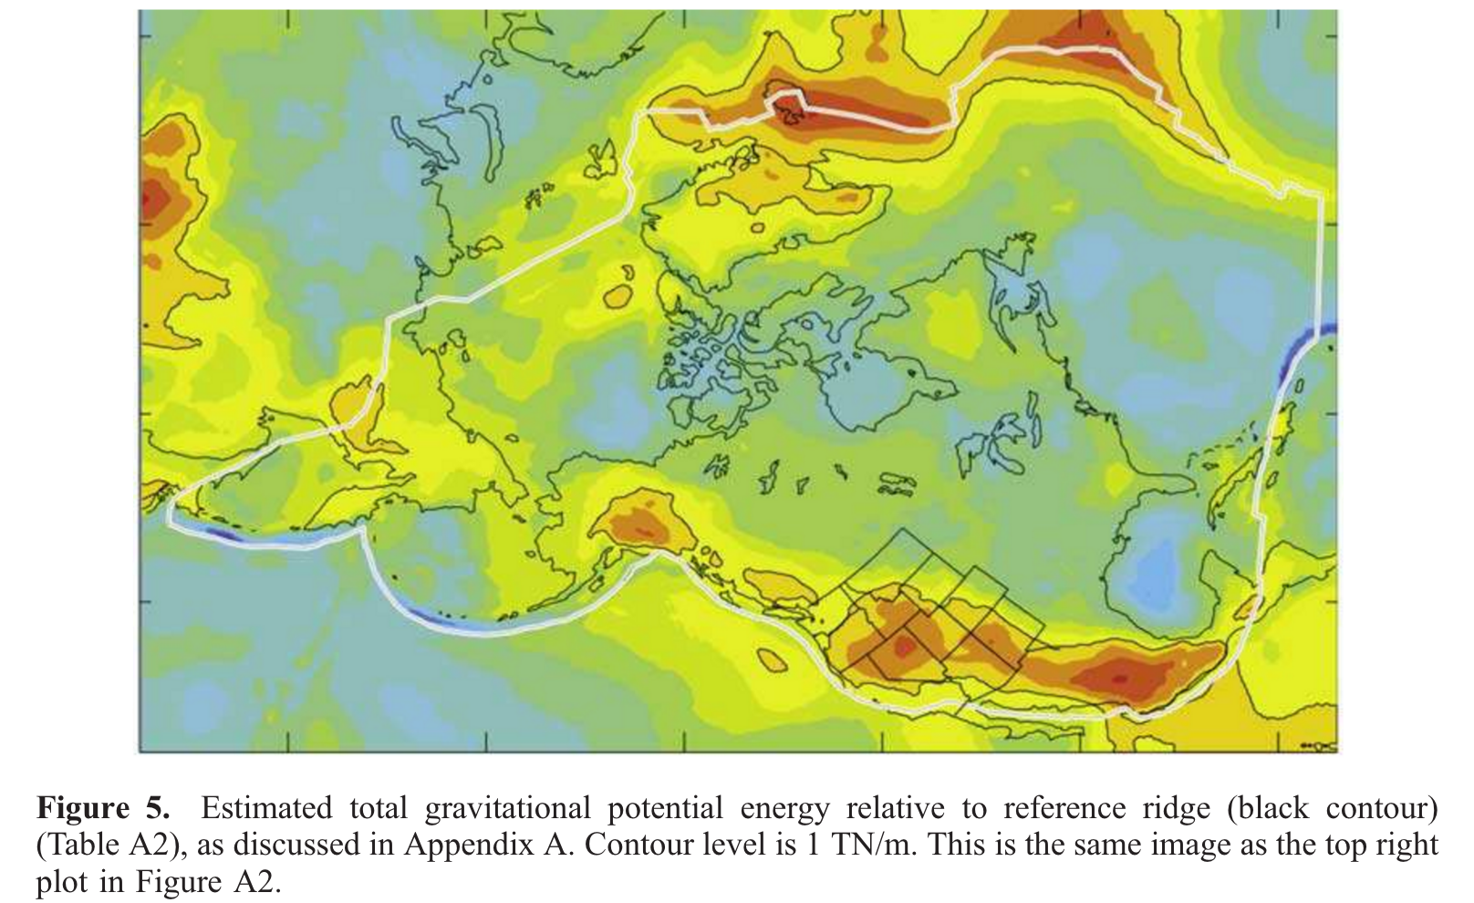
Humphreys & Koblentz, Rev. Geophys. 2007

Slide 30
(if time allows – more examples of yield strength envelopes)

Slide 31
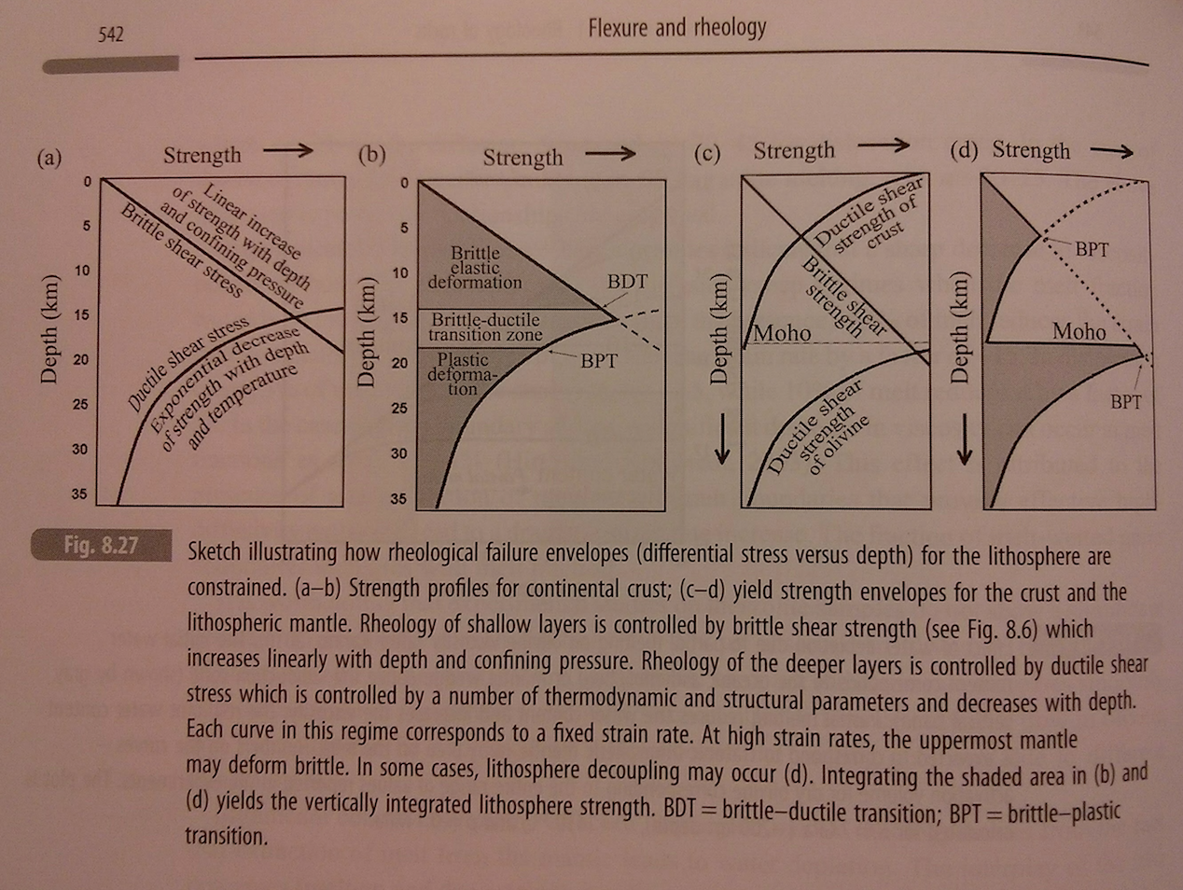
“Jelly sandwich” rheology model
from Artemieva, “The Lithosphere”

Slide 32
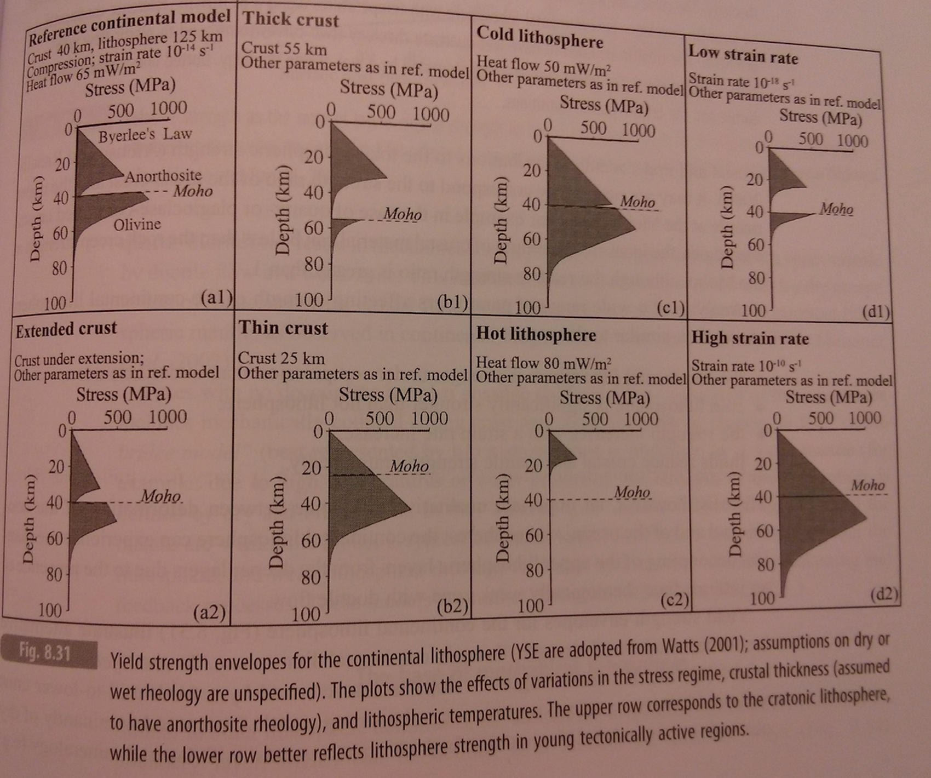
from Artemieva, “The Lithosphere”

Slide 33
Key points: mountains and tectonics
Know and explain the patterns of stress produced by planetary contraction, despinning, and polar wander
Be able to quantify the forces driving thrust wedges, and at least one plate-tectonic driving force
Explain crustal flow.

Slide 34
Additional slides

