Slide 1
GEOS 24705 / ENST 24705 / ENSC 21100
Lecture 17
Transportation & engines

Slide 2
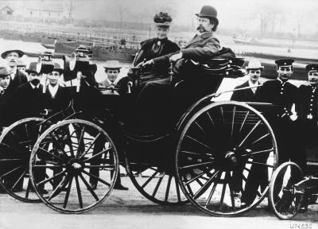
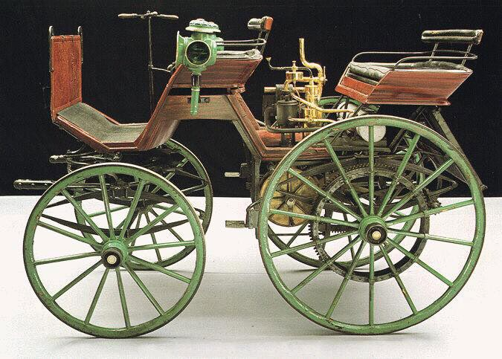
Cars: explosion of development after 1885 proof of concept
1891: Benz forms Benz & Cie co.
1899: 430 workers, 572 cars sold
world’s largest auto company, but production is not fast
1885: Daimler & Maybach develop advanced 4-stroke engine, attach it to motorcycle
1886-1889: Daimler & Maybach makes 4-wheeled automobile
4-cylinder engine, 10 mph top spd, first sale in 1892
Benz & Cie Vikoria automobile, 1894 (Karl and Bertha onboard, image: Wikipedia)
Daimler-Maybach automobile, 1886 (VintageWeb)
Merger to Daimler-Benz 1926

Slide 3
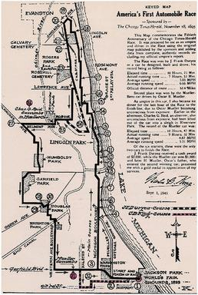
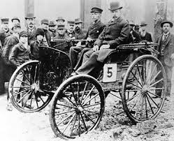
10 years later: demonstrations in the U.S.
1893: First auto manufacturing in U.S. (Duryea Wagon Motor Co., MA), flowering of many small companies
1895: Chicago Times-Herald sponsors first automobile race, Hyde Park to Evanston and back: 60+ entrants, 11 start (6 at start line), 2 finishers
“A Prize for Motors,” with a $5,000 purse for “inventors who can construct practicable, self propelling road carriages.”
Duryea car beats imported Benz
10:23 to finish
(5 mph)
2 electric cars did not finish

Slide 4
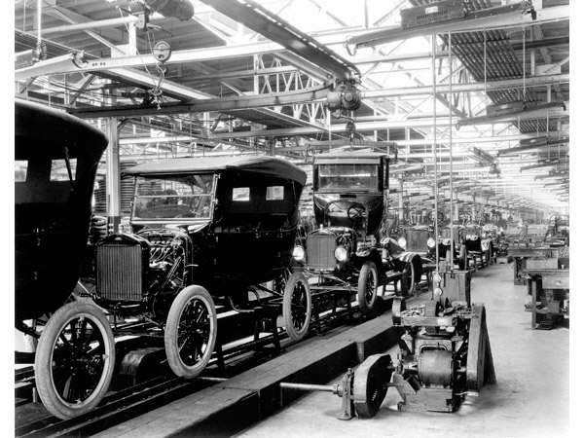
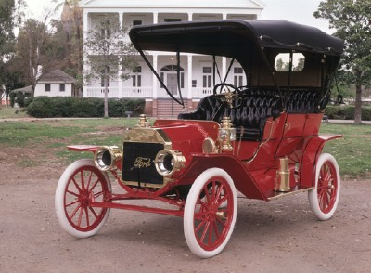
20 years later: Production improvements in U.S.
1896: Henry Ford starts company, Detroit
1908: Mass production of Ford Model Ts
first affordable automobile for the middle class
15,000 orders placed within days, > 15 M total sold
Ford Model T assembly line, 1924.
Ford Model T, 1908. (repainted, howstuffworks.com)

Slide 5
Two-stroke engine
Simple, cheap
First stroke:
Piston rises, compresses fuel/air mix
Meanwhile, unburnt fuel is drawn into crankcase
Second stroke:
Fuel/air is ignited
Piston driven down
Exhaust gas leaves cylinder
Fuel/air mixture enters cylinder

Slide 6
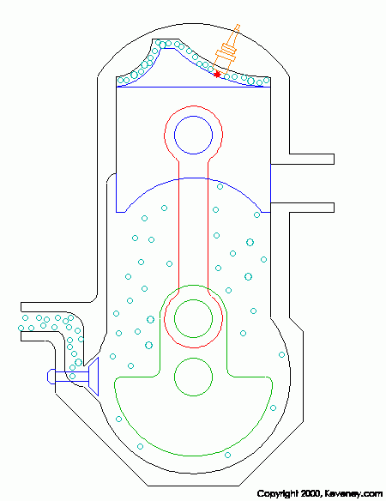
Two-stroke engine
Simple, cheap
Advantages:
Higher power-to-mass since is never “off” – each stroke is power stroke. Smoother power in one-cylinder engine
Therefore: engine of choice for cheap or hand-carried applications
Disadvantages:
Some unburned fuel escapes
– very polluting
Since fuel fills crankcase, lubricating oil must be mixed into fuel mixture – even more polluting

Slide 7
Two-stroke engine
Simple, cheap
Advantages:
Higher power-to-mass since is never “off” – each stroke is power stroke. Smoother power in one-cylinder engine
Therefore: engine of choice for cheap or hand-carried applications
Disadvantages:
Some unburned fuel escapes
– very polluting
Since fuel fills crankcase, lubricating oil must be mixed into fuel mixture – even more polluting

Slide 8
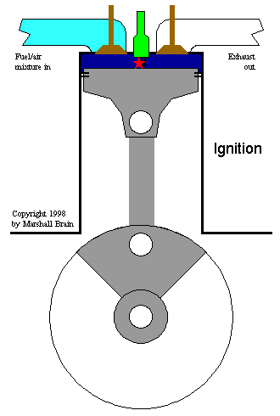
Four-stroke engine: Otto cycle
driver of most transportation
One preparation cycle and one power cycle (down/up/down/up)
Intake
Compression
Combustion
Expansion (Exhaust)
Note use of spark plug to set off combustion (same for 2-stroke)

Slide 9
Thermodynamic cycles: Otto cycle (Rochas 1862, Otto 1876)
Fast combustion at constant volume. Sparkplug to ignite quickly and completely.
ideal Otto efficiency = 1 – (1/r)^{γ-1} where r = compression ratio V₁/V₂
(γ = specific heat ratio, property of the gas, ~ 1.4 for air)

Slide 10
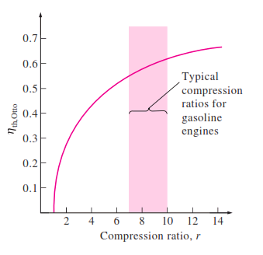
Thermodynamic cycles: Otto cycle (Rochas 1862, Otto 1876)
Fast combustion at constant volume. Sparkplug to ignite quickly and completely.
Efficiency is a function of compression ratio, so design for high ratios: r ~ 7-10 in cars
Ideal Otto efficiency (actual is ~ ½ as large)
ideal Otto efficiency = 1 – (1/r)^{γ-1} where r = compression ratio V₁/V₂
(γ = specific heat ratio, property of the gas, ~ 1.4 for air)

Slide 11
Four-stroke engine: Otto cycle
driver of most transportation
Advantages:
Produces heated, compressed, very dense fuel/air mixture
Separation of unburnt fuel/air from combustion cycle
Disadvantages:
“off” half the time – half the power-to-mass ratio that it might have
Generally have at least two cylinders, so that when one is “off” the other can provide the push to keep rotating the shaft

Slide 12
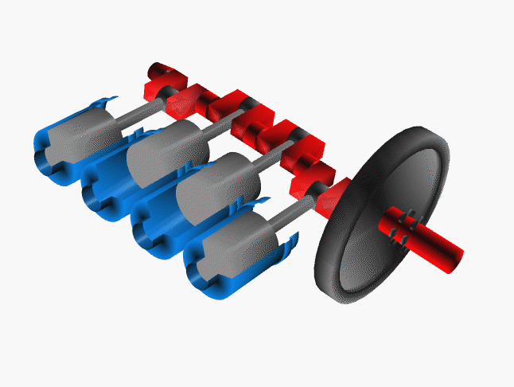
Four-stroke engines: generally have pairs of cylinders
Gasoline engines for automobiles typically have 4-8 cylinders
Out-of-phase cylinders provide force to drive pistons through compression phase and yield balanced power
Note central crankshaft turns linear piston motion into rotational motion and puts work into the same shaft
Notes:
Question: typical number of cylinders in car? A: 4, 6 at times, 8 for highest power

Slide 13
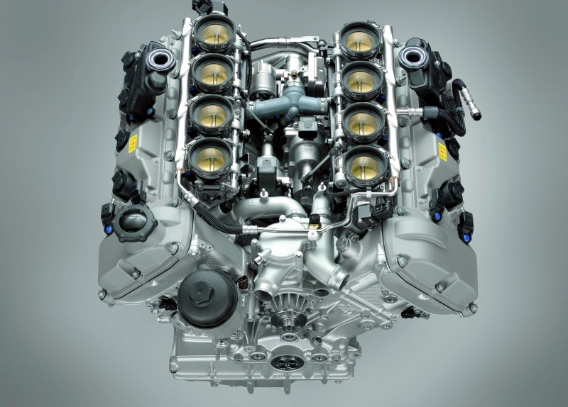
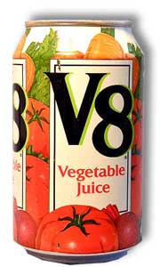
More power = more cylinder volume
get more volume from bigger cylinders, or more cylinders
Some high-power automobile engines have 8 cylinders, hence “V8”
BMW M3 V8 Engine: 4.0-litres total, i.e. 4000 cc in 8 cylinders
(lab lawnmower engine ~ 100 cc (1 cylinder)
Notes:
Get students to remember that as in Newcomen engine, power is proportional to cylinder volume. Remind students that engines are described in terms of total volume across all cylinders.

Slide 14
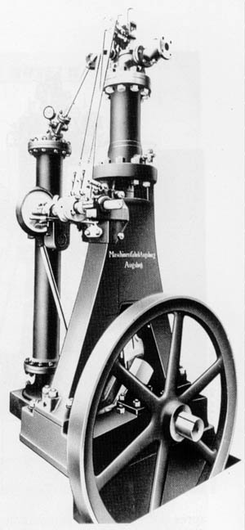
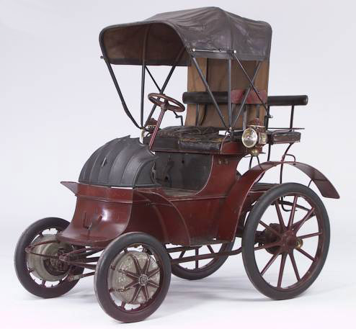
Engine history: non-Otto-cycle engines
2 other famous German-speaking auto inventors: who were they?
Both exhibited at the 1900 Paris Exposition
One (former electric shop worker) won the speed competition with an all-electric car carrying a 900-pound battery with a 38 mile range & top speed of 36 mph.
The other (former steam engine designer) won the Grand Prix of the whole Exposition for a new bio-fueled engine running on peanut oil, operating on a new thermodynamic cycle he’d invented from 1st principles
Lohner-Porsche Elektromobil, designer: Ferdinand Porsche, Austrian, age 24. Note electric motors in front wheels.
Diesel engine, invented 1893, 17% efficient. Designer:
Rudolf Diesel, German-trained

Slide 15
Thermodynamic cycles: Otto cycle (Rochas 1862, Otto 1876)
Do you need to combust at constant volume? Wastes power (area on graph)

Slide 16
Thermodynamic cycles: Diesel cycle (Diesel 1893)
Do you need to combust at constant volume? Wastes power (area on graph)
You would get more power if you continued compressing gas before igniting...
3
Diesel cycle involves
higher pressure
lower final volume
→ higher compression ratio
r ~ 14 – 22 or more
ideal Diesel efficiency = 1 – [(1/r)^{γ-} * (α^{γ} -1)/(γ(α -1))]
where α is the “cutoff ratio” V₄/V₃. Lower than Otto for a given r, but r is bigger for Diesel.

Slide 17
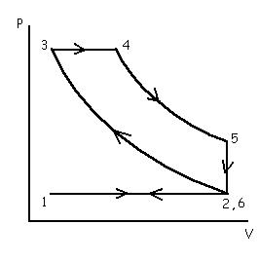
Thermodynamic cycles: Diesel cycle
Cycle designed for higher efficiencies.
Diesel cycle achievable only if system can withstand higher pressures before igniting.
First compress air, THEN spray fuel in to control ignition.
Use specially designed “Diesel fuel” that can reach higher pressures before ignition (originally used peanut oil)
Diesel fuel is less volatile than gasoline, ignites on compression... but only at very high P
ideal Diesel efficiency = 1 – [(1/r)^{γ-} * (α^{γ} -1)/(γ(α -1))]
where α is the “cutoff ratio” V₄/V₃. Lower than Otto for a given r, but r is bigger for Diesel.
Notes:
ask students – ignites on compression means what? no spark plugs

Slide 18
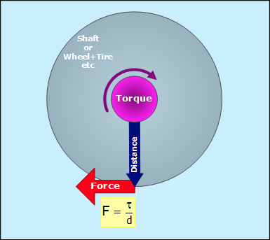
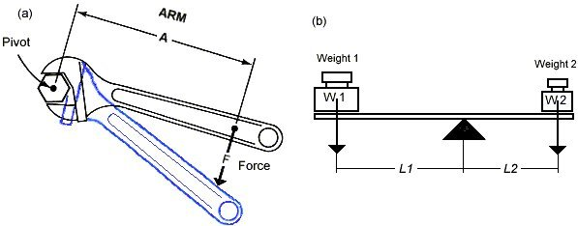
Torque = “turning force”
Your ability to turn something depends not just on the force you apply but on the lever arm you have
Torque = force x distance units of energy
Power = energy/time
= torque x rotation rate (P = τ x ω)

Slide 19
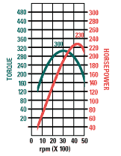
NO internal combustion engines runs well at slow speeds
Fundamental problem with ICEs:
Low torque at low rpm. How do you start the car from a standstill? How do you accelerate?
Note that ICEs do nothing well at low speed: not torque, not power, not efficiency (not shown here)
Otto engine, Dodge Ram pickup V8 5.9 L engine, 2004
Notes:
Do the calculation here of wheel speed – diameter of wheel is maybe 2 feet, ~ 0.5 meters. each revolution car moves pi*D ~ 1.5 m. Car moves at say 40 mph = 60 km/hr
= 6*10^4 m/(60 min) = 1000 m/min divide by 1.5 m/rev -> 600 rpm. But engine wants to be at 3000 rpm. (Point to 600 rpm on the map)

Slide 20
but, Diesel engine has more torque at low speed than Otto
Otto engine, Dodge Ram pickup V8 5.9 L engine, 2004
peak torque at 3000 rpm
Diesel engine, Dodge Ram pickup 5.9 L, standard output, 2004
peak torque at 1400-2400 rpm
Notes:
point out difference in scales on graphs. point out that both engines have similar peak power, that power at low speed 1000 rpm is similar (50-60 hp), but diesel engine has much more torque: 375 lb-foot (terrible English units) vs. 150 lb-foot

Slide 21
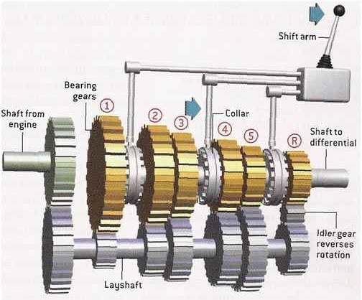
ICEs must run at high speed, else can’t make enough torque
Fundamental mismatch between engine and wheel speed
Kludge = transmission – a gearing system to allow an ICE to operate at high speed even while vehicle moves slowly
P = τ ∗ ω. If want power P, and τ is constrained, must have high ω
Manual transmission schematic, hyperlogos.org

Slide 22
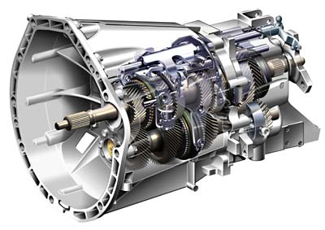
ICEs must run at high speed, else can’t make enough torque
Fundamental mismatch between engine and wheel speed
Kludge = transmission – a gearing system to allow an ICE to operate at high speed even while vehicle moves slowly
P = τ ∗ ω. If want power P, and τ is constrained, must have high ω
Mercedes-Benz C-class coupe 6-speed manual transmission

Slide 23
Diesel: advantages
Higher compression ratios = higher temperatures = higher efficiency (in practice 40%, up to 55% in some demonstrated engines)
→ Fuel efficiency greater than with gasoline hybrids
Reliability: no sparkplugs – ignition occurs from compressional heating alone
More torque at low speeds - very useful for pushing big loads at slow speed.
Lubrication: fuel is better lubricant than gasoline, so piston rings and cylinder bores last longer
Notes:
say, will discuss torque in just a minute

Slide 24
Diesel: disadvantages
Weight – heavier engine construction to deal with higher pressures
Poor torque at high speeds – bad acceleration when at cruising speed
Inherently polluting - incomplete combustion gives sooty particulates
Why? Fuel not pre-mixed outside cylinder but injected just before combustion, after compression.
Notes:
remind students that steam engines steam turbines had same issues – heavier than ICEs because higher pressures.

Slide 25
Overall: drawbacks of the ICE
Engine speed mismatched to wheel speed
→ requires transmission
Single power system
→ requires drivetrain
Single power system but wheels must rotate at different rates (when going around curves)
→ requires ‘differential’

Slide 26
Which engine to choose?
(besides side-effects of pollution, noise, etc, as well as cost/durability/reliability)
Power/mass: heavier engines harder to move or carry.
Efficiency: how much mechanical work you get out of a given amount of energy.
Torque: “turning force”. Affects how fast you can accelerate, or how big a load you can get moving.
Notes:
We discussed 2 vs 4 stroke already, now discuss other features of engine. Say will talk about 2 and 3 now.

Slide 27
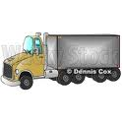
What is each engine type best for?
Gasoline: poor torque at low speed, good torque (acceleration) when at cruising spd., light weight
Diesel: higher torque at low speed, less torque at cruise, heavy weight but high power
Electric: max torque at low speed, very little torque once at cruise, heaviest choice: requires generator (or heavy battery)

Slide 28
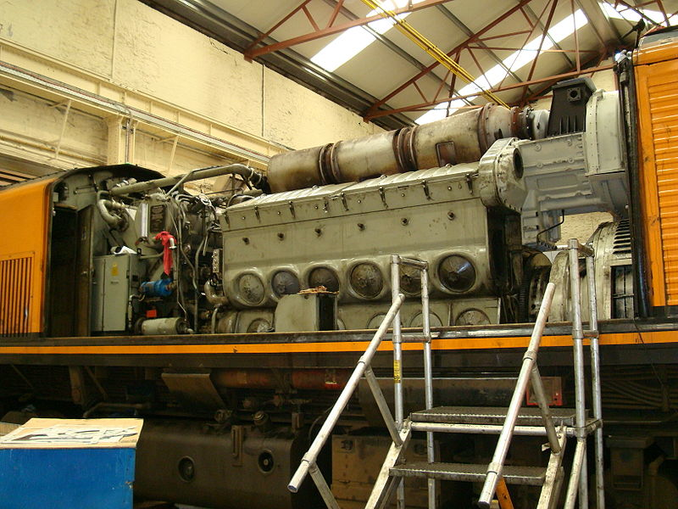
All diesel-electric trains are series hybrids
Hybrid technology: engine (2-stroke diesel for maximum power) drives generator; electricity carried to each wheel to drive separate electric motors. No need for battery in between.
Right: EMD 12-710G3B engine, 3200 hp (2.5 MW)
12 cylinders, each with 11.6 liter displacement, twice that of the biggest gasoline engines. 16:1 compression ratio.
The generator is 6 feet in diameter, weighs ~18,000 pounds, turns at 900 rpm (very slowly).
Figure: Wikipedia

Slide 29
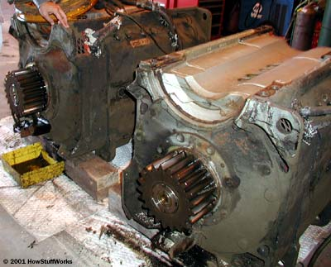
Locomotives: all diesel-electric trains are series hybrids
Individual motors weigh 6000 pounds and draw over 1000 amps.
Electric motors providing braking (avoid friction brakes). Electric motors act as generators and torque slows train.
Electrical energy from braking not necessarily recovered – often dissipated in resistors on top of train.
Batteries to store electrical energy are expensive and trains don’t brake often.
Figure: howstuffworks.com
Electric motors driving wheels have single fixed gear

Slide 30
Early automotive history: non-Otto cycle engines
Notes:
say – we did 2-stroke engines in last lecture, now let’s look through the 4-stroke again

Slide 31
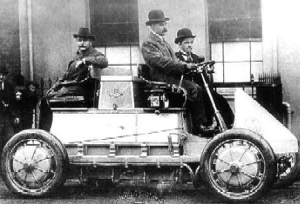
Hybrid gasoline-electric vehicles are not new
First hybrid 1901: to extend range, gasoline engine added to charge battery
Lohner-Porsche, hybrid “Mixte”, top speed 35 mph. In-wheel motors on all four wheels – first four-wheel drive vehicle. 83% efficient at conversion of electrical-mechanical energy.
Figure: jalopnik.com

Slide 32
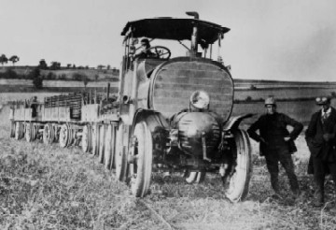
Also not new: linking together single engine, multiple motors
Hybrid technology in “land trains”: gasoline engine in lead car drives generator; electricity carried to each car to drive separate electric motors
Porsche “Landwehr”, post-1905 (while Porsche employed by Daimler), used by Emperor Joseph’s military to bring supplies to troops..
Figure: hybrid-vehicle.org

Slide 33
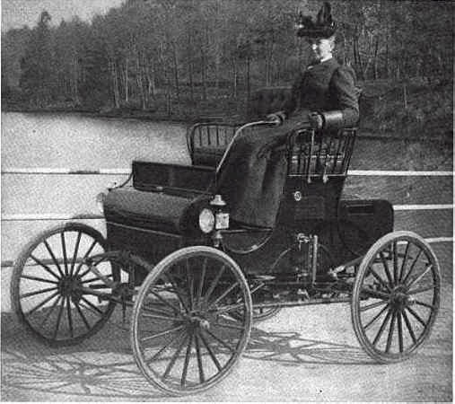
Transportation: steam also viable in personal vehicles
Design: Double-acting but closed system – water is condensed and re-used.
Advantages:
Max torque at zero speed = no need for transmission
Also no need to idle
And lower speed engine –
= less wear and tear
Fewer moving parts
Fuel supply often flexible.
Disadvantages:
Heavier
Slow to start
Figure: 1901 Kidder Steam Wagon. Kidder Motor Vehicle Co., CT (1900-1)

Slide 34
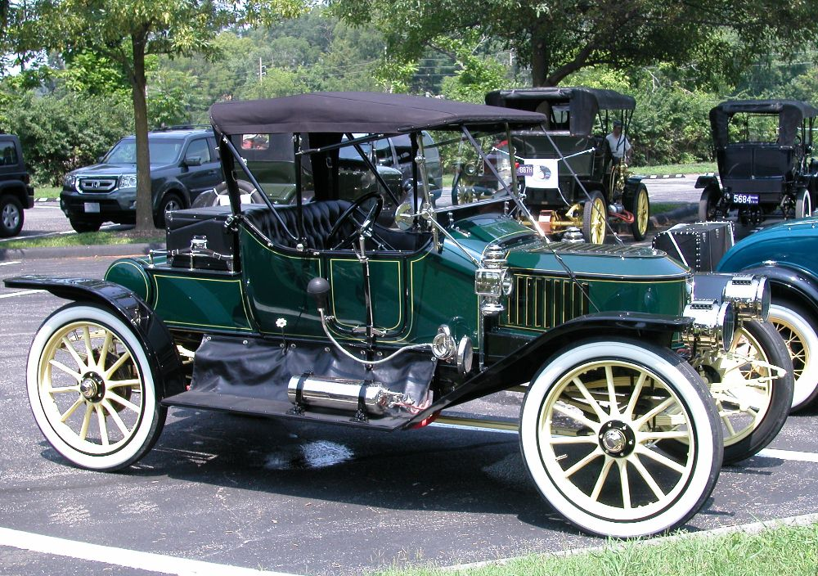
Transportation: steam cars persisted for ~30 years
Stanley Steamer: biggest selling U.S. car by 1899 (200 sold).
Burned gasoline or kerosene externally & made steam in vertical-tube boiler
Set world speed record in 1906 (128 mph). Production til 1927.
1911 Stanley Corp. Model 72 20 hp Roadster
(Photo: Ken Hand)

Slide 35
History of autos summary: we’ve seen it all before….
Innovation in engine fundamentals
Multiple competing technologies:
electric, gasoline, steam
Hybrid gasoline-electric vehicles
Multiple small car manufacturers with small production volumes
Innovation as response to fuel prices or standards

Slide 36
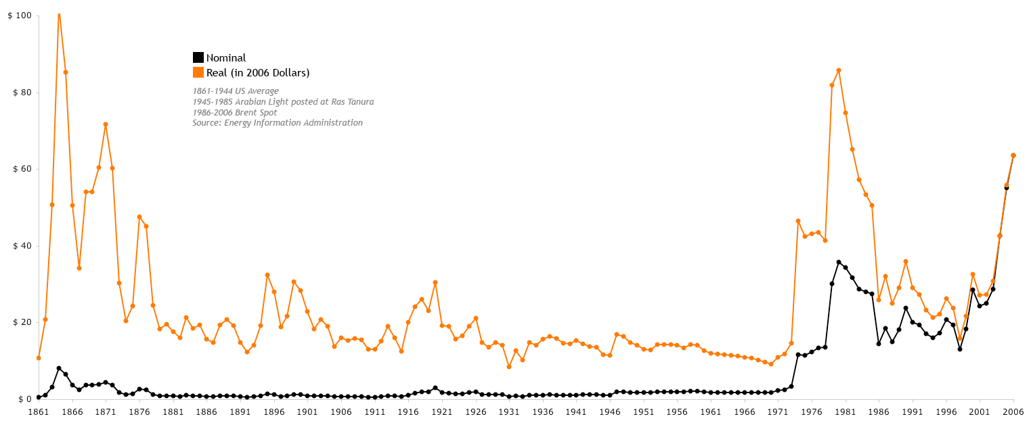
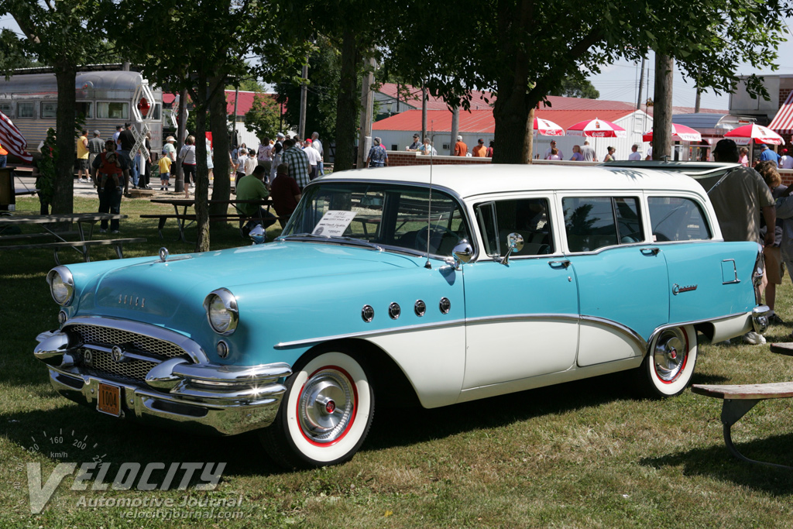
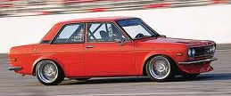
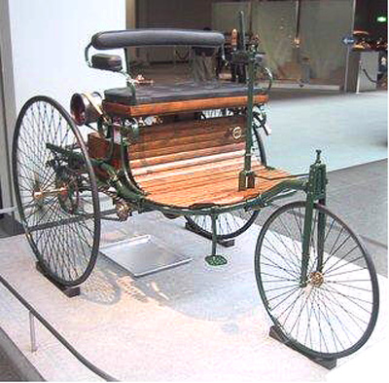
Why did the internal combustion engine win out?
In part, because fuel became cheap…
Big-car era: 1955 Buick Century wagon , < 10 mpg ?
the era of diversity
The “Big 3” era
1888: Bertha Benz’ drive
1908: Production of Model T Fords begins in Detroit
1973 oil shock
1973 Datsun 510

Slide 37
OPEC crisis drove interest in fuel economy
Notes:
say – we did 2-stroke engines in last lecture, now let’s look through the 4-stroke again

Slide 38
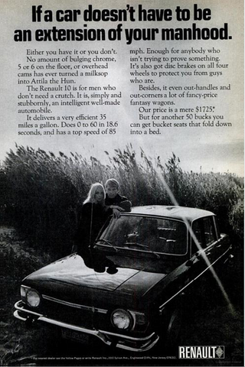
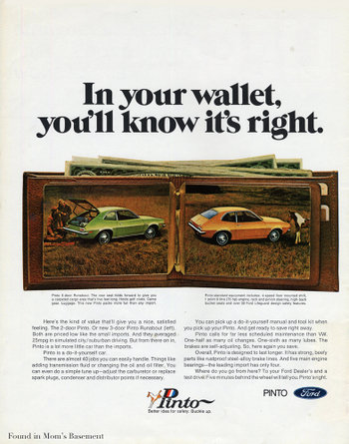
Pitching small cars to the American people
required new approaches….

Slide 39
What governs fuel usage?
Notes:
draw on blackboard to discuss relative sizes

Slide 40
What happens to the fuel burnt in a car engine?
ENGINE
Typically ~ 25% efficiency ) in Otto, 30% in Diesel
( that is, 25-30% fuel energy→ kinetic energy)
So ~ 75-70% loss to heat
What then happens to the kinetic energy?
Must dissipate somehow and eventually also become heat
DISSIPATION
Braking (kinetic energy must be replaced later on acceleration)
Frictional losses in gears, bearings
Rolling resistance
Air resistance (aerodynamic drag)
Roughly equal in size
Notes:
draw on blackboard to discuss relative sizes

Slide 41
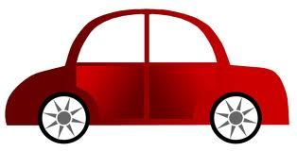
Fuel uses in transportation: air resistance
Energy used to push air in front of car – goes into kinetic energy of the air
v
v
Worst-case scenario: the car pushes all air it intersects up to its speed v. Power to do this is same as energy in flow of air at that speed:
P = ½ ρ A v³
where A is the cross-sectional area of the car.

Slide 42
Fuel uses in transportation: air resistance
Real life is not the worst-case scenario – car slips through air without having to accelerate it all to v
v
Solution: adjust formula by some fudge factor that describes how “streamlined” the car shape is:
P = C_{a} ½ ρ A v³
Sports cars want low C_{a} because of v³ depend. Typical C_{a}: Porsche 0.3, Hummer 0.6.

Slide 43
Fuel uses in transportation: rolling resistance or “rolling friction”
In real deformable tires, friction between tires and road causes force opposing motion of the car.
v
F_{rr}

Slide 44
Fuel uses in transportation: rolling resistance or “rolling friction”
In real deformable tires, friction between tires and road causes force opposing motion of the car.
v
F_{Norm} = m g
F_{rr}
= C_{rr} m g
Force of rolling friction is proportional to normal force that opposes car’s weight against ground.
(Stick in a constant C_{rr} , the “coefficient of rolling resistance”)
Power dissipated is energy/time = force x distance / time :
P = C_{rr} m g v

Slide 45
Rolling resistance
Value of C_{rr} depends on tire and surface properties – including deformability of tires
Approximate C_{rr} values
Steel wheels on steel rails .001
Car tires on concrete .01
Car tires on asphalt .03
Car tires in sand > .1
Steel rails are slick – low friction – so low rolling resistance, great for minimizing power losses in long-distance travel.
But problematic for starting up or stopping suddenly, when torque must be high. Need some friction to apply torque to the wheel, or just spins in place.
Trains needs some solution that combines efficient long-distance travel with ability to brake and start.

Slide 46
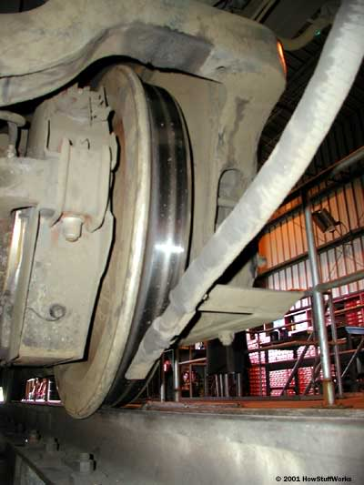
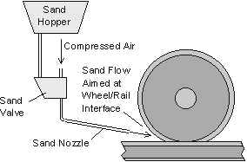
Sand provides as-needed increases in friction for train tracks
Sand is released through nozzle onto tracks when traction needed
Sanding system
Image: Univ. of Sheffield
Sand temporarily increases friction
(and so also C_{rr} )
Sanding nozzle
Image: HowStuffWorks

