Slide 1
Electricity & Electricity Generation
GEOS 24705/ ENST 24705

Slide 2
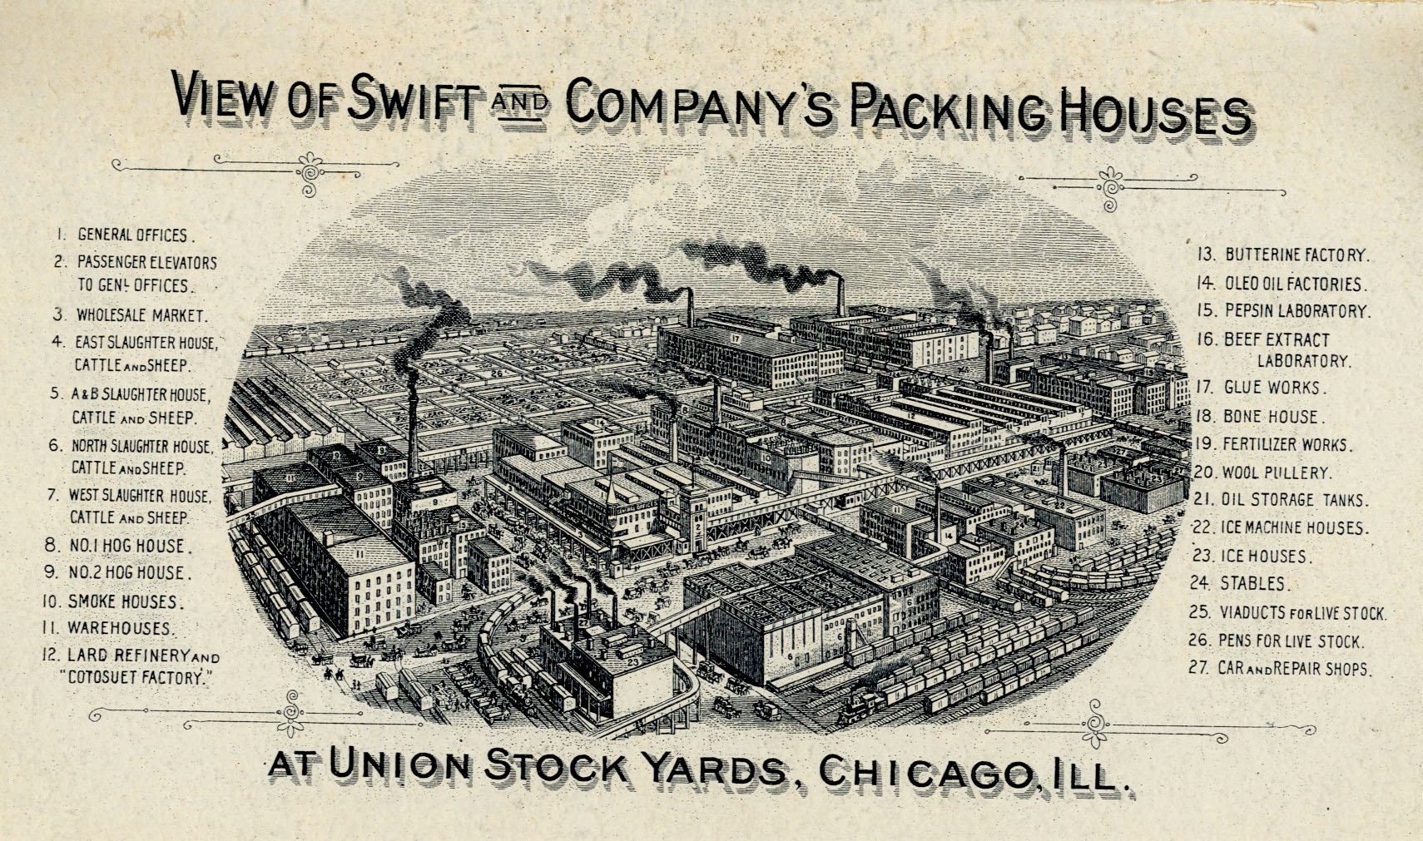
Refrigeration by ice made Chicago rich
Swift meatpacking (merged with Armour & Co. to become Swift and Armour)

Slide 3
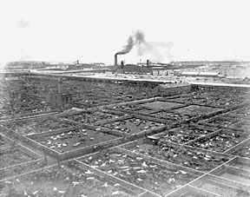
Refrigeration by ice made Chicago rich
Union Stockyards, founded 1864 (photo 1880)

Slide 4
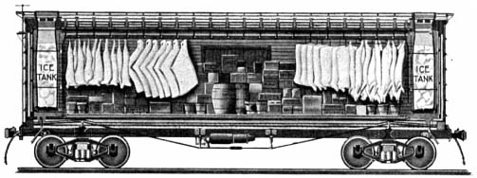
Refrigeration by ice made Chicago rich
ice-cooled refrigerator traincar, ca. 1870
meatpacking was fully vertically integrated from slaughterhouse to butcher shop

Slide 5
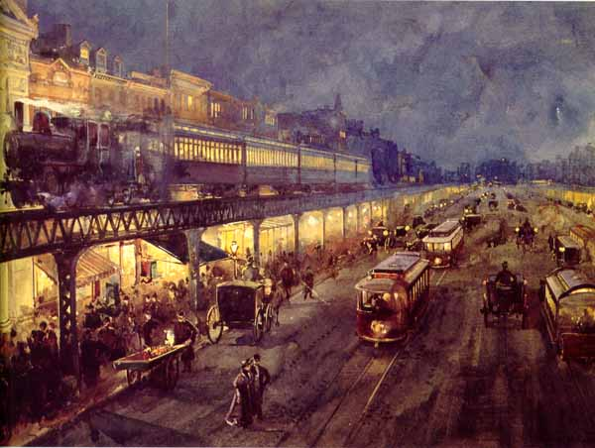
First commercial use of electricity is for lighting
Individual private grid systems operation on their own standards, DC or AC from 25-133 Hz
W.L. Sontag, 1895, "The Bowery at Night"

Slide 6
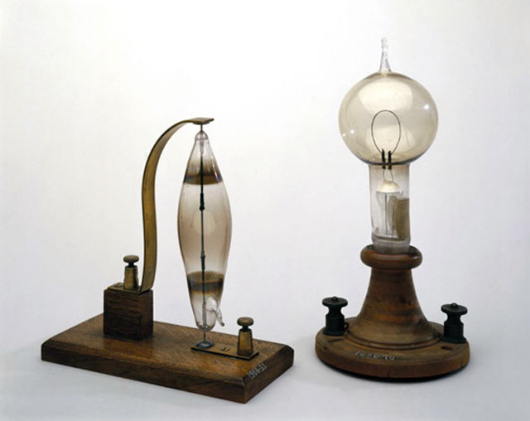
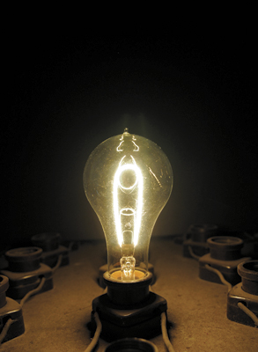
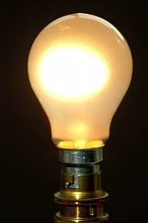
Incandescents improved by getting hotter, longer-lived
Replica of Eidson’s 1890 carbon filament bulb (J. & L. Casey)
Joseph Swan, 1860s
Thomas Edison, 1880s
Modern bulb

Slide 7
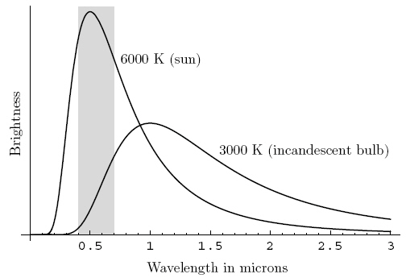
Lightbulb is just very hot space heater
not as hot as the sun though

Slide 8
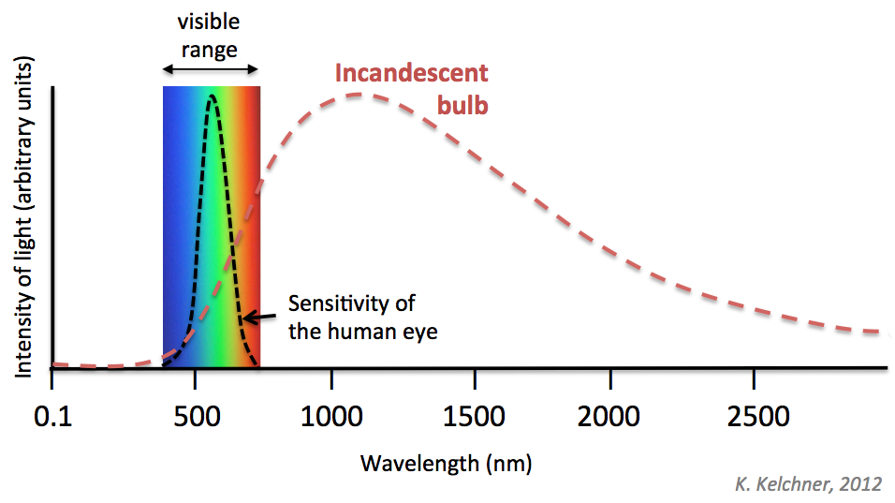
If lightbulb were hotter it would be more “efficient”

Slide 9
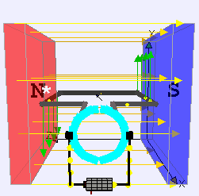
Force on a brushed DC motor
Magnetic field lines video

Slide 10
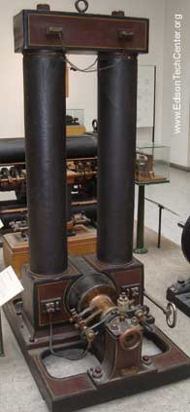
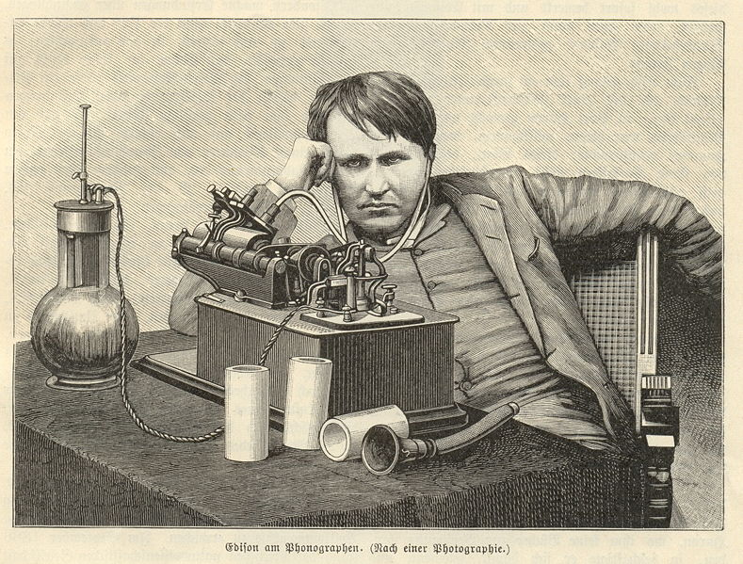
Direct current (DC)
Proponent: Edison
Advantages:
Understandable
Available motors
Charges batteries
Available meters
Disadvantages
Cannot transform voltage easily
Commercialization
London 1882
New York 1882
(both coal)
Also invented:
Lightbulb (commercial)
Phonograph
Improved telegraph
Early DC generator, “long-legged Mary Anne”, 1884

Slide 11
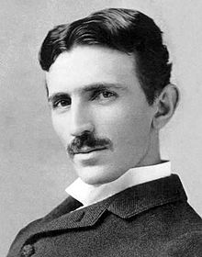
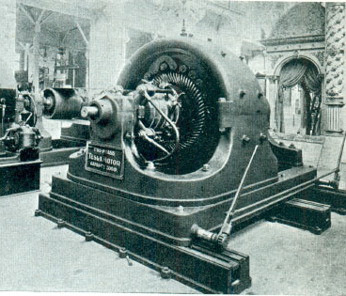
Alternating current (AC)
Proponent: Tesla
(former Edison engineer)
Advantages:
Transforms voltage easily
Disadvantages
No reliable motors available
No battery charge
Commercialization
Ames hydro: 1891
Chicago coal: 1893
Niagara hydro: 1895
AC dynamo, Chicago 1893
Also invented:
Induction AC motor
Radio communication
Wireless energy transmission

Slide 12
Edison vs. Tesla: “war of the currents”
DC
Edison’s company:
General Electric, founded 1890, now ranked (Forbes, 2009) the largest company in the world. Precursor: Edison Illuminating Co., 1880
Technical achievement:
First steam-powered electricity & electric utility, 1882, first U.S. transmission standard, multiple power plants (1.5 mi. transmission) (for lighting only)
PR stunt: invented (AC) electric chair, attempted execution, 1890
AC
Tesla’s company:
Westinghouse Electric Company, founded 1886, now (after purchase of CBS) knows as CBS Corp. (sold power generation to Siemens, itself provider of first electric street lighting in 1881). Hired first woman electrical engineer in 1890s.
Technical achievement: long-distance transmission of hydropower at Niagara Falls to factories in Buffalo New York, 1895 (25Hz)
PR stunt: lit Chicago World’s Fair, 1893

Slide 13
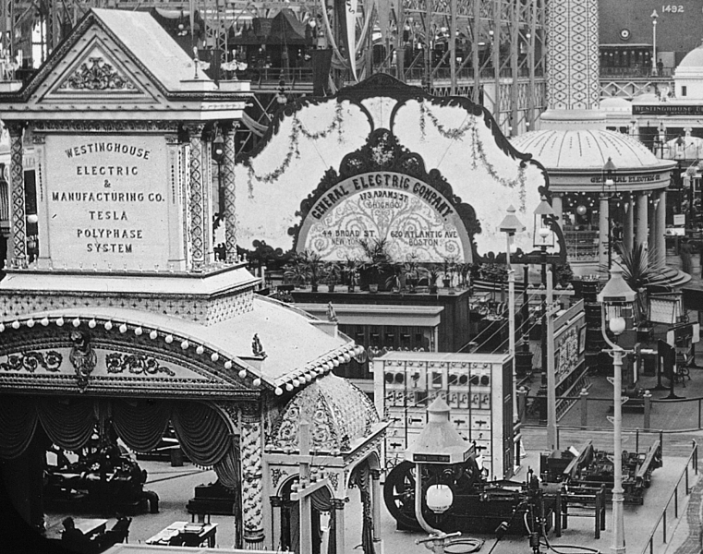
Edison vs. Tesla at 1893 Chicago World’s Fair
Tesla’s system already had most characteristics of the modern electricity system in 1893..
World’s Fair + choice at Niagara 2 years later committed us to AC
Comparatively little evolution after choice was made – standardization of frequencies.

