Slide 1
Turbines IV: Wind
Transportation & engines
GEOS 24705/ ENST 24705
Copyright E. Moyer 2015

Slide 2
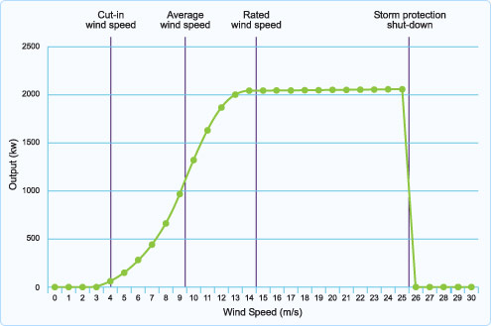
Actual windpower is less than rated power
(and rated power is itself less than power in wind)
Betz’ law: 59%, or ~ 50% in practice recoverable (this is rated power)
…. Then capacity factor ~ 30% (of rated power)
Total recoverable from wind kinetic power ~ 15%
(Image from Partnerships for Renewables)

Slide 3
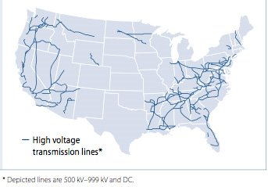
Electrical transmission is not where wind is
Source: Platts PowerMap

Slide 4
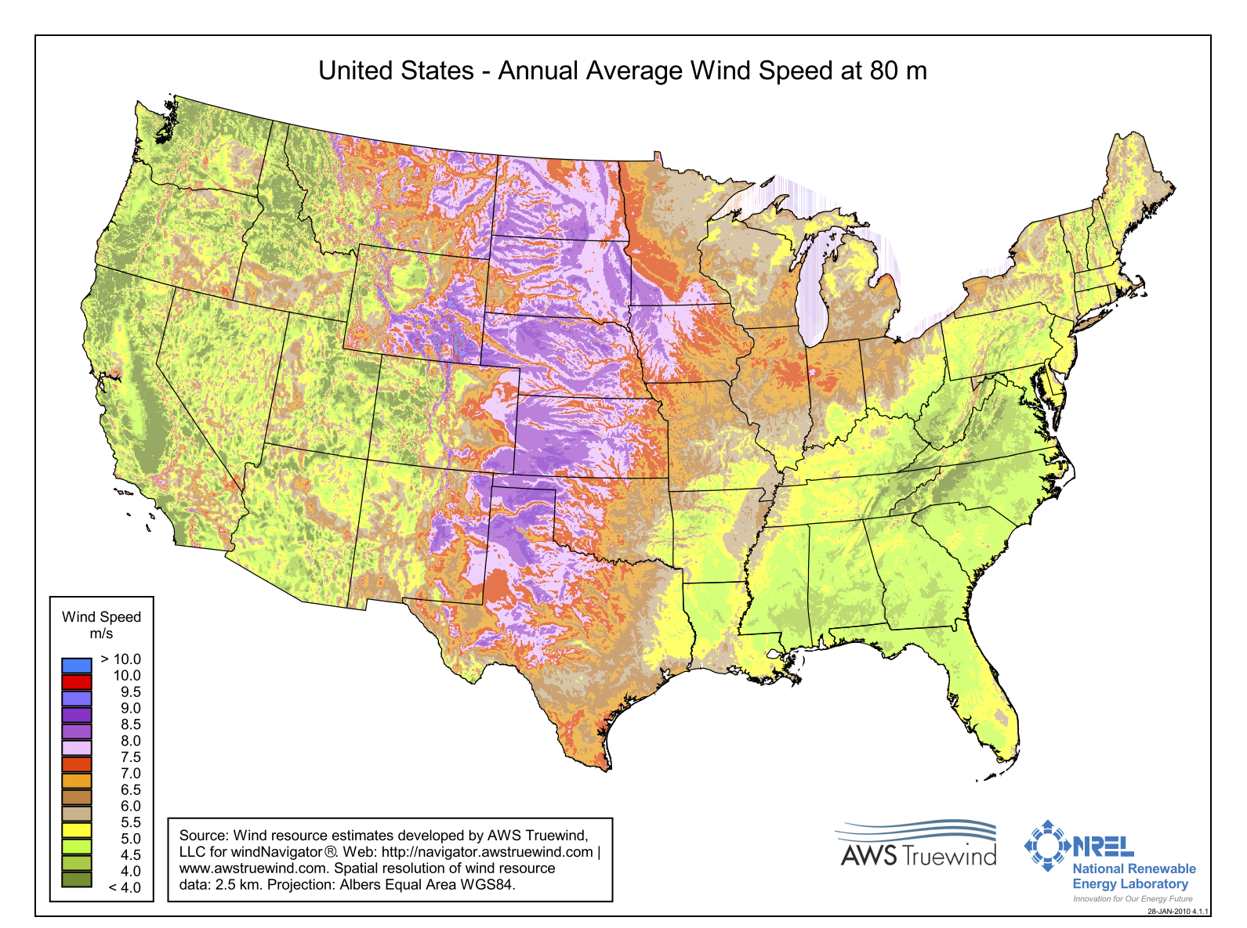
“Wind belt” runs through the middle of the U.S.

Slide 5
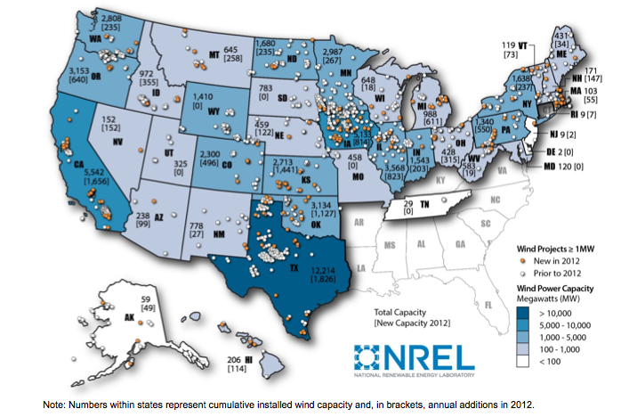
What’s driving wind power growth in U.S.?
Wind is biggest installation type, but not always in obvious locations
in 2009
Figure: NREL, from Wiser and Bolinger 2012

Slide 6
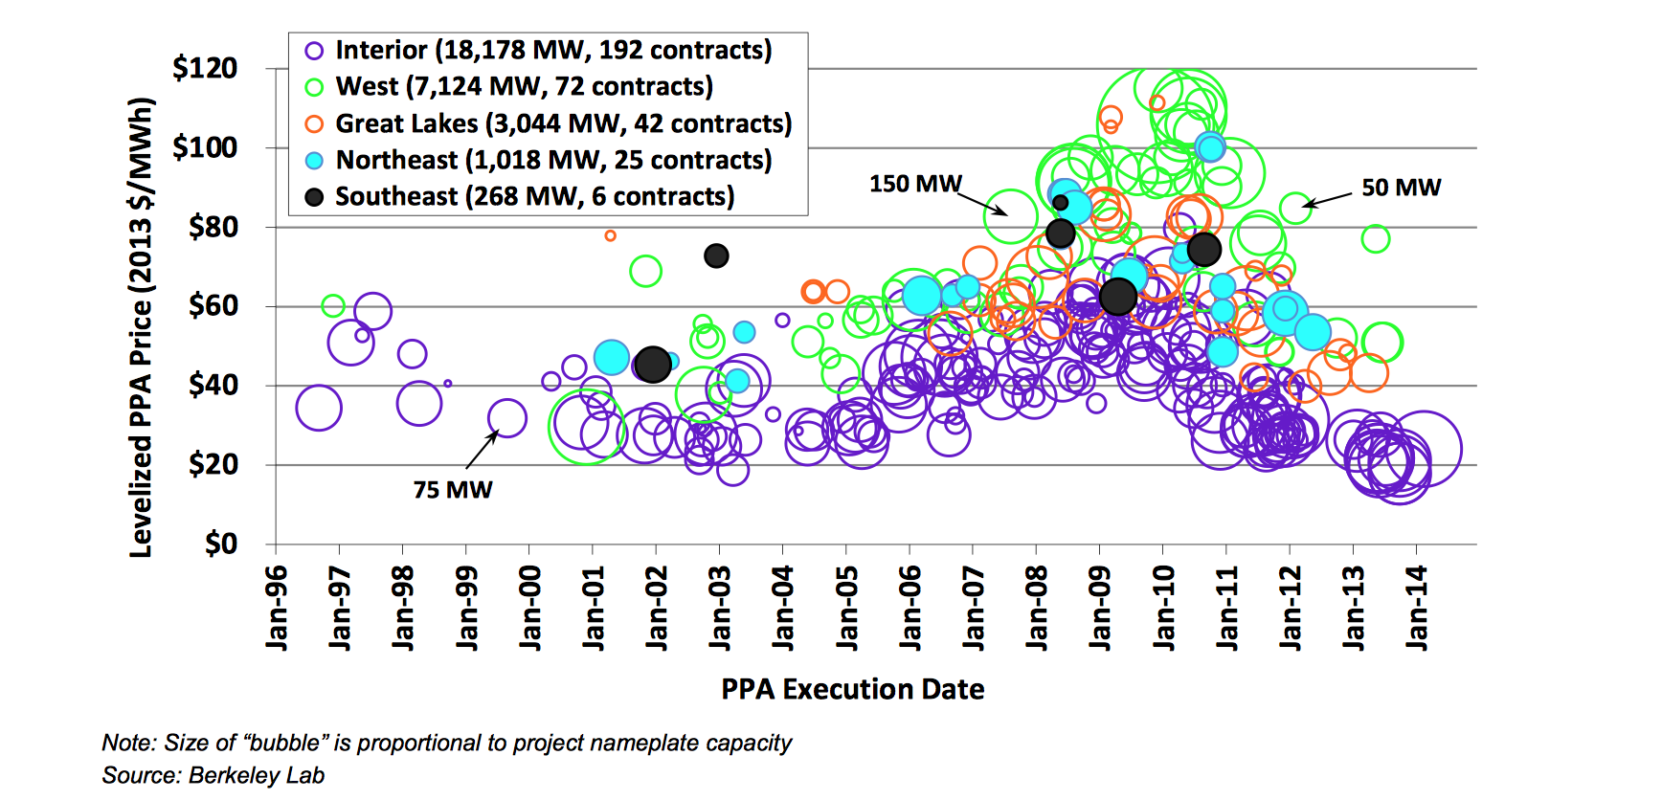
Wind power levelized costs differ by location
(Note: these costs include effect of federal subsidies)

Slide 7
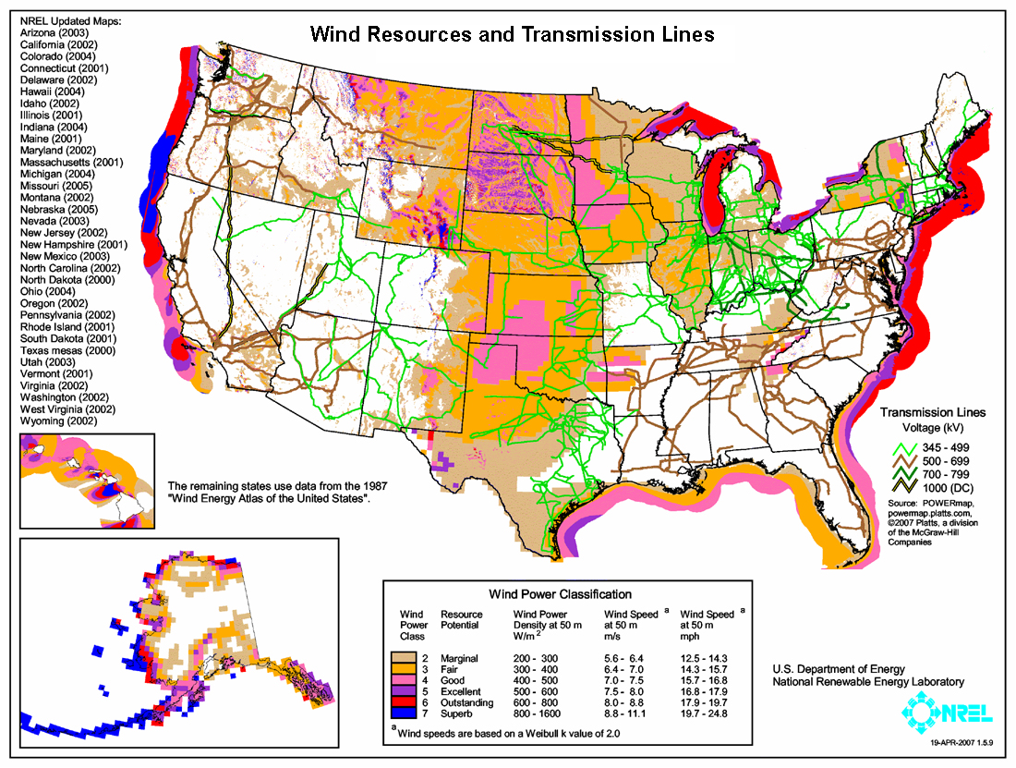
Wind is better offshore than onshore

Slide 8
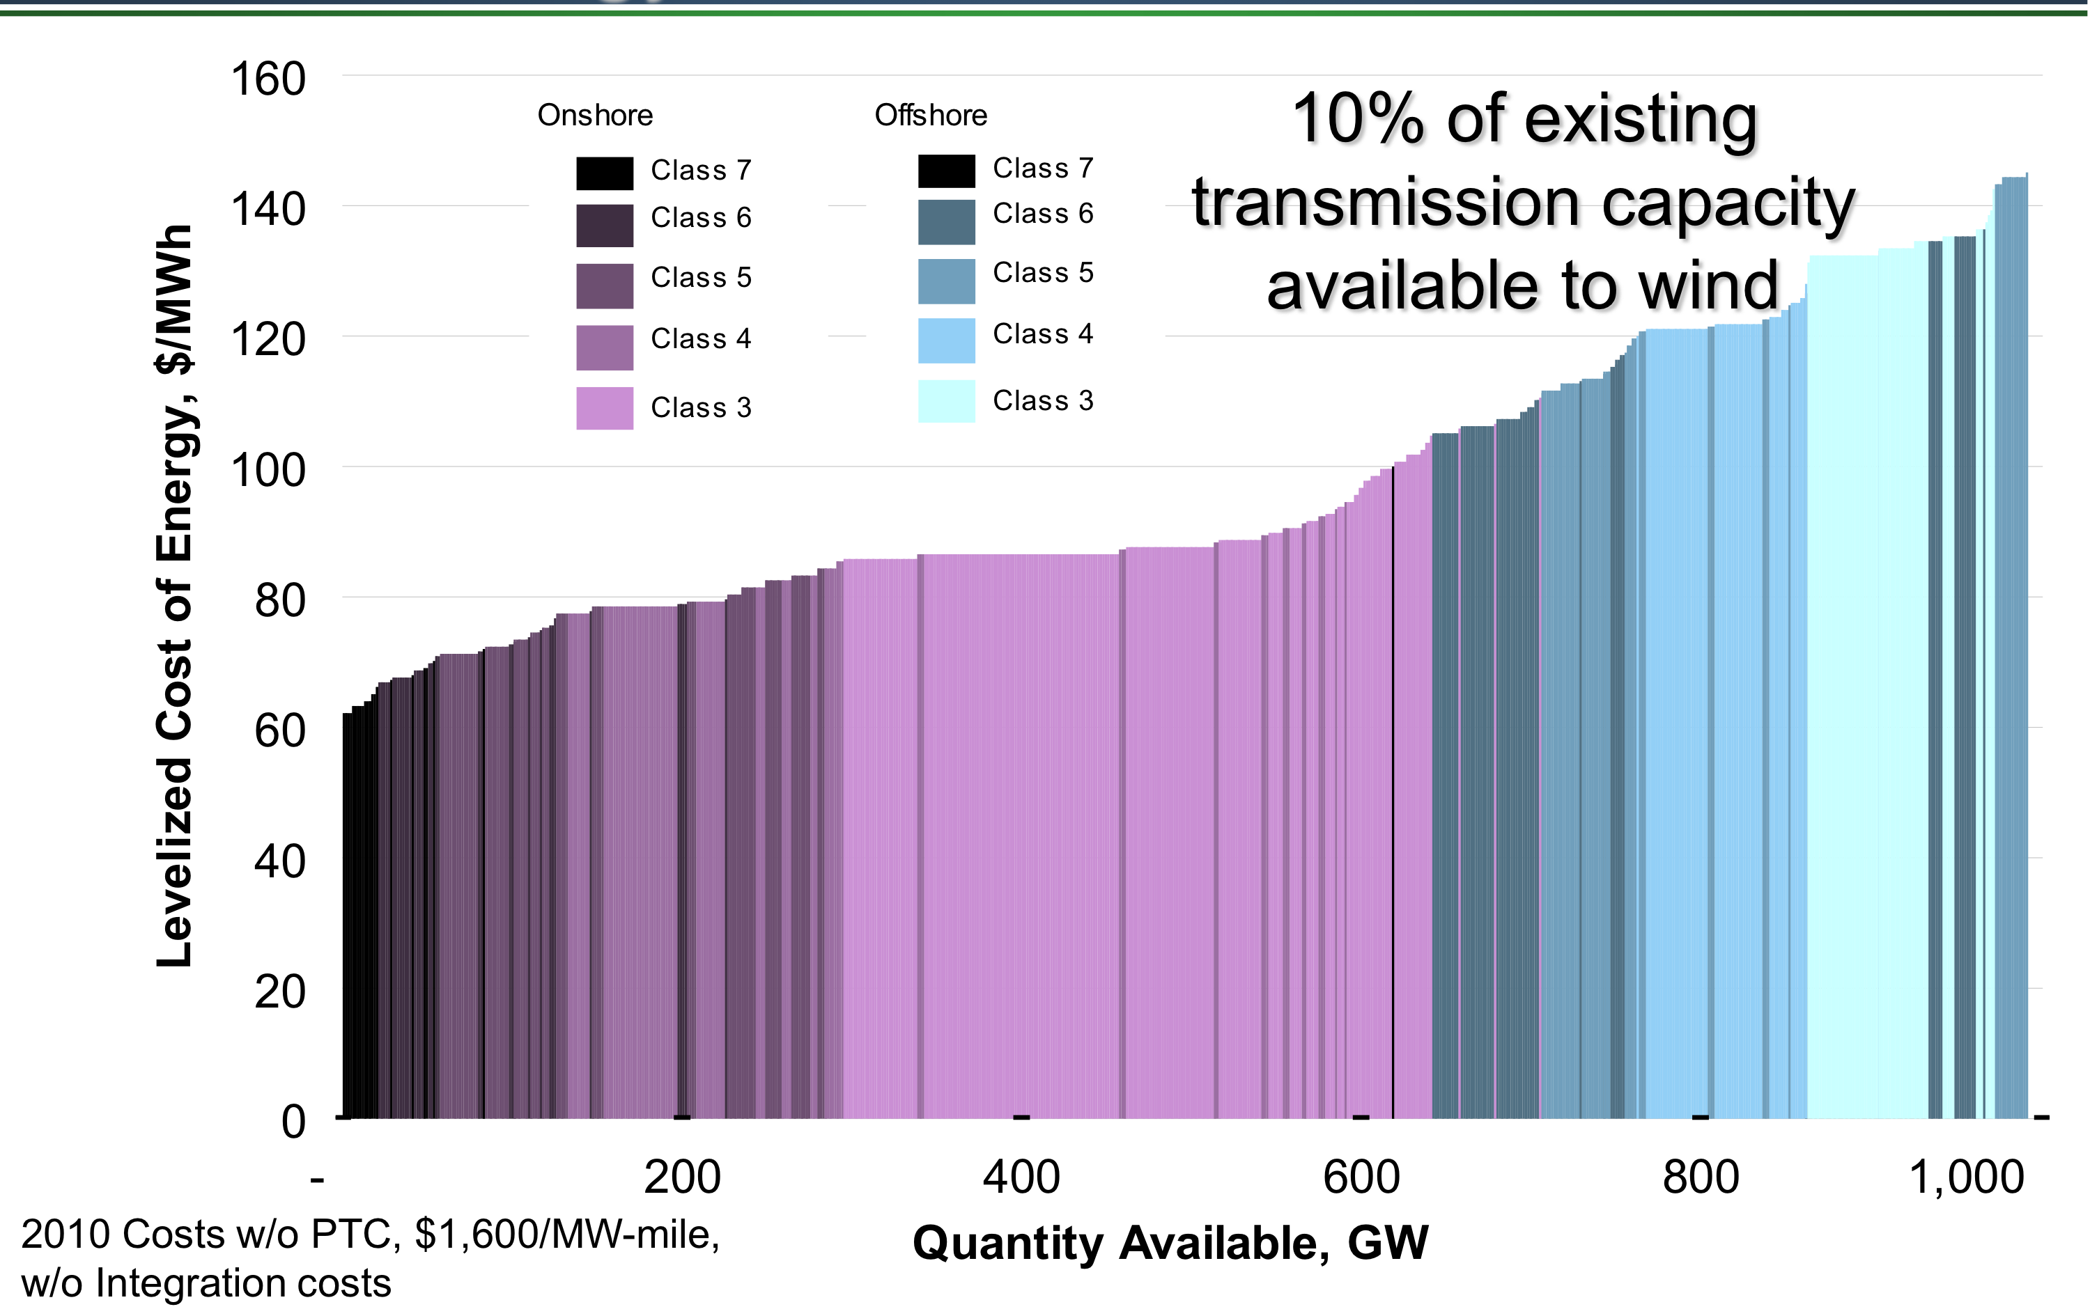
Even relatively bad on-shore wind is more cost-effective than almost all offshore wind
Image: NREL

Slide 9
Electrical grid operation: basic questions
How big is the grid?
Total U.S. network: ~ 300,000 km
Most of this is high-voltage
(> 250,000 km are > 230 kV)
Cost of high-voltage on average $1M/km
Total value of the transmission part of the grid is of order $300 billion dollars.

Slide 10
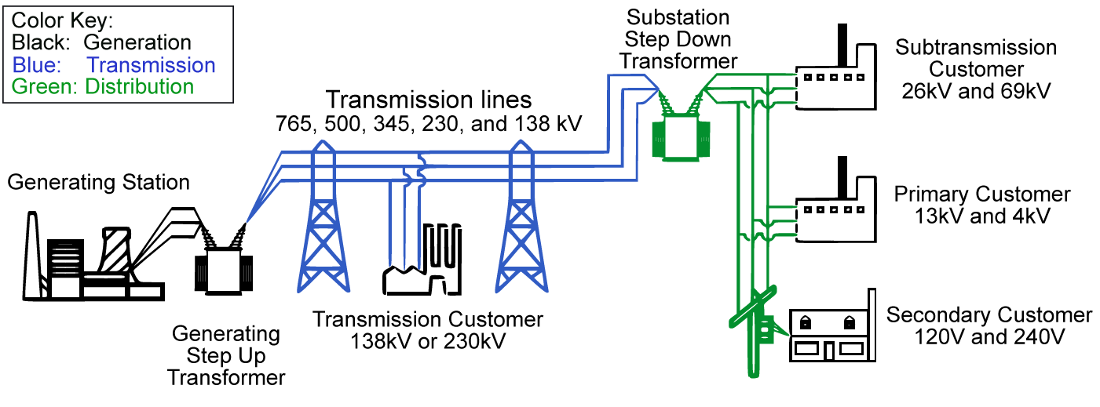
Electrical grid: Who owns and manages what?
Image: Wikipedia
For most of 20th century, one entity owned all components in chain
Now typically owned by 2 or 3 diff. entities, managed by another, and market can be managed by outside broker – up to 5 players in game
Generator
Transmitter (long-dist. wires)
Grid operator (wires operator)
Utility for distribution (local wires)
Load-serving entity
(seller to consumer)

Slide 11
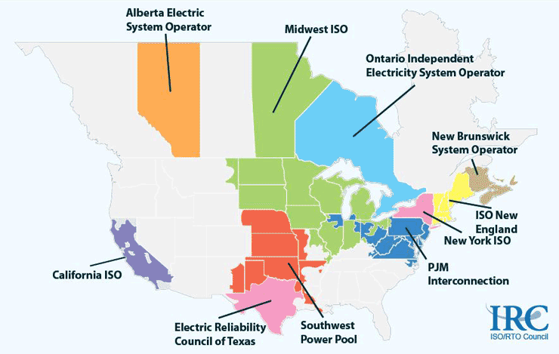
Electrical grid organization and management: basic questions
Who owns what? (generation, transmission, distribution)
RTOs as of 2010 (ISO/RTO Council)
Note: Chicago area is part of PJM, not of MISO
Notes:
RTO not same as power pool necessarily – cross boundaries (SPP is also an RTO)
PJM = pennsylvania new jersey maryland

Slide 12
Electrical grid organization and management: basic questions
Who sets the amounts that people pay?
In the old days
The utilities owned everything, and would charge customers enough to recover their costs. The state utilities commission would approve the rates.
Nowadays
Generator price set by the day-ahead market: Sets the hour by hour price that generators receive for power or for capacity.
Wholesale price set by market and by FERC: Sets the markup that the RTO can charge over market. Sets the transmission rates.
Retail price set by state utilities commissions: Determines the rates that the utilities can charge their customers. Flat rates – no hourly changes.

Slide 13
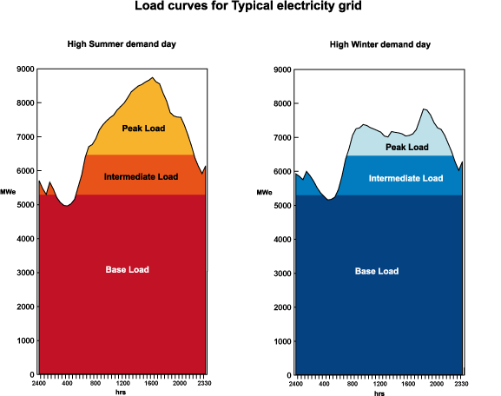
Usefulness of electricity market driven by
1) diurnal demand curve
.
Image: World Nuclear Org.

Slide 14
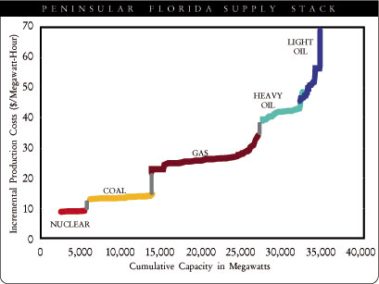
Usefulness of electricity market driven by
2) different operating cost for different generation technologies
Market clearing means that everyone receives the price bid by the last (most expensive) generator whose bid is accepted. (Hourly bids).
Nuclear will bid zero because it wants to be on always and its operating costs are tiny. Oil is expensive so will bid high – will only turn on if price > operating costs.
.
Pre-fracking-era supply stack: coal cheaper than gas

Slide 15
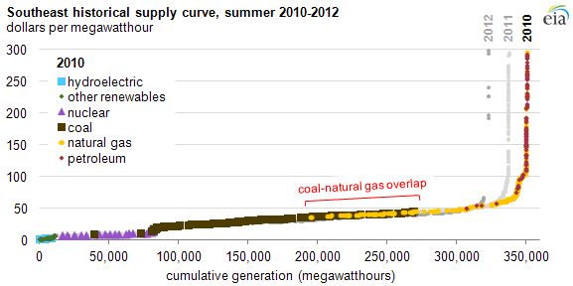
But, supply stack is changing dramatically
What happens when gas becomes cheaper than non-dispatchable coal?
When coal plants shut down?
If bring on must-take no-marginal cost wind?
.

Slide 16
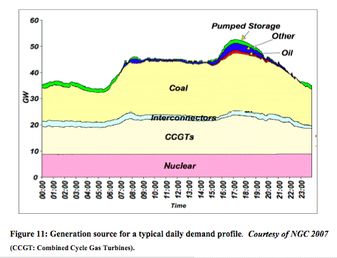
Old system: expensive peakers on only during max load
Baseload power stays on all the time. High-marginal-cost power is purchased only during times of day when demand is highest.
But how to manage now if marginal generation is coal, not easily dispatchable?
(figure from the U.K.?)

Slide 17
Electricity strategies driven by the diurnal cycle
Peakers: buy high cost but fast turn-on generation that can come on just for the peak energy demand period. (Big complications now that relative costs are flipped.)
Peak-shaving: buy electricity when it’s cheap and store it, then sell it back to the grid when it’s expensive
Demand-side management: sign contracts with customers forcing them to turn off if demand is too high
Demand-side management: introduce time-variable pricing for customers to incentivize less use at peak periods, more off-peak
Load-dumping: since baseload power can’t turn off, sometimes just have to dump it if have too much

Slide 18
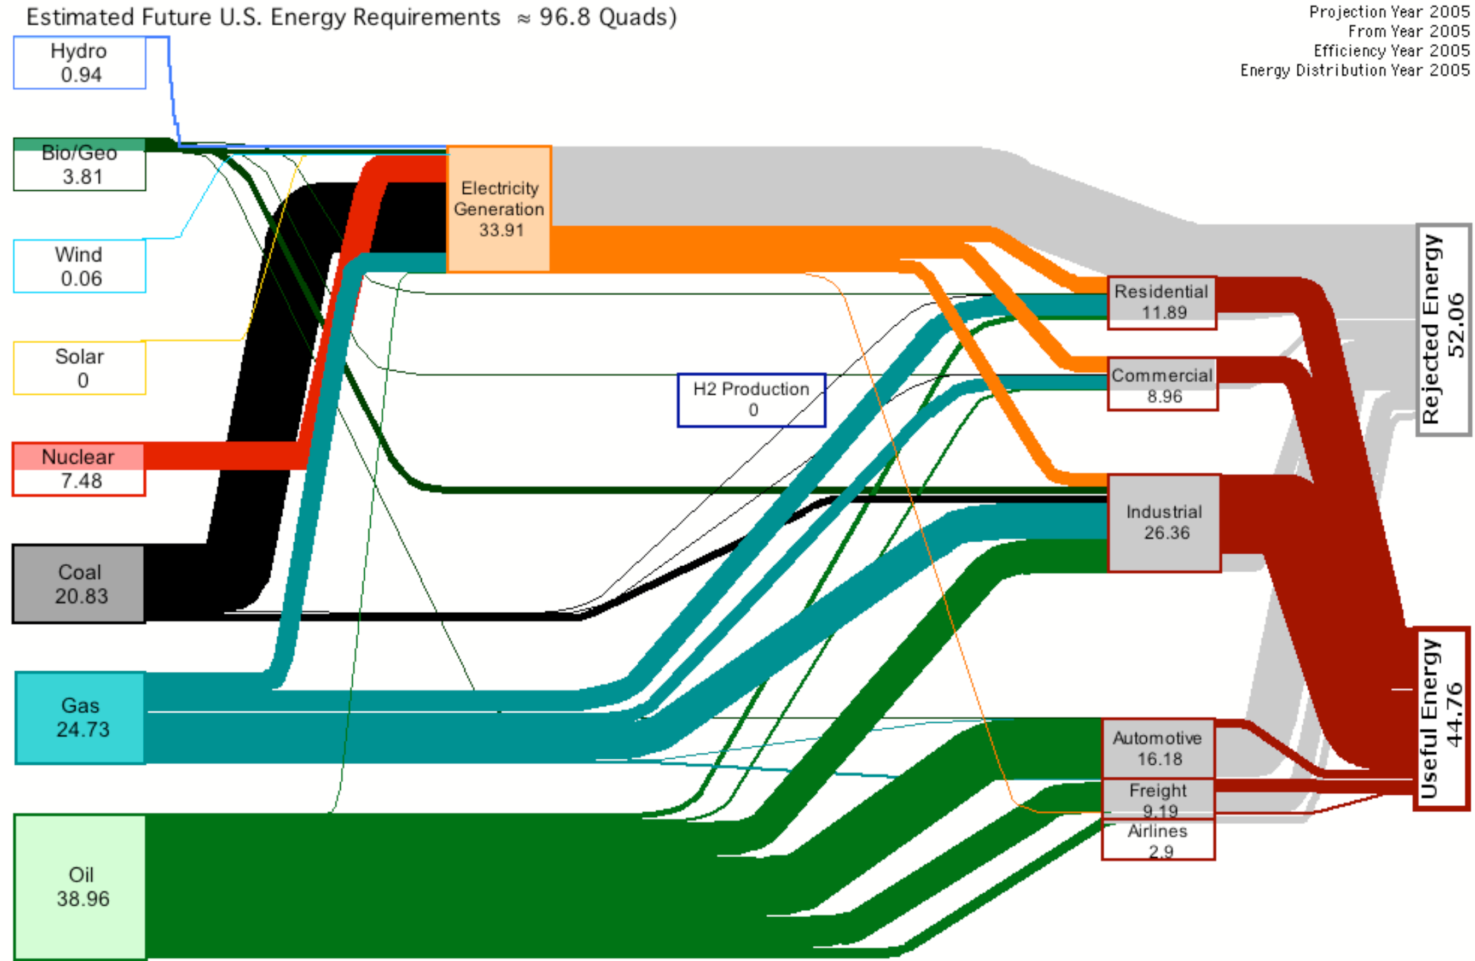
Oil is now 1/3 of U.S. primary energy use
U.S. energy use, 2005
from LLNL, in quads/yr : 1 Q / yr ~ 10¹⁸ J / yr ~ 30 GW
= 3*10¹² W / 300M people = 10,000 W/person

Slide 19
Why are liquid fuels so important?
Why are they the primary transportation fuel ?
Allow internal combustion engine which is intrinsically lighter than external combustion engine (W/kg)
Fuel has high mass energy density so range is high (J/kg)
Fuel has high volume energy density so again, easy to bring enough to get high range (J/m³)

Slide 20
Reciprocating internal combustion engines
…. Power nearly everything that runs on liquid fuel
…. Consume nearly all oil used
…. Make up 1/3 of U.S. primary energy consumption
Automobiles and trucks
Motorcycles
Locomotives
Boat engines
Propeller airplanes
Diesel generators
Riding lawnmowers
Outboard motors
Chainsaws (the non-electric kind)
Weed-whackers
Uses: things that need to be mobile, where power-to-mass matters

Slide 21
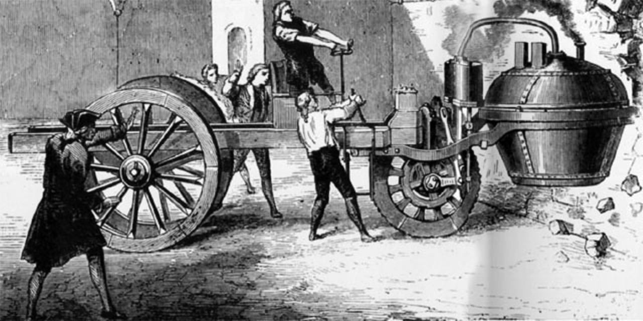
Transportation: early attempts with steam
Nicolas Cugnot, steam-powered automobile
First car (1769), military tractor for carrying artillery, 2.5 mph
First car accident (1771)
(First fatal accident 1869, also steam)
Notes:
english were messing around with steam cars – first fatal car accident in Britain in 1869, steam car built by William Parsons, Mary Ward died, car driven two Parsons sons, one Charles Parsons inventor of steam turbine. Speed limit at the time was 4 mph and 2 mph in towns.

Slide 22
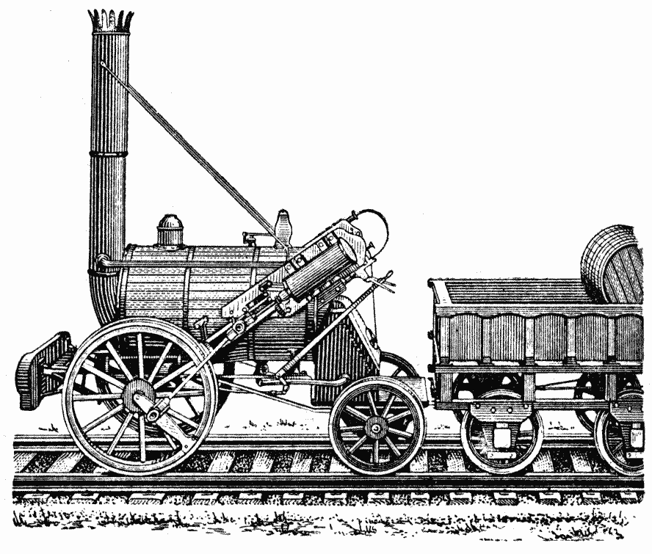
19th century: steam used mainly for locomotives
First full-scale steam rail locomotive in Britain in 1804
First U.S. railroad in 1829
Adjust power via valve that changes steam intake to piston
Stephenson’s Rocket, 1829, winner of Rainhill Trials race between Liverpool and Manchester..

Slide 23
Desire to get away from steam and external combustion
But what fuel to use? What is available?
* Gunpowder
* Coal gas (made by heating and gasifying coal)
* Hydrogen (made chemically)
.. and only later…
* Liquid petroleum distillates

Slide 24
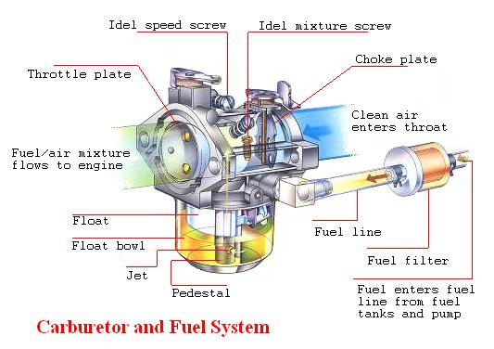
Obstacles to liquid fuel
Availability
(little petroleum refining before mid-1800s, even by 1888 petrol purchasable only in drugstores as medicine)
Mixing liquid fuel into gaseous air
(required invention of carburetor, later fuel injection)

Slide 25
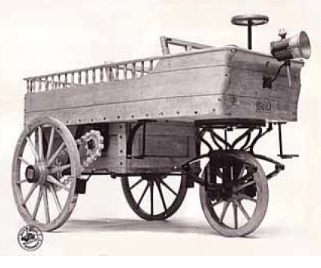
Internal combustion engine history: early history
1680: Christian Huygens (Holland) designs (but doesn’t build) an internal combustion engine driven by gunpowder
1690: Denis Papin (France) designs (but doesn’t build) an internal combustion engine driven by gunpowder. Gives up and invents steam engine instead (against design but no build, later built by Newcomen).
Early-mid 1800’s: experiments with modifying steam engines to run on coal gas (i.e. natural gas).
1858: Jean Joseph Étienne Lenoir (France) patents spark-ignition 2-stroke ICE running on coal gas. In 1863 drives hydrogen-powered vehicle 9 km in 3 hours (1.8 mph). Also drives vehicle with engine modified
to run on liquid petroleum : 7 miles at 4.5 mph.
1862: Alphonse Eugène Beau de Rochas (France) designs and patents (but doesn’t build) a four-stroke engine with compression cycle
1872: George Brayton (U.S.) develops 2-stroke gas/kerosene engine, ct. pressure combust.
Hippomobile, ~400 sold
Notes:
english were messing around with steam cars – first fatal car accident in Britain in 1869, steam car built by William Parsons, Mary Ward died, car driven two Parsons sons, one Charles Parsons inventor of steam turbine. Speed limit at the time was 4 mph and 2 mph in towns.

Slide 26
The birthplace of the internal combustion engine was not France

Slide 27
Internal combustion engine
President Obama, State of the Union speech,
Feb. 2009, on bailing out Detroit automakers:
“The nation that invented the automobile cannot walk away from it.”

Slide 28
Internal combustion engine
Edmunds Inside Line, 2009:
“In what will surely be seen as a provocative move by the new administration, President Barack Obama announced last night in a televised address to the U.S. Congress that all inventions of note from at least the last 200 years will now be credited to Americans.
The president revealed last evening that credit for the invention of the automobile will be transferred from one Karl Benz of Germany to an unspecified American.”

Slide 29
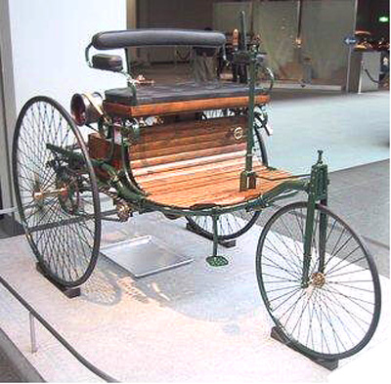
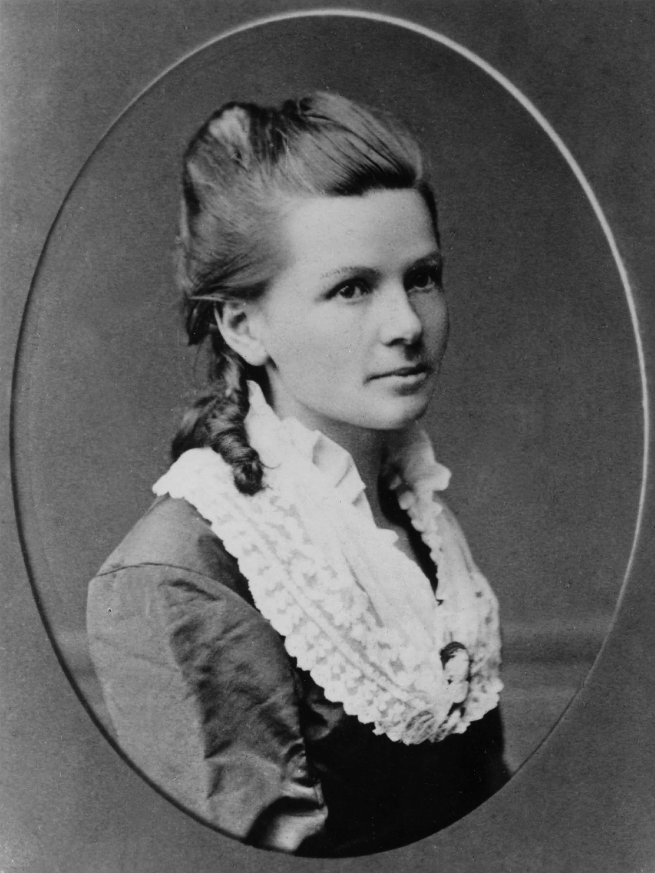
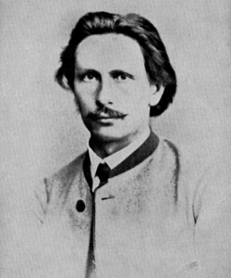
Internal combustion engine history:
development in German-speaking countries
1876: Nicolaus Otto builds workable, commercial version of 4-stroke gas (not gasoline!) engine, patents it (again). Now known as “Otto cycle”.
1879: Karl Benz gets patent on 2-stroke version of gas-fueled Otto engine.
1885: Karl Benz builds 3-wheeled automobile with 4-stroke engine, 2/3 hp
patent 1886. also patents: spark ignition, sparkplug, carburetor, clutch, gear shift, radiator
Benz Patent Motorwagen 1885 – gas or petrol use
Bertha Benz. 1888 first test drive, 65 miles Mannheim-Pforzheim and back
Karl Benz

Slide 30
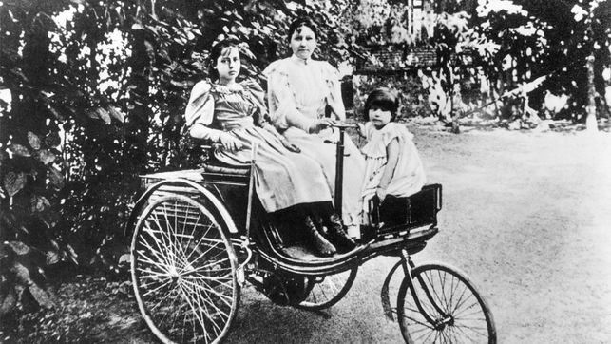
Internal combustion engine history:
Bertha Benz’s bold drive
`Bertha was a wife, but also an investor, and a shrewd marketer. She understood that in order for this to be a success, people had to actually see the cars run and drive, and she knew her husband would never attempt anything more than the short test runs he'd been driving. Bertha knew something more dramatic was needed.
And so, one of history's greatest “f--- it, I'm doing this” moments was born.
Bertha took the three-wheeler to see her mom. This doesn't sound like a big deal now, but then it was like saying “I'm gonna go visit my mom who lives on an orbiting platform, and to get there I'm going to take this experimental anti-gravity pod that runs on niobium, which I'll just figure out how to find along the way. See ya!” ’
----- Jason Torchinsky, Jalopnik
Image: Bertha Benz on the Patent Motorwagen, date unknown. On the actual ride she took her 14- and 15- year old sons. Image from Ca. Automotive Museum.

Slide 31
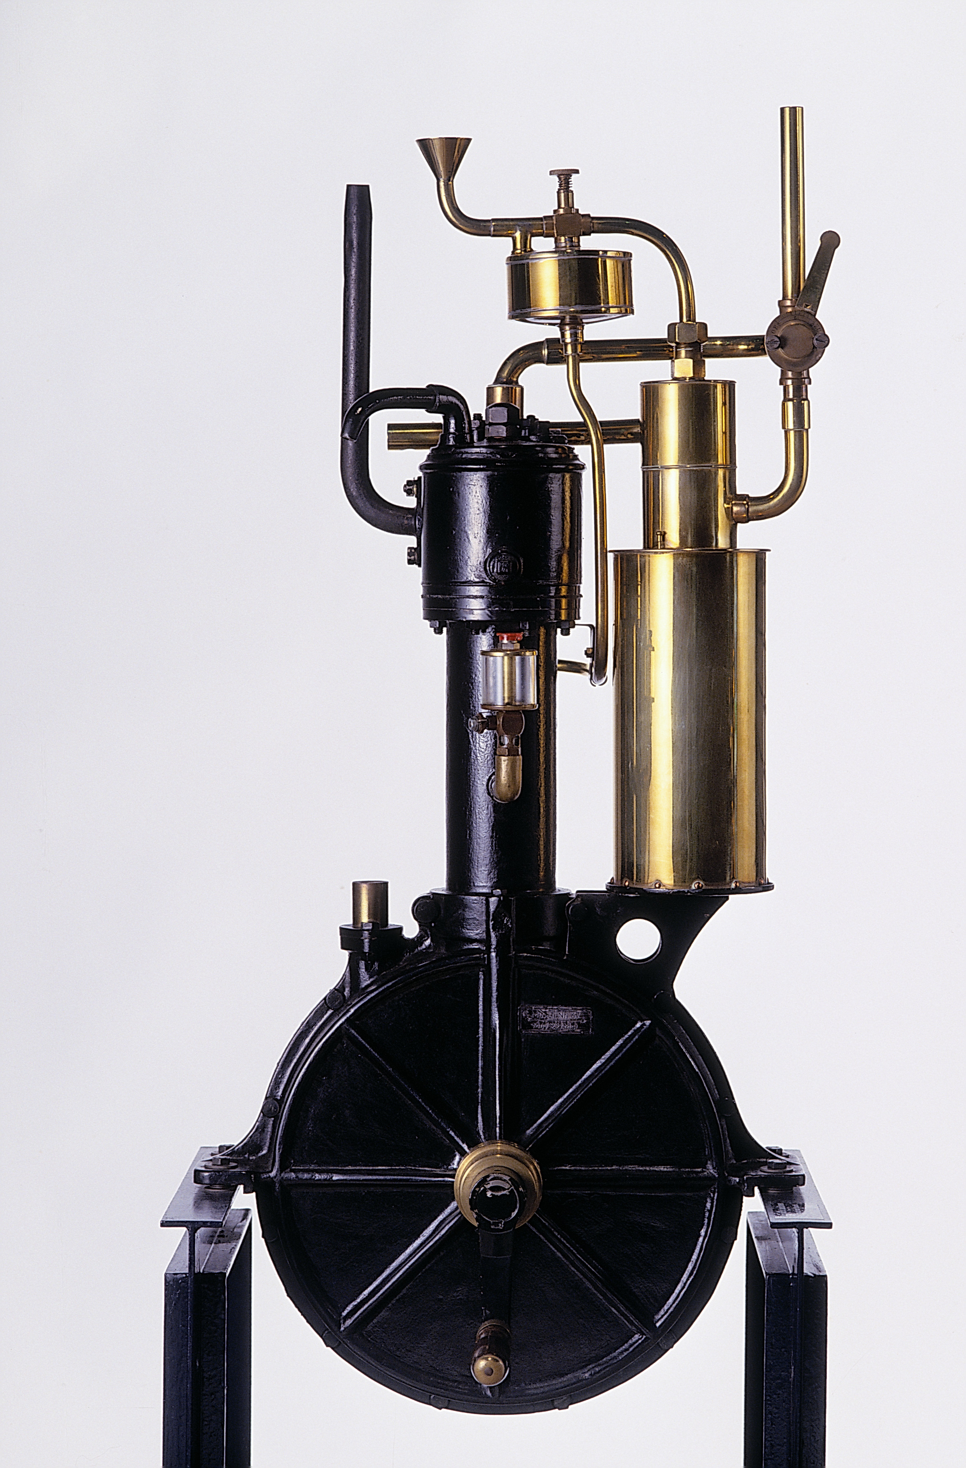
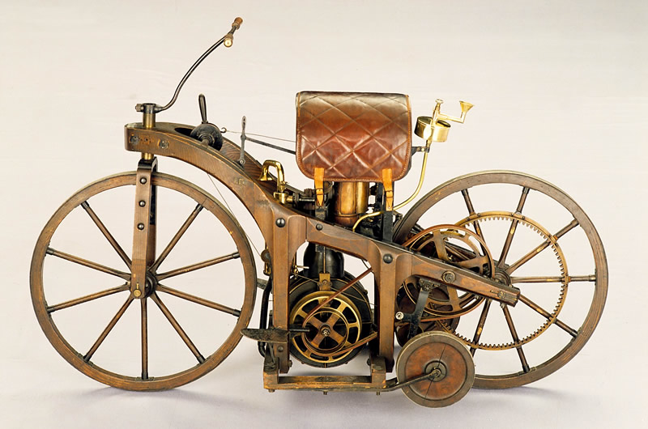
Internal combustion engine history:
multiple developments in German-speaking countries
1885: Daimler & Maybach (having quit Otto’s company) develop advanced 4-stroke engine, attach it to motorcycle
Daimler-Maybach grandfather-clock engine (1885, horizontal cylinder. Image: Daimler.com)
Daimler-Maybach motorcycle, 1885 (replica. Image: Daimler.com)
Daimler-Maybach, 1886. (VintageWeb)

Slide 32
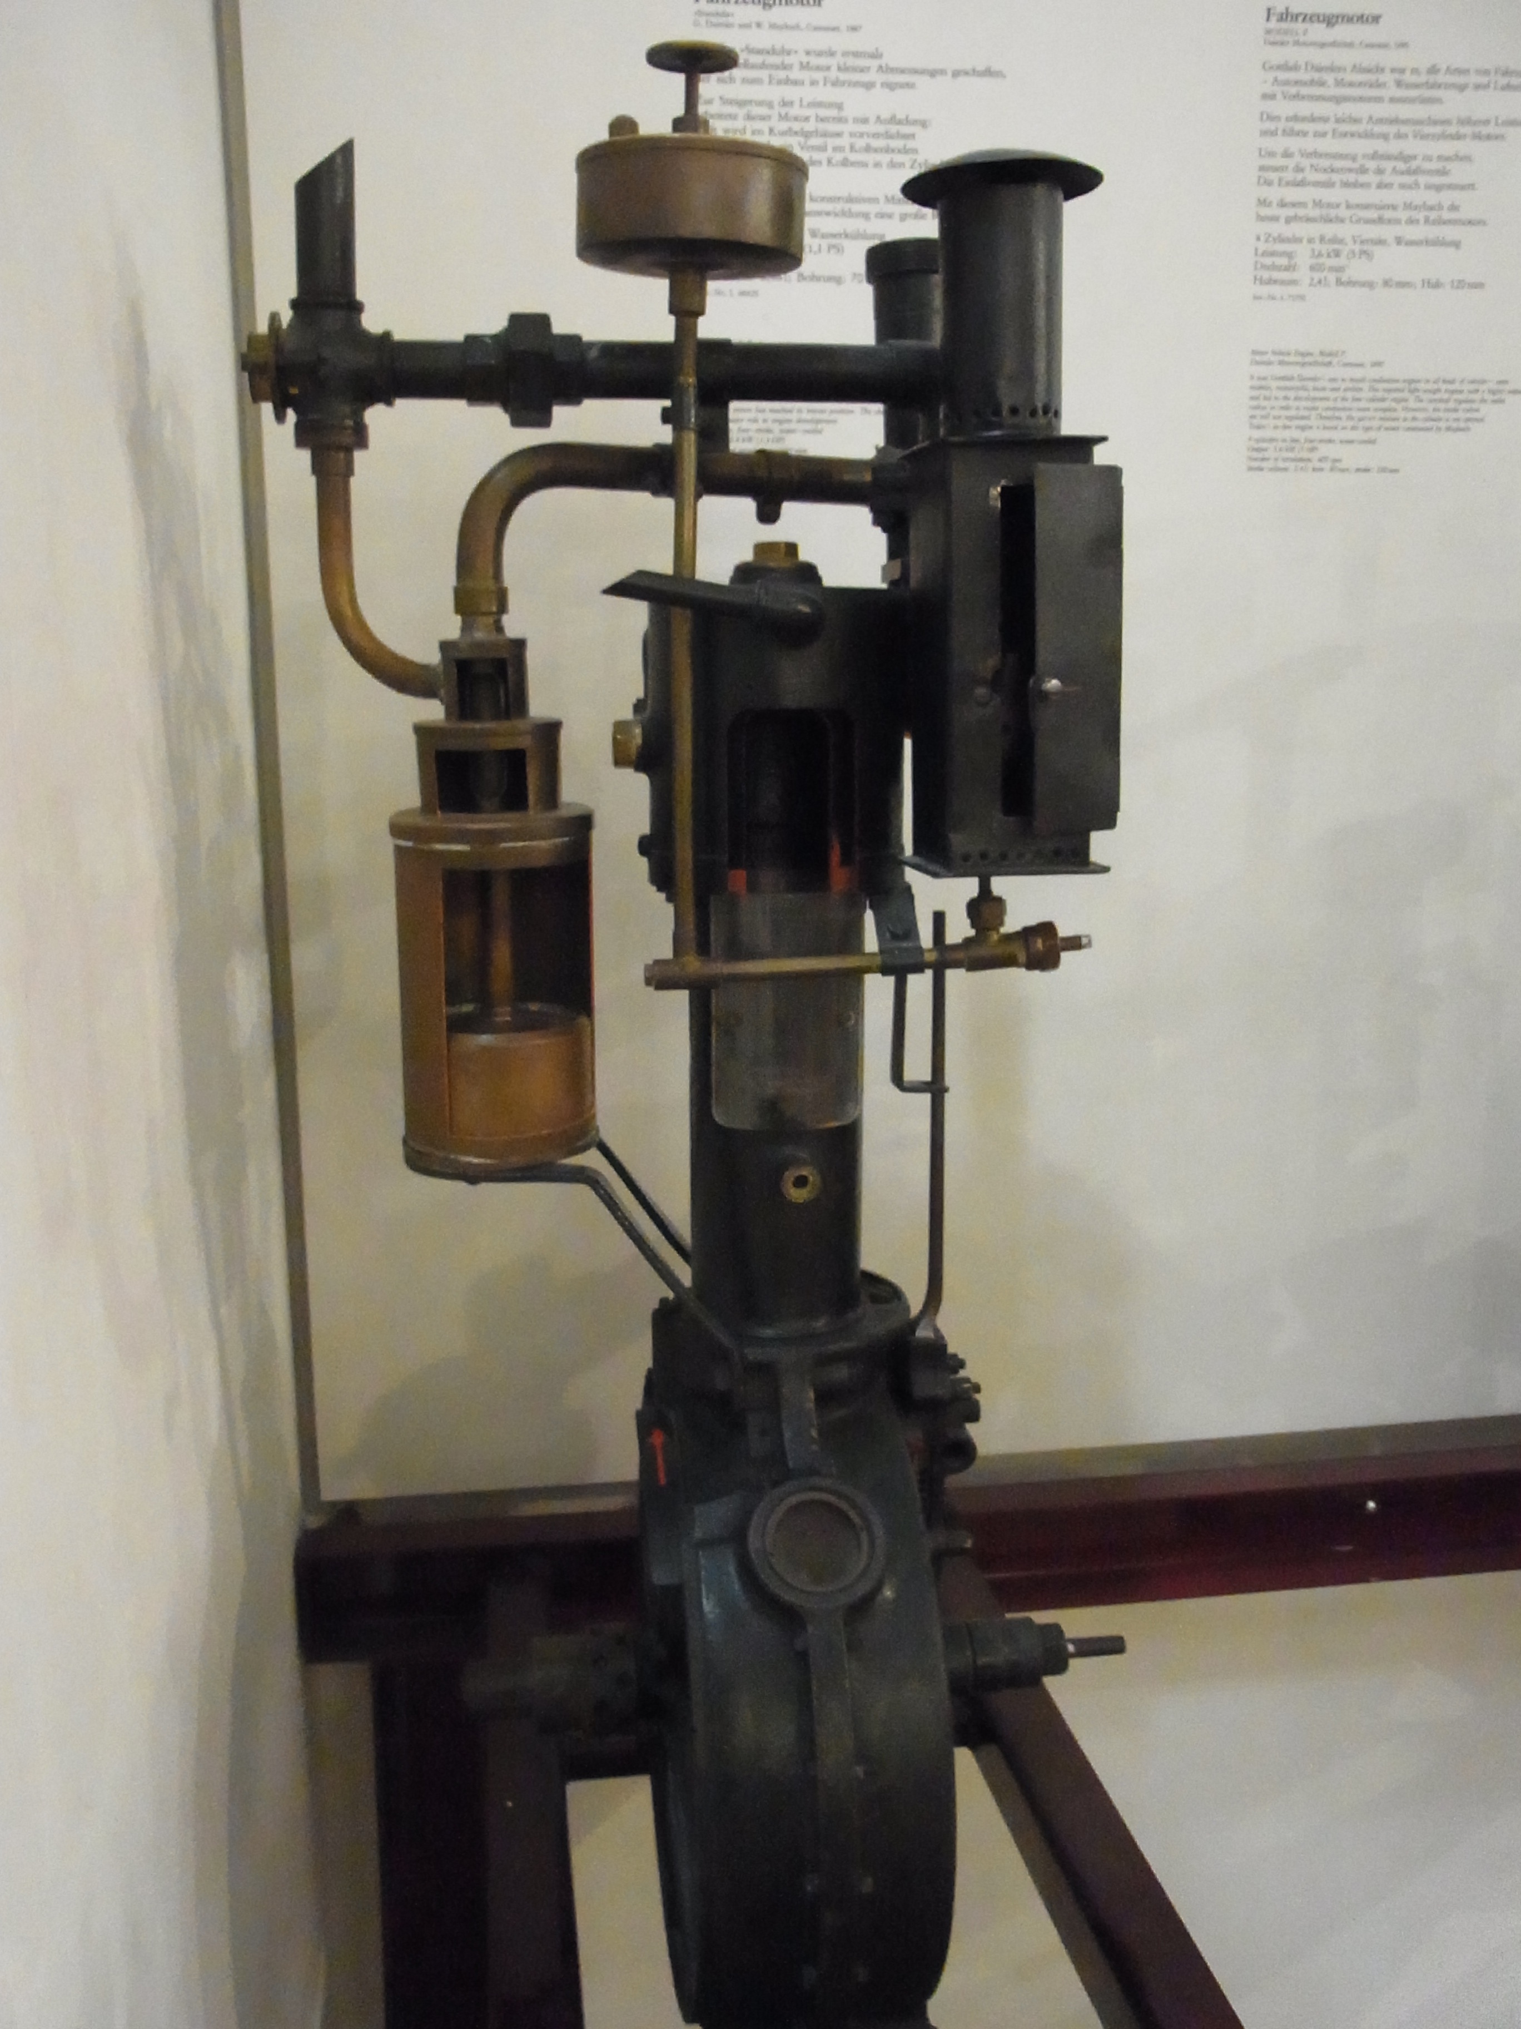
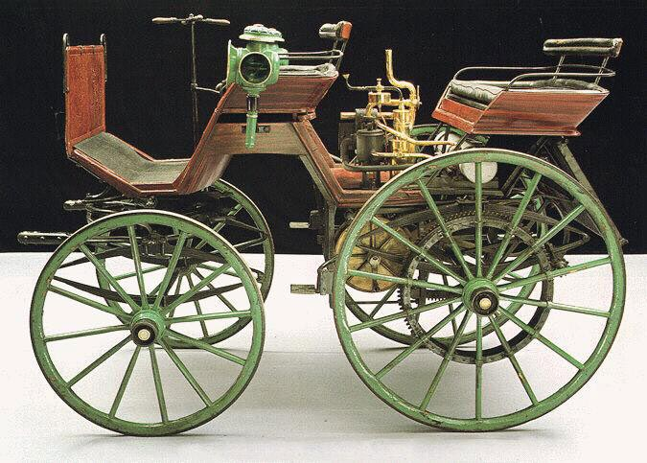
Internal combustion engine history:
multiple developments in German-speaking countries
1885: Daimler & Maybach develop advanced 4-stroke engine, attach it to motorcycle
1886-1889: Daimler & Maybach makes 4-wheeled automobile
4-cylinder engine, 10 mph top spd, first sale in 1892
Daimler-Maybach engine, 1887 (at Deutsches Museum)
Daimler-Maybach automobile, 1886 (VintageWeb)

Slide 33
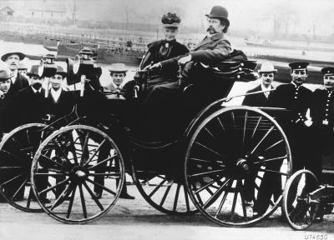
Internal combustion engine history:
multiple developments in German-speaking countries
1891: Benz forms Benz & Cie co.
1899: 430 workers, 572 cars sold
world’s largest auto company, but production is not fast
1885: Daimler & Maybach develop advanced 4-stroke engine, attach it to motorcycle
1886-1889: Daimler & Maybach makes 4-wheeled automobile
4-cylinder engine, 10 mph top spd, first sale in 1892
Benz & Cie Vikoria automobile, 1894 (Karl and Bertha onboard, image: Wikipedia)
Daimler-Maybach automobile, 1886 (VintageWeb)
Merger to Daimler-Benz 1926

Slide 34
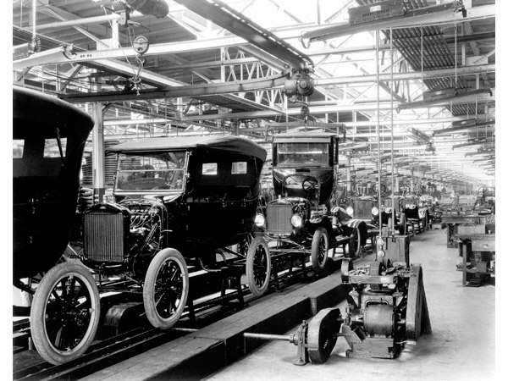
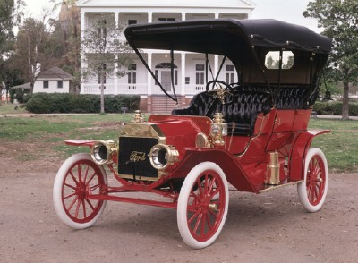
Internal combustion engine history:
--> production improvements in U.S.
1893: First auto manufacturing in U.S. (Duryea Co., MA), flowering of many small companies
1896: Henry Ford starts company, Detroit
1908: Mass production of Ford Model Ts
Ford Model T assembly line, 1924.
Ford Model T, 1908. (repainted, howstuffworks.com)

Slide 35
Two-stroke engine
Simple, cheap
First stroke:
Piston rises, compresses fuel/air mix
Meanwhile, unburnt fuel is drawn into crankcase
Second stroke:
Fuel/air is ignited
Piston driven down
Exhaust gas leaves cylinder
Fuel/air mixture enters cylinder

Slide 36
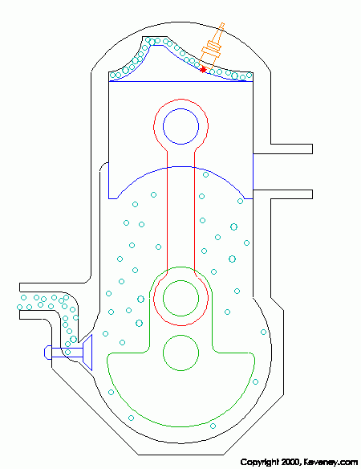
Two-stroke engine
Simple, cheap
Advantages:
Higher power-to-mass since is never “off” – each stroke is power stroke. Smoother power in one-cylinder engine
Therefore: engine of choice for cheap or hand-carried applications
Disadvantages:
Some unburned fuel escapes
– very polluting
Since fuel fills crankcase, lubricating oil must be mixed into fuel mixture – even more polluting

Slide 37
Two-stroke engine
Simple, cheap
Advantages:
Higher power-to-mass since is never “off” – each stroke is power stroke. Smoother power in one-cylinder engine
Therefore: engine of choice for cheap or hand-carried applications
Disadvantages:
Some unburned fuel escapes
– very polluting
Since fuel fills crankcase, lubricating oil must be mixed into fuel mixture – even more polluting

Slide 38
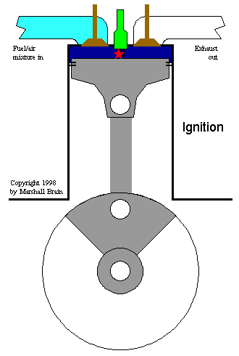
Four-stroke engine: Otto cycle
driver of most transportation
One preparation cycle and one power cycle (down/up/down/up)
Intake
Compression
Combustion
Expansion (Exhaust)
Note use of spark plug to set off combustion (same for 2-stroke)

Slide 39
Four-stroke engine: Otto cycle
driver of most transportation
Advantages:
Produces heated, compressed, very dense fuel/air mixture
Separation of unburnt fuel/air from combustion cycle
Disadvantages:
“off” half the time – half the power-to-mass ratio that it might have
Generally have at least two cylinders, so that when one is “off” the other can provide the push to keep rotating the shaft

