Slide 1
Lecture 5
GEOS24705
History of Energy Use II

Slide 2
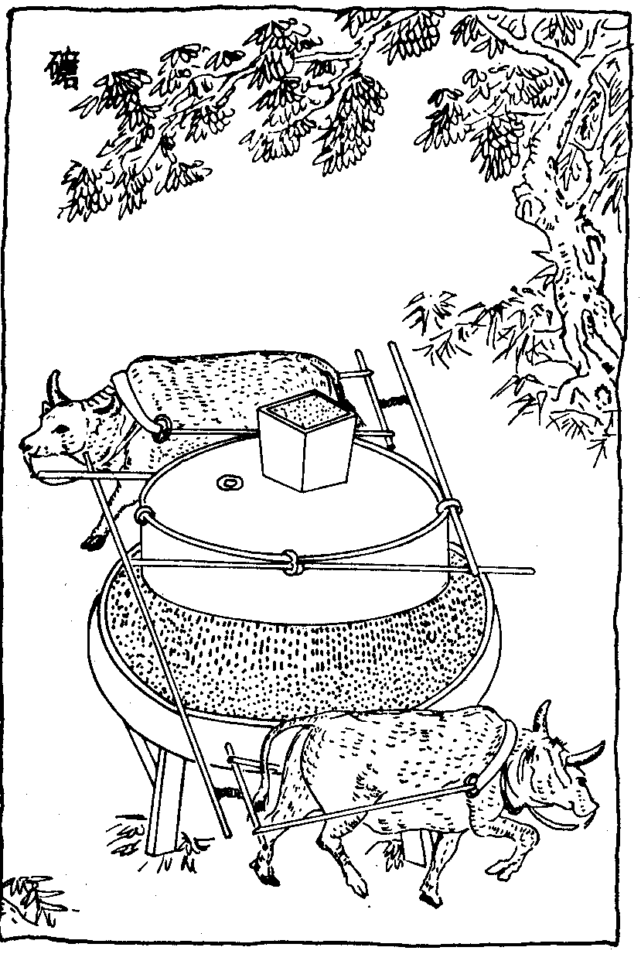
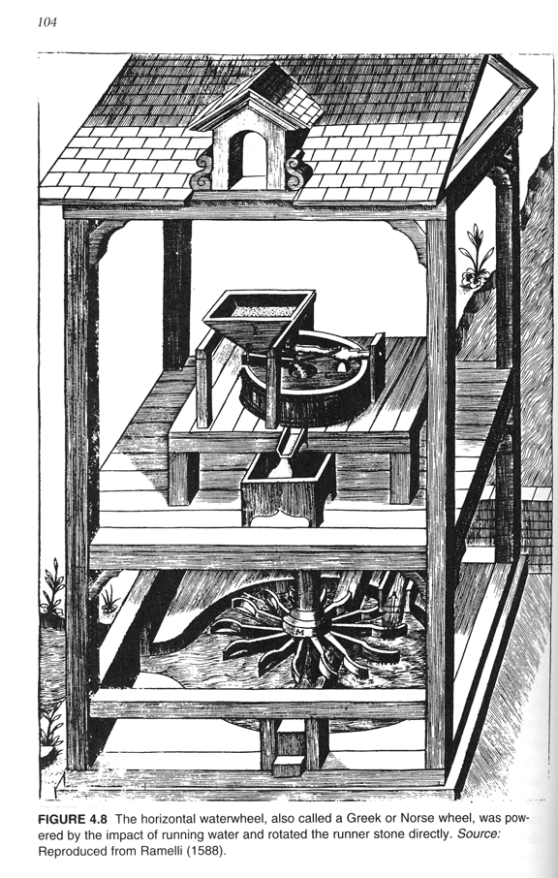
Early uses of mechanical work from animals, wind, water
Grindstone, China from the encyclopedia “Tiangong Kaiwu”, by Song Yingxing (1637)
Vertical-axis waterwheel
1500s or earlier

Slide 3
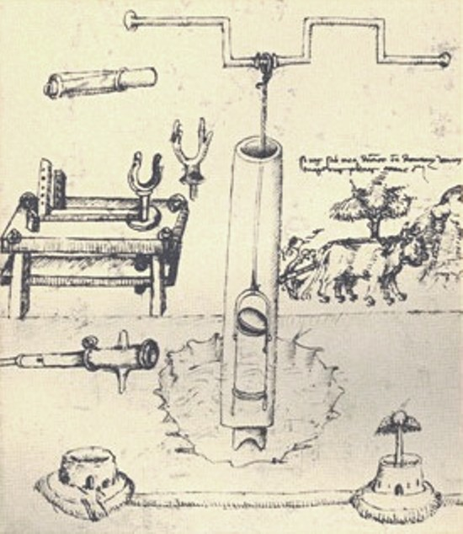
First recorded piston pump is in Renaissance
Taccola, 1450
Siena, Italy
De ingeneis 1433
(Concerning engines)
De machinis 1449
(Concerning machines)
but, pumps don’t replace bucket chains in England until 1700s
reproduction from: Donald Routledge Hill: A history of engineering in classical and medieval times
Grindstone, China from the encyclopedia “Tiangong Kaiwu”, by Song Yingxing (1637)

Slide 4
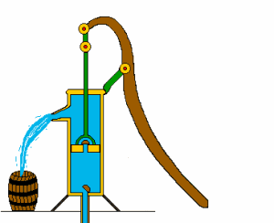
Basic lift pump design basically unchanged
Same technology used today in oil wells
The lift pump
Animation from Scuola Media di Calizzano

Slide 5
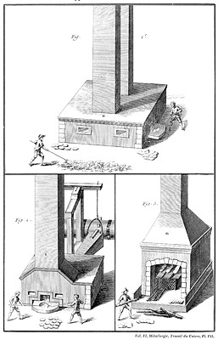
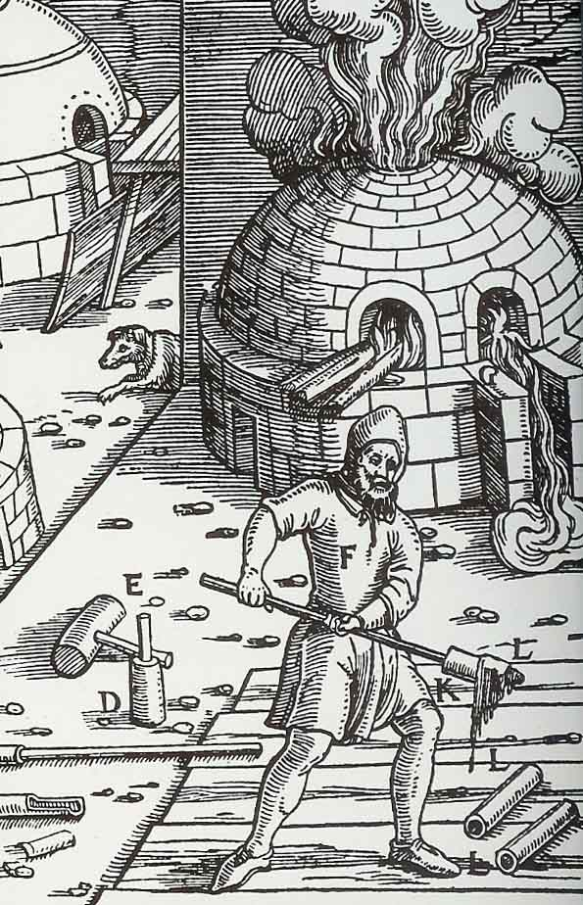
Heating: Large-scale wood-burning for industry
Georg Acricola “De res metallica”, Book XII (“Manufacturing salt, soda, alum, vitriol, sulphur, bitumen, and glass”), 1556.
D. Diderot & J. Le Rond d`Alembert eds, Encyclopédie méthodique. Paris 1763-1777 & 1783-87.

Slide 6
By the 18th century, Europe’s energy crisis limits growth
“Lack of energy was the major handicap of the ancien régime economies”
--- F. Braudel, The Structures of Everyday Life
18th century Europeans had complex and sophisticated technology, and an abundance of industrial uses for energy, but not enough supply

Slide 7
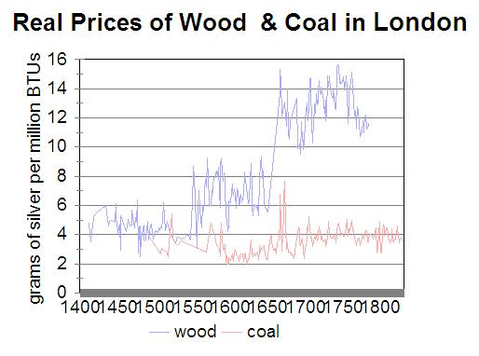
Wood → coal: changing an energy system
“Within a few years after the commencement of the seventeenth century the change from wood fuel to coal, for domestic purposes, was general and complete.”
--- R. Galloway, A History of Coal Mining in Great Britain, 1882.
1600
Robert Allen, The British Industrial Revolution in Global Perspective

Slide 8
The 2nd British energy crisis: flooding of the mines
1600s

Slide 9
The 2nd British energy crisis: flooding of the mines
“The miners, no less than the smelters, had their difficulties during the seventeenth century, but of a totally different kind; for while the latter were suffering from too little fire, the former were embarrassed by too much water… the exhaustion of he coal supply was considered to be already within sight. In 1610, Sir George Selby informed Parliament that the coal mines at Newcastle would not last for the term of their leases of twenty-one years.”
--- R. Galloway, A History of Coal Mining in Great Britain, 1882.
1600s

Slide 10
The 18th century European energy crisis has 3 parts
Fuel had become scarce even when only used for heat
Wood was insufficient, & coal was getting hard to extract
Surface “sea coal” → deep-shaft mining below the water table
2. There were limited ways to make motion
No way to make motion other than through capturing existing motion or through muscle-power
3. There was no good way to transport motion
Water and wind weren’t necessarily near demand

Slide 11
Early complaints about intermittent renewables
“In the year 1708 a plan was projected in Scotland for draining collieries by means of windmills and pumps... one John Young, a millwright of Montrose... had been sent to Holland at the expense of the town to inspect the machinery there... Wind mills were erected at several collieries, but though they were powerful their action was found to be too intermittent; the mines being drowned and all the workmen thrown idle during long periods of calm weather. ”
--- R. Galloway, A History of Coal Mining in Great Britain, 1882.

Slide 12
The heat to work barrier
the 18th century technological impasse
All technology involved only two energy conversions
Mechanical motion → mechanical motion
Chemical energy → heat
There was no way to convert chemical energy to motion other than muscles (human or animal)
– no engine other than flesh
The only means out of the energy crisis was coal
– but to mine the coal required motion for pumps.

Slide 13
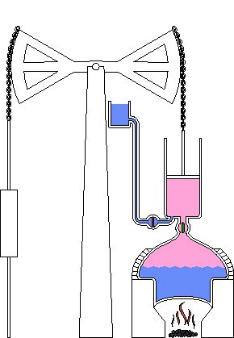
The revolutionary solution = break the heat → work barrier

Slide 14
The revolutionary solution = break the heat → work barrier
use heat to make ordered motion
Newcomen “Atmospheric Engine”, 1712
(Note that widespread use & Industrial Revolution followed invention
by ~100 years – typical for energy technology)

Slide 15
What is a “heat engine”?
A device that generates converts thermal energy to mechanical work by exploiting a temperature gradient
Makes something more ordered:
random motions of molecules → ordered motion of entire body
Makes something less ordered:
degrades a temperature gradient (transfers heat from hot to cold)

Slide 16
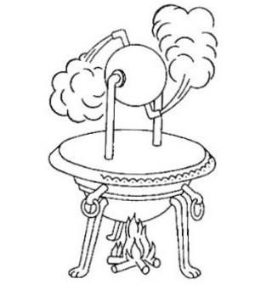
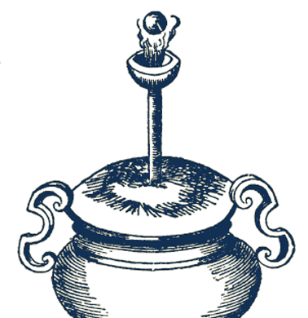
Physics: long understood that steam exerted force
Evaporating water produces high pressure
Pressure = force / area
“aeliopile”
“lebes”: demonstration of lifting power of steam
Hero of Alexandria, “Treatise on Pneumatics”, 120 BC

Slide 17
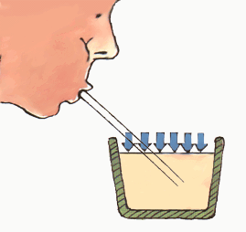
Physics: condensing steam can produce suction force
Low pressure in airtight container means air exerts force
Same physics that lets you suck liquid through a straw

Slide 18
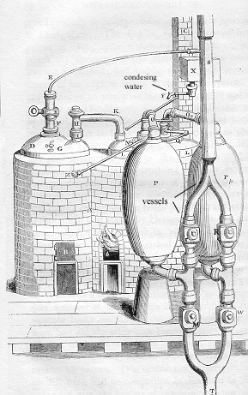
First commercial use of steam:
the Savery engine
“A new Invention for Raiseing of Water and occasioning Motion to all Sorts of Mill Work by the Impellent Force of Fire which will be of great vse and Advantage for Drayning Mines, serveing Towns with Water, and for the Working of all Sorts of Mills where they have not the benefitt of Water nor constant Windes.”
Thomas Savery, patent application, filed 1698

Slide 19
Savery engine is not a commercial success
“.. Savery’s engine was wholly unsuited for draining mines, and he failed to induce the miners to take it up. The greatest height to which it could raise water was.. not more than sixty or eighty feet...Moreover the miners [were]...afraid to introduce furnaces into their shafts, on account of ...their giving rise to explosions... ”
Robert Galloway, “A History of Coal Mining in Great Britain”

Slide 20
Principles of Savery engine
Sucks water as one would with a straw
Heat water to make steam
Fill chamber with steam
Cool chamber, steam condenses
Pressure in chamber is now lower than atmospheric pressure
Open up valve connecting chamber to pipe in water
Atmospheric pressure causes water to flow up into chamber
Issues:
Good only for pumping liquids. Efficiency below 0.1%
Max pumping height: ~30 ft.
Why used at all? Because the coal was essentially free and the industry was desperate for a solution.
Notes:
2000 times less efficient than people or animals, but they cant eat coal.

Slide 21
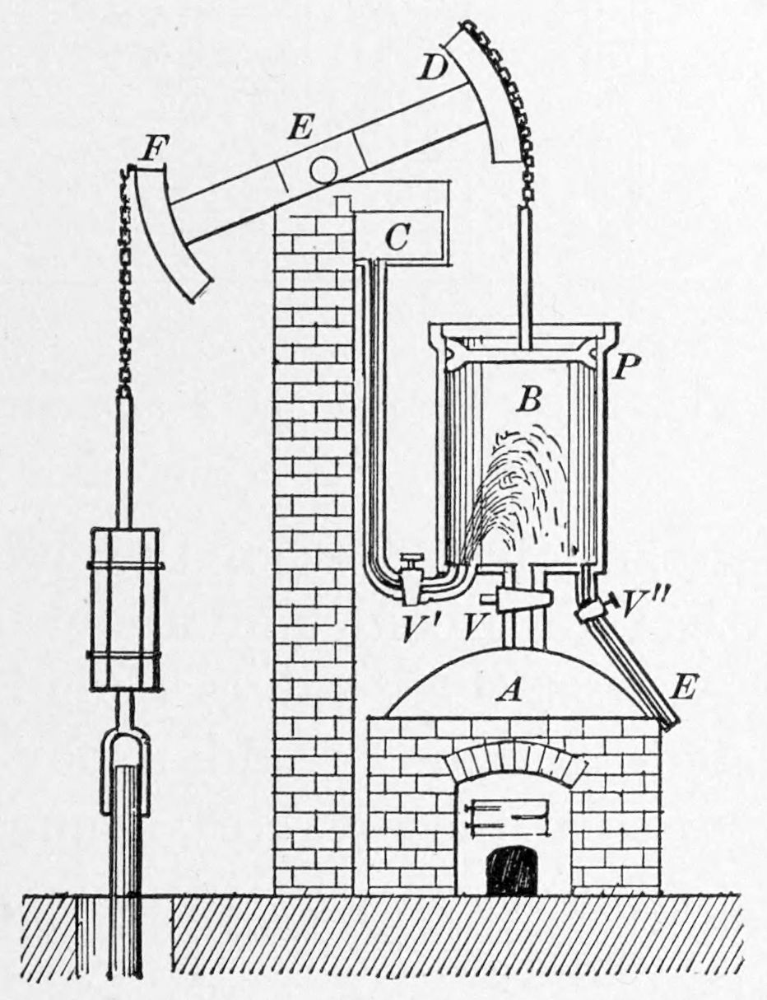
First true steam engine:
Thomas Newcomen, 1712, blacksmith
“It was at this juncture that the miners had put into their hands the most wonderful invention which human ingenuity had yet produced – the Newcomen steam-engine.. a machine capable of draining with ease the deepest mines; applicable anywhere; requiring little or no attention; so docile that its movements might be governed by the strength of a child; so powerful that it could put forth the strength of hundreds of horses; so safe that... the utmost damage that can come to it, is its standing still for want of fire.”
Robert Galloway, “A History of Coal Mining in Great Britain”
Newcomen’s design is state of the art for 60+ years

Slide 22
First true steam engine:
Thomas Newcomen, 1712, blacksmith
Copy of Papin’s engine of design of 1690
First reciprocating engine: linear motion of piston that transmits force
Steps
Fill chamber with steam
Cool the chamber to condense steam
Low pressure in chamber pulls piston down, lifts pump side
Open valve at bottom of piston, let gravity pull pump side down again
Steam fills chamber as piston rises
Issues:
Very low efficiency: 0.5%
Intermittent force transmission
Newcomen’s design is state of the art for 60 years

Slide 23
First true steam engine:
Thomas Newcomen, 1712, blacksmith
Copy of Papin’s engine of design of 1690
First reciprocating engine: linear motion of piston that transmits force
Steps
Fill chamber with steam
Cool the chamber to condense steam
Low pressure in chamber pulls piston down, lifts pump side
Open valve at bottom of piston, let gravity pull pump side down again
Steam fills chamber as piston rises
Issues:
Very low efficiency: 0.5%
Intermittent force transmission
Newcomen’s design is state of the art for 60 years

Slide 24
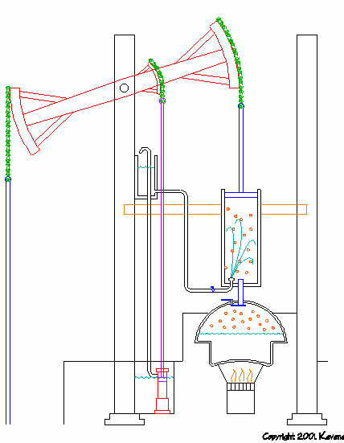
First true steam engine:
Thomas Newcomen, 1712, blacksmith
Copy of Papin’s engine of design of 1690
First reciprocating engine: linear motion of piston that transmits force
Steps
Fill chamber with steam
Cool the chamber to condense steam
Low pressure in chamber pulls piston down, lifts pump side
Open valve at bottom of piston, let gravity pull pump side down again
Steam fills chamber as piston rises
Issues:
Very low efficiency: 0.5%
Intermittent force transmission
Newcomen’s design is state of the art for 60 years

